Slide 1

The Pressure Playbook:
The 2025 Updated
Hypertension Game Rules
Brittany Messer, PharmD, FACC

Slide 2
Objectives
Define hypertension according to the 2025 guideline update
Describe screening process for primary aldosteronism
Review lifestyle approaches for people with hypertension
Discuss revised and new recommendations for special population with hypertension and in specific disease states

Slide 3
Definition
Table 4
 | SBP | DBP
Normal | <120 | <80
Elevated | 120-129 | <80
Stage 1 Hypertension | 130-130 | 80-89
Stage 2 Hypertension | ≥140 | ≥90

Slide 4
What is New?

Slide 5
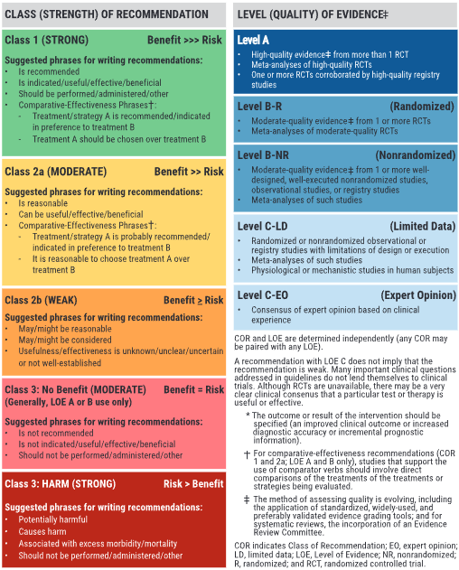
Applying the Strategies

Slide 6
Secondary Hypertension
Screen for primary aldosteronism without or without presence of hypokalemia
    Benefits by increasing:
      Rates of detection
      Diagnosis
      Targeted therapy
COR 1

Slide 7
Primary Aldosteronism
Continue medications other than MRA prior to initiating screening
  Minimizes barriers in care
  Prevents delayed screening
COR 1

Slide 8
Lifestyle Modifications
With/without diagnosis of hypertension
  Use salt substitutes (potassium-based)
Presence of CKD
  Avoid potassium-based salt substitutes as primary treatment
  Monitor potassium as indicated
COR 2a

Slide 9
Acute Intracerebral Hemorrhage
For SBP 150-220:
  Lower to <130-140 x 7 days
  Stop medications if SBP <130
COR 2a

Slide 10
Acute Ischemic Stroke
In successful brain reperfusion with endovascular treatment for large vessel occlusion
  DO NOT lower SBP to <140 within 24-72 hours
  Worsens functionality in the future
COR 3 HARM

Slide 11
Hypertension & Pregnancy
SBP ≥160 or DBP ≥110 should receive med to lower BP to <160/<110 within 30-60 minutes
SBP 140-159 and/or DBP 90-109 prior to 20 weeks gestation ("chronic hypertension") should receive med to achieve BP <140/90
Prior to pregnancy: counsel on benefits of low-dose aspirin to reduce preeclampsia risk
COR 1

Slide 12
Resistant HTN & Renal Denervation
Screen for secondary causes, including medications that may impact BP lowering
MULTIDISCPLINARY TEAMWORK
Shared decision-making process if renal denervation is being considered
COR 1

Slide 13
Hypertensive Emergencies &
Severe Hypertension
BP >180/120 hospitalized for noncardiac issues without target organ damage, intermittent use of IV or PO meds are not recommended
COR 3 HARM

Slide 14
What Plays have been Revised?

Slide 15
Treatment Threshold CVD Risk Estimation
Secondary prevention of recurrent CVD events and avg SBP of ≥130 or DBP ≥80 and primary prevention in ASCVD <10% and SBP ≥140 or DBP ≥90
HTN without clinical CVD but DM, CKD, or 10-year CVD risk (≥7.5% per PREVENT), start meds when avg SBP ≥130 or DBP ≥80

Slide 16
Treatment Threshold CVD Risk Estimation
Primary prevention of CVD with no prior events and ASCVD risk of <10% and SBP ≥140 or DBP ≥90
HTN without clinical CVD and 10-year CVD risk (<7.5% per PREVENT), start meds when avg SBP ≥130 or DBP ≥80 after lifestyle modifications

Slide 17
Diabetes
Consider ACEi or ARB in adults with HTN and DM in presence of albuminuria
Use ACEi or ARB if CKD (eGFR <60 mL/min/m² or albuminuria >30 mg/g) and if mild albuminuria is present (<30 mg/g) to delay progression of DM-related CKD

Slide 18
HTN Treatment in CKD
In CKD stage 3 or albuminuria ≥300 mg/d or ≥300 mg/g albumin-to-creatinine ratio or = to 1st morning void, use ACEi or ARB is ACEi cannot be used
In CKD (eGFR <60 mL/min/m² with albuminuria of ≥30 mg/g, use ACEi or ARB to decrease CVD and delay progression of CKD

Slide 19
Acute Intracerebral Hemorrhage
In ICH with SBP >220, use IV antihypertensive
In acute spontaneous ICH, carefully titrate IV meds to ensure safe and sustained BP control, avoiding large fluctuations, to improve outcomes

Slide 20
Mild Cognitive Impairment and Dementia
Lowering BP prevents further decline is cognitive status
BP goal of SBP <130 to prevent mild cognitive impairment and dementia

Slide 21
HTN and Pregnancy
Avoid ACEi or direct renin inhibitors
If planning pregnancy, avoid ACEi, ARB, direct renin inhibitors, nitroprusside, or MRA

Slide 22
Keys to make Touchdowns

Slide 23
Top Take-Home Messages
Hypertension, a major risk factor for CVS, is prevalent and modifiable and prevents other disease states. Consider a BP goal of <130/80 for adults along with other considerations for special populations, such as pregnancy.
Advocate for screening and guideline-based treatments for blood pressure management.
MULTIDISCIPLINARY TEAMWORK

Slide 24
Top Take-Home Messages
Classify blood pressure as normal (<120/80), elevated (120-129/<80), stage 1 (130-139/80-89), stage 2 ≥140/90
Incorporate lifestyle modifications, i.e. DASH diet, increased physical activity, stress management, avoid alcohol
Initiate antihypertensive medications in adults with stage 2 hypertension or those stage 1 with known CVD/past events, CKD, or increased ASCVD risk of ≥7.5% defined by PREVENT

Slide 25
Top Take-Home Messages
If stage 1 hypertension and low 10-year CVD risk, initiate medication therapy after 3-6 months of lifestyle modifications
Initiate 2 first-line antihypertensives as a combination pill for stage 2 hypertension
Utilizing the multidisciplinary team for close follow up of home BP readings (with appropriate cuff) improve rates of control
Evaluate and treat outpatient unless severe hypertension in nonpregnant patients with evidence of acute target organ damage

Slide 26
The Playmakers

Slide 27
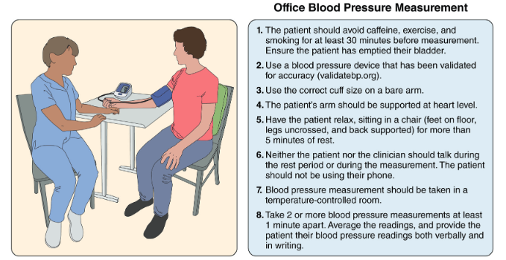
Diagnosis
Accurate BP measurement in office
Labs
  CMC
  BMP
  Lipid panel
  TSH
  Urine albumin-to-creatinine ratio
Figure 3.Checklist for Accurate Office Blood Pressure Management

Slide 28
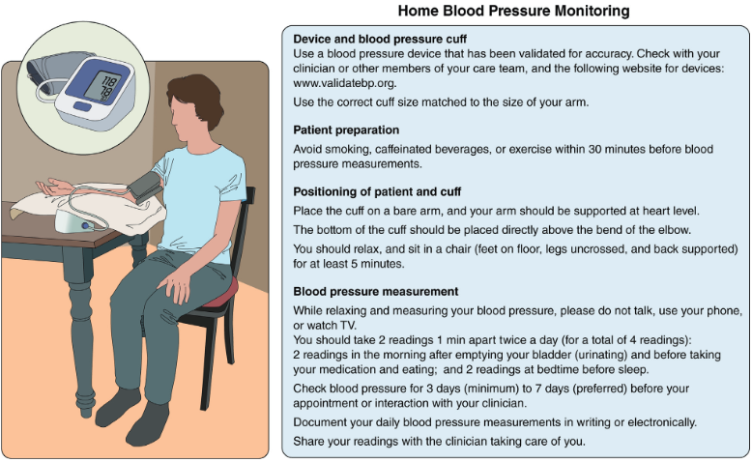
Ambulatory and Self-Measured BP Monitoring
Recommended for titration of medications
  ABPM: gold standard
  SMBP: improves office BP control
Avoid cuffless devices
  www.validatebp.org
Figure 4. Home Blood Pressure Monitoring

Slide 29
Causes of HTN
Dietary Factors | Nondietary Factors
Excess sodium intake | Genetics
Low potassium intake | Weight
Low calcium/mag intake | Sedentary lifestyle
Poor dietary quality | Poor sleep quality
Alcohol use | Psychosocial stress
 | Air pollution

Slide 30
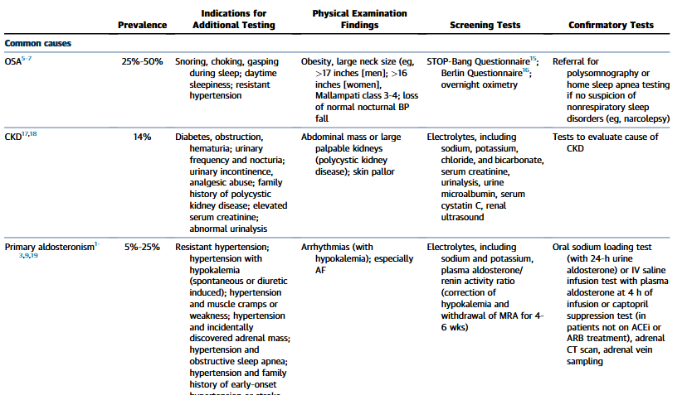
Secondary HTN
Table 10. Causes of Secondary Hypertension With Indications for Additional Testing and Diagnostic Screening Tests

Slide 31
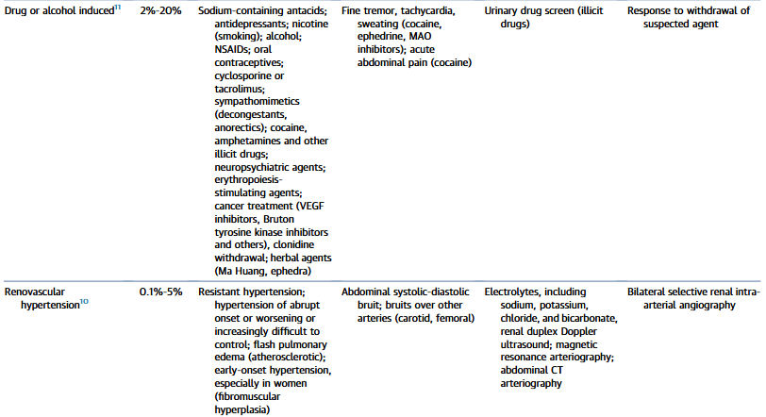
Secondary HTN
Table 10. Causes of Secondary Hypertension With Indications for Additional Testing and Diagnostic Screening Tests

Slide 32
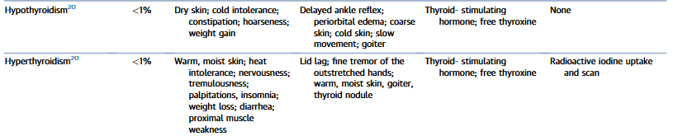
Secondary HTN – Uncommon Causes
Table 10. Causes of Secondary Hypertension With Indications for Additional Testing and Diagnostic Screening Tests

Slide 33
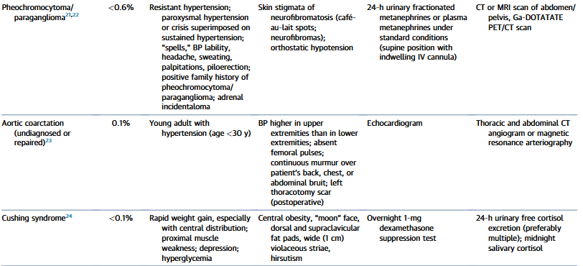
Secondary HTN – Uncommon Causes
Table 10. Causes of Secondary Hypertension With Indications for Additional Testing and Diagnostic Screening Tests

Slide 34
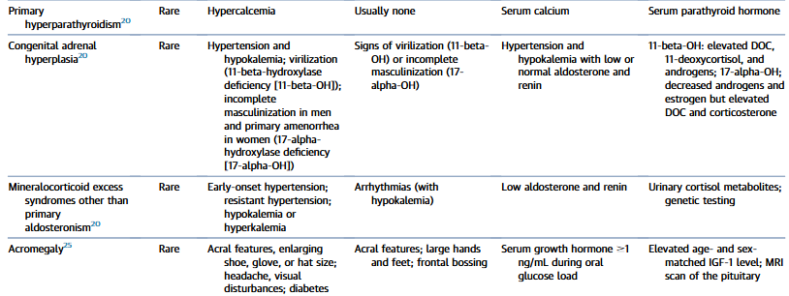
Secondary HTN – Uncommon Causes
Table 10. Causes of Secondary Hypertension With Indications for Additional Testing and Diagnostic Screening Tests

Slide 35
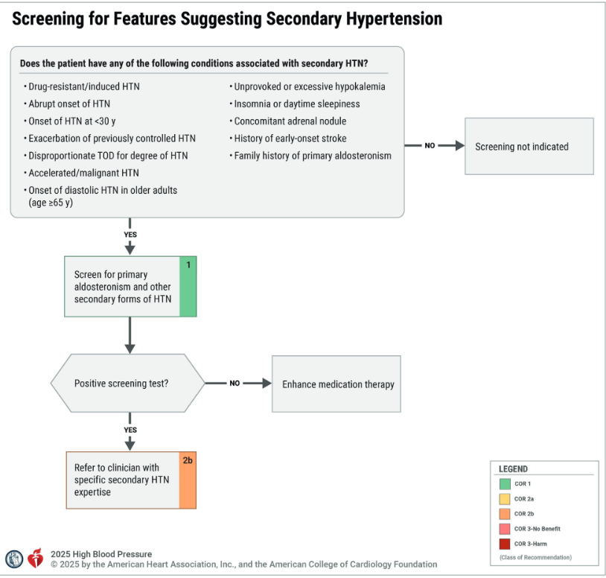
Secondary HTN-Screening
Figure 5. Screening for Features Suggesting Secondary Hypertension

Slide 36
Secondary HTN-Nonprescription Substance Induced
Alcohol
Caffeine
Decongestants
Black licorice
Herbals
NSAIDs
Recreational drugs

Slide 37
Secondary HTN-Prescription Substance Induced
Clonidine
Amphetamines
Antidepressants (SNRIs, MAOIs, TCAs)
Atypical antipsychotics
Immunosuppressants

Slide 38
Primary Aldosteronism
Old guidance suggests to stop medications that may affect renin and aldosterone levels
  Beta blockers
    suppress renin and aldosterone
  Central-alpha agonists (clonidine)
    suppress renin and aldosterone
  ACEi/ARB
    stimulate renin, suppress aldosterone
  Diuretics
    stimulate renin and aldosterone

Slide 39
Primary Aldosteronism
New guidance states to continue medications (except MRAs), then if screening is negative/borderline, may switch medications for at least 2-4 weeks prior to repeat testing
  CCBs (non-dihydropyridine>dihydropyridine)
  Vasodilators (minoxidil)
  Peripheral alpha-blockers (-zosins)
COR 1a

Slide 40
Renal Artery Stenosis
Atherosclerotic renal artery stenosis, medical therapy recommended (COR 1)
CORAL trial (Cardiovascular Outcomes in Renal Atherosclerotic Lesions)
  RAS blocker
  High intensity statin
  T2DM control
  Antiplatelet
  Smoking cessation
Revascularization
  Atherosclerotic but worsening kidney function or acute heart failure who were not represented in randomized control trials or failed management (COR 2a)
  Nonatherosclerotic renal artery disease (COR 2b)

Slide 41
Obstructive Sleep Apnea
Weight loss + CPAP use
  SURMONT OSA trial studied use of tirzepatide vs placebo which showed significant difference in population using CPAP
BP impairment varies based on CPAP compliance
COR 2a

Slide 42
Prevention
DASH diet (COR 1)
  <2300 mg sodium per day (goal <1500)
  3500-5000 mg of potassium per day
Salt substitutes (except in CKD or medications that cause potassium retention/reduced excretion) (COR 2a)
≥150 min per week of moderate physical activity with resistance ≥2 days (COR 1)
Stress management (COR 2b)
  Meditation
  Breathing techniques
Low alcohol intake (COR 1)
  ≤1 drink per day for women
  ≤2 drink per day for men
Weight loss (-5% ) (COR 1)

Slide 43
BP Thresholds for Medication Initiation
All adults with HTN
SBP ≥140
DBP ≥90
DBP ≥80
HTN + high short-term risk for CVD
HTN + CVD
SBP ≥130
SBP ≥130
DBP ≥80
HTN + CVD risk <7.5% (after 3-6 months of lifestyle modifications)
SBP ≥130
DBP ≥80
COR 1

Slide 44
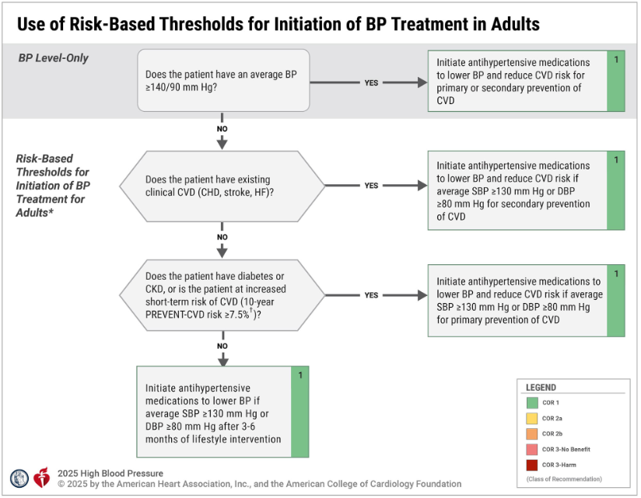
BP Thresholds for Medication Initiation
Figure 6. Use of Risk-Based Thresholds for Initiation of BP Treatment in Adults

Slide 45
Calling the Plays

Slide 46
Medication Selection
First Line
Thiazide
Dihydropyridine CCB
ACEi
Nondihydropyridine CCB
Loop diuretics
MRA
Beta Blockers
Alpha-1 blockers
Alternative
Direct renin inhibitors
Direct vasodilators
COR 1​

Slide 47
Monotherapy vs Combinations
Single-pill combination
class 1 recommendation
SBP ≥140 + DBP ≥90 [stage 2 hypertension]
Improves adherence
Single pill monotherapy
class 2a recommendation
SBP 130-139 + DBP 80-89 [stage 1 hypertension]
Titrate dose and add other agent of different class if needed
HARM
AVOID ACEi + ARB +/- renin inhibitor combination

Slide 48
Adherence Strategies
Once daily dosing or combination pills (COR 1)
Med sync
Reminder aids (alarms/notifications) (COR 2a)
Pharmacist education
Counseling for stress reduction

Slide 49
Drug interactions--Absorption
Thiazide + cholestyramine
Reduced BP lowering
Amlodipine/ furosemide/beta blockers/ telmisartan + potassium binder
Decreased absorption
Reduced BP lowering
Methyldopa + iron salts
Decreased absorption
Reduced BP lowering
Decreased absorption

Slide 50
Drug interactions--Metabolism
CHF beta blockers + CYP2D6 inhibitors
Increased BB concentration
Bradycardia/ hypotension
Diltiazem/verapamil + CYP3A4 inhibitors
Increased CCB concentration
Bradycardia/ hypotension
Diltiazem/verapamil + CYP3A4 inducers
Decreased CCB concentration
Reduced clinical effects

Slide 51
Drug Interactions--Miscellaneous
Lithium + thiazides/RAS blockers
Reduced lithium clearance
Increased risk of toxicity
Verapamil via P-gp inhibition + dabigatran
Reduced P-gp efflux of dabigatran
Increased dabigatran levels (higher bleed risk)
Verapamil/carvedilol via P-gp inhibition + digoxin
Reduced P-gp efflux of digoxin
Increased digoxin levels (higher risk of toxicity)

Slide 52
Advantageous interactions
Dihydropyridine CCB + RAS inhibitor
Reduced risk of leg swelling
RAS inhibitors + diuretics
Balanced effects on potassium
RAS inhibitors + potassium binders
Lower risk of hyperkalemia
Diuretics + potassium supplement
Lower risk of hypokalemia

Slide 53
BP Goals
Increased risk for CVD (COR 1)
SBP <130 + DBP <80
SBP <120 encouraged
HTN only (COR 2b)
SBP <130 + DBP <80
SBP <120 encouraged

Slide 54
Recommendations for Diabetes
More than 80% of adults with
T2DM have HTN
Treat for SBP ≥130 + DBP ≥80
BP goal >130/80
SBP <120 encouraged
Treatment choice:
Thiazides
CCBs
ACEi
First-line in CKD
ARB
First-line in CKD
COR 1

Slide 55
Recommendations for Obesity
GLP1 agonist
BMI ≥35 kg/m²
antihypertensives
bariatric surgery
BMI ≥27 kg/m²
behavioral interventions
COR 2b

Slide 56
Heart Failure Prevention
SBP <130
DBP <80
Lower risk of HF
GDMT Reduced Ejection Fraction
Beta Blockers
  Bisoprolol
  Metoprolol succinate
  Carvedilol
MRA
  Eplerenone
  Spironolactone
SGLT2i
  Empagliflozin
  Dapagliflozin
4. RAASi
  ACEi
  ARB
  ARNI
Preserved Ejection Fraction
Blood pressure control
MRA
  Finerenone
  Spironolactone
  Eplerenone
SGLT2i
  Empagliflozin
  Dapagliflozin
COR 1

Slide 57
Recommendation for CKD
eGFR <60 mL/min/1.73 m² or albuminuria ≥30 mg albumin/g creatinine
SBP <130
ACEi or ARB to decrease CVD and delay progression of kidney disease
Can reduce dose or hold if hyperkalemic or eGFR decline of >30%
COR 1

Slide 58
Recommendations for
Acute Intracerebral Hemorrhage
SBP 150-220 mmHg (COR 2a)
Immediately lower BP to 130-<140 mm Hg for at least 7 days after
Stop meds of SBP <130 mm Hg
Acute spontaneous ICH requiring acute BP lowering (COR 2a)
Titrate carefully to ensure stable BP lowering
Lowering SBP to <130 mm Hg
HARM! (COR 3)
INTERACT-2 Trial showed improved outcomes lowering SBP to <140 mm Hg within 6 hours of ICH onset
  Post-hoc analysis showed <130mm Hg was harmful
INTERACT-3 showed improvement with maintenance of this goal for 7 days

Slide 59
Recommendations for Acute Ischemic Stroke
Correct hypotension and hypovolemia (COR 1)
SBP <185 mm Hg and DBP <110 mm Hg before thrombolytics and maintained <180/105 mm Hg for 24 hours after initiating (COR 1)
BP ≤180/105 mm Hg 24 hours after endovascular treatment (COR 2a)
BP ≥220/120 and did not receive thrombolytics/endovascular treatment and no comorbidities for acute antihypertensive treatment, lower BP by 15% during first 24 hours after onset of stroke (COR 2b)
BP treatment of the discussed patient scenario but within the first 48-72 hours after onset of stroke shows NO BENEFIT
Successful bran reperfusion with endovascular treatment for large vessel occlusion, lowering SBP <140 mm Hg within 24-72 hrs can cause HARM
Studies: BP TARGET, ENCHANTED-2 MT, OPTIMAL BP, BEST II Trial

Slide 60
Secondary Stroke Prevention
Treatment (COR 1):
  Thiazide
  ACEi
  ARB
Office BP goal <130/80 mm Hg (COR 1)
If no Hx of HTN but office avg of ≥130/80 mm Hg, initiate antihypertensive
(COR 2a)

Slide 61
Recommendation for Prevention of Mild Cognitive Impairment and Dementia
SBP goal <130 mm Hg (COR 1)

Slide 62
Recommendations for Plan of Care
COR 1
Team-Based Care
Recommended to achieve goal
Response to adverse events and monitoring
Framework in Clinical Practice
Integrated treatment model for accurate technique, prompt treatment, engagement, and ongoing monitoring
Follow-Up
Monthly intervals until goal is met
Health information Technology
Telehealth is beneficial to improve access to care and adherence (COR 2a)
EHR and registries beneficial for screening and identification of those who need treatment

Slide 63
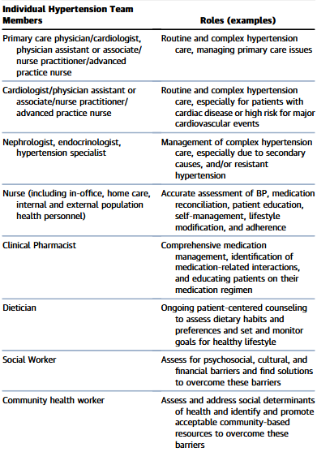
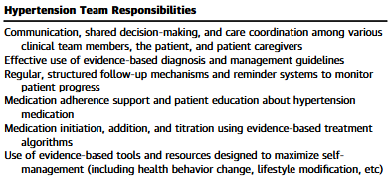
Responsibilities and Roles of HTN Team
Team Members: primary care clinicians, HTN specialists, nurses, pharmacists, dieticians, social workers, community health workers
Table 19. Responsibilities and Roles of the Hypertension Team

Slide 64
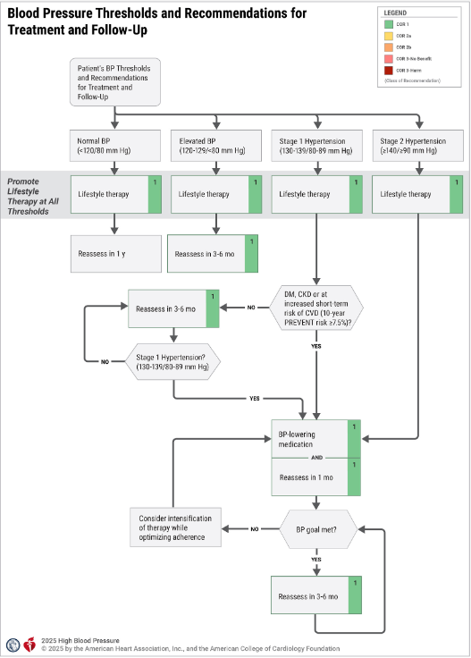
Recap of Plays
Figure 7. BP Thresholds and Recommendations for Treatment and Follow-Up

Slide 65
Recommendations for HTN in Pregnancy
Planning pregnancy/become pregnant
Labetalol or Nifedipine ER
Counsel on use of low-dose aspirin
Pregnant
SBP ≥160 mm Hg or DBP ≥110 mm Hg: treat to lower to <160/110 mm Hg within 30-60 minutes
Chronic HTN (SBP 140-159 mm Hg and/or SBP 90-109 mm Hg prior to 20 wks gestation): treat to achieve BP <140/90 mm Hg
HARM
DO NOT use ACEi, ARB, direct renin inhibitors, nitroprusside, MRA
COR 1
COR 1
COR 3

Slide 66
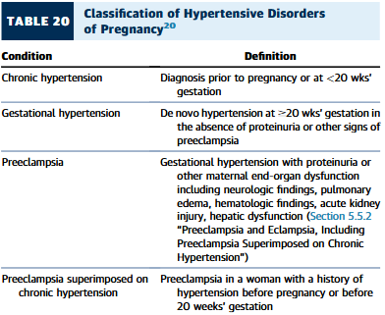
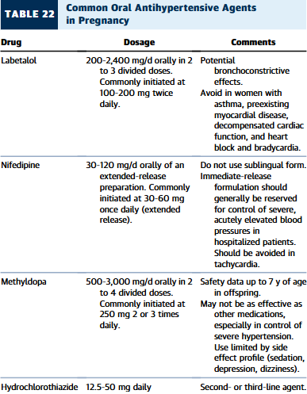
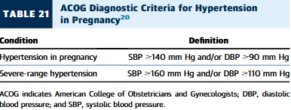
HTN in Pregnancy

Slide 67
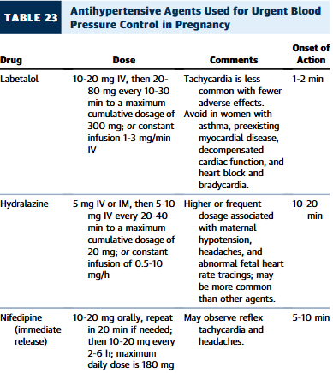
Urgent Treatment of HTN in Pregnancy

Slide 68
Resistant HTN
Detailed evaluation of secondary causes (COR 1)
  Medication interference
  Removal of medication
    ~20% of adults use OTC meds that raise BP
On optimized first-line therapy (combination) (COR 1)
  Add an MRA
Intolerance/contraindication to MRA (COR 2a)
  Add an alternative second-line agent

Slide 69

Recommendations for Renal Denervation
Resistant HTN with off BP 140-180/≥90 mm Hg, or intolerance to medications, consider renal denervation with lifestyle modifications + antihypertensives is reasonable (COR 2b)
If pursuing RDN, take multidisciplinary team approach (COR 1)
Use shared decision-making process to ensure patient know the risks and benefits of RDN vs treatment with medications alone (COR 1)

Slide 70
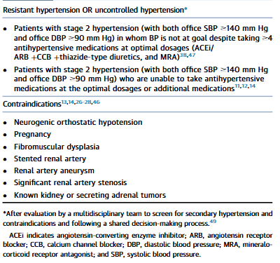
Table 25. Patient Selection for Renal Denervation

Slide 71
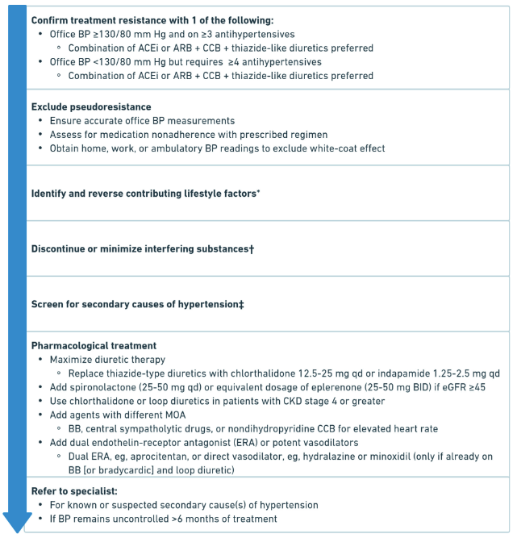
Figure 8. Resistant HTN, Diagnosis, Evaluation, and Treatment

Slide 72
When Plays Fail

Slide 73
Management of Orthostatic Hypotension
Improved BP control reduces risk of OH (COR 1)
If on intensive therapy with asymptomatic OH, SBP <130 is reasonable (COR 2a)
If initiating treatment or escalating medication regimen with a SBP goal of <130 mm Hg, assess symptomatic OH for detection of other chronic conditions (COR 2a)

Slide 74
Hypertensive Emergencies + Severe HTN in Nonpregnant + Nonstroke Patients
In Emergency (BP >180 and/or >120 mm Hg and evidence of acute organ damage), admit to ICU for continuous monitoring and consider IV treatment (COR 1)
If emergency related to condition like acute aortic syndrome or dissection, reduce SBP to <140 mm Hg and to <120 mm Hg in aortic dissection during 1st hour (COR 1)
If emergency WITHOUT compelling condition, reduce SBP no more than 25% within 1st hour, then if stable, to <160/100 mm Hg within next 2-6 hours then 130-140 mm Hg over next 24-48 hours (COR 1)
HARM! In severe HTN hospitalized for noncardiac conditions without acute target organ damage, intermittent use of IV/oral meds are not recommended

Slide 75
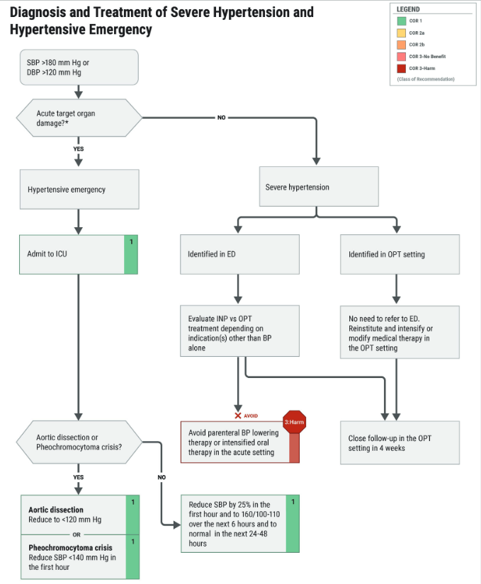
Figure 9. Diagnosis and Treatment of Severe Hypertension and Hypertensive Emergency

Slide 76
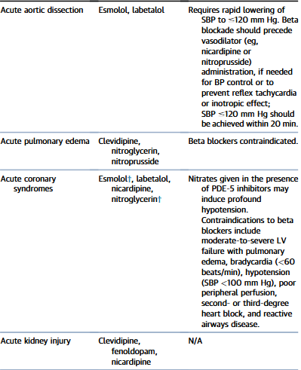
Table 27. Intravenous Antihypertensive Drugs for Treatment of Hypertensive Emergency in Patients with Selected Comorbidities

Slide 77
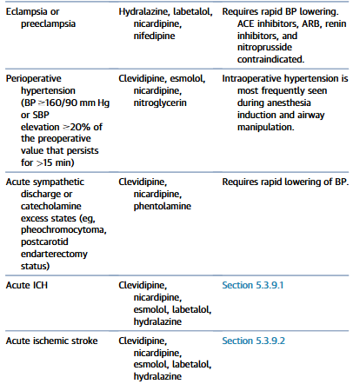
Table 27. Intravenous Antihypertensive Drugs for Treatment of Hypertensive Emergency in Patients with Selected Comorbidities

Slide 78
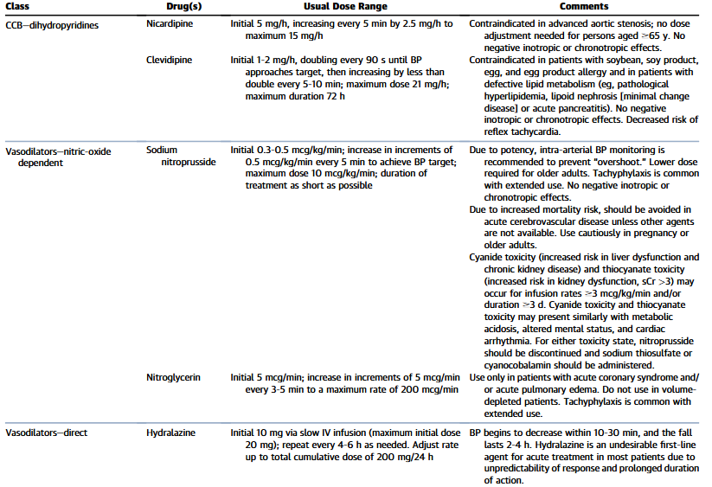
Table 26. Intravenous Antihypertensive Drugs for Treatment of Hypertensive Emergencies

Slide 79
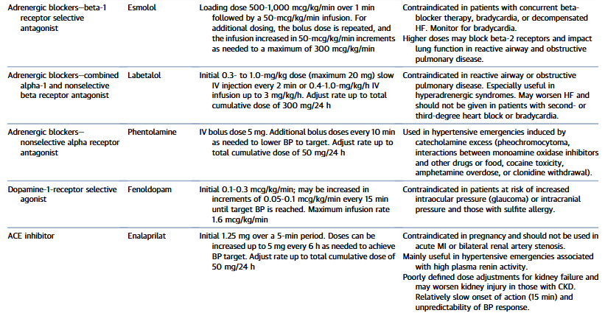
Table 26. Intravenous Antihypertensive Drugs for Treatment of Hypertensive Emergencies

Slide 80
Recommendations for Scheduled Surgical Procedures
In major surgery
  continue beta blockers perioperatively if chronic use (COR 1)
  discontinue ACEi/ARB preop (COR 2b)
In elective surgery
  continue most meds perioperatively (COR 2a)
  Defer if SBP ≥180 mm Hg or DBP ≥110 mm Hg (COR 2b)
In general scheduled surgery
  Do not abruptly stop beta blocker or clonidine preop (HARM)
  Do not start beta blocker on day of surgery in BB-naïve patient (HARM)

Slide 81
References
Jones, D, Ferdinand, K, Taler, S. et al. 2025 AHA/ACC/AANP/AAPA/ABC/ACCP/ACPM/AGS/AMA/ASPC/NMA/PCNA/SGIM Guideline for the Prevention, Detection, Evaluation, and Management of High Blood Pressure in Adults: A Report of the American College of Cardiology/American Heart Association Joint Committee on Clinical Practice Guidelines. JACC. 2025 Nov, 86 (18) 1567–1678. https://doi.org/10.1016/j.jacc.2025.05.007

Slide 82

Questions?
Brittany Messer, PharmD, FACC
Brittany.Messer@wvumedicine.org
304-638-4818
Instagram: @the.mod.pharmacist
X: @Mod_Pharmacist

