Slide 1
General Principles of Antimicrobial Therapy
Jamie Allman, Pharm.D., BCPS
APNP Conference - May 15, 2026

Slide 2
Objectives
Review Antibiotic Principles
  Bacteria Review
  Signs/Symptoms of Infection
  Select Antibiotics based on need of empiric coverage
Analyze Antimicrobial Stewardship Concepts
Assess Local Antibiogram Application to assist with Appropriate Antibiotic Coverages
Discuss and Apply Pros and Cons of Antibiotic Options with Common Clinical Case Scenarios

Slide 3
Simplified Microbiology 101
Gram Positive
  Staphylococcus (MSSA, MRSA)
  Streptococcus (PCN Resistant Strep Pneumo)
  Enterococcus (VRE)
Gram Negative
  Simple/Piddly
    Haemophilus, Moraxella, Salmonella, Shigella, Morganella, Neisseria)
  FENCE BUGS (PEK)
    Proteus, Escherichia coli (E.coli), Klebsiella
  SPACE
    (Serratia, Pseudomonas, Acinetobacter, Citrobacter, Enterobacter)

Slide 4
Simplified Microbiology 101
Atypical Organisms
  Chlamydia
  Mycoplasma
  Legionella
Anaerobes
  Peptostreptococcus
  Bacteroides
  Clostridium

Slide 5
Confirm Presence of Infection
Antimicrobial Stewardship
Fever
Signs and Symptoms
  Physical findings (Crackles, SOB, Erythema, Dysuria)
  Leukocytosis/left shift
  Pain
  Blood
Predisposing Factors
  Disruption of natural barriers
  Immunosuppressive state
  Age

Slide 6
Basic Steps In Therapy
Determine Site of Infection
Determine causative organism(s)
  Most likely pathogen
  Which ABX are effective against it(them)
Select a drug based on:
  Sensitivity of the microorganism
  Penetration of the antibiotic
  Toxicities of the drug
  Patient characteristics (Allergies, Renal function)
Assess patient for clinical response
Adjust therapy PRN

Slide 7
Antimicrobial Stewardship (AMS)
Key Concept:
-Optimize antibiotic prescribing for cure while minimizing resistance and toxicities

Slide 8
Multi-factorial Focus on AMS Programs
Educational Campaigns
  Local Facility Education
  Patients/Family Members education
The Joint Commission new standards effective January 1, 2017
Implementation and Evaluations of Sites
  ***Data Feedback to Providers***
  ***Resistance Patterns***

Slide 9
Key Stewardship Focus
Timely collection of urine, blood, and sputum cultures
  Prior to ABX administered ideally
Knowing when an ABX is held
  Loss of IV access, ptn off floor for procedure
  Especially with antibiotics administered 1-2 times/day
Monitor patients BP and temperature closely: if excessive low or high
Monitor urine output significantly decreases
  ABX dose most likely needs adjusted for increase/decreased clearance
Outpatient Pearl: don’t collect urine samples in asymptomatic patients
  Color change, smell do NOT rush to treat
  Do not use the urine collection bag for urine cultures to send to lab.
  Clean catch, midstream urine collections are imperative
Pharmacokinetic Optimization:
  Monitor patient admin times with Vancomycin and Aminoglycosides (Tora/Gentamicin)
  Consistent administration times to allow accurate Trough assessments

Slide 10
Key Stewardship Focus
Allergy screening in CPRS (#1 documented allergy is to antibiotics)
  Hx of allergy to assist in providing clear documentation of allergy
  Penicillin Allergy Testing (10 year out risk)
Dose Optimization
  Assess for treatment of disease (Osteomyelitis/Endocarditis)
  Therapeutic Drug Level assessment
  Balance Therapeutic Levels vs Toxicity
  Minimize risk of developing resistance via underdosing
  Patient parameter adjustments for renal improvement/decline, Vd changes, Liver clearance
Screening Patient Parameters
  Renal function via SCR and Acute Kidney Injury (AKI)
    Concomitant nephrotoxic meds;
    Bactrim with AKI/Hyper K+
  Drug-Drug Interactions (watch Fe or MVI with oral FQN/TCNs binding; SSRI + Linezolid)
  EKG review of QTc close to 500msec
    (Fluoroquinolones and Macrolides; Anti-nausea or Antipsychotics)

Slide 11
Key Stewardship Focus
Appropriate Duration /Stopping when Inappropriate or Cultures Clear
  Ensure duration is long enough and not excessive
  Ensure dose is high enough to penetrate and not too low to avoid promoting resistance
Monitoring Patient Clinical Progress
  Renal function recovery (all antibiotics for CrCl or Acute Kidney Injury)
  New Rash or Eosinophilia (indicative of allergic reactions)
  Hyperkalemia (i.e. Bactrim)
  Restricted use of class of antibiotics (Daptomycin, Linezolid, Carbapenems, etc)
Recommend best antibiotics for disease state per Guidelines (idsociety.org)
Review Local Antibiogram for Resistance Patterns from year to year

Slide 12
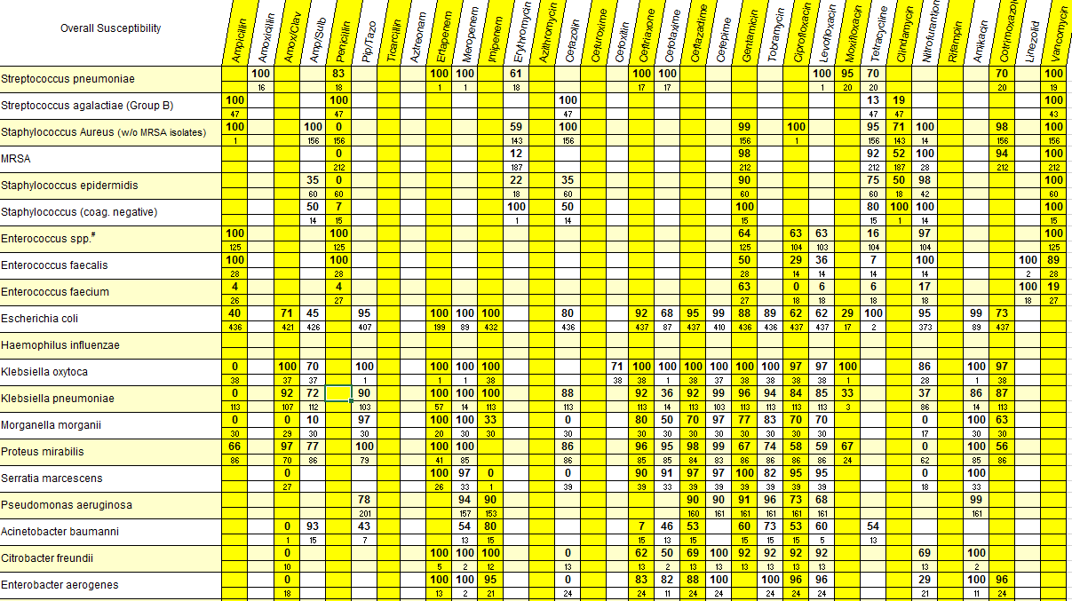
Utilizing Antibiograms for Resistance

Slide 13
Case Assessment:
Asymptomatic Bacteriuria
A 72‑year‑old woman is evaluated during a routine follow‑up visit. She has a history of hypertension and osteoarthritis.
She reports no urinary symptoms, including no dysuria, frequency, urgency, suprapubic pain, flank pain, or fever. Vital signs are normal.
As part of pre‑visit labs, a urinalysis was obtained and shows positive leukocyte esterase and nitrites.
Urine culture grows >100,000 CFU/mL of E. coli. She remains completely asymptomatic. What is the most appropriate next step in management?
  A. Start oral nitrofurantoin for 5 days
  B. Repeat the urine culture in 1 week
  C. Begin empiric broad‑spectrum IV antibiotics
  D. Do not treat; no antibiotics are indicated
  E. Order renal ultrasound to evaluate for obstruction

Slide 14
Case Assessment:
Asymptomatic Bacteriuria
A 72‑year‑old woman is evaluated during a routine follow‑up visit. She has a history of hypertension and osteoarthritis.
She reports no urinary symptoms, including no dysuria, frequency, urgency, suprapubic pain, flank pain, or fever. Vital signs are normal.
As part of pre‑visit labs, a urinalysis was obtained and shows positive leukocyte esterase and nitrites.
Urine culture grows >100,000 CFU/mL of E. coli. She remains completely asymptomatic. What is the most appropriate next step in management?
  A. Start oral nitrofurantoin for 5 days
  B. Repeat the urine culture in 1 week
  C. Begin empiric broad‑spectrum IV antibiotics
  D. Do not treat; no antibiotics are indicated
  E. Order renal ultrasound to evaluate for obstruction

Slide 15
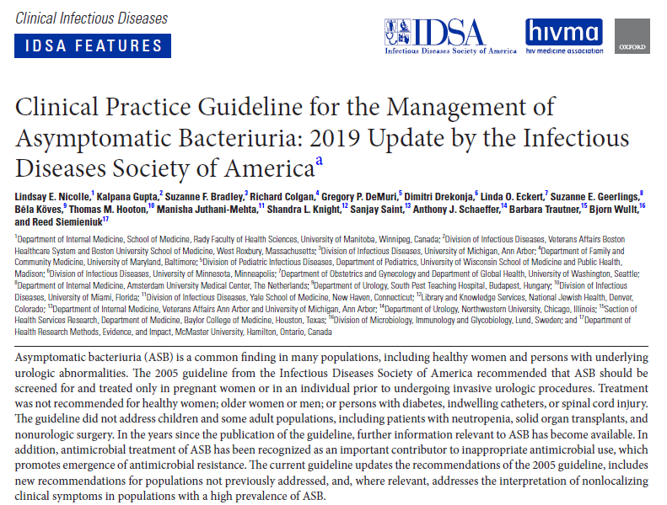
Asymptomatic Bacteriuria Guidelines
(released: March 21, 2019) CID 2019: 68 (15 May) e83-110
https://www.idsociety.org/practice-guideline/asymptomatic-bacteriuria/

Slide 16
Asymptomatic Bacteriuria (ASB)
2019 Guidelines Updates the 2005 Guidelines
  Address several disease states not covered previously
RECOMMEND SCREENING
  ***PREGNANT WOMAN ***
    Screen early in pregnancy
    Treat if Cx >100,000 CFU/ml
    4-7 days of targeted therapy
  ***Endoscopic Urologic Procedures w/ mucosal trauma prior to procedure (short course 1-2 doses)
    Especially those with expected mucosal bleeding
    Screen and treat prior to procedure
NO RECOMMENDATION for or against High Risk Neutropenic patients (ANC<100 for >7 days)

Slide 17
Asymptomatic Bacteriuria (ASB)
Recommends Against Screening for or treating ASB in the following categories:
  Nonpregnant women
  Functionally Impaired Women/Men in long term care facility
  Cognitively impaired patients w/o local GU sxs or systemic signs of infection (Fever or Hemodynamic Instability)
  Diabetic patients
  Kidney transplant >1 month out
  Non-renal solid organ transplant
  Spinal cord injury w/o clinical sxs
  Indwelling urethral catheter <30 days or long dwelling catheters
  Non-urologic surgery procedures
  Implantation of Urologic Devices or Penile Prosthesis

Slide 18
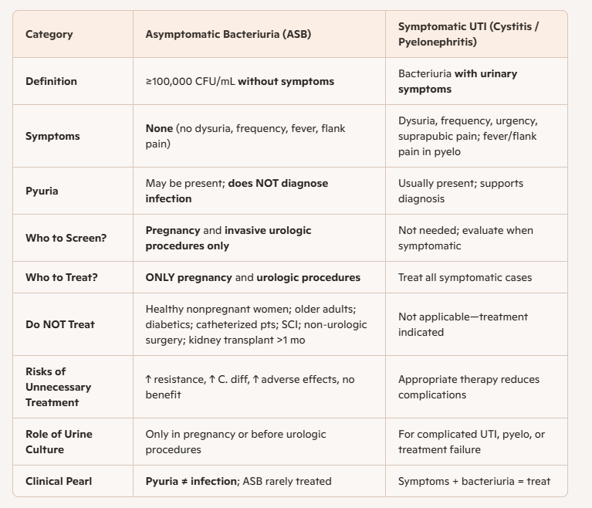

Slide 19
General Assessment Question
Which of the following statements about nitrofurantoin therapy for acute uncomplicated cystitis are TRUE?
A. Nitrofurantoin should be avoided in patients with significantly reduced
renal function (eGFR <30 mL/min)
B. Nitrofurantoin is appropriate for treating pyelonephritis due to excellent
renal tissue penetration
C. Nitrofurantoin is considered a first‑line agent for uncomplicated cystitis in
non‑pregnant women
D. Nitrofurantoin commonly causes tendon rupture and should be avoided
in older adults
E. Nitrofurantoin achieves high urinary concentrations but poor serum and
tissue levels

Slide 20
General Questions
Which of the following statements about nitrofurantoin therapy for acute uncomplicated cystitis are TRUE?
A. Nitrofurantoin should be avoided in patients with significantly reduced
renal function (eGFR <30 mL/min)
B. Nitrofurantoin is appropriate for treating pyelonephritis due to excellent
renal tissue penetration
C. Nitrofurantoin is considered a first‑line agent for uncomplicated cystitis in
non‑pregnant women
D. Nitrofurantoin commonly causes tendon rupture and should be avoided in
older adults
E. Nitrofurantoin achieves high urinary concentrations but poor serum and
tissue levels

Slide 21
Origins of Extended spectrum Beta Lactamases (ESBL)
Carbapenem Resistant Enterobacteriaceae (CRE)
Penicillinase was the first beta lactamase –hydrollized the B lactam ring (1940)
Gram negatives most commonly produce resistance via:
  Chromosomal Class C (may hyperproduce)
  Naturally produce AmpC enzymes in new bacteria that didn’t normally produce it
ESBL
  Common expression of resistance is plasmid encoded (TEM-1, TEM-2, SHV-11) –spared expanded cephalosproins
  First saw ESBL production 1979—Oxyimino side chain hydrolyze these expanded cephalosporins
    TEM B lactamases (TEM-1 is most common)
    SHV-1 similar to TEM-1 (most common Kleb)
    CTX-M (most active against cefotaxime, ceftaz, ceftriaxone, cefepime)
    OXA (most active against oxacillin)
Largest Threat are Five Carbapenemases (CRE)
  Klebsiella pneumonia carbapenemase (KPC)
  New Delhi metallo-beta-lactamase (NDM)
  Verona integrin encoded metallo-beta-lactamase (VIM)
  Imipenemase (IMP)
  Oxacillinase-48-like-carbapenemase (OXA-48)

Slide 22
Extended spectrum Beta Lactamases (ESBL)
Carbapenem Resistant Enterobacteriaceae (CRE)
Central Line associated blood stream infections (CLABSIs)
Catheter associated urinary tract infections (CAUTIs)
Most common pathogens seen with this resistance
  E.coli***
  Klebsiella oxytoca & pneumonia**
  Enterobacter*
  Citrobacter
  Serratia

Slide 23
Assessment Question
Which of the following would be appropriate to utilize for a patient who cultures out and ESBL producing E.coli from their urine culture?
A. Vancomycin IV 1250mg q12 hours x 7 days
B. Augmentin 875mg q12hrs
C. PO Azithromycin 500mg Daily x 7 days
D. Meropenem IV 1gram q12 hours
E. Ciprofloxacin IV 500mg q12hrs
F. Imipenem-cilastatin IV1000mg q8 hours

Slide 24
Assessment Question
Which of the following would be appropriate to utilize for a patient who cultures out and ESBL producing E.coli from their urine culture?
A. Vancomycin IV 1250mg q12 hours x 7 days
B. Augmentin 875mg q12hrs
C. Azithromycin PO 500mg Daily x 7 days
D. Meropenem IV 1gram q12 hours
E. Ciprofloxacin IV 500mg q12hrs
F. Imipenem-cilastatin IV1000mg q8 hours

Slide 25
Assessment Question
A 67‑year‑old woman is hospitalized with fever, dysuria, and flank pain. She has a history of type 2 diabetes and recurrent urinary tract infections.
Urinalysis shows pyuria and bacteriuria. CT abdomen shows no obstruction.
Urine culture grows >100,000 CFU/mL of E. coli producing an extended‑spectrum β‑lactamase (ESBL). The organism is resistant to ceftriaxone, cefepime, ciprofloxacin, and TMP‑SMX.
Susceptibilities from C&S are pending. The patient is clinically stable but has pyelonephritis.
What is the most appropriate antibiotic therapy?
A. Oral nitrofurantoin
B. Oral Vancomycin
C. Oral fosfomycin
D. IV piperacillin‑tazobactam
E. Oral amoxicillin‑clavulanate
F. IV Ertapenem

Slide 26
Assessment Question
A 67‑year‑old woman is hospitalized with fever, dysuria, and flank pain. She has a history of type 2 diabetes and recurrent urinary tract infections.
Urinalysis shows pyuria and bacteriuria. CT abdomen shows no obstruction.
Urine culture grows >100,000 CFU/mL of E. coli producing an extended‑spectrum β‑lactamase (ESBL). The organism is resistant to ceftriaxone, cefepime, ciprofloxacin, and TMP‑SMX.
Susceptibilities are pending at this time. The patient is clinically stable but has pyelonephritis.
What is the most appropriate antibiotic therapy?
A. Oral nitrofurantoin
B. Oral Vancomycin
C. Oral fosfomycin
D. IV piperacillin‑tazobactam
E. Oral amoxicillin‑clavulanate
F. IV Ertapenem

Slide 27
MRSA Coverage
Traditional Coverages
  Vancomycin IV to treat MRSA (PO is Cdiff only),
  Oral Options: Doxy/TCN, Bactrim, Clindamycin
Newer Kids on the Block–
  IV or PO: Linezolid
  IV only: Quinupristin/Dalfopristin, Tigecycline, Daptomycin, Ceftaroline
Newest Kids on the Block –
  IV or PO: Tedizolid
  IV only: Telavancin, Oritavancin, Dalbavance, Delafloxacin*

Slide 28
Assessment Question
A 58‑year‑old man is hospitalized with fever, productive cough, and shortness of breath. He has a history of COPD and was recently treated with a 10‑day course of levofloxacin for a presumed COPD exacerbation.
Chest X‑ray shows a new right‑lower‑lobe infiltrate. He is started on empiric therapy for hospital‑acquired pneumonia.
Sputum culture later grows methicillin‑resistant Staphylococcus aureus (MRSA). Blood cultures are negative. What is the most appropriate antibiotic therapy?
A. IV vancomycin
B. Oral doxycycline
C. IV linezolid
D. Oral trimethoprim‑sulfamethoxazole
E. IV cefazolin

Slide 29
Assessment Question
A 58‑year‑old man is hospitalized with fever, productive cough, and shortness of breath. He has a history of COPD and was recently treated with a 10‑day course of levofloxacin for a presumed COPD exacerbation.
Chest X‑ray shows a new right‑lower‑lobe infiltrate. He is started on empiric therapy for hospital‑acquired pneumonia.
Sputum culture later grows methicillin‑resistant Staphylococcus aureus (MRSA). Blood cultures are negative. What is the most appropriate antibiotic therapy?
A. IV vancomycin
B. Oral doxycycline
C. IV linezolid
D. Oral trimethoprim‑sulfamethoxazole
E. IV cefazolin

Slide 30
Case Assessment
A 54‑year‑old man presents with fever, chills, and malaise for 3 days. He has a history of IV drug use and poorly controlled diabetes. On exam, he is febrile to 38.9°C and tachycardic.
Blood cultures drawn in the emergency department grow methicillin‑resistant Staphylococcus aureus (MRSA) in both sets.
Repeat cultures are pending. A transthoracic echocardiogram is ordered. What is the most appropriate initial antibiotic therapy?
A. IV vancomycin
B. Oral doxycycline
C. IV linezolid
D. IV cefazolin
E. Oral trimethoprim‑sulfamethoxazole

Slide 31
Case Assessment
A 54‑year‑old man presents with fever, chills, and malaise for 3 days. He has a history of IV drug use and poorly controlled diabetes. On exam, he is febrile to 38.9°C and tachycardic.
Blood cultures drawn in the emergency department grow methicillin‑resistant Staphylococcus aureus (MRSA) in both sets.
Repeat cultures are pending. A transthoracic echocardiogram is ordered. What is the most appropriate initial antibiotic therapy?
A. IV vancomycin
B. Oral doxycycline
C. IV linezolid
D. IV cefazolin
E. Oral trimethoprim‑sulfamethoxazole

Slide 32
NEW SPACE Bug ABX Coverage
  Cell Wall Inhibitors
    Penicillins (Piperacillin &Ticarcillin)
    Cephalosporins (Ceftazidime & Cefepime)
    ***Ceftaz-avibactam: Avycaz
    *** Ceftolozane-tazobactam: Zerbaxa),
    Carbapenems (Imipenem, Meropenem, Doripenem,
    *** Meropenem-vaborbactam: Vabomere)
    Anaphylaxis PCN allergy = Aztreonam
  Combine with one of the two below for different MOA
    DNA gyrase = FQN (Cipro, Levaquin &
    *** Delafloxacin)
    30 S = Aminoglycosides (Gent, Tobra, Amikacin)

Slide 33
SPACE Bug Coverage
PCN Piperacillin Ticarcillin | Cephalosporin Ceftazidime Cefepime | Carbapenem Imipenem Meropenem | Ace In the Hole Aztreonam
AG (30S) Gentamicin Tobramycin Amikacin | FQN (DNA gyrease) Ciprofloxacin Levofloxacin |  | Colistin

Slide 34
Case Assessment
A 62‑year‑old man with severe COPD presents with fever, increased sputum production, and worsening shortness of breath. He was recently hospitalized 3 weeks ago for an exacerbation and received IV ceftriaxone and azithromycin.
Chest X‑ray now shows a new right‑upper‑lobe infiltrate. He is started on empiric therapy for hospital‑acquired pneumonia.
Sputum culture later grows Pseudomonas aeruginosa. Blood cultures are negative. What is the most appropriate antibiotic therapy?
A. IV cefepime
B. Oral levofloxacin 500 mg daily
C. IV piperacillin‑tazobactam
D. IV meropenem
E. Oral amoxicillin‑clavulanate

Slide 35
Case Assessment
A 62‑year‑old man with severe COPD presents with fever, increased sputum production, and worsening shortness of breath. He was recently hospitalized 3 weeks ago for an exacerbation and received IV ceftriaxone and azithromycin.
Chest X‑ray now shows a new right‑upper‑lobe infiltrate. He is started on empiric therapy for hospital‑acquired pneumonia.
Sputum culture later grows Pseudomonas aeruginosa. Blood cultures are negative. What is the most appropriate antibiotic therapy?
A. IV cefepime
B. Oral levofloxacin 500 mg daily
C. IV piperacillin‑tazobactam
D. IV meropenem
E. Oral amoxicillin‑clavulanate

Slide 36
Case Application
Patient is receiving Piperacillin/Tazobactam (Zosyn) and Vancomycin for empiric coverage of a severe hospital acquired pneumonia. He has been receiving this combination for 6 days when he suddenly develops a fever and leukocytosis.
What are potential options for this sudden turn in clinical status?
What would you like to ask the patient to assist in ruling in or out your suspicion?

Slide 37
Case Application
Patient is receiving Piperacillin/Tazobactam (Zosyn) and Vancomycin for empiric coverage of a severe hospital acquired pneumonia. He has been receiving this combination for 6 days when he suddenly develops a fever and leukocytosis.
What are potential options for this sudden turn in clinical status?
  Super-infection (most likely)
  Side effect of the antibiotic; less likely resistance to combo
What would you like to ask the patient?
  Experiencing bouts of Diarrhea?

Slide 38
Case Application
With this secondary infection, why do we need to treat it in the first place?
  Review the drawbacks of not treating
What therapy should you not prescribe to control his symptoms?
Why would you not want to use these agents?

Slide 39
Case Application
With this infection, why do we need to treat it in the first place?
  Toxic mega colon
  Electrolyte abnormalities
  Dehydration
What are you going to use to treat?
  Vancomycin via the PO route 125-500mg QID
  Fidaxomicin (Dificid) PO route 200mg BID x 10days
  Metronidazole (Flagyl) IV or PO 3rd line **fulminant may need Vanc + IV Metro
  Fecal microbiotia transplantation (FMT)- typically reserved for >2 recurrences
    FDA approved – very expensive
    Liquid filtrate feces from healthy donor
      Colonoscopic 200-250mL of stool suspension cecum and terminal ileum
      NG tube 30-60mL stool suspension
      Enema 50-100mL
      Capsule 24-30 capsules taken in single session

Slide 40
Case Application
What therapy will you not prescribe to control his symptoms?
  Loperamide (Immodium)
  Pepto-Bismol
  Diphenoxylate-atropine (Lomotil)
Why would you not want use these agents?
  Risk of toxic megacolon

Slide 41
Case Application
A 49‑year‑old woman presents with dysuria, urinary frequency, and suprapubic discomfort. She is afebrile and hemodynamically stable.
Urinalysis shows pyuria and bacteriuria.
Urine culture grows >100,000 CFU/mL of Pseudomonas aeruginosa with pending susceptibilities. She has no nausea or vomiting and can tolerate oral medications.
What is the most appropriate oral antibiotic therapy?
A. Oral ciprofloxacin
B. Oral levofloxacin
C. Oral nitrofurantoin
D. Oral amoxicillin‑clavulanate
E. Oral fosfomycin

Slide 42
Case Application
A 49‑year‑old woman presents with dysuria, urinary frequency, and suprapubic discomfort. She is afebrile and hemodynamically stable.
Urinalysis shows pyuria and bacteriuria.
Urine culture grows >100,000 CFU/mL of Pseudomonas aeruginosa with pending susceptibilities. She has no nausea or vomiting and can tolerate oral medications.
What is the most appropriate oral antibiotic therapy?
A. Oral ciprofloxacin
B. Oral levofloxacin
C. Oral nitrofurantoin
D. Oral amoxicillin‑clavulanate
E. Oral fosfomycin** (watch for clinical improvement, Pseudo susceptibilities vary greatly)

Slide 43
Take Away Points
AMS Principles whenever deciding to use antibiotics or not
  Assess Infection likely pathogen or true need for treatment with an ABX
Bacteria associated with Common Infections
  MRSA, Pseudomonas, ESBL producers
All antibiotics run the risk of Clostridioides difficile (2016 name change)
  Avoid Antidiarrheals!!!
  C.difficile; C.Diff, formerly known as Clostridium (both name remain in literature
  PO Vanc (125-500mg QID), Fidaxomicin (may reduce recurrence $4-5K), Fecal Microbiota transplantation (consider FMT for > 2 recurrences)
  When Fulminant High dose Oral Vanc 500mg q6hrs plus IV Metronidazole
Special cases with Resistant Organisms
  IV vs PO options; optimize dosing to minimize side effects, length, and resistance

Slide 44

Questions/Discussion
What stewardship change will you make from today’s talk?
  Cut down by 10-30% on duration (10 days → 7 days)
  Avoid antimotility agents in patients post antibiotics for up to 90 days
  Avoid treating your next Asymptomatic Bacteriuria case
What is one clinical pearl that will stick with you as a great take home point?

