Slide 1

2026
Legislative Update
Policy and Advocacy of WVNA
Joyce Wilson, MSN, APRN, FNP-C
WVNA Immediate Past President
Julie Huron, BSH, LNHA
WVNA CEO

Slide 2




Objectives
Compare and contrast the WVNA Health Policy & Legislative (HP&L) Statement to a Legislative Agenda
Describe the role & responsibilities of a WVNA Legislative Leader
Describe recommendations for strategic communication with policy-makers as a WVNA Legislative Leader
Summarize state legislative process

Slide 3
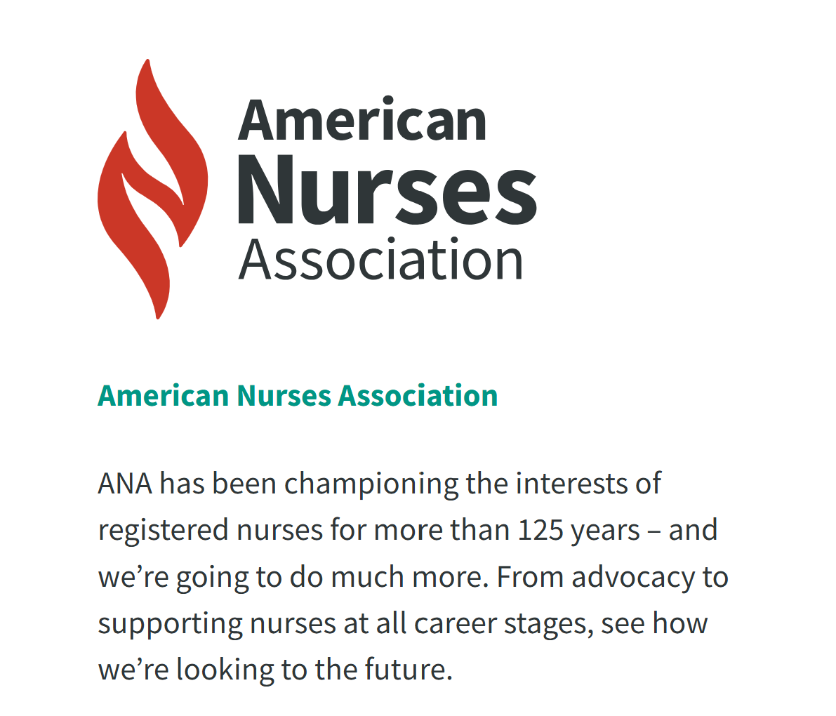
American Nurses Association
Lead the profession to shape the future of nursing and health care
Notes:
Advocate
Pollicies
Code of Ethics
Standards of Professional Practice

Slide 4

Only political voice for ALL WV nurses
  Lobbyist
  Grassroots/Membership coordination
    Identification of policy issues impacting nurses
    Political advocacy plan
    Communication recommendations

Slide 5
West Virginia Legislature
Timeline
60 days- start date depends on election years
January – March (unless gubernatorial election year)
Two Bodies to approve: Legislative and Executive
Moves through two chambers of the Legislature
  Senate (17)
  House (100)
  Executive (governor)
Multiple committees

Slide 6
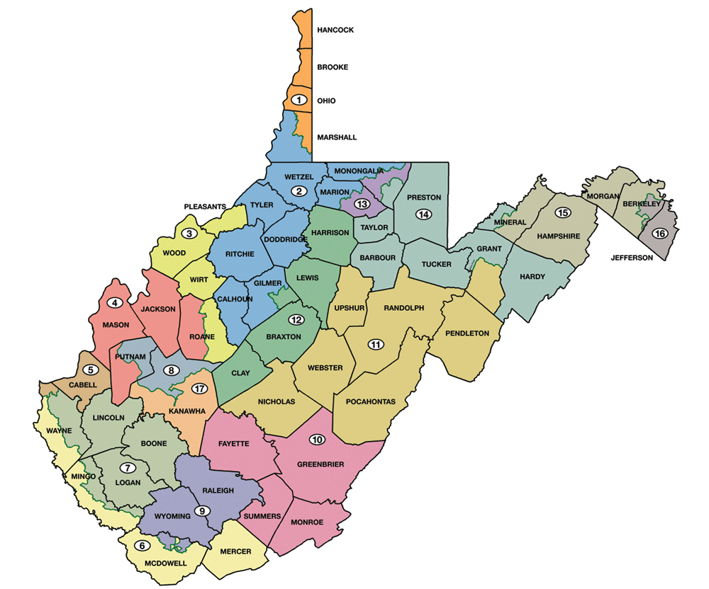
17 Senatorial Districts http://www.wvlegislature.gov/legisdocs/redistricting/senate/SENATE_MAP_FINAL.pdf

Slide 7
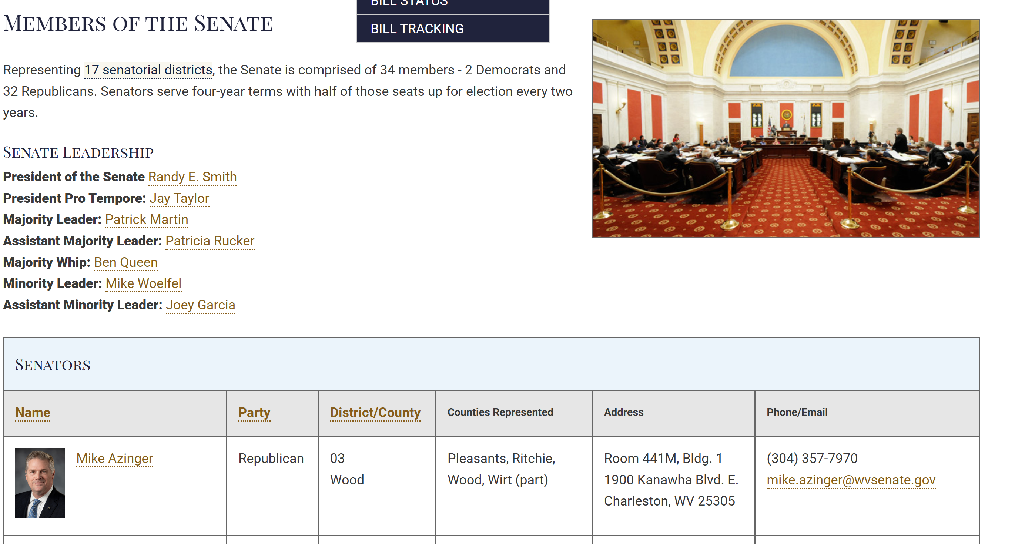
Members of the Senate
https://www.wvlegislature.gov/senate1/roster.cfm

Slide 8
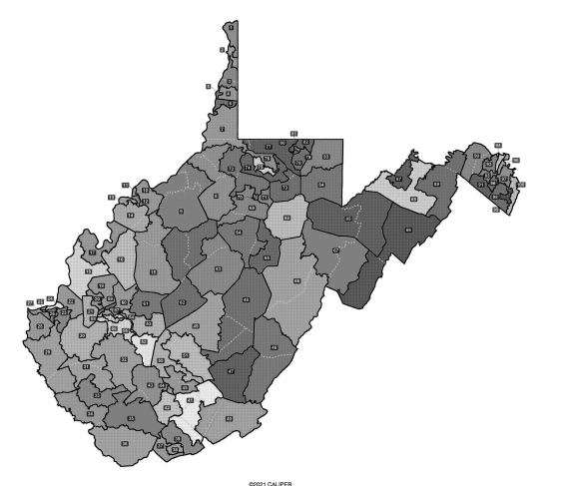
100 House Districts http://www.wvlegislature.gov/legisdocs/redistricting/house/hse_prop1_sub_rev_book.pdf

Slide 9
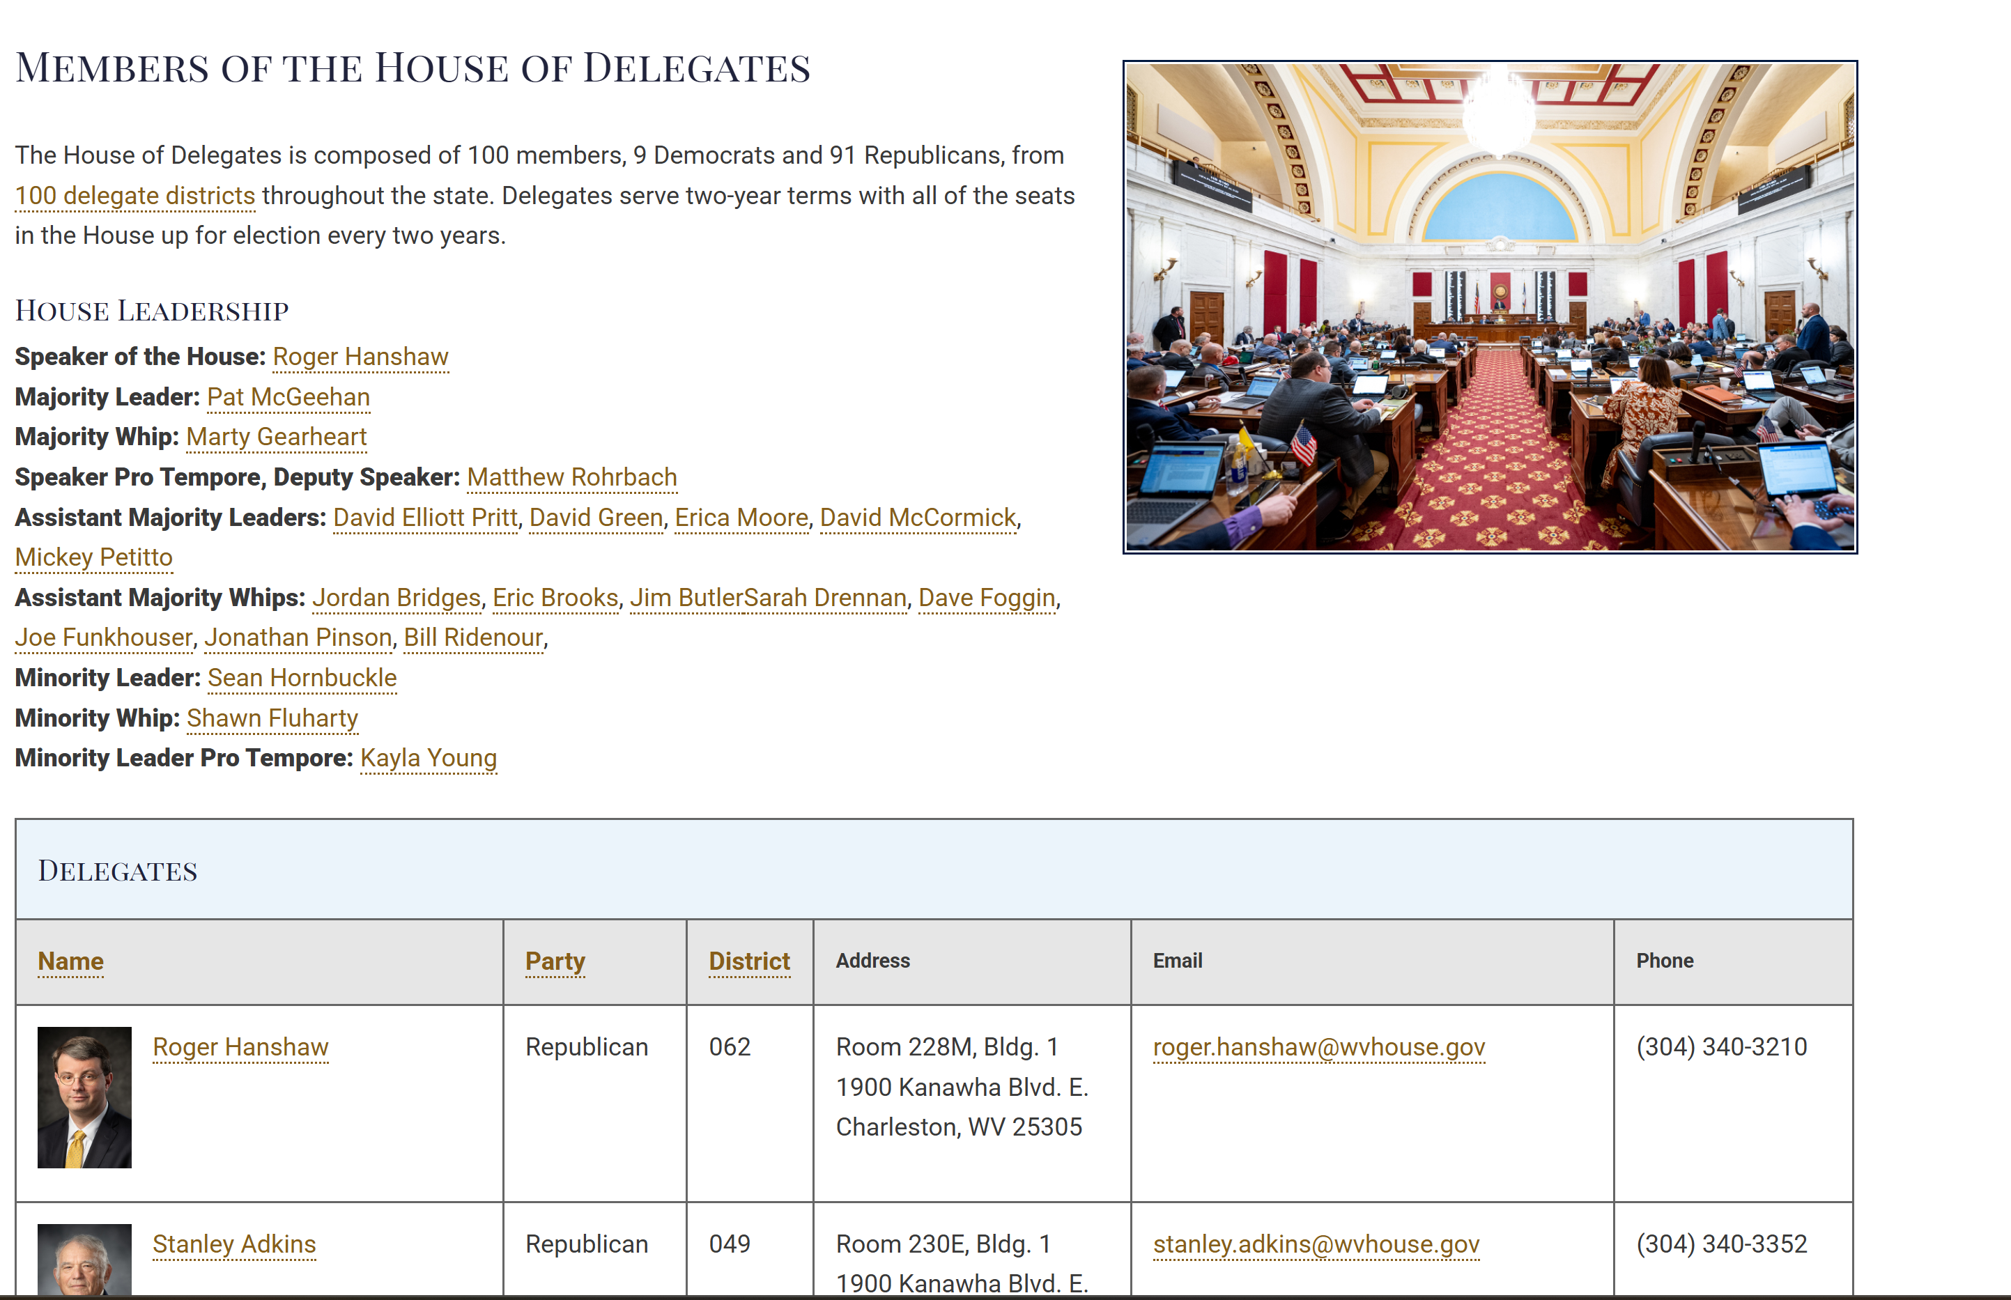
Members of the House
https://www.wvlegislature.gov/house/roster.cfm#

Slide 10
WVNA Legislative Leaders
How Can You be involved?
Legislative Leaders | West Virginia Nurses Association | Nursing Network
Created in 2013 – restructure of WVNA Districts
  Strategic decision to improve political advocacy
  New districts aligned with 17 state senatorial districts
  Leader identified for each new WVNA district = “Legislative Leaders”
  Focus on political communications versus local membership organization/meetings
    Per bylaws, districts still have authority to elect local officers and have meetings but not required
Notes:
Per WVNA bylaws, the state organization is made up of “districts”. Prior to 2013, the districts were geographically designed and each district had capability of leadership/officers. If active (officers and meetings), there are district funds paid as part of state membership dues. By 2012 none of the individual districts were “active” by bylaw definition (no officers/no meetings) so all district funds reverted to state. With political advocacy as a key identified priority of WVNA, a political communication strategy was developed to include the realignment of districts in such a way to facilitate political advocacy.

Slide 11
WVNA Legislative Leaders
Join us as a
Legislative Leader
We are asking current nurse leaders to become legislative grass root advocates in their senatorial districts. What does this involve?
1. Be willing to call local legislators and educate them on what issues are and how they can help.
2. Must participate in Webcast in November to learn the nursing concerns and issues to be address in the legislative session.
3. Make a great effort to attend Nurses Health Policy Day at the capital to meet with your elected official in the AM and attend a March of nurses for strength and attend an afternoon leadership session for nurse leaders.
4. Contact your local grassroots nurses and friends as needed to push a legislative nursing issue when appropriate.
5. As your time allows, educate you local nurses on the “hot topic” nursing policy issues.

Slide 12
Legislative Leader Role
Communication Liaison/Coordinator for political advocacy
HP&L Committee/ WVNA Board
Legislative Leader
District WVNA Members
Legislators
Notes:
Communicate with members in your district. Information FROM them – what issues/barriers/challenges are they having professionally that may need political engagement? Information TO them – what issues WVNA is working on in Legislative Agenda for the year; feedback on HP&L annual update; communication actions to policy-makers; coordinate meetings with specific elected officials from district;
Communicate with HP&L Committee – ALL Legislative Leaders welcome to attend HP&L Committee meetings although not all may necessarily be voting member of HP&L Committee
Communicate with WVNA Board - One individual Legislative Leader is on WVNA Board
Communicate with Elected Officials – each Legislative Leader should identify their two Senators and 1-5 Delegates (some crossover of Delegates between Leaders). Call/email their offices – tell them you are a constituent and are a local liaison/contact they have for nursing & healthcare issues.

Slide 13
Legislative Leader Responsibilities
What
What will you communicate?
  To Senators/Delegates
    Introduction as constituent and district leader for nursing
      Available as resource for healthcare and nursing issues – remind them that nursing is LARGEST single profession in healthcare, so ANY healthcare bill impacts nursing. Please contact us for input.
    Requests for actions on bills as directed by WVNA/Lobbyist
      If you are discussing an issue not endorsed by WVNA but as personal position, make sure to clearly articulate (you are expressing a personal opinion/not speaking for WVNA). Try to minimize conflicting positions.
    Invitation(s) to meetings with local nurses to discuss issues
  To WVNA Members in your District
    Notify them when communication with their elected official is needed.
      Provide specific language and recommended action (i.e.: email, call, meeting).
    Serve as local resource – collect professional challenges/barriers related to public policy
    Communicate HP&L Statement and Legislative Agenda
Notes:
Get to know your policy-makers. Try to foster a positive, friendly working relationship. Do some research on these people and identify commonalities. Be aware if WVN-PAC endorsed the elected officials last election. Overall responsibility is to INFORM and to BE INFORMED..

Slide 14
Legislative Leader Responsibilities
  When
    Prior to session – best time to encourage members to develop relationships with Legislators and when legislative agenda for next session developed.
    During session – 60-day regular legislative session may require RAPID communication requests. Interim sessions may also require advocacy.
  Where
    Capitol or District
    Fundraisers
    Advocacy/Public Interest Meetings/PAC events
  How
    Calls, emails
    In person – Capitol or District. Consider coordinating a lunch/dinner/coffee out with a group and legislators
    Coordinated fashion
Notes:
When – there are certain dates during session that require action before (cross-over day, last day of session). Offensive efforts shouldn’t START past 2nd week in session. Coordination – as a Legislative Leaders speaking for WVNA, remember to coordinate communication.

Slide 15
HP&L Statement VS. Legislative Agenda
HP&L Statement VS. Legislative Agenda
Tool to communicate policy positions of WVNA
General and broad in nature
Reviewed annually
Can only be amended at Membership Assembly by majority of attendees
HP&L Committee
Legislative Agenda
Specific plan for a specific legislative session
Offense/Proactive
  Specific bill(s) WVNA desires to have passed
    Timing
    Likelihood of success
    Cost/Benefit analysis
Defense/Reactive
  EVERY session has a defensive element – must be aware of all bills introduced and monitor for impact on nursing
HP&L Committee/WVNA Board/Legislative Leaders/Lobbyist

Slide 16
2026
HP & L Statement
The goal of West Virginia Nurses Association (WVNA) is to support enactment and implementation of policy that will benefit the health and welfare of all citizens. The WVNA strives to provide information, advocacy, representation and protection for the state's professional nurses. As part of the American Nurses Association (ANA), the organization establishes policies and goals for the profession that form the basis for nursing's contribution to the advancement of health care policy.
HP&L Sections:
I. PROFESSIONAL ISSUES
II. HEALTH CARE DELIVERY
III. PATIENT RIGHTS
IV. NURSING RETENTION AND RECRUITMENT
V. SOCIAL ISSUES

Slide 17
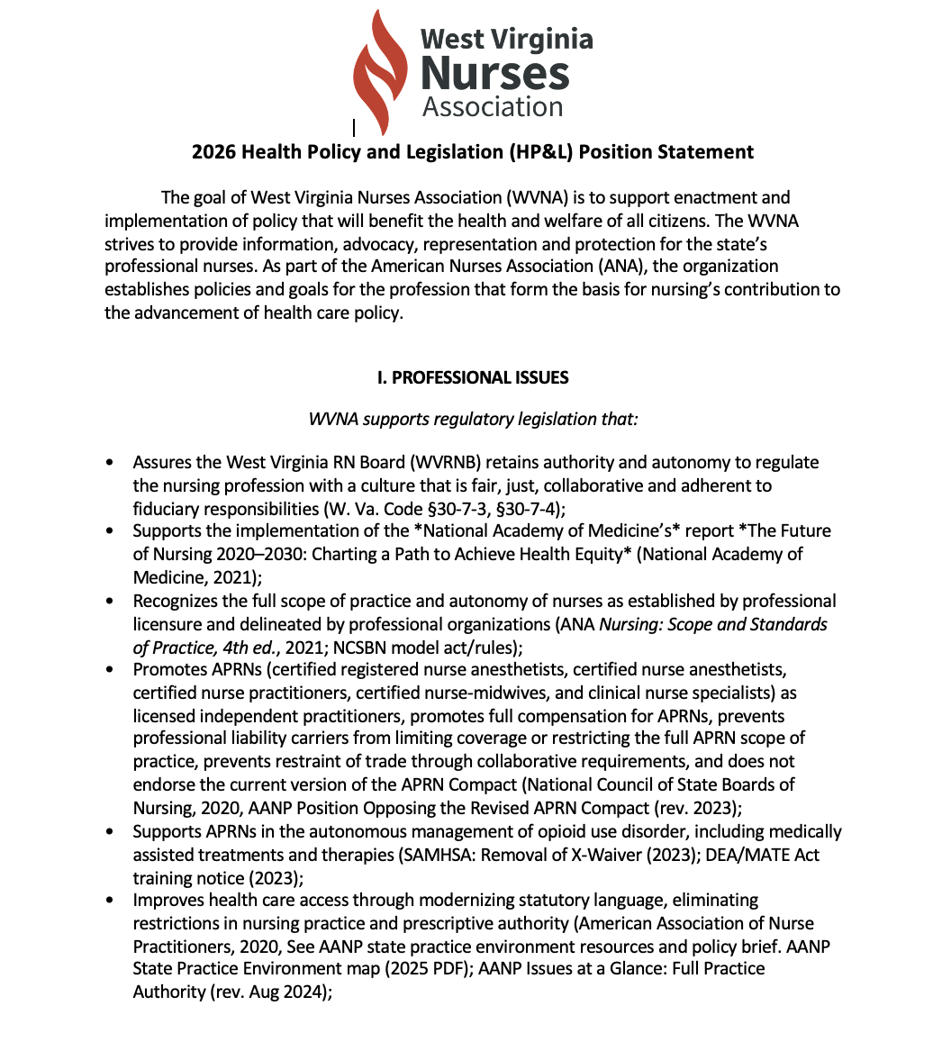
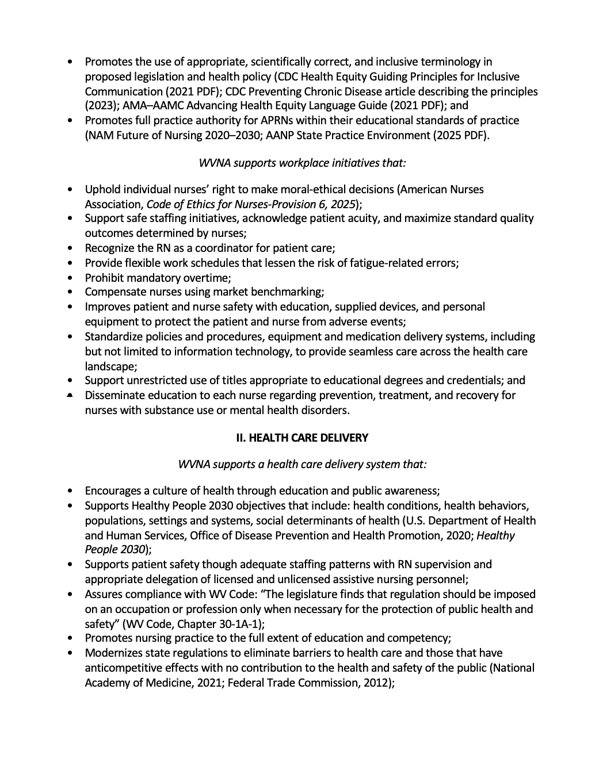
Caption

Slide 18
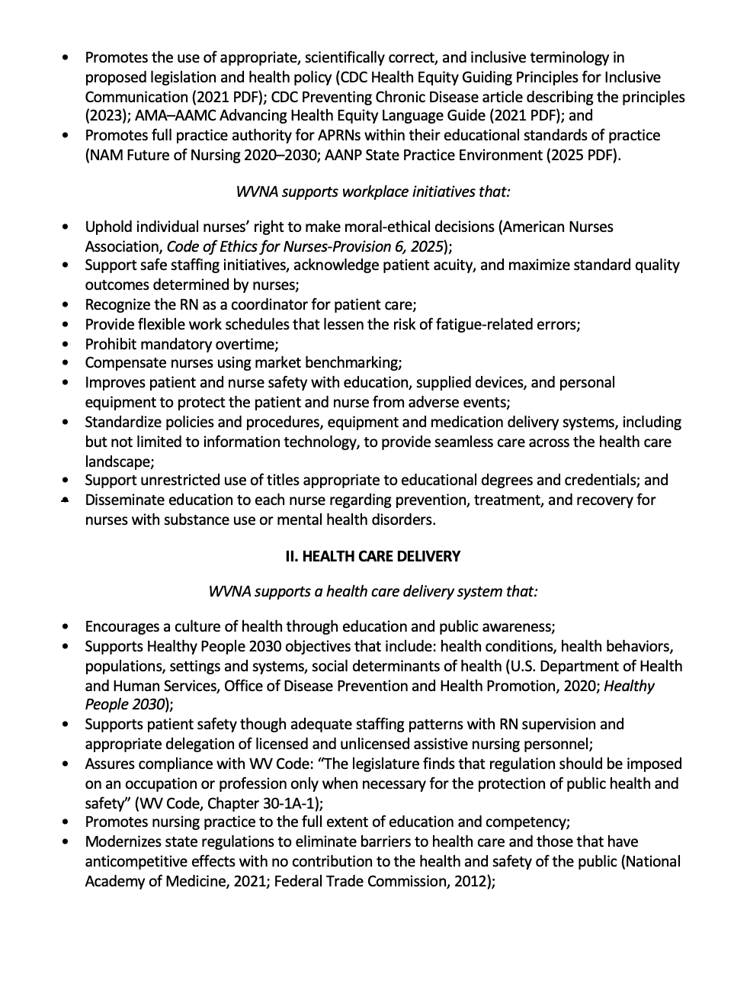
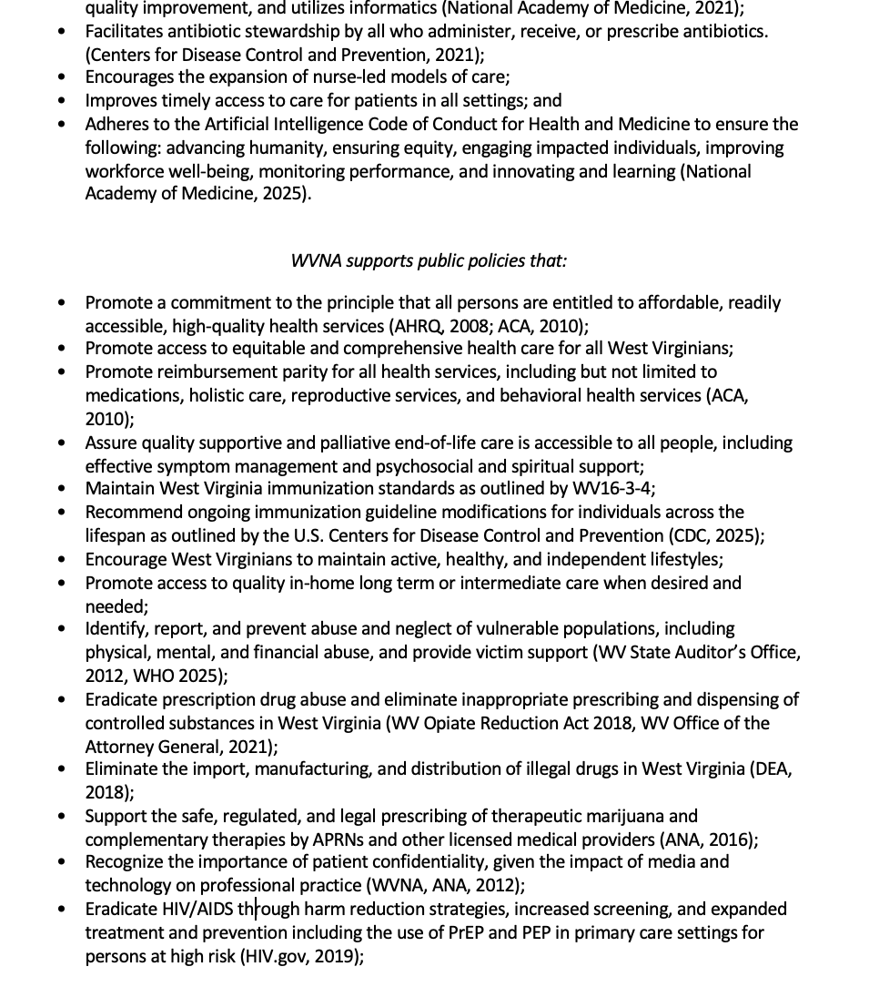
Caption
Caption

Slide 19
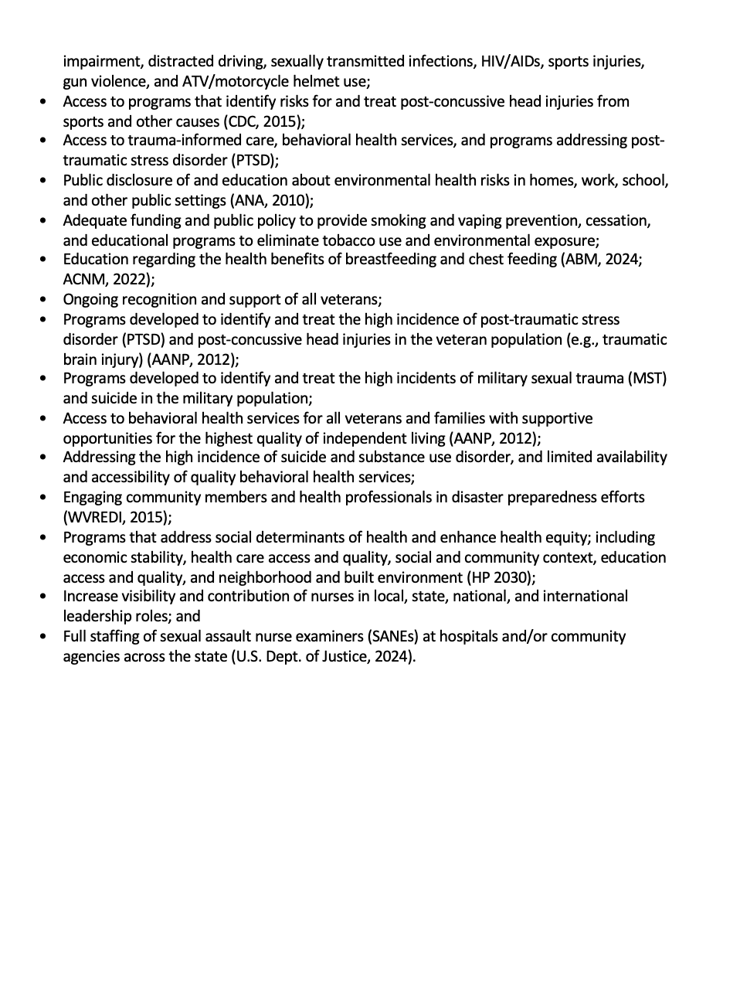
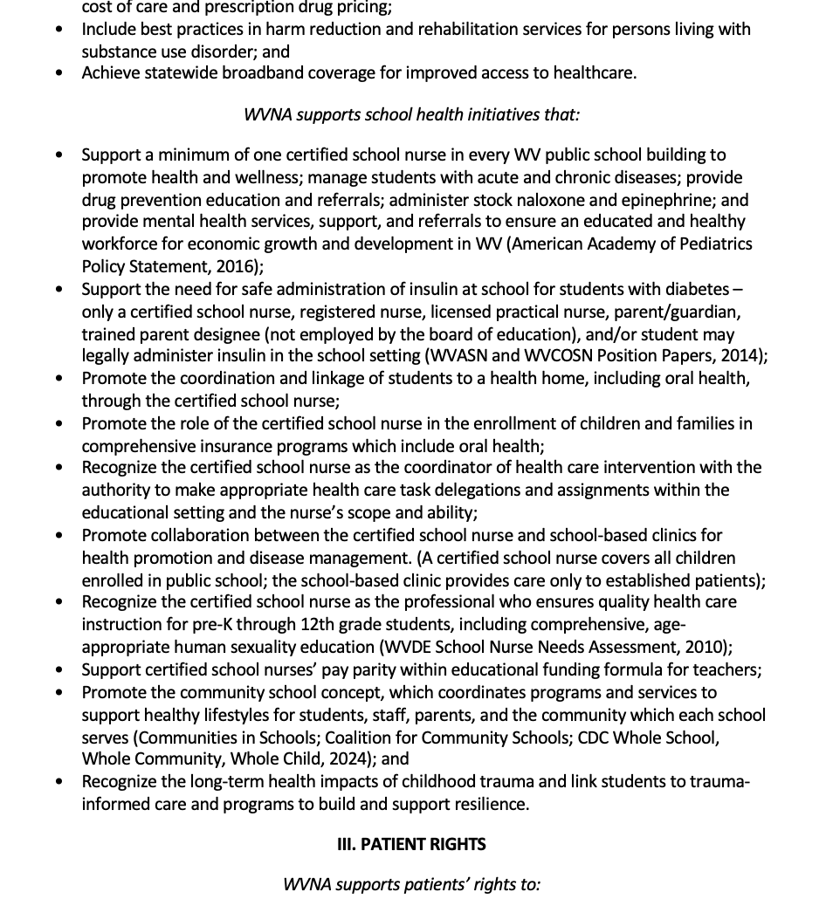
Caption
Caption

Slide 20
Legislative Leader Responsibilities
Assessment: Do you have the information you need to coordinate political advocacy in your District?
Who, what, when, where, how?
Who will you communicate with?
  Know the Senators & Delegates in your district
    Email centraloffice@wvnurses.org your district # and the Delegates
    you will be responsible for communicating with to avoid overlap;
    please note if you already have an existing relationship with Delegate
  List of WVNA members in your district
    Executive director can provide if needed
  Do you know the Legislative Leader currently on the Board?
    Legislative Updates Virtual Meeting: Every Tuesday during session @7pm
    HP&L Committee Chair: Lya M. Stroupe
    President: Donte Newsom
    Vice-President: Jodi Biller
Notes:
Do you know how to identify your Senators and Delegates? 17 Senatorial Districts (34 Senators) and 67 Delegate Districts (100 Delegates). Some multi-member Delegate districts. Some crossover of Delegates in Senatorial Districts. For example, Senatorial District 13 and 14 share some of the same Delegates (District 51 – Monongalia).

Slide 21
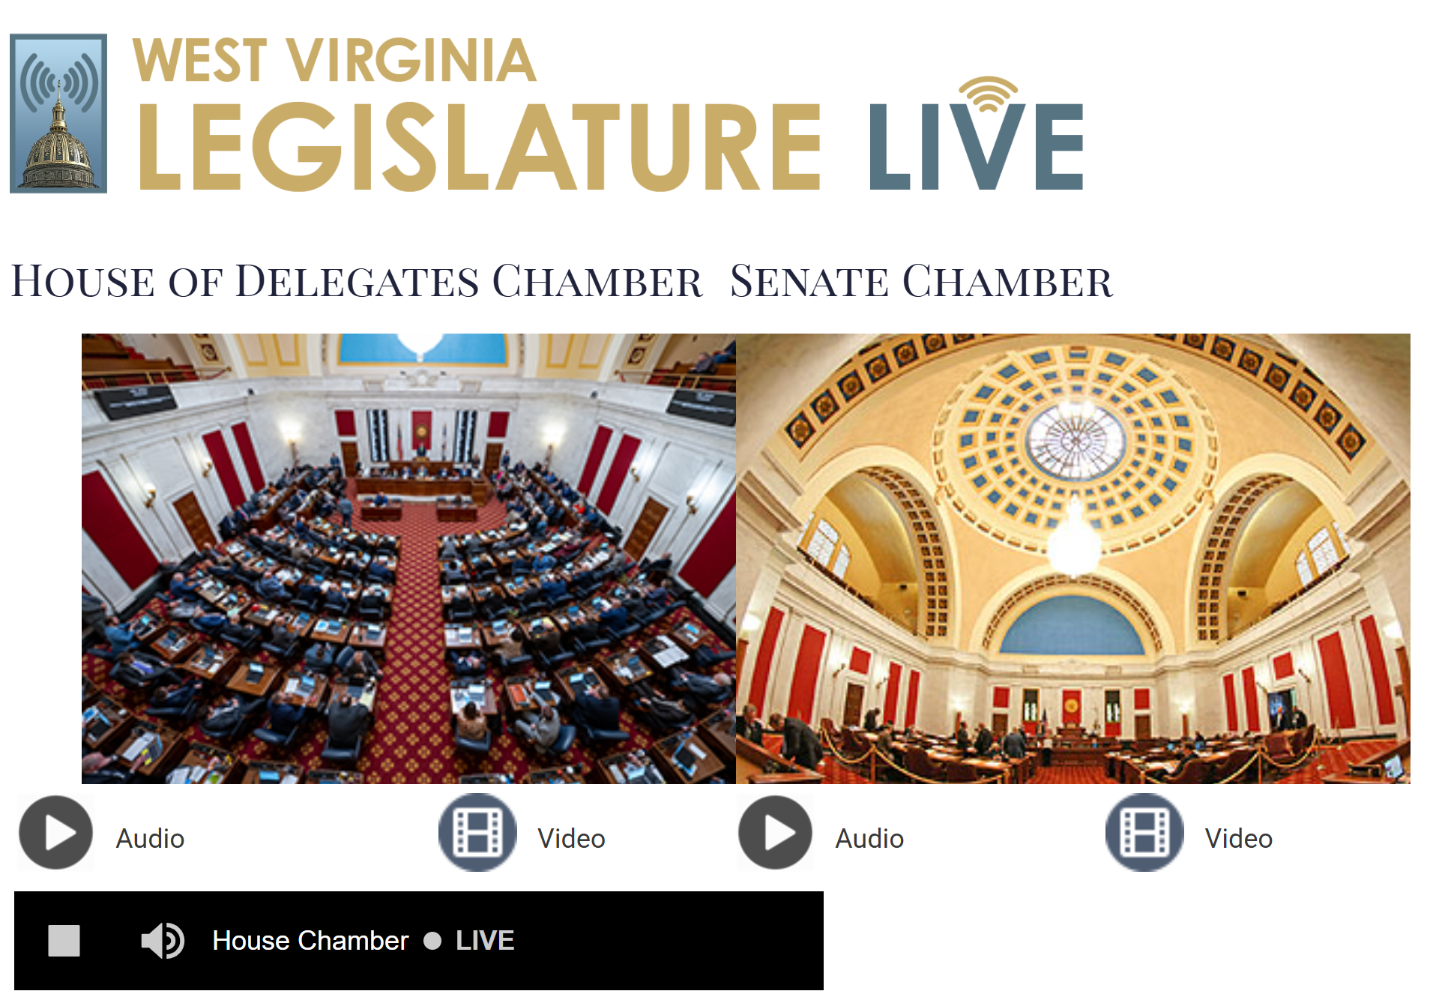
How to listen to the WV Legislative Session
https://www.wvlegislature.gov/live.cfm

Slide 22
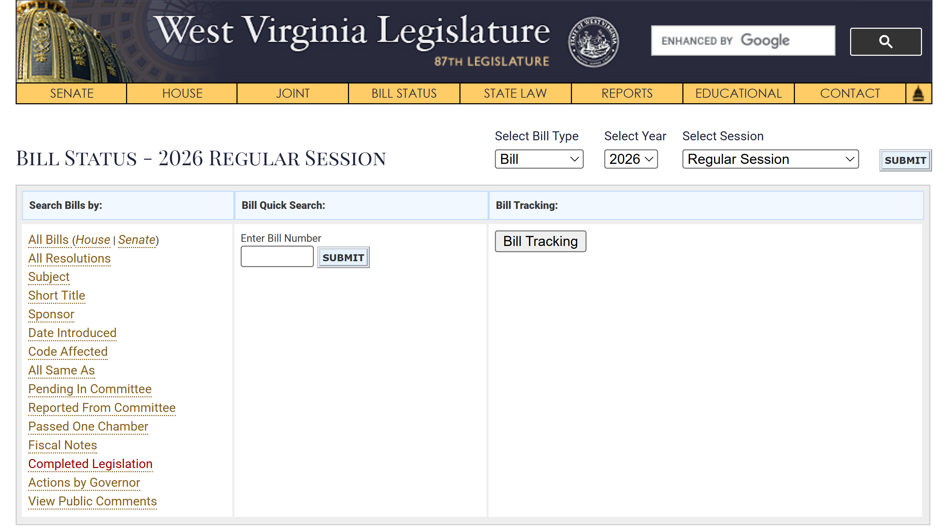
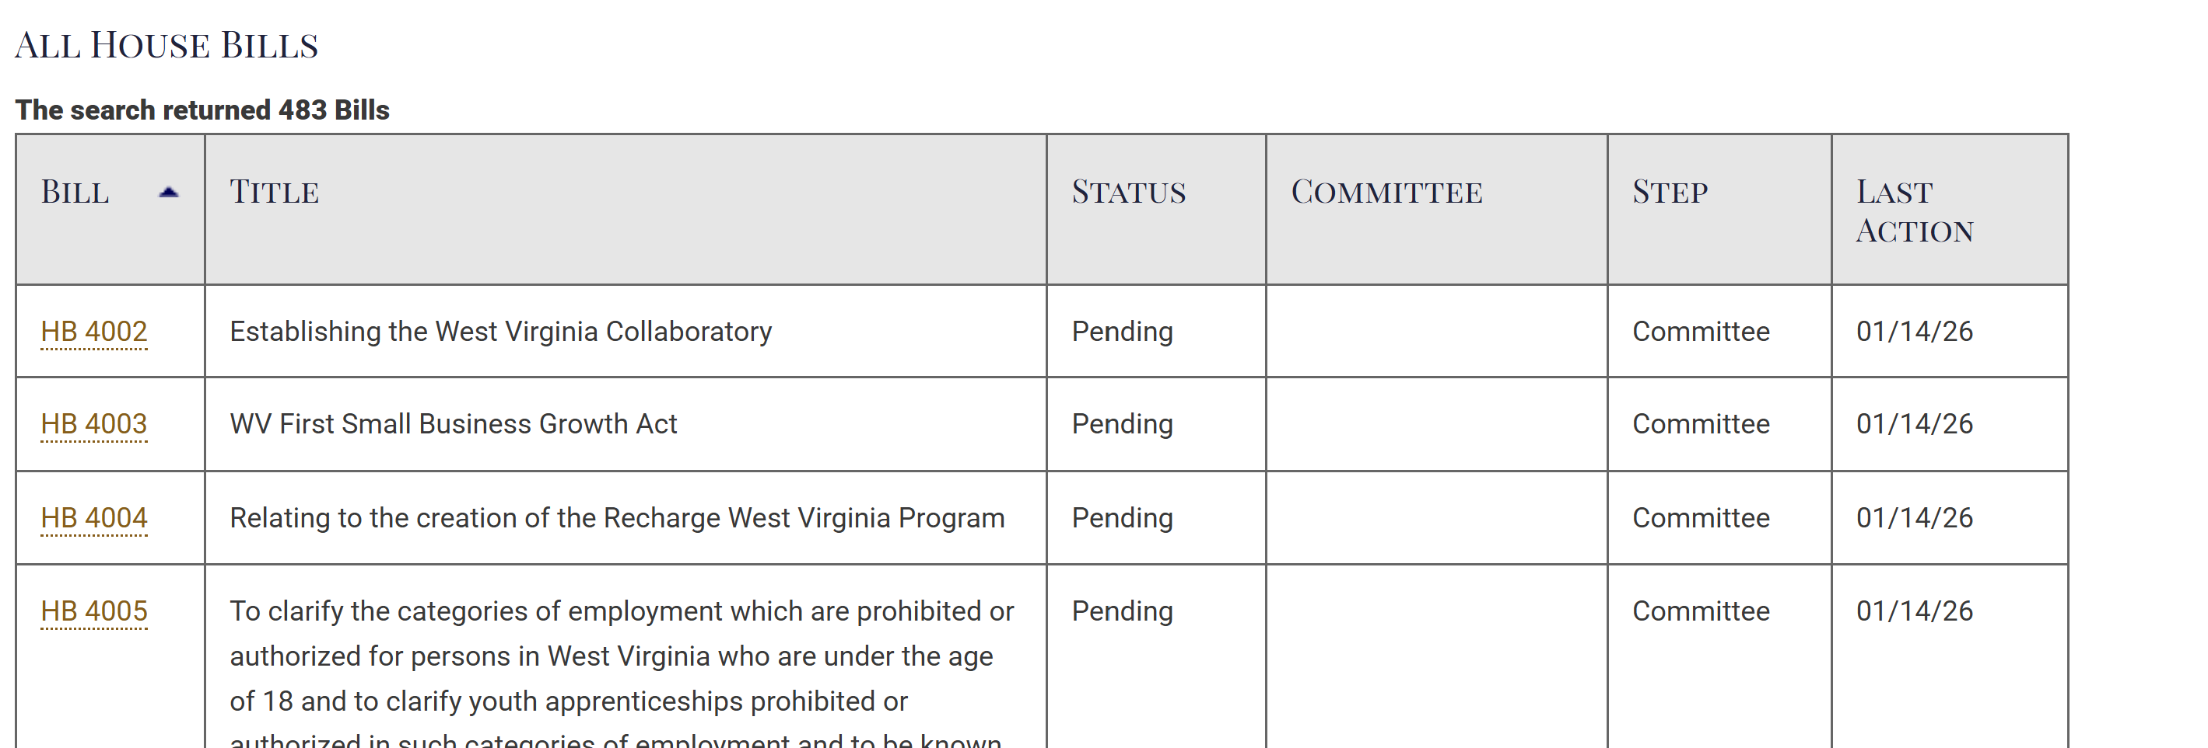
Tracking Bills
https://www.wvlegislature.gov/Bill_Status/Bills_all_bills.cfm?year=2026&sessiontype=rs&btype=bill&orig=h

Slide 23
2009-2021 Legislation
APRN payment for services without collaborative agreement
  Passed 2017
AMAPs
  Defeated 2018 (Governor veto) & 2019
Removal of regulations for nursing programs
  Passed 2018
Palliative Care Recommendation Committee – nurse representation
  Passed 2018
PMHNP approved to provide therapy in MAT clinics
  Passed 2019
Hospice Recommendation Committee – nurse representation
  Passed 2019

Slide 24
WVNA Legislative Action: 2009-2021
SANE nurses
  Passed 2014
Expedited partner therapies
  Passed 2014
Lobbied to maintain WV Center for Nursing
  Saved 2013
Establish nurse health program
  Passed 2012
APRN definition & license (LACE model)
    Passed 2012
  BOM limitation minor surgical procedures
    Defeated 2012
  Safe needle requirements
    Passed 2010

Slide 25
WVNA Legislative Action: 2009-2021
  Remove Collaborative agreement
    Passed 2016
  Removal of prescriptive barriers
    Some removed 2016
  Death certificates
    Passed 2016
  Sign DNR and order
    Passed 2016
  Annual prescribing of Rx for chronic illnesses APRN
    Passed 2012
  Medical Home – APRN as PCP
    Passed 2012

Slide 26
2022 Legislation
Changed WV RN board member requirements, defined criteria for the license to practice, and created a nine-member nursing shortage study commission. (SB 518)
  Passed Regular Session 2022
Expanded APRN prescriptive authority and codified executive orders to include prescribing all medications except Schedule I and limited to three day supply of opioid Schedule II medications
  Passed Summer Session 2022
Notes:
http://www.wvlegislature.gov/Bill_Status/bills_text.cfm?billdoc=SB518%20SUB1%20ENR.htm&yr=2022&sesstype=RS&i=518
By July 1, 2022, the Governor, by and with the advice and consent of the Senate, shall appoint a new board as follows:
(1) One person licensed as an advanced practice registered professional nurse by the board;
(2) One person who is certified as a dialysis technician by the board;
(3) Four persons licensed as a registered professional nurse by the board and meet the following requirements:
(A) One registered professional nurse, who provides direct patient care in a long-term care facility, home health or hospice;
(B) Two registered professional nurses, who provide direct patient care in a hospital setting or acute care setting; and,
(C) One registered professional nurse, who teaches nursing; and,
(4) One citizen member who is not licensed under the provisions of this chapter and who has never performed any services as a health care professional.
Organizations that represent nurses may submit to the Governor recommendations for the appointment of the licensed board members.
(d) The appointment term is four years. A member may not serve more than two consecutive terms. A member may continue to serve until his or her successor has been appointed and qualified.

Slide 27
2023 Legislation
Patient Safety and Transparency. Relating to the implementation of an acuity-based patient classification system (HB2436)
  Passed Regular Session 2023
Eliminating Certificate of Need for Birth Centers: Certificate-of-need (CON) laws require healthcare providers to obtain permission before they open or expand their services or purchase certain devices or new technologies (SB613)
  Passed Regular Session 2023

Slide 28
2024 Legislation
Support Anti-Doxing Bill (introduced by WVHA)
  Passed Regular Session
Eliminating Surgical Smoke (OR Smoke)
  Passed Regular Session
Keep WV Childhood Immunization Standards Strong
  Defeated (Governor Justice veto)

Slide 29

  2025 Legislation
Support enhanced autonomy of Certified Registered Nurse Anesthetists (CRNAs) Senate Bill 810 (Introduced by WVANA)
  Passed regular session 2025
Keep WV Childhood Immunizations Strong. Senate Bill 460 - proposed religious exemptions,
  Failed in the House of Delegates (42–56)

Slide 30
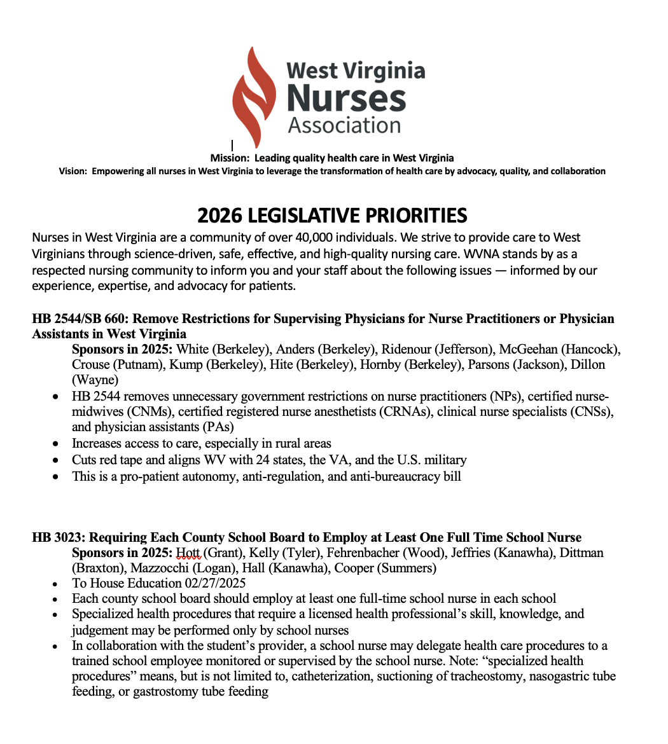
2026
Legislative Priorities

Slide 31
CONTACT WVNA
West Virginia Nurses Association
centraloffice@wvnurses.org
WVNurses.org
West Virginia Legislature
http://www.legis.state.wv.us./

Slide 32
Original Content Creation
Created by: Toni DiChiacchio, DNP, APRN, FNP-BC, FAANP
Health Policy & Legislative Chair, WVNA (2020)
Updated by: Lya M. Cartwright-Stroupe DNP, RN, APRN, CPNP-PC, NEA-BC, NPD-BC, FAAN
Health Policy & Legislative Chair, WVNA (2026)
Reviewed and Updated:
January 9, 2024
January 13, 2025
January 7, 2026
March 17, 2026

Slide 33

THANK YOU!
Questions

