Slide 1
Unlocking Focus: Breakthrough Pharmacological Treatments for ADHD
Presented By: Ryan Archer, PharmD, MBA; Kaleb Thompson, PharmD
Notes:
Today we will review pharmacological ADHD treatment options, including FDA-approved medications and medications with literature-supported, off-label use for certain age groups with an
ADHD diagnosis

Slide 2
Disclosures
Ryan Archer and Kaleb Thompson have nothing to disclose concerning possible financial relationships with ineligible companies that may have a direct or indirect interest in the subject matter of this presentation.

Slide 3
Learning Assessment Questions
1. Which of the following are important considerations when initiating a medication for ADHD?
2. Which of the following is not a contraindication for a stimulant medication?
3. Which of the following is a non-stimulant medication for ADHD?
4. True or False: Nurse Practitioners can write a prescription for a 90-day supply of methylphenidate.
5. Per West Virginia state law, how often, at minimum, must the CSMP be accessed when prescribing Class II controlled substances?
Notes:
May delete if we don’t need

Slide 4
Objectives
Outline the steps for initiating pharmacological therapy, including confirming the ADHD diagnosis, establishing clear objectives for treatment, anticipating potential adverse effects, and outlining follow-up protocols to evaluate medication efficacy.
Describe various ADHD medications, including stimulant and non-stimulant options and how to personalize treatment based on individual patient-specific factors.
Recall federal and state regulations governing stimulant prescribing and how they apply to nurse practitioners.

Slide 5
Prior to Starting Medication
Confirm diagnosis
Review goals of treatment
Address symptoms medication will not improve
Review potential adverse effects
Review follow-up requirements and processes to assess the effectiveness of treatment
Notes:
Pre-Therapy Assessment:
Conduct a thorough family history and patient evaluation before starting any therapy.
Ensure that the patient meets the DSM-5-TR criteria for an ADHD diagnosis.
Patient Education:
Before initiating medication, educate the patient/caregiver about the treatment plan.
Explain that medication aims to improve focus and self-control to manage ADHD symptoms.
Setting Realistic Expectations:
Have an honest discussion about what medication can and cannot address.
Emphasize that medications may not significantly help with symptoms of disorganization.
Highlight that ADHD has no "cure" to set realistic treatment goals.
Follow-Up Requirements:
Educate the patient/caregiver about follow-up requirements.
Discuss the frequency of follow-up visits.
Explain what symptoms or behaviors to monitor and report.
Instruct on how to assess the efficacy of treatment.
Advise on what information to bring to follow-up appointments.

Slide 6
Preschool-aged Children¹
(< 6 years of age)
Behavioral parent management training (BPMT) and/or classroom interventions
School-aged Children¹
(6 years of age to 12th birthday)
FDA-approved medication for ADHD
With non-pharmacological interventions
Adolescents¹
(12 years of age to 18th birthday)
FDA-approved medication for ADHD
Non-pharmacological interventions encouraged
Adults²
(18 years of age and older)
FDA-approved medication for ADHD
Non-pharmacological interventions may help symptoms
If there is no significant improvement and continued moderate to severe disturbance, consider methylphenidate (4 years of age and older). Weigh the risks of starting methylphenidate against the harm of delaying treatment before the age of 6 years in areas in which evidence-based behavioral treatment are not available.
Medications by Age
Notes:
Age-Based Treatment Guidelines for ADHD:
Treatment approaches for ADHD vary depending on the patient's age.
*Of note, the AAP advises to avoid a diagnosis of ADHD prior to the age of four years.
Behavioral intervention, which focuses on equipping children with essential behavior management skills, is the first-line treatment for children under the age of 6.
For children aged 6 to 12, a multimodal treatment plan is recommended, combining behavioral therapy with FDA-approved medications.
Benefits of Early Nonpharmacological Interventions:
Early implementation of nonpharmacological interventions can have significant advantages. It may delay the need for medication or even make it unnecessary.
Nonpharmacological interventions, particularly when initiated early, play a crucial role in managing ADHD.
Wolraich, M. L., Hagan, J. F., Allan, C., Chan, E., Davison, D., Earls, M., . . . Zurhellen, W. (2019). Clinical Practice Guideline for the Diagnosis, Evaluation, and Treatment of Attention-Deficit/Hyperactivity Disorder in Children and Adolescents. Pediatrics, 144(4). doi:https://doi.org/10.1542/peds.2019-2528
Post, R. E., & Kurlansik, S. L. (2012). Diagnosis and management of adult attention-deficit/hyperactivity disorder. American Family Physician, 85(9), 890-896. Retrieved from https://www.aafp.org/pubs/afp/issues/2012/0501/p890.html

Slide 7
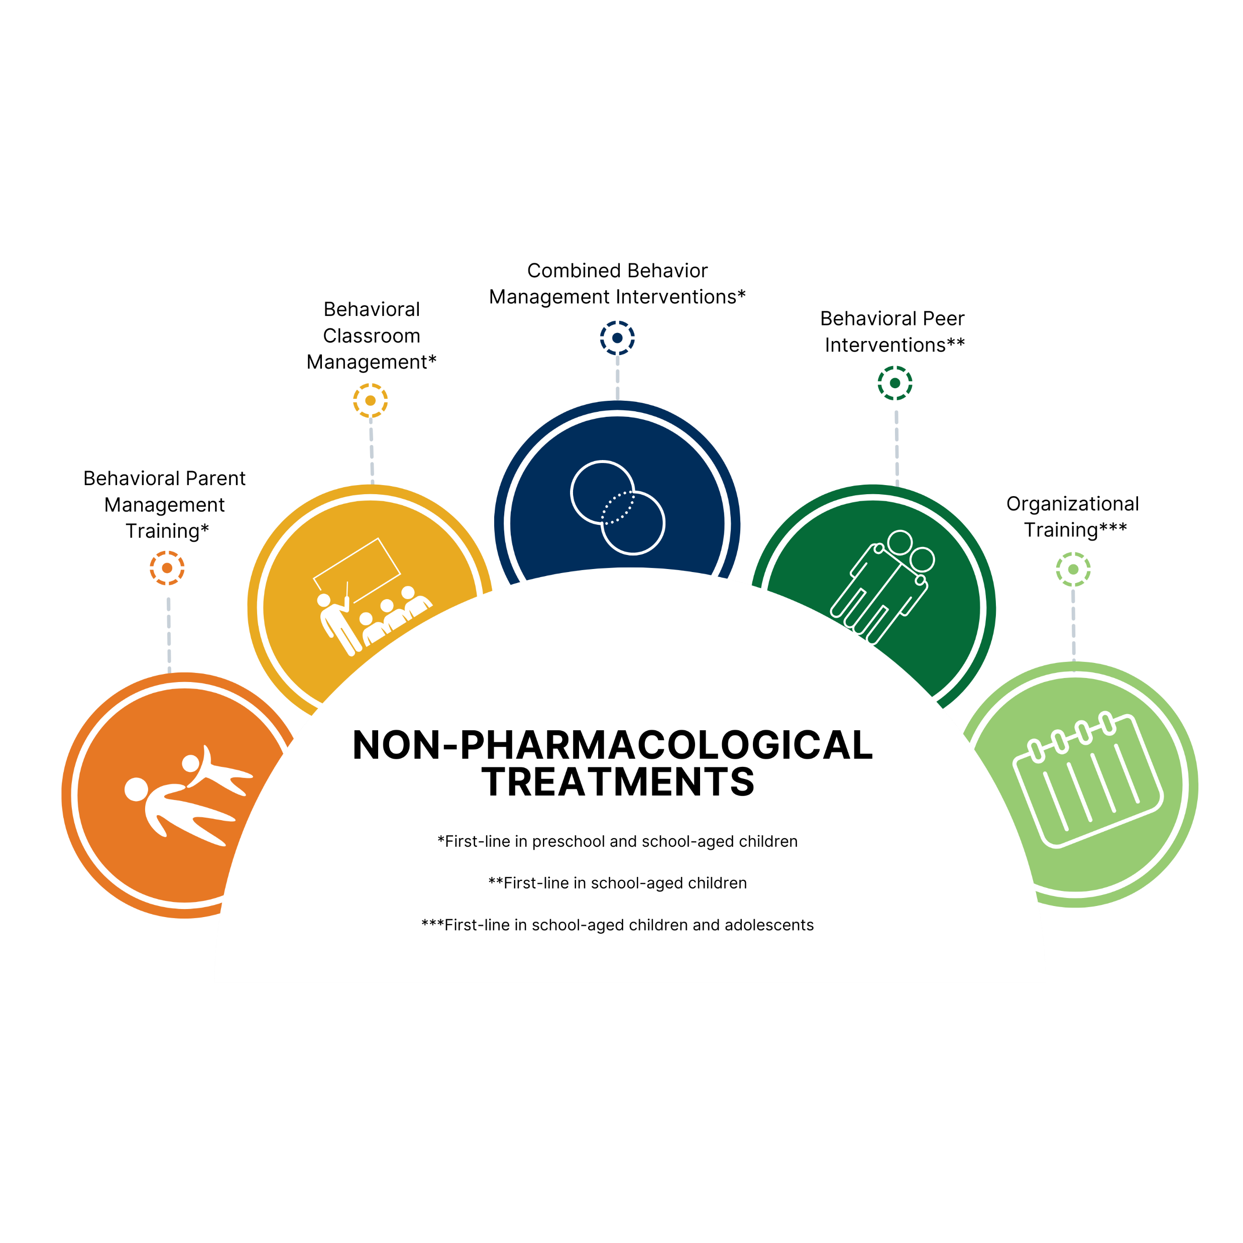
*First-line in preschool and school-aged children
**First-line in school-aged children
***First-line in school-aged children and adolescents
Notes:
First-Line Treatment Options by Age Group
The representation provided illustrates the first-line treatment options for different age groups:
One asterisk (*) corresponds to preschool and school-aged children.
Two asterisks (**) apply to school-aged children.
Three asterisks (***) encompass school-aged children and adolescents.

Slide 8
Considerations for Selecting an ADHD Agent
Patient/caregiver preference
Patient’s age
Medical/family/social history
Symptom severity
Current medications and previous trials
Timing of needed coverage
Cost
Notes:
Considerations for Selecting an Agent for ADHD:
Timing of symptom coverage is an essential factor. Long-acting stimulants offer consistent coverage throughout the day, reducing the need for additional doses. The timing of medication administration should align with the patient's daily routine, whether it's for school or work.
Side effects vary among medications. For instance, some stimulants may lead to appetite suppression or sleep disturbances. It's crucial to discuss potential side effects with the patient and carefully balance the benefits of symptom relief with the risks of side effects.
Coexisting conditions often accompany ADHD. These comorbidities are common and can influence the choice of medication.
Medication formulation is another consideration. Medications are available in various forms, including tablets, capsules, patches, or liquids. Patient preferences and their ability to swallow specific forms should be taken into account, as the chosen formulation can impact both effectiveness and side effects.

Slide 9
Stimulants
Methylphenidates versus Amphetamines
Stimulants are effective in 75-80% of children with ADHD ³
40% of children will respond to both methylphenidates and amphetamines¹
40% will respond to either one but not the other ¹
20-35% will not respond to either methylphenidates or amphetamines⁴
Notes:
Understanding Stimulant Categories for ADHD:
While there are several stimulant formulations approved by the FDA for ADHD treatment, they can be broadly categorized into two types: methylphenidates and amphetamines, which simplifies the choices.
Notably, around 40% of patients exhibit positive responses to both amphetamines and methylphenidates. However, an equally significant 40% may respond to only one of these two stimulant categories.
Wolraich, M. L., Hagan, J. F., Allan, C., Chan, E., Davison, D., Earls, M., . . . Zurhellen, W. (2019). Clinical Practice Guideline for the Diagnosis, Evaluation, and Treatment of Attention-Deficit/Hyperactivity Disorder in Children and Adolescents. Pediatrics, 144(4). doi:https://doi.org/10.1542/peds.2019-2528
3. Briars, L., & Todd, T. (2016). A review of pharmacological management of attention-deficit/hyperactivity disorder. The Journal of Pediatric Pharmacology and Therapeutics, 21(3), 192–206. https://doi.org/10.5863/1551-6776-21.3.192
4. Childress AC, Sallee FR. Attention-deficit/hyperactivity disorder with inadequate response to stimulants: approaches to management. CNS Drugs. 2014;28(2):121‐129. doi:10.1007/s40263-013-0130-6

Slide 10
Stimulants: Mechanism of Action
Methylphenidate
Amphetamine
Blocks reuptake of norepinephrine and dopamine in the synaptic cleft⁵
Recommended after failure of behavioral interventions in patients 4 to 6 years of age by the AAP¹, although not FDA-approved for children under 6 years of age
Blocks reuptake of norepinephrine and dopamine in the synaptic cleft AND promotes the release of norepinephrine and dopamine into the synaptic cleft⁶
FDA approval in preschool-aged children for some products
Notes:
Understanding the Impact on Neural Transmitters:
When discussing medications for ADHD, it's crucial to recognize their impact on essential neurotransmitters like dopamine and norepinephrine, which play a pivotal role in ADHD management. Both amphetamines and methylphenidates (MPHs) influence these neurotransmitters, ultimately leading to increased availability of norepinephrine and dopamine in the synaptic cleft.
Treatment Considerations for Preschool-Aged Children:
While amphetamines are FDA-approved for preschool-aged children, the American Academy of Pediatrics (AAP) recommends methylphenidate due to its comparatively better side effect profile.
5. Verghese, C., & Abdijadid, S. (2023). Methylphenidate. In StatPearls. StatPearls Publishing. http://www.ncbi.nlm.nih.gov/books/NBK482451/
6. Drug Facts and Comparions online. (2019a). Amphetamines. Retrieved November 9, 2021, from Facts & Comparisons eAnswers online: https://online.factsandcomparisons.com

Slide 11
Adverse Effects of Stimulants
Adverse Effects⁷
Decreased appetite, nausea, dry mouth, headache, irritability, insomnia, increased blood pressure, tachycardia, palpitations
Rare: Dermatologic reactions
Boxed Warning (May 2023)⁷
CNS stimulants, including amphetamine-containing products and methylphenidate, have a high potential for abuse and dependence. Assess the risk of abuse prior to prescribing and monitor for signs of abuse and dependence while on therapy.
Notes:
Understanding Stimulant Medication Side Effects:
Just like any other medications, stimulants used in ADHD treatment come with potential side effects. It's crucial to be aware of the ins and outs of these drugs and tailor them best for each patient.
FDA Box Warning:
Notably, the FDA added a box warning in the spring, specifically cautioning about the potential for misuse associated with stimulants. This warning serves as a critical reminder of the need for responsible and vigilant use of these medications in clinical practice.
7. Methylphenidate. In: Micromedex [database on the Internet]. Greenwood Village (CO): IBM Corporation; publication year [2023]. Available from: www.micromedexsolutions.com.

Slide 12
Contraindications and Precautions for Stimulants
Cardiovascular disease
Growth suppression
Hypertension
Glaucoma
Anxiety
Psychosis
History of substance misuse or substance use disorder
Notes:
Common Concerns and Considerations with Stimulant Use
Introduction:
This list highlights common concerns associated with stimulant use, but it's not an exhaustive list.
Cardiovascular Risks:
Stimulant use typically doesn't pose serious cardiovascular event risks in individuals without cardiac issues.
However, it's crucial to assess for a personal or family history of cardiac disease before initiating stimulant treatment due to associated risks.
Growth Suppression:
There is an association with mild growth suppression, which will be discussed further in a later slide.
Glaucoma:
Glaucoma is considered a contraindication for stimulant use.
Elevating blood pressure with stimulants can also increase eye pressure, which is a concern.
Anxiety:
Stimulant use can be a precaution for individuals with anxiety.
Increasing heart rate and blood pressure with stimulants may exacerbate anxiety, although not all patients with ADHD experience worsening anxiety symptoms with stimulant treatment.
New Onset Psychosis:
New onset psychosis is a consideration with stimulant medications.
Substance Use History:
Per the AAFP Adult ADHD Toolkit - https://www.aafp.org/family-physician/patient-care/prevention-wellness/emotional-wellbeing/adhd-toolkit/frequently-asked-questions.html
Stimulant medications should be used with caution or avoided in patients with a history of substance use.
Patients with active intravenous drug use (IVDU) or active nonmedical stimulant use (cocaine, amphetamines, or methylphenidates) should not be initiated on a stimulant for ADHD.
Patients with a history of substance use disorder (SUD) in remission may benefit from stimulant medication.
Methylphenidate OROS or lisdexamfetamine are preferred options to reduce the risk of nonmedical use via formulation manipulation to induce a rapid peak level in the serum.
Seizure Risk:
Seizures have been associated with prescription stimulant use, occurring in approximately 1 in 660 patients.
There is a slightly increased risk with the use of amphetamines compared to methylphenidate.

Slide 13
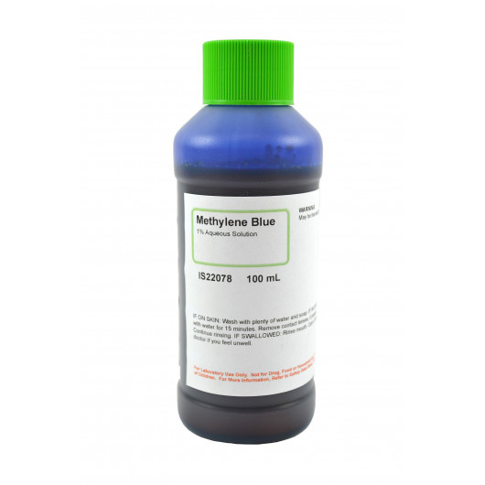
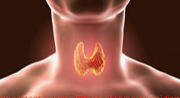
Who may not be a candidate for stimulants?
Cardiac conditions⁸
Abnormal BP/HR
Personal/family history of MI, sudden death, stroke or Wolff-Parkinson-White Syndrome
Electrocardiogram if⁸:
Suspected cardiac disease prior to initiating stimulant use
Chest pain, syncope, or other cardiac symptoms present with stimulant use
Known Hypersensitivity
Recent use of MAOI or methylene blue
Glaucoma
Hyperthyroidism
Substance use (active or historical)
Notes:
Cardiovascular Risk:
One of the primary concerns associated with the use of prescription psychostimulants is the potential for cardiovascular risk, including the rare but serious outcome of sudden death. This risk is particularly relevant in children and adolescents with underlying cardiac abnormalities.
Pre-treatment Assessment:
Prior to initiating psychostimulant therapy, it is imperative to conduct a thorough assessment for any personal or family history of cardiac disease. This evaluation should encompass factors such as a family history of sudden death, conditions like Wolff-Parkinson-White syndrome, hypertrophic cardiomyopathy, and long QT syndrome. If any findings suggest the possibility of cardiac disease, further evaluation, including an electrocardiogram, should be performed before commencing psychostimulant use.
Monitoring and Immediate Evaluation:
Additionally, it is essential to monitor patients for any cardiac symptoms or adverse events during the course of stimulant treatment. If chest pain, syncope, or other cardiac symptoms manifest in association with stimulant use, a prompt cardiac evaluation should be conducted.
Positive Findings:
Importantly, it's worth noting that while there are these concerns, studies have demonstrated that the use of stimulant medications does not increase the risk of serious cardiovascular events in children and adults who do not have preexisting cardiac concerns.
Per the AAFP Adult ADHD Toolkit - https://www.aafp.org/family-physician/patient-care/prevention-wellness/emotional-wellbeing/adhd-toolkit/frequently-asked-questions.html
Stimulant medications should be used with caution or avoided in patients with a history of substance use.
Patients with active intravenous drug use (IVDU) or active nonmedical stimulant use (cocaine, amphetamines, or methylphenidates) should not be initiated on a stimulant for ADHD.
Patients with a history of substance use disorder (SUD) in remission may benefit from stimulant medication.
Methylphenidate OROS or lisdexamfetamine are preferred options to reduce the risk of nonmedical use via formulation manipulation to induce a rapid peak level in the serum.
8. Drug Facts and Comparisons online. (2021a). Methylphenidate. Retrieved November 9, 2021, from Facts & Comparisons eAnswers online: https://online.factsandcomparisons.com

Slide 14
Benefits of Long-Acting Stimulants
Improved adherence
Consistent coverage throughout day
Prevents school/work-time administration
Prevents peaks and valleys
More likely to result in monotherapy
Lowers risk of misuse
Notes:
Long-Acting Formulations:
Preferred for school-aged children, adolescents, and adults due to their extended duration of action. These formulations offer several advantages, including the ability to avoid the need for medication administration during school hours, ensure continuous symptom coverage throughout the day, prevent the occurrence of peak and valley effects, and ultimately enhance medication adherence.

Slide 15
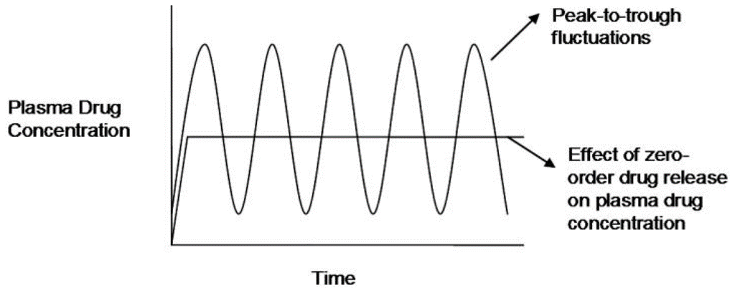
Preventing Peak and Valley Effects
Short-acting Formulations
Plasma concentrations increase and decrease with each new dose
Higher peak concentrations can potentiate adverse effects
Lower trough concentrations can lead to uncontrolled symptoms
Long-acting Formulations
Plasma concentrations remain more consistent with once-daily dosing, avoiding peaks and troughs
Can improve adherence
Prevents school/work time administration
Short-acting medication can result in peaks and troughs of drug concentrations
Long-acting medication avoids peaks and troughs
Notes:
Here is a visual representation of how long-acting stimulants provide a more consistent and even plasma concentration than short-acting ones. This leads to smoother and more sustained symptom control throughout the day.

Slide 16
Higher Likelihood of Monotherapy
2009
Retrospective study⁹
Compared various ADHD medications
Atomoxetine and long-acting stimulants = more likely to result in monotherapy
2013
Meta-analysis¹⁰
Once daily regimes = higher adherence
Notes:
Research Insight:
A retrospective study conducted in 2009 compared various ADHD medications, including atomoxetine, long-acting stimulants, intermediate-acting stimulants, short-acting stimulants, bupropion, and alpha-2 adrenergic agonists.
The study found that atomoxetine and long-acting stimulants were more likely to lead to monotherapy unless the patient had a hyperactive component of ADHD. This suggests that long-acting stimulants can be effective as standalone treatments for many patients.
Pohl, G. M., Van Brunt, D. L., Ye, W., Stoops, W. W., & Johnston, J. A. (2009). A retrospective claims analysis of combination therapy in the treatment of adult attention-deficit/hyperactivity disorder (Adhd). BMC Health Services Research, 9(1), 95. https://doi.org/10.1186/1472-6963-9-95
Srivastava, et al. 2013. Impact of reducing dosing frequency on adherence to oral therapies: a literature review and meta-analysis. Patient Prefer Adherence. 20; 7:419-34.

Slide 17
Long-Acting Stimulants: Reducing Potential for Misuse
Extended-release formulations of stimulants are potentially less likely to be misused than immediate-release medications¹¹
More difficult to manipulate the extended-release formulations and administer via injection or intranasal routes¹¹
Notes:
Why are long-acting medications less likely to be misused?
Extended-release formulations of stimulants are generally less susceptible to misuse compared to immediate-release medications due to several factors.
They are harder to manipulate into forms for injection or intranasal use, reducing the potential for abuse.
Extended-release stimulants release the medication gradually over an extended period, resulting in lower peak plasma concentrations, which lowers the risk of abuse.
Some extended-release formulations are tamper-resistant, making them difficult to break, crush, or manipulate for non-therapeutic purposes.
Examples of tamper-resistant formulations include Concerta (a long-acting methylphenidate with an osmotic delivery system), Vyvanse (a long-acting amphetamine prodrug), and QuilliChew ER (chewable tablets with a unique polymer matrix that requires thorough chewing before swallowing).
11. Substance Abuse and Mental Health Services Administration (SAMHSA). (2015). Adults with attention deficit disorder and substance use disorders. Retrieved 2022, from SAMHSA: https://store.samhsa.gov/sites/default/files/d7/priv/sma15-4925.pdf

Slide 18
The Use of Short-Acting Stimulants
Alternative to long-acting
Usually more frequent dosing
May offer more flexibility
Sometimes utilized to mitigate adverse effects
(e.g., insomnia, appetite suppression)
Notes:
That’s not to say that you can’t or shouldn’t use a short-acting stimulant.
Considerations for Short-Acting Stimulants
Short-acting stimulants have their place in ADHD treatment and can be considered based on specific factors:
Additional Dosing: Short-acting stimulants can be used to provide an additional dose later in the day, extending the coverage of long-acting stimulants.
Limited Daily Need: They may be suitable when symptom relief is only required for a few hours a day.
Flexible Schedule: Short-acting stimulants allow for a more flexible dosing schedule.
Consideration Factors: Clinicians and patients should evaluate various factors, including the timing of symptom coverage, potential side effects, coexisting conditions, required formulation, insurance coverage, and cost when deciding on the initial pharmacological approach for ADHD treatment.

Slide 19
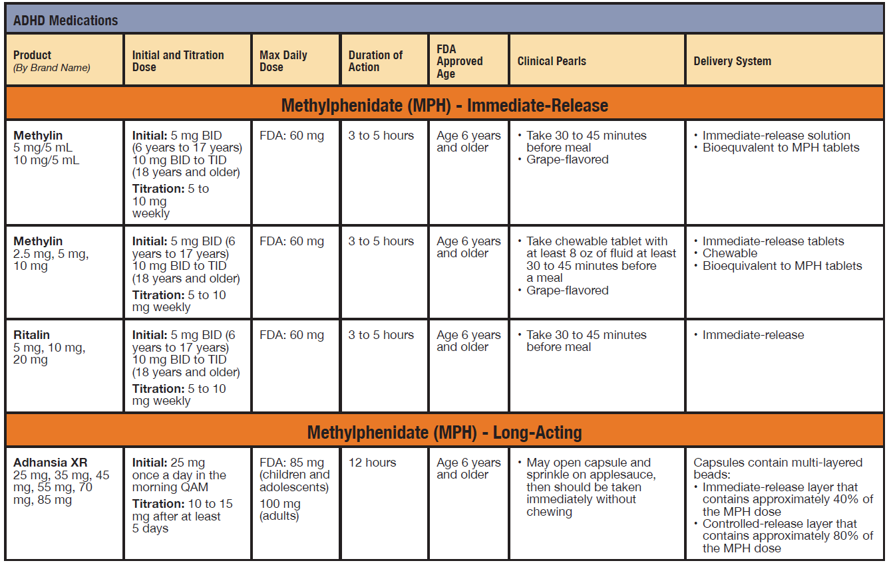
¹² https://wvadhd.org/guidelines
Notes:
That’s not to say that you can’t or shouldn’t use a short-acting stimulant.
Considerations for Short-Acting Stimulants
Short-acting stimulants have their place in ADHD treatment and can be considered based on specific factors:
Additional Dosing: Short-acting stimulants can be used to provide an additional dose later in the day, extending the coverage of long-acting stimulants.
Limited Daily Need: They may be suitable when symptom relief is only required for a few hours a day.
Flexible Schedule: Short-acting stimulants allow for a more flexible dosing schedule.
Consideration Factors: Clinicians and patients should evaluate various factors, including the timing of symptom coverage, potential side effects, coexisting conditions, required formulation, insurance coverage, and cost when deciding on the initial pharmacological approach for ADHD treatment.

Slide 20
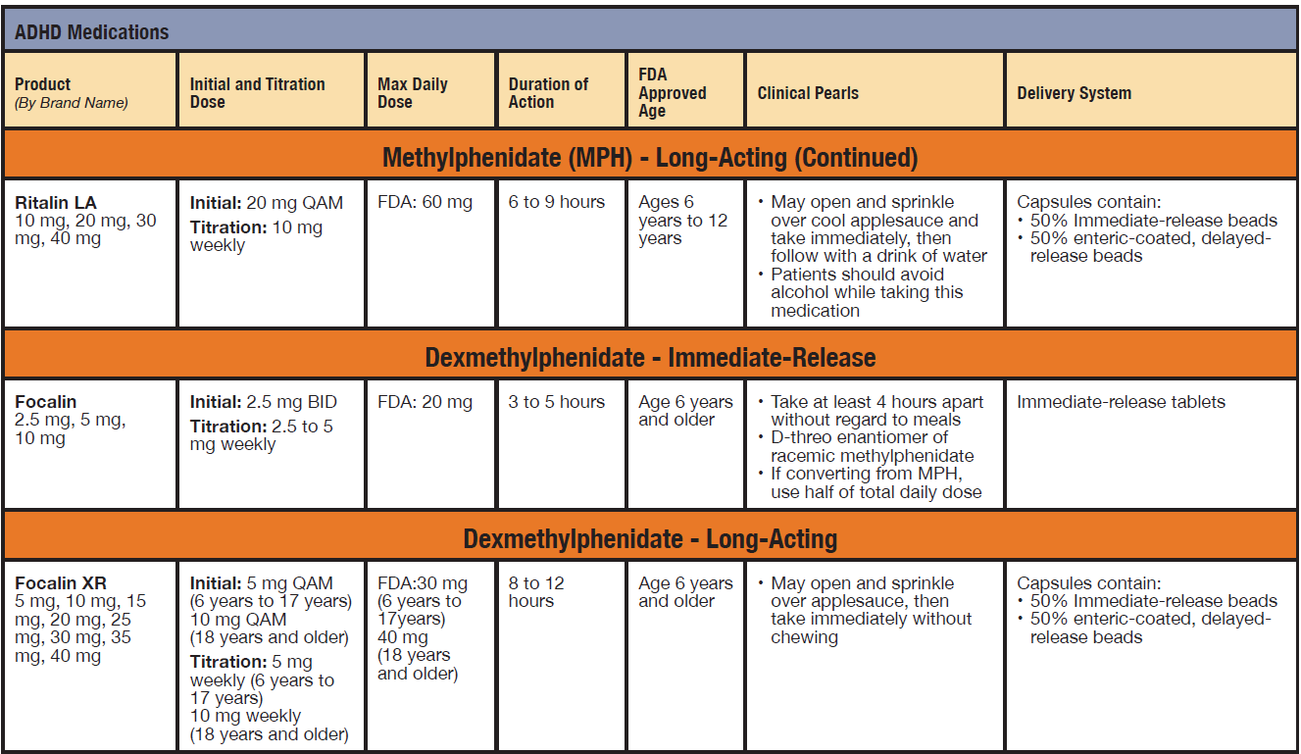
¹² https://wvadhd.org/guidelines
Notes:
That’s not to say that you can’t or shouldn’t use a short-acting stimulant.
Considerations for Short-Acting Stimulants
Short-acting stimulants have their place in ADHD treatment and can be considered based on specific factors:
Additional Dosing: Short-acting stimulants can be used to provide an additional dose later in the day, extending the coverage of long-acting stimulants.
Limited Daily Need: They may be suitable when symptom relief is only required for a few hours a day.
Flexible Schedule: Short-acting stimulants allow for a more flexible dosing schedule.
Consideration Factors: Clinicians and patients should evaluate various factors, including the timing of symptom coverage, potential side effects, coexisting conditions, required formulation, insurance coverage, and cost when deciding on the initial pharmacological approach for ADHD treatment.

Slide 21
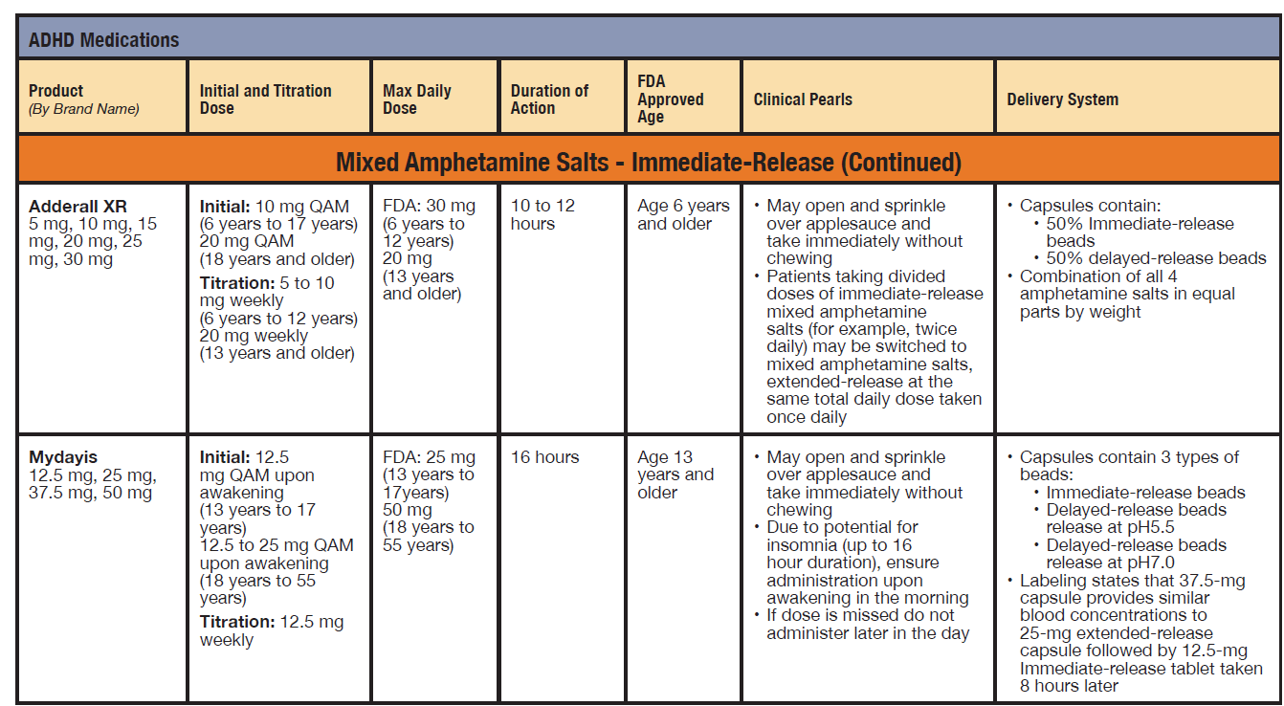
¹² https://wvadhd.org/guidelines
Notes:
That’s not to say that you can’t or shouldn’t use a short-acting stimulant.
Considerations for Short-Acting Stimulants
Short-acting stimulants have their place in ADHD treatment and can be considered based on specific factors:
Additional Dosing: Short-acting stimulants can be used to provide an additional dose later in the day, extending the coverage of long-acting stimulants.
Limited Daily Need: They may be suitable when symptom relief is only required for a few hours a day.
Flexible Schedule: Short-acting stimulants allow for a more flexible dosing schedule.
Consideration Factors: Clinicians and patients should evaluate various factors, including the timing of symptom coverage, potential side effects, coexisting conditions, required formulation, insurance coverage, and cost when deciding on the initial pharmacological approach for ADHD treatment.

Slide 22
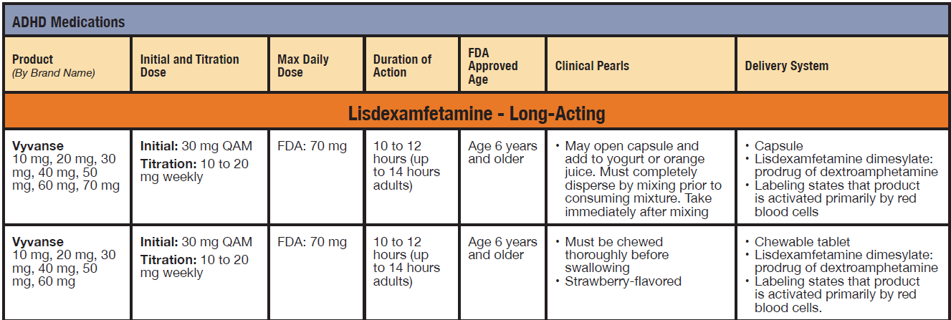
¹² https://wvadhd.org/guidelines
Notes:
That’s not to say that you can’t or shouldn’t use a short-acting stimulant.
Considerations for Short-Acting Stimulants
Short-acting stimulants have their place in ADHD treatment and can be considered based on specific factors:
Additional Dosing: Short-acting stimulants can be used to provide an additional dose later in the day, extending the coverage of long-acting stimulants.
Limited Daily Need: They may be suitable when symptom relief is only required for a few hours a day.
Flexible Schedule: Short-acting stimulants allow for a more flexible dosing schedule.
Consideration Factors: Clinicians and patients should evaluate various factors, including the timing of symptom coverage, potential side effects, coexisting conditions, required formulation, insurance coverage, and cost when deciding on the initial pharmacological approach for ADHD treatment.

Slide 23
Non-stimulant, Non-controlled Treatment Options
Notes:
Contraindications, Patient Preferences, and Stigma: Not everyone is an ideal candidate for stimulant medications such as methylphenidate. Some individuals may have a history of substance use disorder, or they might experience heightened sensitivity to stimulants, making them less suitable.
Furthermore, it's important to consider that certain patients or their families may harbor concerns regarding the use of controlled medications. These concerns often revolve around the stigma attached to such medications, which can be particularly relevant in West Virginia's healthcare environment.
Non-stimulant treatment alternatives offer a valuable solution in cases of medical contraindications or concerns related to the stigma associated with controlled substances. By providing these non-stimulant options, we demonstrate our commitment to delivering personalized, stigma-sensitive care that respects the unique needs and preferences of each patient. This approach aligns seamlessly with our goal of fostering a supportive and inclusive healthcare environment in West Virginia.

Slide 24
Selective Norepinephrine Re-uptake Inhibitors
First-line for adults and patients with substance use (active or historical)
Useful when anxiety, tics, or insomnia is present
FDA-approval
6 years of age and older
Max treatment benefit seen in 6 to 8 weeks
Mechanism of action:
Selective norepinephrine reuptake inhibition indirectly increases the concentration of norepinephrine in the synapse
Common Adverse Effects
Headache, insomnia, decreased appetite
Boxed Warning
Suicidal thoughts and behavior
Atomoxetine¹³
Viloxazine¹⁴
Notes:
Non-Stimulant Alternative: SNRIs
SNRIs (Selective-Norepinephrine Reuptake Inhibitors) are a non-stimulant alternative for ADHD treatment. They work indirectly by increasing the concentration of norepinephrine in the synaptic cleft.
There are two FDA-approved SNRIs for ADHD treatment. It’s essential to note that, unlike stimulants, SNRIs take approximately 6-8 weeks to reach their full therapeutic effect. Patient education is crucial to help them understand the need for patience as the medication builds to its therapeutic level.
12. Drug Facts and Comparisons online. (2021b). Atomoxetine. Retrieved November 9, 2021, from Facts & Comparisons eAnswers online: https://online.factsandcomparisons.com
13. Drug Facts and Comparisons online. (2021c). Viloxazine. Retrieved November 9, 2021, from Facts & Comparisons eAnswers online: https://online.factsandcomparisons.com

Slide 25
Atomoxetine¹³
Available as a generic
Metabolized by CYP2D6
Flexible dosing options: once or twice daily
Uncommon adverse effect:
liver toxicity
Notes:
Atomoxetine: A Non-Stimulant Option
Atomoxetine is a valuable option for patients, both children, and adults when stimulants are not effective, not appropriate, intolerable, or contraindicated. Unlike prescription stimulants, atomoxetine is not a controlled substance.
While atomoxetine, with an effect size of 0.7, has not shown superiority over stimulants for treating ADHD symptoms, multiple studies have demonstrated its effectiveness compared to a placebo.
However, it's important to note that although rare, patients should be monitored for signs of liver failure, such as jaundice or changes in urine color. If these symptoms occur, the medication should be immediately discontinued, and liver function tests should be conducted.
12. Drug Facts and Comparisons Online. (2021b). Atomoxetine. Retrieved November 9, 2021, from Facts & Comparisons eAnswers online: https://online.factsandcomparisons.com

Slide 26
Viloxazine¹⁴
Currently, no generic available
CYP1A2 Inhibitor
(Caffeine)
Useful when there are CYP2D6 metabolizing concerns
Capsules can be opened and sprinkled on applesauce or pudding
Notes:
Viloxazine: A New Non-Stimulant Option
Viloxazine, a more recent addition to ADHD treatment options, gained FDA approval in 2021 for use in pediatric patients aged 6 to 17 years and in 2022 for adults with ADHD.
This non-stimulant, non-controlled medication has demonstrated effectiveness in treating ADHD symptoms in children aged 6 and older when compared to a placebo. Viloxazine shares a similar mechanism of action with atomoxetine, leading to a comparable side effect profile, including increased diastolic blood pressure, elevated heart rate, drowsiness, and headaches.
It's important to note that Viloxazine may not yet have a generic version available, potentially affecting patient affordability and accessibility.
13. Drug Facts and Comparisons online. (2021c). Viloxazine. Retrieved November 9, 2021, from Facts & Comparisons eAnswers online: https://online.factsandcomparisons.com

Slide 27
Alpha-2 Agonists
*Useful as adjunctive therapy
Max treatment benefit seen in 2 to 4 weeks
FDA-approval
6 to 17 years of age
Literature supports use in adults
Immediate-release formulations are off-label use for ADHD
Mechanism of action:
It is hypothesized agents mimic the effect of norepinephrine at the alpha₂-adrenoreceptors in the prefrontal cortex
Adverse Effects
Hypotension, rebound hypertension, somnolence, dry mouth, irritability
Guanfacine (Extended-release [ER])¹⁵
Clonidine (ER)¹⁶
Notes:
Clonidine and Guanfacine: Potential Options for ADHD
While not officially approved by the FDA for the treatment of ADHD in adults, there is literature available to suggest that extended-release formulations of clonidine and guanfacine may be considered as treatment options in this population.
It's worth noting that the AAP's Clinical Practice Guideline for ADHD in children and adolescents does not recommend the use of clonidine or guanfacine for preschool-aged children. However, the Society for Developmental and Behavioral Pediatrics Clinical Practice Guideline, published in 2020, does advise considering clonidine or guanfacine for children aged 3 to 6 with ADHD who exhibit severe impulsivity, aggression, oppositional behavior, and/or irritability. It's important to acknowledge that there is limited evidence available to support their use in this age group at this time.
14. Drug Facts and Comparisons online. (2019). Guanfacine. Retrieved November 9, 2021, from Facts & Comparisons eAnswers online: https://online.factsandcomparisons.com
15. Drug Facts and Comparisons online. (2019). Clonidine. Retrieved November 9, 2021, from Facts & Comparisons eAnswers online: https://online.factsandcomparisons.com

Slide 28
Off-label Use for ADHD
Amantadine
Modafinil
Bupropion
Tricyclic Antidepressants (TCA)’s
May be appropriate in certain patients with co-existing conditions
Should only be used at the careful discretion of the clinician; in most cases, prescribing should not be done without specialized training and/or consultation with a specialist
Notes:
Off-Label Medications for ADHD: Use with Caution
It's important to note that certain medications may be used in clinical practice to treat ADHD, even though they do not have an FDA-approved indication for this purpose. The decision to use these off-label medications should be made with caution and careful consideration.
These off-label medications may be appropriate for certain patients, particularly those with coexisting conditions that make traditional ADHD treatments less suitable. However, it's crucial to recognize that off-label medications have less documented safety and efficacy data for treating ADHD. Therefore, their use should only be considered under the careful discretion of a qualified clinician.
In most cases, prescribing off-label medications for ADHD treatment should be reserved for specialists with specialized training in this area. If such treatment is deemed necessary, patients should be referred to these specialists for appropriate evaluation and management.

Slide 29
Bupropion¹⁷
May be beneficial for those patients with coexisting conditions such as tobacco use, or substance use disorder¹⁷
Superior to placebo to reduce symptoms of ADHD
Mechanism of action:
Weak inhibitor of neuronal uptake of dopamine and norepinephrine
Adverse effects:
Tachycardia, weight loss, nausea and vomiting
Warnings for suicidal ideation and behavior, dose-dependent seizures, potential for precipitating mania in patients with bipolar disorder¹⁵
Notes:
Bupropion for ADHD: Off-Label Use with Some Evidence
While bupropion is not FDA-approved for the treatment of ADHD, it's worth noting that there is some evidence suggesting its potential efficacy in managing ADHD symptoms. A meta-analysis of 133 clinical trials involving children, adolescents, and adults with ADHD has shown that bupropion may be superior to placebo in reducing ADHD symptoms.
However, it's important to emphasize that the use of bupropion for ADHD is considered off-label, meaning it is not the primary approved use of the medication. Clinicians should exercise caution and carefully assess individual patient needs and risk factors before considering bupropion as a treatment option for ADHD. Additionally, any off-label use of medications should be closely monitored and guided by a qualified healthcare professional.
16. Drug Facts and Comparisons online. (2021d). Bupropion. Retrieved November 9, 2021, from Facts & Comparisons eAnswers online: https://online.factsandcomparisons.com

Slide 30
Modafinil¹⁸
Schedule IV controlled substance due to potential for misuse
Avoid in patients who are not candidates for stimulant therapy
Not efficacious for improvement in ADHD symptoms in adults when compared to placebo.
Symptom benefit in children by both clinicians and teachers
Mechanism of action:
Unclear, but has been shown to block dopamine transporters and increase dopamine in the brain
Common adverse effect:
insomnia
Rare adverse effect:
Toxic Epidermal Necrolysis, Stevens-Johnson Syndrome
Notes:
Modafinil for ADHD: Limited Efficacy and Risk of Misuse
Modafinil is another medication that has been explored for the treatment of ADHD, particularly in children. Some clinicians and teachers have reported benefits in managing ADHD symptoms with modafinil in pediatric patients. However, it's essential to note that modafinil was not found to be efficacious in improving ADHD symptoms in adults when compared to placebo in clinical studies. Modafinil was not approved for use in children with ADHD due to the severe skin conditions associated with its adverse effect profile.
It's crucial to exercise caution when considering modafinil for ADHD treatment due to its potential for misuse. Modafinil is classified as a DEA Schedule IV controlled substance, indicating a risk of abuse or dependence. Therefore, it should be reserved for patients who are considered suitable candidates for stimulant therapy and should only be prescribed and monitored by qualified healthcare professionals.
17. Drug Facts and Comparisons online. (2019). Modafinil. Retrieved November 9, 2021, from Facts & Comparisons eAnswers online: https://online.factsandcomparisons.com

Slide 31
Amantadine¹⁹
In children and adolescents, the reduction in ADHD symptoms was not significantly different from methylphenidate
Improves irritability, impulsiveness, hyperactivity, aggression, and oppositional behavior in children
Mechanism of action:
Dopamine reuptake inhibition/NMDA receptor antagonist
Adverse effects:
suicidal ideation, psychosis, orthostatic hypotension, and dizziness
Notes:
Amantadine for ADHD: Off-Label Use with Potential Benefits
Amantadine, primarily an antiviral medication, has shown promise in treating ADHD symptoms. It is worth noting that amantadine has demonstrated efficacy and tolerability, even in children as young as 1 year of age. However, it's essential to highlight that amantadine is not FDA-approved for the treatment of ADHD.
While the reduction in ADHD symptoms with amantadine may be somewhat less pronounced compared to stimulant medications, it has been found to be effective in improving specific symptoms such as irritability, impulsiveness, hyperactivity, aggression, and oppositional behavior in children. This suggests that amantadine may be a valuable option for certain patients, especially when other treatments are not suitable or have not provided sufficient relief from these challenging symptoms.
As with any off-label use of medications, the decision to prescribe amantadine for ADHD should be made with careful consideration and the informed judgment of the treating clinician. Patient response and potential side effects should be closely monitored In such cases.
18. Donfrancesco, R., Calderoni, D., & Vitiello, B. (2007). Open-label amantadine in children with attention- deficit/hyperactivity disorder. Journal of Child and Adolescent Psychopharmacology, 17(5), 657–663. https://doi.org/10.1089/cap.2006.0128

Slide 32
Tricyclic Antidepressants (TCAs)²⁰
Can be beneficial for patients with a coexisting tic disorder
Can be utilized when depression, anxiety disorders, or concerns for substance use are present
Mechanism of action:
Inhibition of presynaptic reuptake of norepinephrine and serotonin
Inhibition of histamine and acetylcholine activity
Adverse effects:
cardiovascular concerns, weight gain, sedation, insomnia, agitation, and sexual dysfunction
Notes:
Tricyclic Antidepressants (TCAs) for ADHD: An Off-Label Option with Caution
Tricyclic Antidepressants (TCAs) have been considered as an off-label treatment option for reducing symptoms in individuals with ADHD. However, it's important to note that the evidence supporting their use for ADHD is weaker compared to the first-line medications recommended by the AACAP's Practice Parameter.
Specific TCAs such as Desipramine, Nortriptyline, and Imipramine have been used off-label to address ADHD symptoms. Desipramine, in particular, may be beneficial for individuals with ADHD who also have a coexisting tic disorder. However, caution should be exercised when considering Desipramine due to its association with a rare but serious side effect: sudden death.
Before initiating treatment with TCAs for ADHD, it is crucial to conduct a comprehensive cardiac evaluation, as these medications may pose cardiovascular risks. This evaluation helps ensure the safety of the patient and allows for informed decision-making regarding the use of TCAs in the context of ADHD treatment.
19. Lexi-Drugs. (2021, December 7). Desipramine. I. Wolters Kluwer UpToDate (Editor).

Slide 33
Monitoring, and Follow-up
Less than half (43.9%) of children on Medicaid’s HMO received follow-up care within 30 days of initiating a new medication for ADHD in 2020²¹
Just over half (53.5%) of children on Medicaid’s HMO received at least 2 follow-up visits within 9 months of initiating a drug for ADHD²¹
Review of Symptoms
Comparison to baseline
BP, HR, height, weight
Medication Management
Adverse events
Symptom Control
Adherence
Risk Reduction Strategies
Nonpharmacological Management
Appropriate referrals and coordination of care
School/workplace accommodations
Overall Review of Treatment Plan
Patient-related concerns addressed
Scheduling follow-up visits
Notes:
Monitoring and Follow-up in ADHD Treatment
After initiating therapy for ADHD, a structured approach to monitoring and follow-up is crucial to optimize treatment outcomes and ensure patient safety. Here are the key recommendations for monitoring and follow-up in ADHD treatment:
Symptom Tracking: Clinicians should regularly track the patient's symptomology, impairment, and overall improvement throughout the course of therapy. This helps assess the effectiveness of the treatment and make necessary adjustments.
Baseline Measurements: Before starting pharmacological management of ADHD, baseline measurements should be documented. This includes measurements of height, weight, blood pressure, and heart rate. These baseline values serve as a reference point for monitoring changes during treatment.
Initiation of New Medication: When a new medication is initiated, it is recommended to schedule a follow-up visit within 14 to 21 days. This early follow-up allows for close monitoring of the patient's response to the medication.
Frequency of Follow-up: The recommended frequency of follow-up visits can vary, but it generally includes more frequent visits initially and less frequent ones as symptoms improve. Recommendations include:
AAP and AAFP: Follow-up every 30 days until symptoms improve, then every 3 to 6 months.
CHADD: Quarterly monitoring if the patient is stable on their regimen.
Other organizations may recommend 30-, 60-, and 180-day follow-up visits at the start of a new medication.
Titration and Medication Adjustment: Careful titration and monitoring of medications should occur to ensure that the dose is appropriately adjusted. This balance between efficacy and tolerability is essential for successful treatment.
State Regulations: In West Virginia, specific regulations govern the prescription of stimulant medications. Patients in this state should be evaluated at least every three months, as stimulant prescriptions cannot be provided for more than a total of three months' supply according to West Virginia Code of State Regulations. The frequency of visits may increase when coexisting conditions are present.
20. National Committee for Quality Assurance (NCQA). (2022). Follow-up care for children prescribed ADHD medication. Retrieved from www.ncqa.org: https://www.ncqa.org/hedis/measures/follow-up-care-for- children-prescribed-adhd-medication

Slide 34
Risk Reduction
Consider utilizing:
Risk screenings and assessments
Urine drug screenings/tests
Patient and provider agreements
Routinely check West Virginia’s prescription drug monitoring program (PDMP)
Notes:
Risk Reduction and Monitoring in ADHD Medication Prescribing
Prescribing stimulant medications for ADHD comes with the responsibility of mitigating the risks associated with these Schedule II-controlled substances. Here are strategies and tools to consider for risk reduction and monitoring:
Risk Assessment: While there are no specific screening tools to identify prescription stimulant misuse, various assessments can evaluate the risk of substance misuse and behavioral health issues in both adolescents and adults. The West Virginia Academy of Child and Adolescent Psychiatry (WVACC) guidelines provide a helpful National Institute on Drug Abuse (NIDA) chart outlining different screening options.
Drug Screening/Testing: Regular drug screening and testing can be a valuable mechanism to monitor adherence to prescribed pharmacotherapy and detect the use of other substances that may increase the risk of adverse events or overdose.
Prescription Drug Monitoring Programs (PDMP): These programs are available in nearly all states and provide an electronic database for tracking controlled substances. Clinicians, pharmacists, and state agencies can use PDMPs to monitor prescribing trends and identify potential issues. In West Virginia, licensed prescribers are required to check the PDMP at the initiation of each Schedule-II controlled substance prescription, as well as for opioids or benzodiazepines, and at least annually after that for continued treatment.
Patient-Provider Agreement: A patient-provider agreement is a written document signed by the healthcare clinician and the patient (or caregiver). It outlines the roles and responsibilities of each party regarding treatment. The agreement serves several purposes, including promoting responsible medication use, clarifying the understanding of medication risks and benefits, obtaining consent for urine drug screens and pill counts when deemed necessary, and establishing a commitment to regular follow-up appointments with the clinician.

Slide 35
Practical Tips for Prescribing and Monitoring
Start low and go slow
Monitor for side effects
Adjust dosage and timing as needed
Engage patients in shared decision-making
Utilize Risk Reduction Strategies
Notes:
Prescribing Tips for ADHD Medications
When prescribing medications for ADHD, it's important to follow these guidelines to ensure safe and effective treatment:
Shared Decision-Making: The decision to initiate treatment with a controlled substance, such as prescription stimulants, should be a collaborative process between the healthcare clinician and the patient, parent, family, or caregiver. Patient and caregiver education is essential, including counseling to review potential adverse events, symptom monitoring, and guidance on when to seek additional medical advice.
Start Low and Go Slow: Initiate treatment with the lowest effective dose and titrate upwards gradually as needed to achieve symptom control. This approach minimizes the risk of side effects while optimizing treatment effectiveness.
Monitor for Side Effects: Instruct patients to report any side effects they may experience. Regularly monitor parameters such as weight, height, heart rate, and blood pressure. Consider discontinuation or dose reduction if significant side effects occur.
Adjust Dosage and Timing: If symptoms are not adequately controlled, consider increasing the dosage or adjusting the timing of medication administration. If the patient does not respond to the initial medication, be open to switching to a different option.
Engage in Shared Decision-Making: Take the time to explain the benefits and risks of various medication choices. Involve patients in the decision-making process and address any concerns or questions they may have.
Provide Education and Support: Equip patients and caregivers with educational materials about ADHD and its treatment. Offer ongoing support and connect them with appropriate resources as needed.

Slide 36
Drug Holiday Planned period when medication therapy is temporarily discontinued
Drug Holiday
WELCOME TO
WELCOME TO
Myrtle Beach!!!
Planned period when medication therapy is temporarily discontinued
Clinician decision based on patient-specific factors only when believed to be beneficial to patient outcomes
Examples include;
Patients who only require pharmacological control at certain times (e.g., school, work)
Can be short-term (e.g., weekends) or long-term (e.g., summer break)
Myrtle Beach!!!
139
RX
Notes:
Drug Holidays:
A break from medication with plans to restart later.
Can be short (e.g., a weekend) or long (e.g., summer break).
Useful for those needing meds only during specific times, like school or work days.
Suggested potential benefits: potential growth catchup periods, increased doctor oversight, re-sensitization, and fewer side effects.
Growth suppression management in ADHD varies. While the UK's NICE suggests drug holidays for "catch-up," WVACC doesn’t routinely recommend them due to potential issues such as withdrawal symptoms, adherence issues upon return, the potential for drug diversion, and concerns from patients and families. However, clinicians need to make this decision based on patient-specific factors.
One study showed the difference was around 1.29 centimeters shorter than their peers and around 2.5 cm shorter than their expected adult height
Risks: Not a standard practice; should be based on individual needs and clinician's judgment.

Slide 37
Prescriptive Authority for Nurse Practitioners²²
Schedule 1 Substance
Heroin, Lysergic Acid Diethylamide (LSD), Marijuana
May not prescribe
Schedule 2 Narcotics
Oxycodone, Hydrocodone, Tapentadol, Methadone
Schedule 2 non-narcotics
May prescribe up to a maximum of 3-day supply
Stimulants (methylphenidate and amphetamines)
Similar prescriptive limitations imposed on ALL prescribers
Notes:
Prescribing Tips for ADHD Medications
When prescribing medications for ADHD, it's important to follow these guidelines to ensure safe and effective treatment:
Shared Decision-Making: The decision to initiate treatment with a controlled substance, such as prescription stimulants, should be a collaborative process between the healthcare clinician and the patient, parent, family, or caregiver. Patient and caregiver education is essential, including counseling to review potential adverse events, symptom monitoring, and guidance on when to seek additional medical advice.
Start Low and Go Slow: Initiate treatment with the lowest effective dose and titrate upwards gradually as needed to achieve symptom control. This approach minimizes the risk of side effects while optimizing treatment effectiveness.
Monitor for Side Effects: Instruct patients to report any side effects they may experience. Regularly monitor parameters such as weight, height, heart rate, and blood pressure. Consider discontinuation or dose reduction if significant side effects occur.
Adjust Dosage and Timing: If symptoms are not adequately controlled, consider increasing the dosage or adjusting the timing of medication administration. If the patient does not respond to the initial medication, be open to switching to a different option.
Engage in Shared Decision-Making: Take the time to explain the benefits and risks of various medication choices. Involve patients in the decision-making process and address any concerns or questions they may have.
Provide Education and Support: Equip patients and caregivers with educational materials about ADHD and its treatment. Offer ongoing support and connect them with appropriate resources as needed.
NEED to add DEA verbiage

Slide 38
Schedule 2 non-narcotics²²
Per WV Law, Prescriptions may be issued for a total of a 90-day supply with no refills
Most insurers in West Virginia limit controlled substance prescriptions to 30-day supply
Dosing adjustments
One 90-day rx, no refills
Three separate 30-days rx, no refills, “Do not fill until…”, must be dated with date of issuance
Diversion
Ongoing monitoring for efficacy and safety
Notes:
Prescribing Tips for ADHD Medications
When prescribing medications for ADHD, it's important to follow these guidelines to ensure safe and effective treatment:
Shared Decision-Making: The decision to initiate treatment with a controlled substance, such as prescription stimulants, should be a collaborative process between the healthcare clinician and the patient, parent, family, or caregiver. Patient and caregiver education is essential, including counseling to review potential adverse events, symptom monitoring, and guidance on when to seek additional medical advice.
Start Low and Go Slow: Initiate treatment with the lowest effective dose and titrate upwards gradually as needed to achieve symptom control. This approach minimizes the risk of side effects while optimizing treatment effectiveness.
Monitor for Side Effects: Instruct patients to report any side effects they may experience. Regularly monitor parameters such as weight, height, heart rate, and blood pressure. Consider discontinuation or dose reduction if significant side effects occur.
Adjust Dosage and Timing: If symptoms are not adequately controlled, consider increasing the dosage or adjusting the timing of medication administration. If the patient does not respond to the initial medication, be open to switching to a different option.
Engage in Shared Decision-Making: Take the time to explain the benefits and risks of various medication choices. Involve patients in the decision-making process and address any concerns or questions they may have.
Provide Education and Support: Equip patients and caregivers with educational materials about ADHD and its treatment. Offer ongoing support and connect them with appropriate resources as needed.

Slide 39
West Virginia Controlled Substance Monitoring Program (CSMP)²³
WV Law
All licensed prescribers must check the CSMP when initially prescribing a Schedule II controlled substance, any opioid, or any benzodiazepine for a patient not suffering from a terminal illness and at minimum at least annually thereafter if treatment is continued
Best Practice
Checking the CSMP when a new prescription is provided, or at least every 3 months
Notes:
Prescribing Tips for ADHD Medications
When prescribing medications for ADHD, it's important to follow these guidelines to ensure safe and effective treatment:
Shared Decision-Making: The decision to initiate treatment with a controlled substance, such as prescription stimulants, should be a collaborative process between the healthcare clinician and the patient, parent, family, or caregiver. Patient and caregiver education is essential, including counseling to review potential adverse events, symptom monitoring, and guidance on when to seek additional medical advice.
Start Low and Go Slow: Initiate treatment with the lowest effective dose and titrate upwards gradually as needed to achieve symptom control. This approach minimizes the risk of side effects while optimizing treatment effectiveness.
Monitor for Side Effects: Instruct patients to report any side effects they may experience. Regularly monitor parameters such as weight, height, heart rate, and blood pressure. Consider discontinuation or dose reduction if significant side effects occur.
Adjust Dosage and Timing: If symptoms are not adequately controlled, consider increasing the dosage or adjusting the timing of medication administration. If the patient does not respond to the initial medication, be open to switching to a different option.
Engage in Shared Decision-Making: Take the time to explain the benefits and risks of various medication choices. Involve patients in the decision-making process and address any concerns or questions they may have.
Provide Education and Support: Equip patients and caregivers with educational materials about ADHD and its treatment. Offer ongoing support and connect them with appropriate resources as needed.

Slide 40
Summary
It is vital to confirm an ADHD diagnosis through a thorough clinical evaluation, establish clear treatment goals, and set protocols to assess medication efficacy and adjust therapy as needed.
ADHD treatment can vary based on patient needs, response, and comorbid conditions. It is important to individualize treatment plans based on patient factors and medication availability.
Schedule II non-narcotic medications have no additional restrictions for nurse practitioners compared to other prescribers
Notes:
1. Initiating Treatment: • Confirm ADHD diagnosis through clinical evaluation. • Establish clear treatment goals (e.g., symptom reduction, functional improvement). • Consider potential adverse effects of medications. • Set follow-up protocols to assess medication efficacy and adjust as needed. 2. Medications for ADHD: • Stimulants: Common first-line treatment (e.g., methylphenidate, amphetamines). • Non-stimulants: Alternatives for certain patients (e.g., atomoxetine, guanfacine). • Personalize treatment based on individual patient needs, response, and comorbid conditions. 3. Regulatory Considerations: • Understand federal and state regulations for stimulant prescribing. • Nurse practitioners must adhere to prescribing guidelines and controlled substance regulations.

Slide 41
Learning Assessment Question #1
Which of the following are important considerations when initiating a medication for ADHD?
Patient’s age
Current medications and previous trials
Family history
Timing of needed coverage
All of the above
Notes:
Prescribing Tips for ADHD Medications
When prescribing medications for ADHD, it's important to follow these guidelines to ensure safe and effective treatment:
Shared Decision-Making: The decision to initiate treatment with a controlled substance, such as prescription stimulants, should be a collaborative process between the healthcare clinician and the patient, parent, family, or caregiver. Patient and caregiver education is essential, including counseling to review potential adverse events, symptom monitoring, and guidance on when to seek additional medical advice.
Start Low and Go Slow: Initiate treatment with the lowest effective dose and titrate upwards gradually as needed to achieve symptom control. This approach minimizes the risk of side effects while optimizing treatment effectiveness.
Monitor for Side Effects: Instruct patients to report any side effects they may experience. Regularly monitor parameters such as weight, height, heart rate, and blood pressure. Consider discontinuation or dose reduction if significant side effects occur.
Adjust Dosage and Timing: If symptoms are not adequately controlled, consider increasing the dosage or adjusting the timing of medication administration. If the patient does not respond to the initial medication, be open to switching to a different option.
Engage in Shared Decision-Making: Take the time to explain the benefits and risks of various medication choices. Involve patients in the decision-making process and address any concerns or questions they may have.
Provide Education and Support: Equip patients and caregivers with educational materials about ADHD and its treatment. Offer ongoing support and connect them with appropriate resources as needed.

Slide 42
Learning Assessment Question #1
Which of the following are important considerations when initiating a medication for ADHD?
Patient’s age
Current medications and previous trials
Family history
Timing of needed coverage
All of the above
Notes:
Prescribing Tips for ADHD Medications
When prescribing medications for ADHD, it's important to follow these guidelines to ensure safe and effective treatment:
Shared Decision-Making: The decision to initiate treatment with a controlled substance, such as prescription stimulants, should be a collaborative process between the healthcare clinician and the patient, parent, family, or caregiver. Patient and caregiver education is essential, including counseling to review potential adverse events, symptom monitoring, and guidance on when to seek additional medical advice.
Start Low and Go Slow: Initiate treatment with the lowest effective dose and titrate upwards gradually as needed to achieve symptom control. This approach minimizes the risk of side effects while optimizing treatment effectiveness.
Monitor for Side Effects: Instruct patients to report any side effects they may experience. Regularly monitor parameters such as weight, height, heart rate, and blood pressure. Consider discontinuation or dose reduction if significant side effects occur.
Adjust Dosage and Timing: If symptoms are not adequately controlled, consider increasing the dosage or adjusting the timing of medication administration. If the patient does not respond to the initial medication, be open to switching to a different option.
Engage in Shared Decision-Making: Take the time to explain the benefits and risks of various medication choices. Involve patients in the decision-making process and address any concerns or questions they may have.
Provide Education and Support: Equip patients and caregivers with educational materials about ADHD and its treatment. Offer ongoing support and connect them with appropriate resources as needed.

Slide 43
Learning Assessment Question #2
Which of the following is not a contraindication for a
stimulant medication?
Glaucoma
Active substance use
Cardiovascular disease
Male birth sex
Notes:
Prescribing Tips for ADHD Medications
When prescribing medications for ADHD, it's important to follow these guidelines to ensure safe and effective treatment:
Shared Decision-Making: The decision to initiate treatment with a controlled substance, such as prescription stimulants, should be a collaborative process between the healthcare clinician and the patient, parent, family, or caregiver. Patient and caregiver education is essential, including counseling to review potential adverse events, symptom monitoring, and guidance on when to seek additional medical advice.
Start Low and Go Slow: Initiate treatment with the lowest effective dose and titrate upwards gradually as needed to achieve symptom control. This approach minimizes the risk of side effects while optimizing treatment effectiveness.
Monitor for Side Effects: Instruct patients to report any side effects they may experience. Regularly monitor parameters such as weight, height, heart rate, and blood pressure. Consider discontinuation or dose reduction if significant side effects occur.
Adjust Dosage and Timing: If symptoms are not adequately controlled, consider increasing the dosage or adjusting the timing of medication administration. If the patient does not respond to the initial medication, be open to switching to a different option.
Engage in Shared Decision-Making: Take the time to explain the benefits and risks of various medication choices. Involve patients in the decision-making process and address any concerns or questions they may have.
Provide Education and Support: Equip patients and caregivers with educational materials about ADHD and its treatment. Offer ongoing support and connect them with appropriate resources as needed.

Slide 44
Learning Assessment Question #2
Which of the following is not a contraindication for a stimulant medication?
Glaucoma
Active substance use
Cardiovascular disease
Male birth sex
Notes:
Prescribing Tips for ADHD Medications
When prescribing medications for ADHD, it's important to follow these guidelines to ensure safe and effective treatment:
Shared Decision-Making: The decision to initiate treatment with a controlled substance, such as prescription stimulants, should be a collaborative process between the healthcare clinician and the patient, parent, family, or caregiver. Patient and caregiver education is essential, including counseling to review potential adverse events, symptom monitoring, and guidance on when to seek additional medical advice.
Start Low and Go Slow: Initiate treatment with the lowest effective dose and titrate upwards gradually as needed to achieve symptom control. This approach minimizes the risk of side effects while optimizing treatment effectiveness.
Monitor for Side Effects: Instruct patients to report any side effects they may experience. Regularly monitor parameters such as weight, height, heart rate, and blood pressure. Consider discontinuation or dose reduction if significant side effects occur.
Adjust Dosage and Timing: If symptoms are not adequately controlled, consider increasing the dosage or adjusting the timing of medication administration. If the patient does not respond to the initial medication, be open to switching to a different option.
Engage in Shared Decision-Making: Take the time to explain the benefits and risks of various medication choices. Involve patients in the decision-making process and address any concerns or questions they may have.
Provide Education and Support: Equip patients and caregivers with educational materials about ADHD and its treatment. Offer ongoing support and connect them with appropriate resources as needed.

Slide 45
Learning Assessment Question #3
Which of the following is a non-stimulant medication for ADHD?
Viloxazine
Vyvanse
Adderall
Daytrana
Notes:
Prescribing Tips for ADHD Medications
When prescribing medications for ADHD, it's important to follow these guidelines to ensure safe and effective treatment:
Shared Decision-Making: The decision to initiate treatment with a controlled substance, such as prescription stimulants, should be a collaborative process between the healthcare clinician and the patient, parent, family, or caregiver. Patient and caregiver education is essential, including counseling to review potential adverse events, symptom monitoring, and guidance on when to seek additional medical advice.
Start Low and Go Slow: Initiate treatment with the lowest effective dose and titrate upwards gradually as needed to achieve symptom control. This approach minimizes the risk of side effects while optimizing treatment effectiveness.
Monitor for Side Effects: Instruct patients to report any side effects they may experience. Regularly monitor parameters such as weight, height, heart rate, and blood pressure. Consider discontinuation or dose reduction if significant side effects occur.
Adjust Dosage and Timing: If symptoms are not adequately controlled, consider increasing the dosage or adjusting the timing of medication administration. If the patient does not respond to the initial medication, be open to switching to a different option.
Engage in Shared Decision-Making: Take the time to explain the benefits and risks of various medication choices. Involve patients in the decision-making process and address any concerns or questions they may have.
Provide Education and Support: Equip patients and caregivers with educational materials about ADHD and its treatment. Offer ongoing support and connect them with appropriate resources as needed.

Slide 46
Learning Assessment Question #3
Which of the following is a non-stimulant medication approved for ADHD?
Viloxazine
Vyvanse
Adderall
Daytrana
Notes:
Prescribing Tips for ADHD Medications
When prescribing medications for ADHD, it's important to follow these guidelines to ensure safe and effective treatment:
Shared Decision-Making: The decision to initiate treatment with a controlled substance, such as prescription stimulants, should be a collaborative process between the healthcare clinician and the patient, parent, family, or caregiver. Patient and caregiver education is essential, including counseling to review potential adverse events, symptom monitoring, and guidance on when to seek additional medical advice.
Start Low and Go Slow: Initiate treatment with the lowest effective dose and titrate upwards gradually as needed to achieve symptom control. This approach minimizes the risk of side effects while optimizing treatment effectiveness.
Monitor for Side Effects: Instruct patients to report any side effects they may experience. Regularly monitor parameters such as weight, height, heart rate, and blood pressure. Consider discontinuation or dose reduction if significant side effects occur.
Adjust Dosage and Timing: If symptoms are not adequately controlled, consider increasing the dosage or adjusting the timing of medication administration. If the patient does not respond to the initial medication, be open to switching to a different option.
Engage in Shared Decision-Making: Take the time to explain the benefits and risks of various medication choices. Involve patients in the decision-making process and address any concerns or questions they may have.
Provide Education and Support: Equip patients and caregivers with educational materials about ADHD and its treatment. Offer ongoing support and connect them with appropriate resources as needed.

Slide 47
Learning Assessment Question #4
True or False: Nurse Practitioners can write a prescription for a 90-day supply of methylphenidate.
True
False
Notes:
Prescribing Tips for ADHD Medications
When prescribing medications for ADHD, it's important to follow these guidelines to ensure safe and effective treatment:
Shared Decision-Making: The decision to initiate treatment with a controlled substance, such as prescription stimulants, should be a collaborative process between the healthcare clinician and the patient, parent, family, or caregiver. Patient and caregiver education is essential, including counseling to review potential adverse events, symptom monitoring, and guidance on when to seek additional medical advice.
Start Low and Go Slow: Initiate treatment with the lowest effective dose and titrate upwards gradually as needed to achieve symptom control. This approach minimizes the risk of side effects while optimizing treatment effectiveness.
Monitor for Side Effects: Instruct patients to report any side effects they may experience. Regularly monitor parameters such as weight, height, heart rate, and blood pressure. Consider discontinuation or dose reduction if significant side effects occur.
Adjust Dosage and Timing: If symptoms are not adequately controlled, consider increasing the dosage or adjusting the timing of medication administration. If the patient does not respond to the initial medication, be open to switching to a different option.
Engage in Shared Decision-Making: Take the time to explain the benefits and risks of various medication choices. Involve patients in the decision-making process and address any concerns or questions they may have.
Provide Education and Support: Equip patients and caregivers with educational materials about ADHD and its treatment. Offer ongoing support and connect them with appropriate resources as needed.

Slide 48
Learning Assessment Question #4
True or False: Nurse Practitioners can write a prescription for a 90-day supply of methylphenidate.
True
False
Notes:
Prescribing Tips for ADHD Medications
When prescribing medications for ADHD, it's important to follow these guidelines to ensure safe and effective treatment:
Shared Decision-Making: The decision to initiate treatment with a controlled substance, such as prescription stimulants, should be a collaborative process between the healthcare clinician and the patient, parent, family, or caregiver. Patient and caregiver education is essential, including counseling to review potential adverse events, symptom monitoring, and guidance on when to seek additional medical advice.
Start Low and Go Slow: Initiate treatment with the lowest effective dose and titrate upwards gradually as needed to achieve symptom control. This approach minimizes the risk of side effects while optimizing treatment effectiveness.
Monitor for Side Effects: Instruct patients to report any side effects they may experience. Regularly monitor parameters such as weight, height, heart rate, and blood pressure. Consider discontinuation or dose reduction if significant side effects occur.
Adjust Dosage and Timing: If symptoms are not adequately controlled, consider increasing the dosage or adjusting the timing of medication administration. If the patient does not respond to the initial medication, be open to switching to a different option.
Engage in Shared Decision-Making: Take the time to explain the benefits and risks of various medication choices. Involve patients in the decision-making process and address any concerns or questions they may have.
Provide Education and Support: Equip patients and caregivers with educational materials about ADHD and its treatment. Offer ongoing support and connect them with appropriate resources as needed.

Slide 49
Learning Assessment Question #5
Per West Virginia state law, how often, at minimum, must the CSMP be accessed when prescribing Class II controlled substances?
Every 6 months
Every 3 months
Prior to an initial prescription, then monthly
Prior to an initial prescription, then annually
Notes:
Prescribing Tips for ADHD Medications
When prescribing medications for ADHD, it's important to follow these guidelines to ensure safe and effective treatment:
Shared Decision-Making: The decision to initiate treatment with a controlled substance, such as prescription stimulants, should be a collaborative process between the healthcare clinician and the patient, parent, family, or caregiver. Patient and caregiver education is essential, including counseling to review potential adverse events, symptom monitoring, and guidance on when to seek additional medical advice.
Start Low and Go Slow: Initiate treatment with the lowest effective dose and titrate upwards gradually as needed to achieve symptom control. This approach minimizes the risk of side effects while optimizing treatment effectiveness.
Monitor for Side Effects: Instruct patients to report any side effects they may experience. Regularly monitor parameters such as weight, height, heart rate, and blood pressure. Consider discontinuation or dose reduction if significant side effects occur.
Adjust Dosage and Timing: If symptoms are not adequately controlled, consider increasing the dosage or adjusting the timing of medication administration. If the patient does not respond to the initial medication, be open to switching to a different option.
Engage in Shared Decision-Making: Take the time to explain the benefits and risks of various medication choices. Involve patients in the decision-making process and address any concerns or questions they may have.
Provide Education and Support: Equip patients and caregivers with educational materials about ADHD and its treatment. Offer ongoing support and connect them with appropriate resources as needed.

Slide 50
Learning Assessment Question #5
Per West Virginia state law, how often, at minimum, must the CSMP be accessed when prescribing Class II controlled substances?
Every 6 months
Every 3 months
Prior to an initial prescription, then monthly
Prior to an initial prescription, then annually
Notes:
Prescribing Tips for ADHD Medications
When prescribing medications for ADHD, it's important to follow these guidelines to ensure safe and effective treatment:
Shared Decision-Making: The decision to initiate treatment with a controlled substance, such as prescription stimulants, should be a collaborative process between the healthcare clinician and the patient, parent, family, or caregiver. Patient and caregiver education is essential, including counseling to review potential adverse events, symptom monitoring, and guidance on when to seek additional medical advice.
Start Low and Go Slow: Initiate treatment with the lowest effective dose and titrate upwards gradually as needed to achieve symptom control. This approach minimizes the risk of side effects while optimizing treatment effectiveness.
Monitor for Side Effects: Instruct patients to report any side effects they may experience. Regularly monitor parameters such as weight, height, heart rate, and blood pressure. Consider discontinuation or dose reduction if significant side effects occur.
Adjust Dosage and Timing: If symptoms are not adequately controlled, consider increasing the dosage or adjusting the timing of medication administration. If the patient does not respond to the initial medication, be open to switching to a different option.
Engage in Shared Decision-Making: Take the time to explain the benefits and risks of various medication choices. Involve patients in the decision-making process and address any concerns or questions they may have.
Provide Education and Support: Equip patients and caregivers with educational materials about ADHD and its treatment. Offer ongoing support and connect them with appropriate resources as needed.

Slide 51
References
Wolraich, M. L., Hagan, J. F., Allan, C., Chan, E., Davison, D., Earls, M., . . . Zurhellen, W. (2019). Clinical Practice Guideline for the Diagnosis, Evaluation, and Treatment of Attention-Deficit/Hyperactivity Disorder in Children and Adolescents. Pediatrics, 144(4). doi:https://doi.org/10.1542/peds.2019-2528
Post, R. E., & Kurlansik, S. L. (2012). Diagnosis and management of adult attention-deficit/hyperactivity disorder. American Family Physician, 85(9), 890-896. Retrieved from https://www.aafp.org/pubs/afp/issues/2012/0501/p890.html
Briars, L., & Todd, T. (2016). A review of pharmacological management of attention-deficit/hyperactivity disorder. The Journal of Pediatric Pharmacology and Therapeutics, 21(3), 192–206. https://doi.org/10.5863/1551-6776-21.3.192
Childress AC, Sallee FR. Attention-deficit/hyperactivity disorder with inadequate response to stimulants: approaches to management. CNS Drugs. 2014;28(2):121‐129. doi:10.1007/s40263-013-0130-6
Verghese, C., & Abdijadid, S. (2023). Methylphenidate. In StatPearls. StatPearls Publishing. http://www.ncbi.nlm.nih.gov/books/NBK482451/
Drug Facts and Comparions online. (2019a). Amphetamines. Retrieved November 9, 2021, from Facts & Comparisons eAnswers online: https://online.factsandcomparisons.com
Methylphenidate. In: Micromedex [database on the Internet]. Greenwood Village (CO): IBM Corporation; publication year [2023]. Available from: www.micromedexsolutions.com.
Drug Facts and Comparisons online. (2021a). Methylphenidate. Retrieved November 9, 2021, from Facts & Comparisons eAnswers online: https://online.factsandcomparisons.com
Pohl, G. M., Van Brunt, D. L., Ye, W., Stoops, W. W., & Johnston, J. A. (2009). A retrospective claims analysis of combination therapy in the treatment of adult attention-deficit/hyperactivity disorder (Adhd). BMC Health Services Research, 9(1), 95. https://doi.org/10.1186/1472-6963-9-95
Srivastava, et al. 2013. Impact of reducing dosing frequency on adherence to oral therapies: a literature review and meta-analysis. Patient Prefer Adherence. 20; 7:419-34.
Krull, K. R. (2021). Attention deficit hyperactivity disorder in children and adolescents: Treatment with medications. (M. Augustyn, & M. M. Torchia, Editors) Retrieved from UpToDate: https://www.uptodate.com/contents/attention-deficit-hyperactivity-disorder-in-children-and-adolescents-treatment-with-
Briars, L., & Todd, T. (2016, May 1). A Review of Pharmacological Management of Attention-Deficit/Hyperactivity Disorder. The Journal of Pediatric Pharmacology and Therapeutics, 21(3), 192-206. doi:https://doi.org/10.5863/1551-6776-21.3.192
Verghese, C., & Abdijadid, S. (2021, May 4). Methylphenidate. In StatPearls. Treasure Island (FL): StatPearls Publishing. Retrieved from National Library of Medicine: https://www.ncbi.nlm.nih.gov/books/NBK482451/
Drug Facts and Comparions online. (2019). Amphetamines. Retrieved November 9, 2021, from Facts & Comparisons eAnswers online: https://online.factsandcomparisons.com
Faraone, S. V. (2018, April). The pharmacology of amphetamine and methylphenidate: Relevance to the neurobiology of attention-deficit/hyperactivity disorder and other psychiatric comorbidities. Neuroscience & Biobehavioral Reviews, 87, 255-270. doi:10.1016/j.neubiorev.2018.02.001
Pohl, G. M., Van Brunt, D. L., Ye, W., Stoops, W. W., & Johnston, J. A. (2009, June 8). A retrospective claims analysis of combination therapy in the treatment of adult attention-deficit/hyperactivity disorder (ADHD). BMC Health Services Research, 9(1). doi:10.1186/1472-6963-9-95
SAMHSA. (2021). Prescription Stimulant Misuse and Prevention Among Youth and Young Adults. Retrieved from SAMHSA: https://store.samhsa.gov/sites/default/files/SAMHSA_Digital_Download/PEP21-06-01-003.pdf
Drug Facts and Comparisons online. (2021). Atomoxetine. Retrieved November 9, 2021, from Facts & Comparisons eAnswers online: https://online.factsandcomparisons.com
Drug Facts and Comparisons online. (2021). Viloxazine. Retrieved November 9, 2021, from Facts & Comparisons eAnswers online: https://online.factsandcomparisons.com
Canadian ADHD Resource Alliance. (2020). Canadian ADHD Practice Guidelines 4.1 Edition. Retrieved from CADDRA: https://www.caddra.ca/wp-content/uploads/Canadian-ADHD-Practice-Guidelines-4.1-January-6-2021.pdf
Briars, L., & Todd, T. (2016, May 1). A Review of Pharmacological Management of Attention-Deficit/Hyperactivity Disorder. The Journal of Pediatric Pharmacology and Therapeutics, 21(3), 192-206. doi:https://doi.org/10.5863/1551-6776-21.3.192
Yu, C., Garcia-Olivares, J., Candler, S., Schwabe, S., & Maletic, V. (2020). New Insights into the Mechanism of Action of Viloxazine: Serotonin and Norepinephrine Modulating Properties. Journal of Experimental Pharmacology, 2020:12, 285-300. doi:https://doi.org/10.2147/JEP.S256586
Drug Facts and Comparisons online. (2021). Bupropion. Retrieved November 9, 2021, from Facts & Comparisons eAnswers online: https://online.factsandcomparisons.com

Slide 52
References
Substance Abuse and Mental Health Services Administration (SAMHSA). (2015). Adults with attention deficit disorder and substance use disorders. Retrieved 2022, from SAMHSA: https://store.samhsa.gov/sites/default/files/d7/priv/sma15-4925.pdf
WV ADHD. Guidelines. Available at: https://wvadhd.org/guidelines/. Accessed March 11, 2025.
Drug Facts and Comparisons online. (2021b). Atomoxetine. Retrieved November 9, 2021, from Facts & Comparisons eAnswers online: https://online.factsandcomparisons.com
Drug Facts and Comparisons online. (2021c). Viloxazine. Retrieved November 9, 2021, from Facts & Comparisons eAnswers online: https://online.factsandcomparisons.com
Drug Facts and Comparisons online. (2019). Guanfacine. Retrieved November 9, 2021, from Facts & Comparisons eAnswers online: https://online.factsandcomparisons.com
Drug Facts and Comparisons online. (2019). Clonidine. Retrieved November 9, 2021, from Facts & Comparisons eAnswers online: https://online.factsandcomparisons.com
Drug Facts and Comparisons online. (2021d). Bupropion. Retrieved November 9, 2021, from Facts & Comparisons eAnswers online: https://online.factsandcomparisons.com
Drug Facts and Comparisons online. (2019). Modafinil. Retrieved November 9, 2021, from Facts & Comparisons eAnswers online: https://online.factsandcomparisons.com
Donfrancesco, R., Calderoni, D., & Vitiello, B. (2007). Open-label amantadine in children with attention- deficit/hyperactivity disorder. Journal of Child and Adolescent Psychopharmacology, 17(5), 657–663. https://doi.org/10.1089/cap.2006.0128
Lexi-Drugs. (2021, December 7). Desipramine. I. Wolters Kluwer UpToDate (Editor).
National Committee for Quality Assurance (NCQA). (2022). Follow-up care for children prescribed ADHD medication. Retrieved from www.ncqa.org: https://www.ncqa.org/hedis/measures/follow-up-care-for- children-prescribed-adhd-medication
West Virginia Board of Pharmacy. (2022). Controlled Substances Monitoring Program (CSMP) Annual Report. Retrieved from https://www.wvbop.com/download_resource.asp?id=414.
West Virginia Legislature. (2023). West Virginia Code §30-3E-3: Rulemaking. Retrieved from https://code.wvlegislature.gov/30-3E-3/.

Slide 53
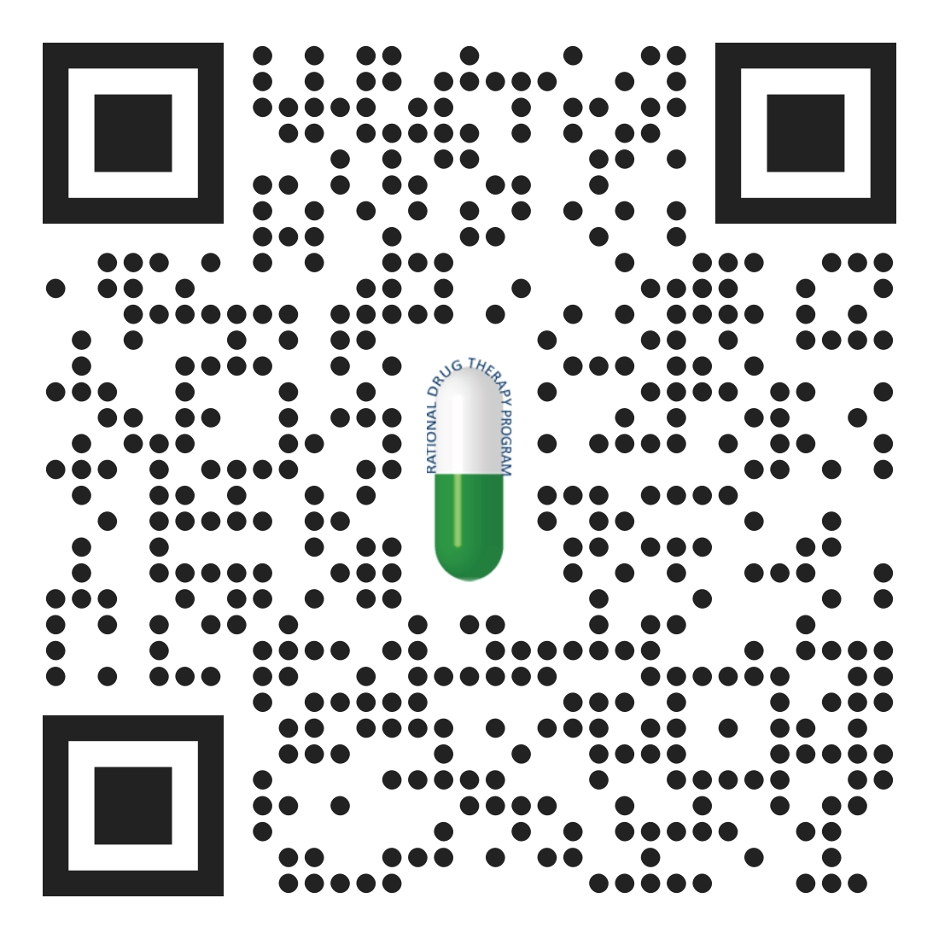
Contact Us
Phone: 304-293-2317
Email: wvadhd@hsc.wvu.edu
Website: https://pharmacy.hsc.wvu.edu/rdtp/academic-detailing/

