Slide 1
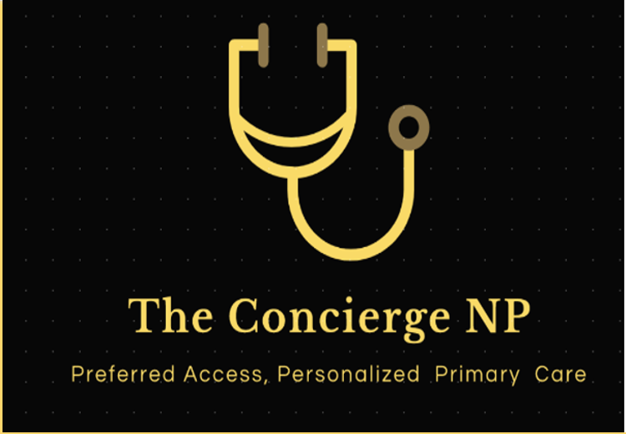
From Bedside to Business: Unleashing the Entrepreneurial Power of Nurses
Laure Marino, DNP, APRN, FNP-BC, CNE,
Owner, The Concierge NP, LLC
May 15, 2025 Marshall Health APN Conference Huntington, WV
Notes:
Slide 1: Title Slide Spoken Script: "Good [morning/afternoon], everyone! I'm so excited to welcome you to today's session, 'From Bedside to Business: Unleashing the Entrepreneurial Power of Nurses.' My name is Laure Marino, and I'm a nurse practitioner, educator, and passionate believer in the power of nurses to lead, innovate, and create. Let’s get started."

Slide 2
Disclosure and Program Objectives
Define entrepreneurship and identify key characteristics of successful nurse-led businesses.
Explain why nurses are uniquely positioned to excel as entrepreneurs.
Outline practical steps to start a healthcare-related venture.
I have no conflict of interest to disclose
Notes:
Slide 2: Program Objectives Spoken Script: "We’re going to walk through three big ideas today. First, we’ll define what entrepreneurship really means—especially in the nursing context—and look at what makes a successful nurse-led business. Second, we’ll talk about why nurses are uniquely positioned to be entrepreneurs. And third, we’ll outline the practical steps to help you move from idea to action."

Slide 3
Notes:
Slide 4: What is Entrepreneurship? Spoken Script: "At its core, entrepreneurship is about identifying a need and building a solution that adds value. It’s not just about starting a business—it’s about solving a problem. Nurse entrepreneurship is simply doing that in the healthcare space, using your clinical insight to make things better."
Nurse entrepreneurship is the process by which nurses use their clinical expertise, leadership skills, and insight into patient and system needs to create and operate healthcare-related ventures that deliver innovative solutions, services, or products. It combines business principles with the nursing perspective to improve care delivery, address system gaps, and advance public health.
Entrepreneurship may be the best kept secret of our profession
Aim to change that
World wide Less than 1 % of nurses own businesses
No real data base and it may not be a health related business
Beckers Hospital conducted a survey in 2023
more than 1,300 U.S. nurses found about 50 percent have side hustles outside of nursing to earn extra income — and many of them plan on making side gigs their full-time job, according to newly released findings from staffing platform ConnectRN.
The staffing platform worked with The Nursing Beat, a newsletter, to conduct the survey, and findings were published Aug. 3. Thirty-nine percent of respondents were certified nursing assistants, 27 percent were licensed practical nurses and more than a third were registered nurses.
Four notes:
Half of respondents who were new nurses, meaning they were in the profession for less than three years, said they plan to transition out of nursing and make their side hustle a full-time job. Among all respondents, this figure was 26 percent.
Eighty percent of respondents said they have ambitions to start their own business.
More than half of nurses indicated they want to further their education, but can't due to their schedule.
For 90 percent of nurses, these were the top five factors they indicated were extremely important to them: maintaining their mental health; being present for family and friends; maintaining a work-life balance; maintaining their physical health; and excelling at work.
I do think entrepreneurship is on the rise, and COVID may have helped this
Nurses looking for better safer practice opportunities, Nurses became capitalists (travel nursing)
Nurse entrepreneurs are individuals who leverage their nursing background to
start and manage businesses or ventures in the healthcare industry.
While the traditional role of nurses involves providing direct patient care in hospitals or other healthcare settings,
nurse entrepreneurs take a more business-oriented approach to contribute to the healthcare sector.
Some nurses will take their innovation to bring new goods and services to the market- this is nurse entrepreneurship.
Other nurses will use their knowledge to effect change and growth in their current position.
This is known as being an intrapreneur, seeing a gap and leveraging existing resources of the institution to create local change.
Worldwide we have seen the expansion of “Innovation Centers” in the health care delivery system,
recognizing that nurses, creative problem solvers, are the key drivers to system change resulting in better health outcomes and cost savings.
Both important, entre the focus of this presentation and what you learn tonight can be used, the process to be innovative while employed

Slide 4
Trends that Support/Hinder NE
Support
Hinder
Policy: ACA. IOM , Telehealth
Policy: ACA, IOM FPA
Public Health: COVID (TH)
Population Demographics
Small Business
Backbone of the Economy
Policy, SOP
Policy: CPA
Business Restrictions (Amazon)
Curriculum Gap
Access to Capital
Visibility
Our own Thinking
Notes:
Aging population
USA< 10 K turn 65 every day! This has been happening every day sinc e2012 and will continue until into the 2030s!
Gen Z and Millenials
Baby Boom
IOM report-
Increased emphasis on the nurse as entrepreneur
ACA: Radical changes in health care reform brought about by the Patient Protection and Affordable Care Act (ACA) in the US, brought upwards of 20 million people into the health care system, clamoring for services and access to providers (ASPE, 2016). This massive influx not only increased the demand for clinicians but also for a broader variety of goods and services. Entities that could rapidly respond to the policy impact of the ACA benefitted the most. Since a primary care physician shortage existed long before the ACA was passed, the medical establishment has been less able to react quickly or adequately to meet the demand for providers (AAMC, 2008). On the other hand, the nursing profession provided a ready solution, increasing the supply of advanced practice nurses. By 2018, APRNs were providing over one billion heath care visits annually with nearly 90% of all Nurse Practitioners (NPs) prepared in primary care (AANP, 2019). APRN care outcomes are shown to be equal to or better than the same care provided by physicians. Patients report a higher satisfaction with APRN care, and they adhere better to the treatment plans they design with an APRN (Stanik-Hutt, et al 2013).
Tell my story of cash pay for PC for small businesses
WV passed a law that this would count as health insurance (Direct access practices)

Slide 5
Let’s Bust a few Myths
Nurses aren’t business-minded
You need an advanced degree/MBA
You need a lot of money
You need an MD to collaborate
It’s risky and unstable
Entrepreneurship means leaving patient care
Notes:
Slide 5: Myths vs. Reality Spoken Script: "Let’s bust a few myths. No, you don’t need an MBA. No, you don’t need a million dollars. And yes, there’s risk—but there’s also reward, and more structure and support than ever before."
Myth #1: Nurses aren't business-minded.
Truth: Nurses are natural problem-solvers and systems thinkers. Their experience managing care coordination, prioritizing tasks, and leading teams makes them well-suited for entrepreneurial roles. Many just haven’t been exposed to business concepts—yet.
🔍 Myth #2: You need an MBA to start a business.
Truth: While formal business education can help, it’s not a requirement. Many successful nurse entrepreneurs learn as they go, take short courses, or surround themselves with mentors and advisors who guide them through the business side.
🔍 Myth #3: Entrepreneurship means leaving patient care.
Truth: Not always. Many nurse-led businesses center around clinical expertise—like starting a concierge NP practice, wellness coaching, legal nurse consulting, or launching a mobile clinic. It’s often an expansion of practice, not an abandonment of it.
🔍 Myth #4: You need a lot of money to get started.
Truth: Some ventures do require significant capital, but many nurse businesses (like telehealth, education, or consulting) can start lean with minimal overhead. Creative funding options—grants, crowdfunding, or low-cost digital platforms—can help.
🔍 Myth #5: It’s risky and unstable compared to a steady job.
Truth: Entrepreneurship carries risk, but so does working in a rapidly changing healthcare environment. With good planning and support, nurse entrepreneurs can create stability and autonomy on their own terms.
🔍 Myth #6: Nurses should just focus on care, not business.
Truth: This mindset undervalues the broad influence nurses can have. Nurse entrepreneurs drive innovation, increase access to care, and improve health outcomes—while showing that nursing and business can go hand-in-hand.
Would you like these turned into a slide or handout format for your nurse entrepreneurship presentation?
4o
window.__oai_logHTML?window.__oai_logHTML():window.__oai_SSR_HTML=window.__oai_SSR_HTML||Date.now();requestAnimationFrame((function(){window.__oai_logTTI?window.__oai_logTTI():window.__oai_SSR_TTI=window.__oai_SSR_TTI||Date.now()}))

Slide 6
Characteristics of Entrepreneurs
Visionary, Confident Risk-Tolerant
Curious Networked Resourceful
Use Persuasive Communication
Lead and Motivate Teams
Resilient Adaptable
Know how to solve problems
Stay the course,--yet---Pivot when needed
Self-Motivated
HEY!
That’s Me!!!!
Notes:
Slide 7: Characteristics of Nurse Entrepreneurs Spoken Script: "What do successful nurse entrepreneurs have in common? They’re visionary, resilient, and adaptable. They know how to solve problems, stay the course, and pivot when needed. Sound familiar? These are the same traits we use every day in patient care."

Slide 7
Why Nurses Excel as Entrepreneurs
The transition is more natural than you think.
Nursing Process- Assess, Diagnose, Act– Same for business.
We lead care teams
We make rapid decisions
We manage complexity
Natural Systems Thinkers
Process Improvers
We are problem finders and problem solvers
Notes:
Slide 8: Why Nurses Excel as Entrepreneurs Spoken Script: "Nurses are trained to assess, diagnose, and act. We are natural systems thinkers and process improvers. These are exactly the kinds of skills entrepreneurs rely on."

Slide 8
And Let’s not forget! We have Built in Trust
Notes:
Slide 9: Built-In Trust Spoken Script: "Every year, Gallup polls rank nurses as the most trusted profession. That trust follows you. In business, trust is a huge asset—you’re already ahead."

Slide 9
How do you get an idea for a business?
Our own experiences!
Frustrations, inefficiencies, or unmet needs
We see a gap-—we know how to meet it
Notes:
Slide 12: Where Business Ideas Come From Spoken Script: "Business ideas often come from your own experience—frustrations, inefficiencies, or unmet patient needs. Keep your eyes open for problems worth solving."
For a lot of us it will be an extension of what you are doing right now
Little Caesars pizza boxes

Slide 10
If you had no worries and all the time and support in the world,
what business would you bring to the market?

Slide 11
What does a nurse-owned business look like ?
Endless, and is based on YOU
Direct Clinical Practices
(PC, MH, Functional, Derm, House Calls, Telehealth)
Niche Practices: Aesthetics, Weight Management, Recovery, Wound Care
Educators (CE, SANE training)
Consultants (Business Coaching, Attorneys)
Speakers (Motivational)
Authors (podcast, books, bloggers
Product Developers: CathWear;
Notes:
Slide 6: Types of Nurse-Led Ventures Spoken Script: "Nurse entrepreneurs are out there building concierge practices, consulting, offering coaching and education, and even inventing medical products. Your business can look any number of ways depending on your interests and strengths."

Slide 12
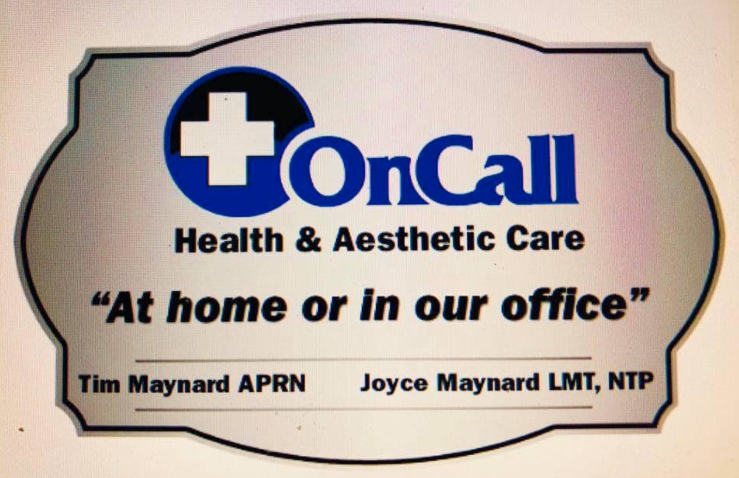
Notes:
Slide 11: Success Stories Spoken Script:
What do nurse owned businesses look like?
Over 200 that I know of in WV
And these images are of adv practice businesses like your self
Each on eof these owners is a potential mentor to you in starting a business
"Nurse Blake started with humor and now sells out theaters.
Donna Cardillo is a speaking and coaching powerhouse.
Latrina Walden built a review business for NP students. Each saw a need and filled it."
Barbars Phillips
Chad Hott
Health O Neal
Mary Curry

Slide 13
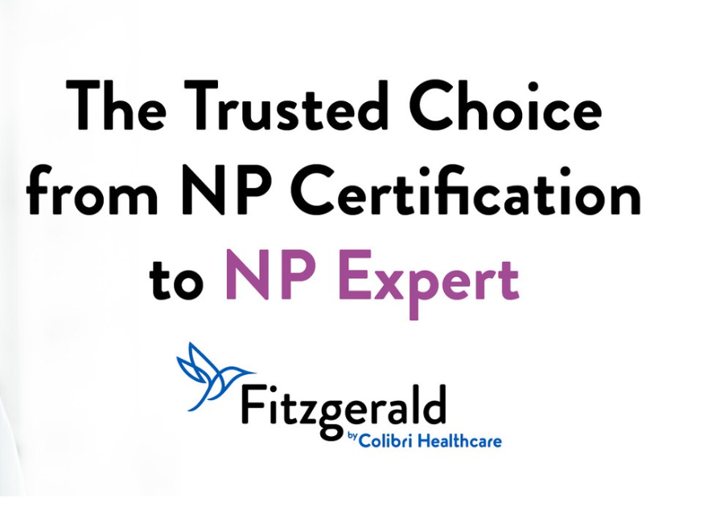
Nationally Recognized Nurse-Owned Businesses

Slide 14
Validate Your Idea
Who is this for?
Do others have this problem too?
Will they pay for it?
Who else offers this service?
Why would someone choose my business?
Your nursing practice is your biggest business asset.
Notes:
Slide 13: Validate Your Idea Spoken Script: "Before you build it, ask: Who is this for? Will they pay for it? Do others have this problem too? Market research doesn’t have to be formal—start with conversations."
Slide 14: Choosing a Business Model Spoken Script: "Think about what you want to sell and how. Do you want to provide services, create a product, or build a digital offering? And do you want active or passive income—or a mix?"

Slide 15
Choose a Business Structure & Name
Conduct a Name Search
Test the Name Out!
Register your business https://business4.wv.gov/startmybusiness/pages/register-your-business.aspx
Notes:
Slide 14: Choosing a Business Model Spoken Script: "Think about what you want to sell and how. Do you want to provide services, create a product, or build a digital offering? And do you want active or passive income—or a mix?"
Slide 15: Business Structures Spoken Script: "This is the legal part. You’ll likely want to form an LLC or PLLC. Make sure you understand liability protection, tax implications, and your state’s scope of practice."
Panacea was a Greek goddess, she cam e from a long line of healers, her grandpa was apollo , her dad was asclepious, the god of medicine. Panacea is a symbol of holistic care , an all in one solution to suffereing
Sounds awesome doesn’t it
So my first beusinees was going to Panacea House Calls Practice PHCP----
Greek Godness, in southern WV
I floated this name in a focus group , you know what they said? PENIS, pancea closed before is ever opened.

Slide 16
Getting Started, Staying Open
SBDC: Free, 1:1 Coaching https://wvsbdc.com/
NNBA National Nurses in Business https://nursesbusiness.com/
SCORE https://www.score.org/
https://www.sba.gov/business-guide/plan-your-business/write-your-business-plan
Nurse Entrepreneur Groups
Notes:
Slide 20: Resources for Nurse Entrepreneurs Spoken Script: "You don’t have to do this alone. Organizations like the ANA, NNBA, and SBDC offer support. SCORE connects you with free business mentors. And don’t underestimate podcasts and books—they keep you learning and inspired."

Slide 17
I want to start a business, but I’ve never written a business plan..
Notes:
Slide 19: Business Planning Tools Spoken Script: "A traditional 30-page business plan isn’t always needed. Start with a one-page business model canvas or lean start-up plan. It keeps you focused and flexible."

Slide 18
Funding your venture
Personal Savings
Crowd Funding
Loans (Grants- maybe)
Investors
Start small, keep your day job
How much money do you really need?
Notes:
Slide 16: Funding Your Venture Spoken Script: "Start-up funding can come from your savings, loans, grants, or investors. Many nurses start small and reinvest earnings to grow. Don’t let funding be the reason you don’t begin."
Slide 17: Marketing Essentials Spoken Script:

Slide 19
Begins with knowing who you want to serve, what problems you want to solve
The BASICS: Clear Signage and Branding
Create a 90-second pitch; business cards/materials
Get out there
Build a strong online presence: website, SEO, Google Ads, online reviews
Use Social Media strategically; it depends on your target audience
Be a Community Partner, Join BNI https://www.bni.com/
Leverage Word of Mouth Referrals
Network with Referral Sources
Notes:
"Marketing starts with knowing who you serve and what problem you solve. Then: build a brand, get online, and get talking. Word of mouth is powerful in nursing circles."
Slide 18: Compliance & Ethics Spoken Script: "Always stay within your license and scope. If you’re collecting patient data

Slide 20
Stay in Scope
You do not need approval from the WV RN Board
The WV RN Board cannot advise you on business structure, services, or fees
Take steps to become informed on HR, hiring and firing, offering benefits
Always have your attorney review any contracts
Enlist other Professionals:
Lawyer, Accountant, Billing/Coding, Web Designer, Marketing

Slide 21
Avoid Pitfalls
Underpricing your Services
Not including your pay in your expenses
Waiting for Perfection
Lacking Clarity (being all things to all consumers in the market)
Growing your team too fast; adding services w/o forecasting
Opening before you are credentialled
Notes:
Slide 22: Build Your Network Spoken Script: "Find people who’ve done what you want to do. Join nurse entrepreneur Facebook groups, attend meetups, reach out to mentors. You’re not alone."

Slide 22
What’s the best part of being an entrepreneur?

Slide 23
Let’s Talk!
If you'd like to stay in touch, here’s how to reach me.
I’m happy to connect, support, or answer questions as you explore your entrepreneurial journey."
Laure Marino
LMarino19@gmail.com
304-419-1300
Notes:
Slide 27: Contact Info Spoken Script: "If you'd like to stay in touch, here’s how to reach me. I’m happy to connect, support, or answer questions as you explore your own entrepreneurial journey."

