Slide 1
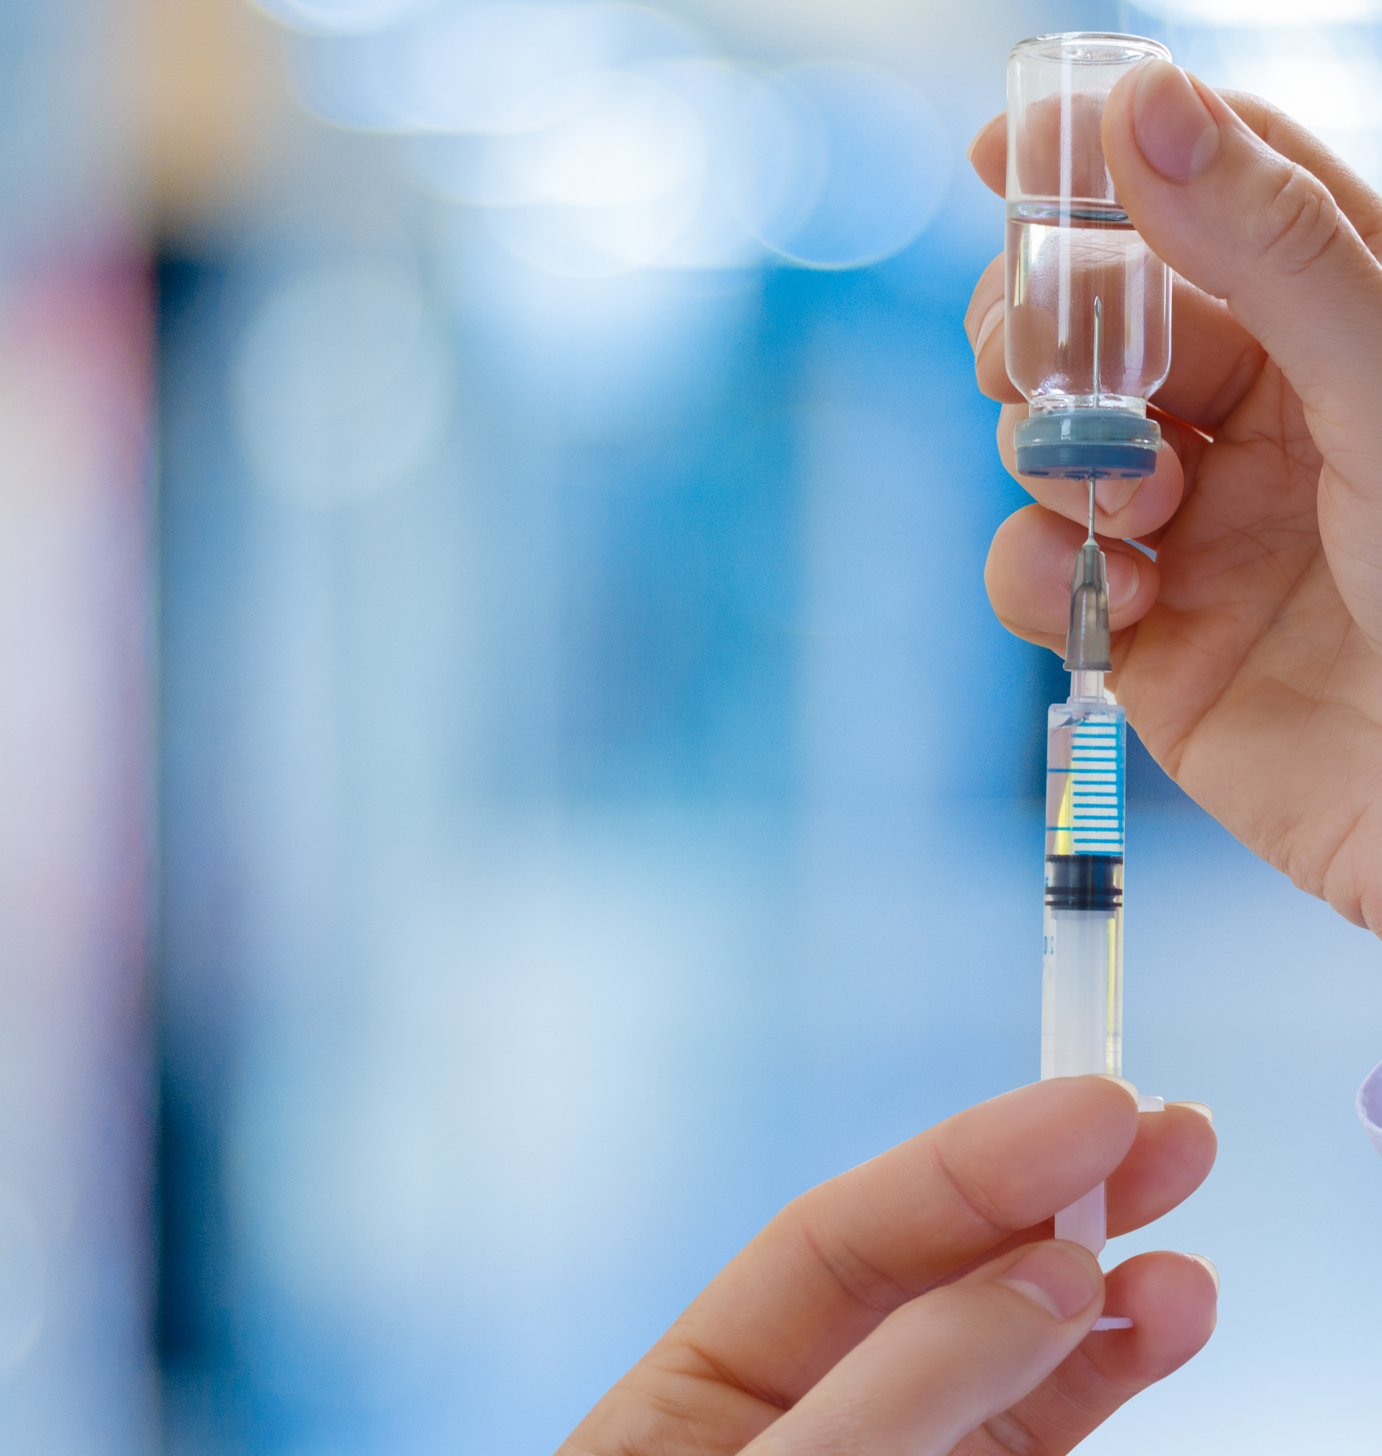
Regenerative Therapies in Advanced Practice
Ashly Yount FNP-BC

Slide 2
Learning Objectives
Define stem cell categories used clinically
Pathways of healing
Identify evidence-based indications
Understand regulatory considerations
Integrate regenerative therapies into NP practice

Slide 3

What Are Stem Cells?
Undifferentiated cells capable of self-renewal
  Differentiate into specialized cells
  Act primarily via paracrine signaling
  Immunomodulation and growth factor secretion

Slide 4
Types of Stem Cells in Practice
Adult Mesenchymal Stem Cells (MSCs)
  Hematopoietic stem cells
    Types of harvesting
  Perinatal / birth tissue-derived products
    Cord blood
    Umbilical tissue
    Wharton’s jelly
  Autologous vs Allogeneic sources

Slide 5
Mechanism of Action for Stem Cells
Altering inflammatory pathways
Tissue repair stimulation and remodeling
Angiogenesis stimulation
Recruitment of native repair cells
Reset immune signaling

Slide 6
Breakdown
Chronic pain/condition now becomes acute
Allows for healing cascade to commence
  Ex. Burn/Cut

Slide 7
*Biggest Takeaway*
Most clinical benefits are received through signaling, not cell replacement!

Slide 8
PRP and PRF
Platelet Rich Plasma
  Faster response time
  Angiogenic, cell proliferation
  Hair, Ortho
Platelet rich Fibrin
  Longer benefits
  Stays at site, improves cell to tissue interaction
  Aesthetics, wounds

Slide 9
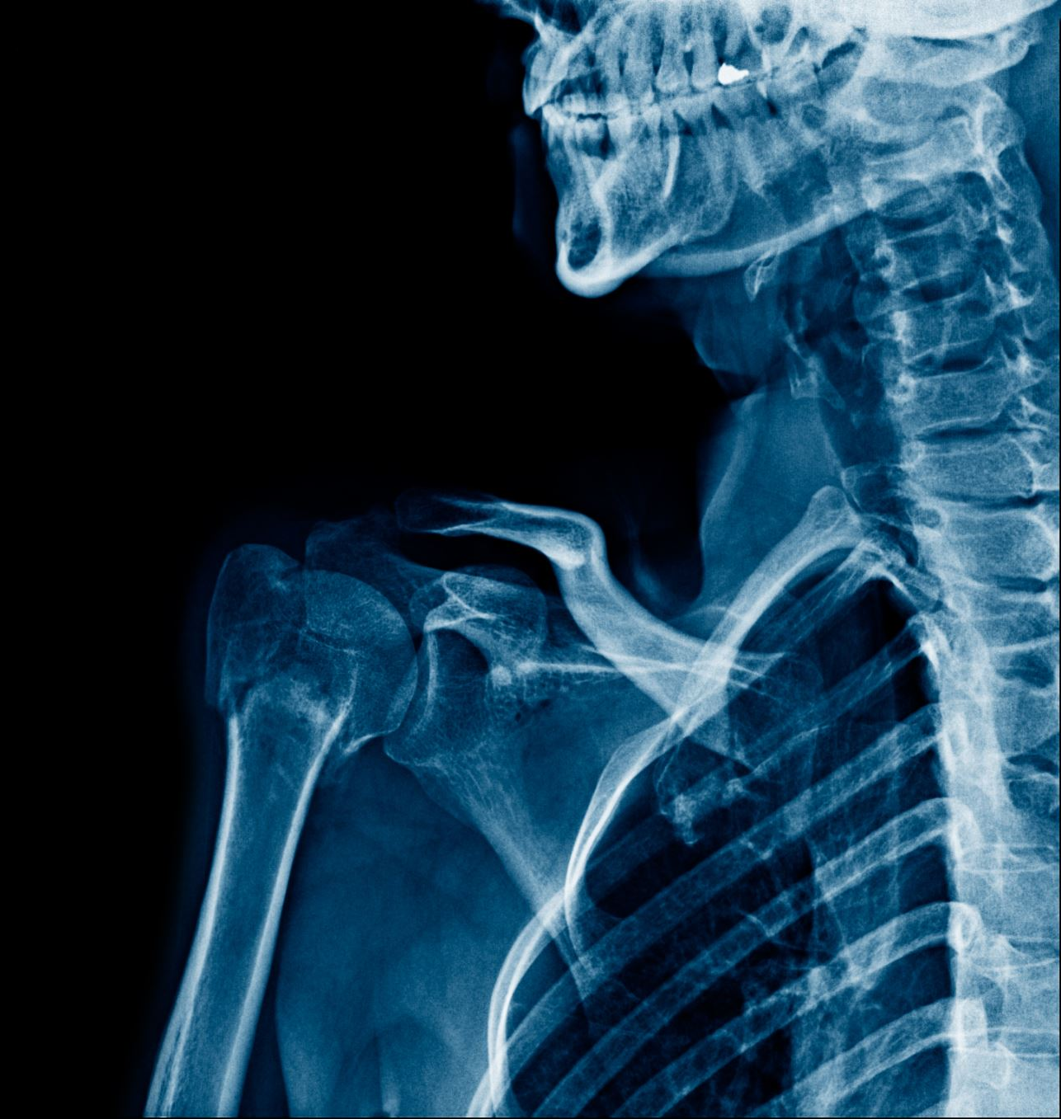
Orthopedic & MSK Indications
Osteoarthritis (knee, hip, shoulder)
  Tendinopathy
  Ligament injuries
  Degenerative disc disease

Slide 10
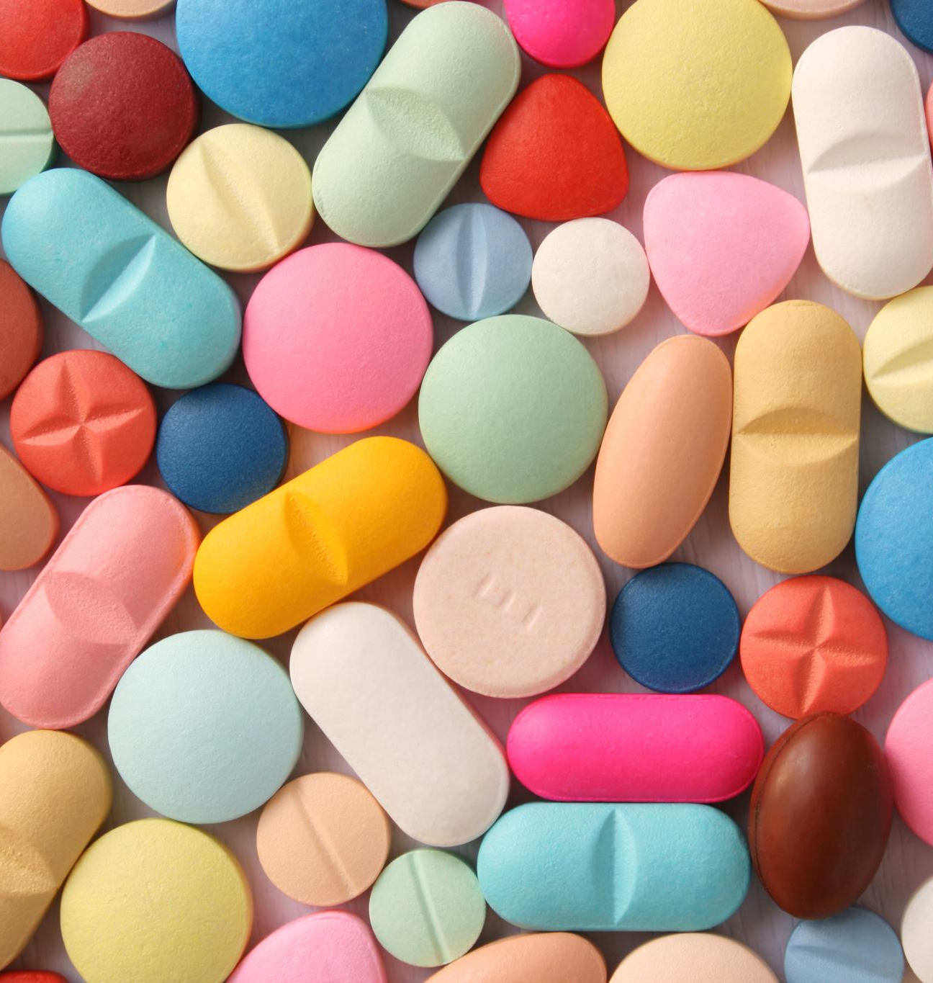
Functional Medicine Applications
Chronic inflammatory conditions
  Immune modulation support
  Chronic fatigue patterns
  Adjunct in metabolic dysfunction (emerging data)

Slide 11
Aesthetic Applications
Facial rejuvenation
  Filler replacement
  Acne scar remodeling
  Post-laser healing support
  Microneedling

Slide 12
Hair Restoration Uses
Androgenic alopecia
  Telogen effluvium
  Perimenopausal thinning
  Often combined with PRP and microneedling

Slide 13
Patient Selection
Mild–moderate degeneration
  Failed conservative therapy
  No active malignancy or infection
  Realistic expectations

Slide 14
Regulatory Considerations
FDA minimal manipulation guidelines
  361 vs 351 product classification
  State NP scope compliance
  Thorough informed consent required
    Must know it is an experimental treatment

Slide 15
Workflow Integration – Orthopedic
Patient screening & imaging
  Procedure protocol
  Post-procedure rehab
  Follow-up at 6 weeks, 3 months, 6 months
  Rehab/Therapy

Slide 16
Workflow Integration – Aesthetic
Consultation & imaging
  Combination therapy planning
  Photo documentation
  Ultrasound
  Maintenance every 6–12 months

Slide 17
Functional Medicine Integration
Optimize Vitamin D, Omega-3, glycemic control
  Correct deficiencies before biologics
  Track inflammatory markers
  Symptom tracking over 3–6 months

Slide 18

Adjunctive Therapies
Physical therapy
  Red light therapy
  Shockwave therapy
  Anti-inflammatory nutrition protocols
  Peptides

Slide 19
Business Integration
Cash-pay model common
  Package pricing strategies
  Membership regenerative programs
  High patient retention potential

Slide 20
Risk Management
Detailed documentation
  Informed consent
  Complication monitoring
  Avoid exaggerated marketing claims

Slide 21
Key Takeaways
Primary benefit = signaling effects
  Strongest evidence in orthopedic care
  Aesthetic & functional uses growing
  Compliance protects your license

Slide 22

Questions & Discussion
Thank you

