Slide 1

The 5 M’s of Geriatrics: What Matters, Medications, Mobility, Mentation & Multicomplexity
Richard Conway, DO

Slide 2
Disclosures
Employed by Marshall Health Network in Family Medicine and Geriatrics
Employed per diem by Hospice of Huntington

Slide 3
Objectives
Be aware of the 5Ms of geriatrics as a framework for comprehensive assessment of elderly patients.
Know tools or screeners to assess each of the 5 Ms
Have a plan of action for each of the 5 Ms
Be able to apply the 5 Ms to work up and treat common syndromes in Geriatrics.

Slide 4
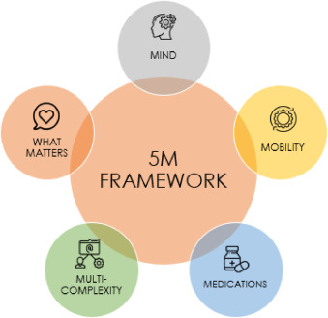

Slide 6
What Matters Most
Should be the first and last thing addressed
Ask patients their goals and what they want of a conversation
Ensure family are involved and MPOA are done early
Educate patients to advocate for themselves.

Slide 8
Medications
An estimated 50% of adults >65 take 4 or more medications
Polypharmacy is often described as 5 or more medications.
39% of patients are reported to be on at least one Potentially Inappropriate Medication (PIM).
One study reported that 66% of patients take supplements

Slide 9
Lists of PIMs and Alternatives
AGS Beers list
  https://agsjournals.onlinelibrary.wiley.com/doi/epdf/10.1111/jgs.18372
Screening Tool Of Older People's Prescriptions (STOPP) and Screening Tool to Alert to Right Treatment (START)
  https://www.cgakit.com/_files/ugd/2a1cfa_bcf4d63c427e4e18963c64e74663728e.pdf
Anti-cholinergic Burden (ACB) Score
  https://www.acbcalc.com/

Slide 10



Inappropriate/overprescribed
Androgens/testosterone Anti-infective agents Anticholinergic agents Antipsychotics Benzodiazepines and nonbenzodiazepine hypnotics (eg, zolpidem, zaleplon, eszopiclone) Digoxin (not a first-line drug for atrial fibrillation or heart failure) Fecal softeners H₂-receptor antagonists Insulin, sliding scale NSAIDs Proton-pump inhibitors Sedating antihistamines (H₁-receptor antagonists, eg, diphenhydramine) Skeletal muscle relaxants Tricyclic antidepressants Urinary and GI antispasmodics Vitamins and minerals

Slide 11
Cardiovascular effects
Bradycardia | Cholinesterase inhibitors, β-adrenergic blockers, diltiazem, verapamil, digoxin
Hypotension | Antihypertensives, diuretics, nitrates, phosphodiesterase type 5 inhibitors, α-blockers, tricyclic antidepressants, trazodone
CNS effects
Delirium | Anticholinergic agents, antiparkinson agents, antidepressants, antipsychotics, opioids, glucocorticoids, benzodiazepines, first-generation antihistamines (eg, diphenhydramine), H₂-receptor antagonists, drug withdrawal (eg, benzodiazepines, ethanol)
Depression | β-Adrenergic blockers, benzodiazepines, central-acting antihypertensives
Dizziness | SSRIs, cholinesterase inhibitors, many others
Parkinsonism | Antipsychotics, metoclopramide
Sedation | Antidepressants, antipsychotics, first-generation antihistamines (eg, diphenhydramine), opioids, anticonvulsants, benzodiazepines
Falls | Benzodiazepines, tricyclic and SSRI antidepressants, antipsychotics, sedatives/hypnotics, anticonvulsants, opioids, diuretics, antihypertensives, anticholinergic agents, antiarrhythmics

Slide 12
GI effects
Bleeding/ulceration | NSAIDs, aspirin, glucocorticoids, bisphosphonates, antiplatelet agents, anticoagulants (eg, warfarin, apixaban, edoxaban, dabigatran, rivaroxaban)
Constipation | Opioids, iron- or calcium-containing antacids, calcium channel blockers, anticholinergic agents, cholestyramine
Diarrhea | Magnesium-containing antacids, SSRIs, cholinesterase inhibitors
Nausea/vomiting | Digoxin, cholinesterase inhibitors, bisphosphonates
Electrolyte, kidney, urinary effects
Hyperkalemia | ACE inhibitors, angiotensin-receptor blockers, potassium supplements, potassium-sparing diuretics
Hypokalemia | Diuretics
Kidney impairment | NSAIDs, triamterene, many others
SIADH/hyponatremia | Carbamazepine, SSRIs, SNRIs, antipsychotics, diuretics, tramadol
Urinary retention | Agents with anticholinergic properties, opioids, calcium channel blockers, α-adrenergic agonists

Slide 13
Deprescribing Approach
Ascertain what medications the patient is taking and the indications
Consider the overall risk of drug-induced harm.
Assess each medication’s benefit to risk ratio
Are there good alternative medications
Implement a discontinuation regimen (tapering),
Monitoring for improvement or adverse withdrawal effects.

Slide 14
Deprescribing Algorithm
The Canadian Deprescribing Network has developed algorithms for deprescribing 5 classes of medications
  PPI
  Antihyperglycemic
  Antipsychotic
  Benzos
  Cholinesterase inhibitors and Memantine
https://deprescribing.org/resources/deprescribing-guidelines-algorithms/

Slide 16
Multi-complexity
Involves many factors about the patient
  Comorbid conditions
  Sensory impairments (Hearing, vision, dental, smell)
  Social determinants/support
  Transitions of care, multiple doctors

Slide 17
Comorbid Conditions
Some data suggests that on average Patients over 65 have at least 2 comorbidities
Disease can cause symptoms (HF: Swelling, SOB, cough)
Disease can exacerbate symptoms (Dementia and infection)
Disease leads to more meds

Slide 18
Sensory Impairments
Hearing/vision
  can mimic and increase risk of dementia
  Impair communication and compliance
  Increase fall risk (balance and depth perception)
Dental issues and olfactory can impact appetite and PO intake
Important to screen and correct

Slide 19
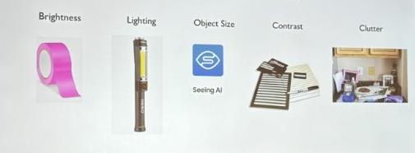
Strategies for Vision Impairment

Slide 20
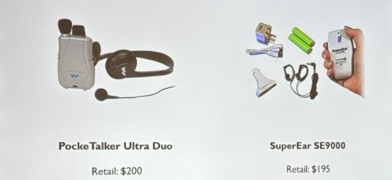
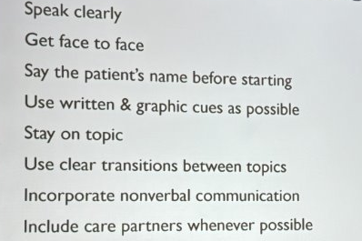

Strategies for Hearing Impairment

Slide 21
Social
Limited access
  Food- Meals on Wheels
  Transportation- Dial-A-Ride
  Housing, electric, water
Lack of family support/Caregiver burnout
  Home Health- SMMC (memory, speech, urinary)
  Cabell County Community Service Organization (CCCSO)
    All the stuff patients want home health to be
  Aged and Disabled Waiver
  Palliative Care- Tri-state Life Care

Slide 22
Transitions
Educate your patients
Give Patients updated documents to keep and give to providers
  med lists
  PMH/surgeries
  office note or visit summary
Ensure documentation is up-to-date
Use comments on orders to give info

Slide 24
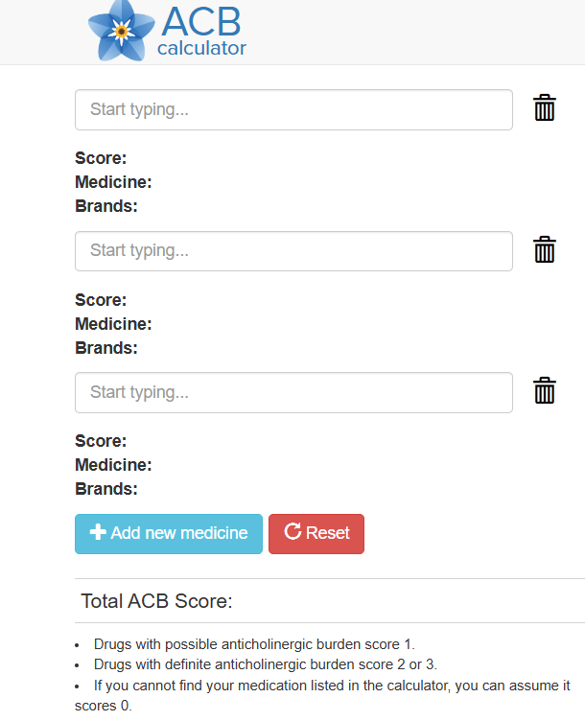
Mind
Depression Makes pts twice a likely to develop cognitive impair
Impact of disease, medication, and life stress
Avoid medications that can result in cognitive impair
Anti-cholinergic Burden score

Slide 25
Memory
Normal | Healthy aging | MCI | Mild Dementia | Moderate | Severe
Life is good | -Normal testing -Normal ADLS | -Abn Testing -Intact ADLs | -Abn Testing -IADLs lost -BADLS intact -DSRS <18 | -Abn testing -IADLs, start to lose BADLs -DSRS >18 | -Complete ADL loss -FAST score 7 -DSRS > 36
-No Tx | -No Tx | -No Tx *** -AD Meds -10% a year to dementia | -Donepezil or rivastigmine -AD meds | -Memantine -Palliative -Stop AD meds | -Stop Meds -Hospice
Basic | Instrumental
Dressing | Shopping
Eating | Housekeeping
Ambulating | Accounting
Toileting | Food Prep
Hygiene | Transport/telephone
 | Meds

Slide 26
Etiology for Dementia
Alzheimer's
  Amyloid and phosphorylated Tau
  ATN profile, P-tau 217, Amyloid PET
  Leqembi and Kisunla
Limbic Associated TDP43 Encephalopathy
  Looks like AD pt in their 80s
Parkinson/Lewy Body
  Bradykinesia + Rigidity or tremor
  Fluctuations and hallucinations
  Dat scan
Vascular
  Stepwise, hx of stroke
Frontotemporal
  Impulsive, changes in personality
  NO Donepezil
Normal Pressure Hydrocephalous
  Wet, wobbly, and weird. (So everyone)
Infectious
  HIV, syphilis,
Pseudodementia
  Depression
  Meds
  Uncontrolled comorbid
  Vitamin Deficiency

Slide 27
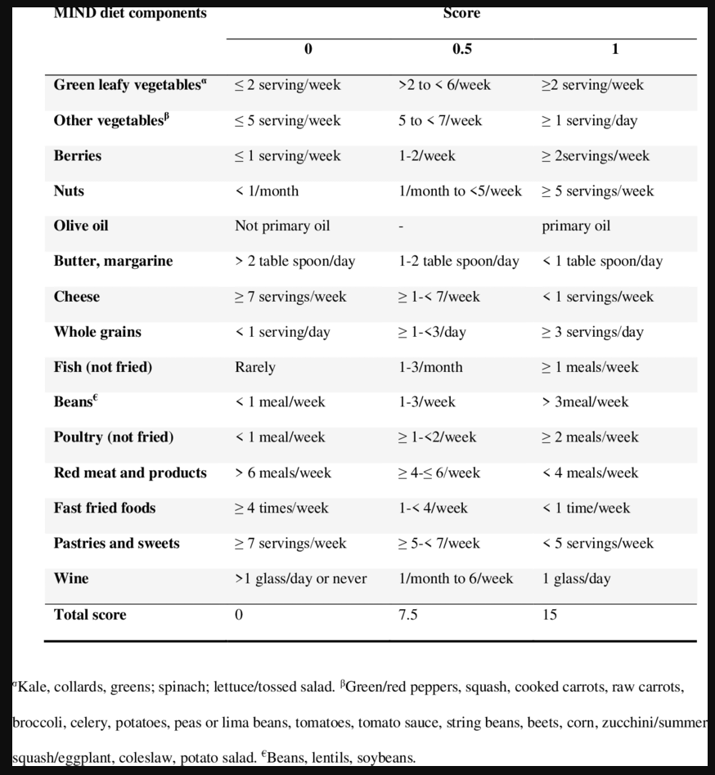

Slide 29
Mobility
One-third of patients ≥70 years old are discharged with a disability that was not present 2 weeks before admission.
May take up to 1 week per day spent in the hospital to recover strength
Decreased mobility can result in
  Pressure wounds
  Swelling
  PNA
  Blood clots
  Falls

Slide 30
Timed Up and Go
Pt starts sitting will stand walk 3 meters (10 feet) turn around and return to their chair
Normal is <10-12 seconds
If slower increased have sarcopenia which increases risk of falls
Refer to PT/OT and/or Balance therapy

Slide 31
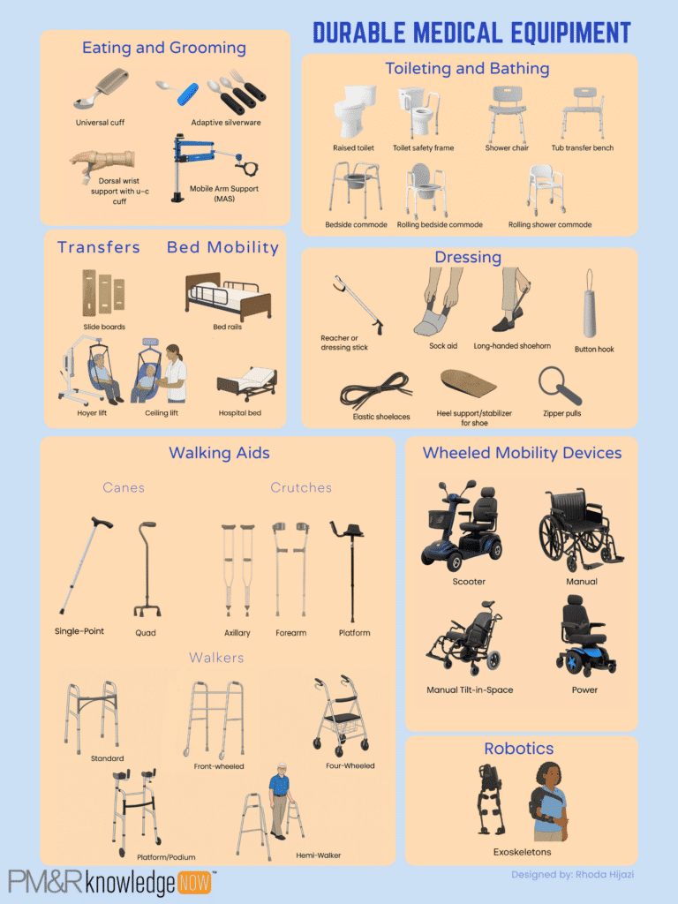
Aids/Transfers
Walking aids
  Canes/Quad Canes
  4 point walkers
  2 wheel walkers
  Rollators
Transfer aids
  Bed rails
  Shower chairs
  Stair lifts
  Hoyer

Slide 33
What Matters Most
Should be the first and last thing addressed
Ask patients their goals and what they want of a conversation
Ensure family are involved and MPOA are done early
Educate patients to advocate for themselves.

Slide 34
Chief Complaint: Insomnia
Pt is a 70 year old male coming in with CC of not sleeping
Has been waking up at night and usually will go to the bathroom when he is up. Wakes up not rested and has to take several naps during the day.
PMH: HTN, T2DM, obesity, depression
Meds: HCTZ 25mg, losartan 100mg, metformin 1000mg BID, Jardiance 10mg, Wellbutrin XR 300mg
Has tried some OTC sleep aids but they make him drowsy the next morning and do not help.

Slide 35
What Matters
Naps and fatigue during the day make it hard for him to watch his grandkids
Wants to limit medications

Slide 36
Differential?
Meds
  HCTZ, Jardiance
  Wellbutrin
  OTC Meds
Multi-complexity
  Depression
  Obesity ->OSA
  Uncontrolled DM
  BPH?
  Sleeping conditions
  Daytime activities
Mind
  Depression
Mobility
  Not Active enough

Slide 37
Our Patient
On discussion he pees a lot during the day but has good stream. Is interested in decreasing diuretics
He snores at night and has not been screened for sleep apnea
Has not great control of either of his HTN (BP 150/100) or his DM (last A1c 8.5)
Depression is well controlled since he has been in therapy
Has a comfortable bed, wife sleeps in bed with him

Slide 38
What Matters
Naps and fatigue during the day make it hard for him to watch his grandkids
Wants to limit medications

Slide 39
Plan
Remove meds
  Wellbutrin (Wean to 150mg then d/c if improving fatigue with below)
  Jardiance
  Ensure HCTZ is in am and remove when HTN controlled
Improve Comorbids/Weight
  Start GLP1 for weight loss-> HTN, DM, Possible OSA
    Ensure exercise to limit muscle mass lose
Work up Possible causes
  Sleep study for OSA
  Void Dairy with decreasing diuretics and r/o BPH
  Consider CBT-I with therapist

Slide 40
Resources
Geriatric Review Syllabus- Chapter on pharmacotherapy
All websites listed in slides

