Slide 1

Treatment and Collaborative Care of Chronic Heart Failure
George G. Sokos, DO FACC
Abnash C. Jain, Endowed Chair, Professor Department of Cardiology
West Virginia University

Slide 2
Disclosure of Financial Relationships
None

Slide 3
Introduction

Slide 4
Learning Objectives
Discuss nonpharmacologic and pharmacologic management of chronic heart failure in primary care
Summarize the goals of care for patients with chronic heart failure
Describe the role of the primary care clinician in monitoring patients with chronic heart failure
Identify which patients with chronic heart failure should be referred to cardiology as part of their care, including consultation, primary management, or co-management
Apply knowledge about treatment, monitoring, and referral of patients with chronic heart failure to a patient scenario
Notes:
#bullet 1 with info
#bullet 2 with info

Slide 5
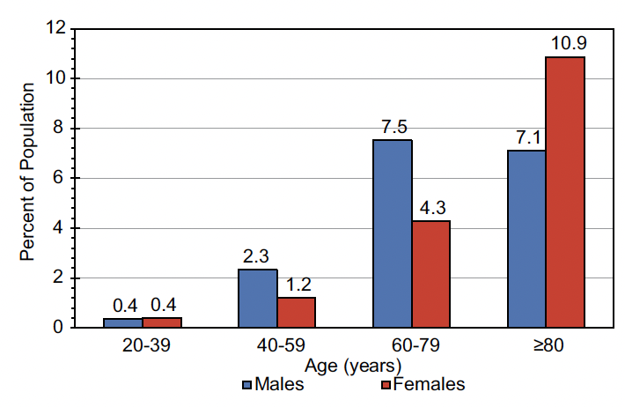
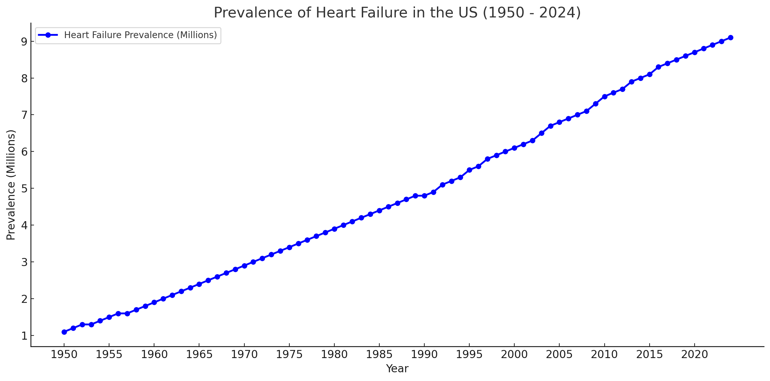
Scope of the Problem: Heart Failure
Prevalence of HF and future projection if current trends continue
6.7 million Americans ≥20 years of age have HF
Costs the US healthcare system nearly $31 billion annually
10
8.5 M
8
6.7 M
6 M
6
People with HF (in millions)
4
2
0
2017
2020
2025
2030
HF, heart failure; M, million
Adapted from Bozkurt B et al. J Card Fail. 2023;29(10):1412-1451.
Notes:
On the basis of data from NHANES 2017 to 2020, 6.7 million Americans ≥20 years of age had HF
This is increased from ≈6.0 million according to NHANES 2015 to 2018
Prevalence of HF is projected to increase by 46% from 2012 to 2030, affecting >8 million people ≥18 years of age.
The total percentage of the population with HF is projected to rise from 2.4% in 2012 to 3.0% in 2030.

Slide 6
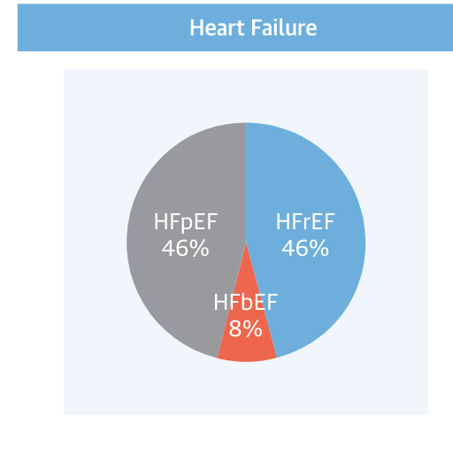
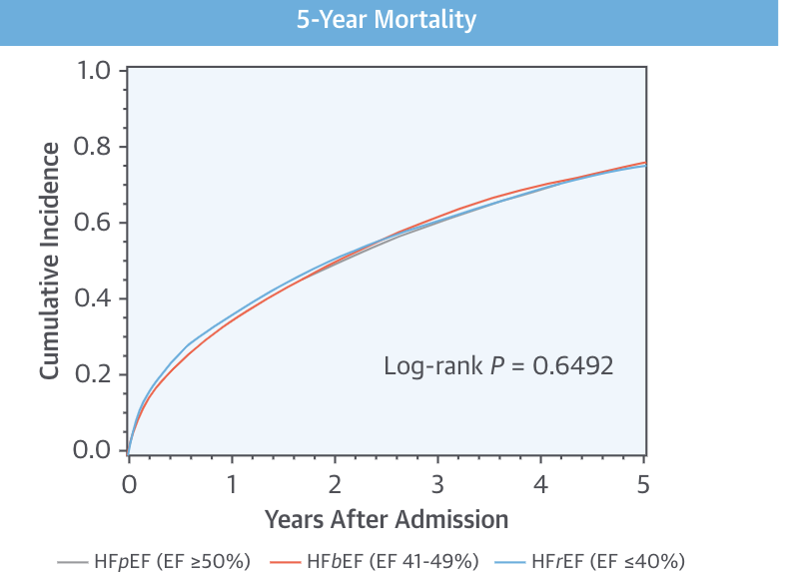
Classification and Prognosis
Heart failure
5-year mortality
1.0
HFpEF (EF ≥50%)
HFmrEF (EF 41%-49%)
HFrEF (EF ≤40%)
0.8
0.6
Cumulative incidence
0.4
0.2
Log-rank P=.6492
0.0
0
1
2
3
4
5
Years after admission
HFmrEF, heart failure with mildly reduced ejection fraction; HFpEF, heart failure with preserved ejection fraction; HFrEF, heart failure with reduced ejection fraction
Adapted from Shah KS et al. J Am Coll Cardiol. 2017;70:2476-2486.
Notes:
We know that HFpEF and HFrEF have a similar incidence in the population.
And we know that outcomes once established HF is present are poor. In fact, if we look at recent data, the 5 year mortality for clinical HF is about 75%. Now, as our therapies improve, we assume this will translate into improvements in outcome. However, prevention is key to reduce the effects of this disorder.
Why should we care about this? Because HF plays a role in increasing death and disability of the individual as well as healthcare costs to the society.

Slide 7
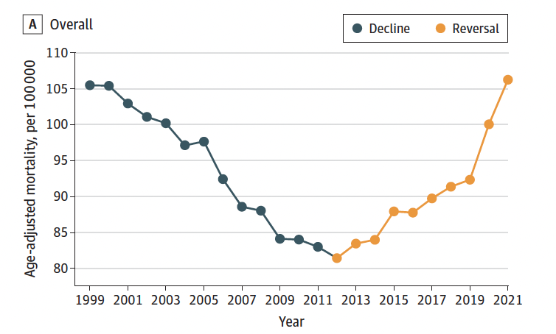
Heart Failure Mortality Is Rising
Overall
110
Decline
Reversal
105
100
Age-adjusted mortality, per 100,000
95
90
85
80
1999
2001
2003
2005
2007
2009
2011
2013
2015
2017
2019
2021
Year
Adapted from Sayed A. JAMA Cardiol. 2024;e240615.
Notes:
Sayed A, Abramov D, Fonarow GC, Mamas MA, Kobo O, Butler J, Fudim M. Reversals in the Decline of Heart Failure Mortality in the US, 1999 to 2021. JAMA Cardiol. 2024 Apr 24:e240615. doi: 10.1001/jamacardio.2024.0615. Epub ahead of print. PMID: 38656398; PMCID: PMC11044007.

Slide 8
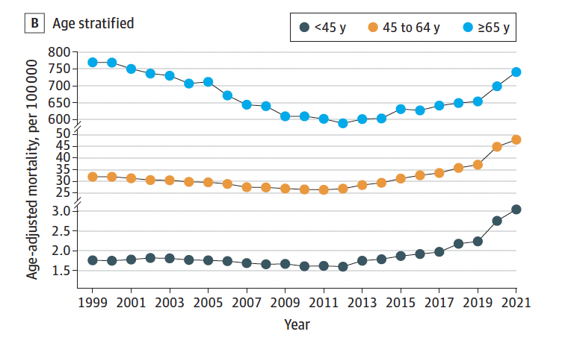
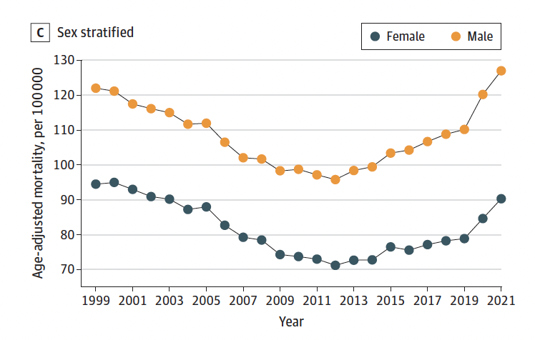
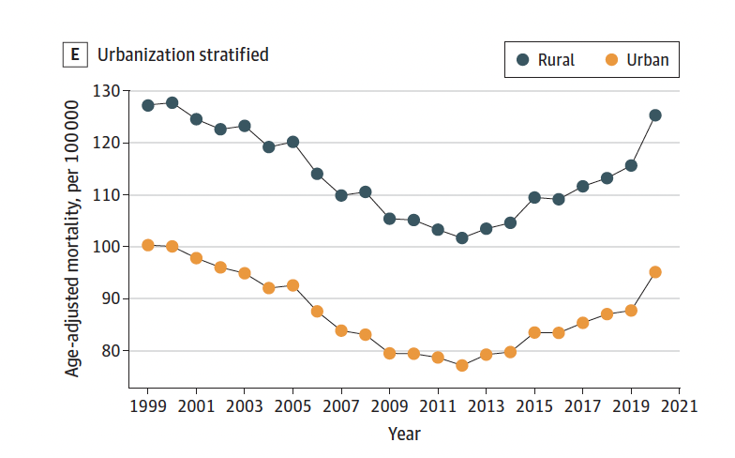
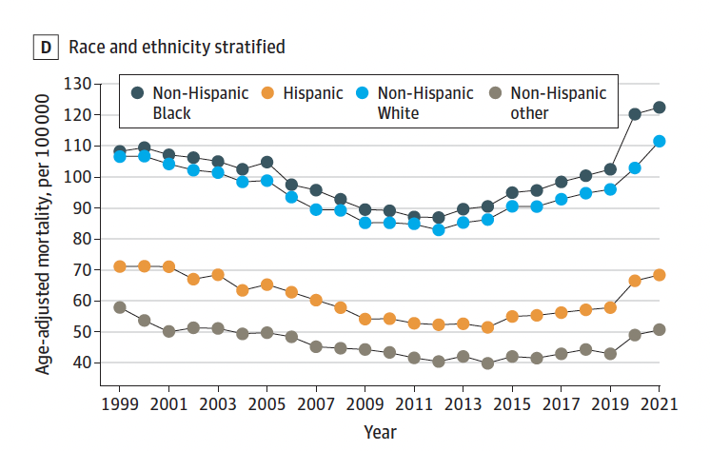
Heart Failure Mortality Is Rising: All Groups
Age stratified
Urbanization stratified
800
≥65 years
130
Rural
700
120
Urban
600
45-64 years
110
50
Age-adjusted mortality, per 100,000
Age-adjusted mortality, per 100,000
40
100
25
<45 years
3.0
90
2.5
2.0
80
1.5
1999
2005
2010
2015
2021
1999
2005
2010
2015
2021
Year
Year
Sex stratified
Race and ethnicity stratified
130
Male
Non-Hispanic Black
120
Female
120
110
100
Non-Hispanic White
Age-adjusted mortality, per 100,000
Age-adjusted mortality, per 100,000
100
80
Hispanic
90
80
60
Non-Hispanic other
70
40
1999
2005
2010
2015
2021
1999
2005
2010
2015
2021
Year
Year
Adapted from Sayed A. JAMA Cardiol. 2024;e240615.
Notes:
On the basis of data from NHANES 2017 to 2020, 6.7 million Americans ≥20 years of age had HF
This is increased from ≈6.0 million according to NHANES 2015 to 2018
Prevalence of HF is projected to increase by 46% from 2012 to 2030, affecting >8 million people ≥18 years of age.
The total percentage of the population with HF is projected to rise from 2.4% in 2012 to 3.0% in 2030.

Slide 9

Relevance to Primary Care
Indication for advanced testing in cases of Dx uncertainty
Management of special or unusual cardiomyopathies, pulmonary HTN, pericardial disease
Enrollment in clinical trials
Evaluation for advanced therapies
Heart failure is a common condition
Excellent care requires a multidisciplinary team
Electrophysiologist for AF
Interventional cardiologist and/or cardiac surgeon for CAD
Endocrinologist for diabetes
Nephrologist for CKD
Pulmonologist for sleep apnea
Multi-disciplinary specialist
HF
specialist
AF, atrial fibrillation; CAD, coronary artery disease; CKD, chronic kidney disease; Dx, diagnosis; GDMT, guideline-directed medical therapy; HF, heart failure; HFpEF, heart failure with preserved ejection fraction; HTN, hypertension
Cardiology specialist
Primary care clinician
Confirmation of HFpEF diagnosis
Optimization of GDMT
Enrollment in clinical trials
Referral to advanced HF specialist if needed
Diagnosis of HFpEF
Initiation of GDMT
Management of comorbidities
Referral to cardiologist if needed
Adapted from Kittleson MM. J Am Coll Cardiol. 2023;81:1835-1878.
Notes:
Kittleson MM, et al. 2023 ACC Expert Consensus Decision Pathway on Management of Heart Failure With Preserved Ejection Fraction: A Report of the American College of Cardiology Solution Set Oversight Committee. J Am Coll Cardiol. 2023;81:1835-1878 PMID: 37137593.

Slide 10
Practical Tips
Recognize that heart failure has a high mortality.
Heart failure mortality is increasing overall in the United States.
Heart failure care requires a team.

Slide 11
Medical Management

Slide 12
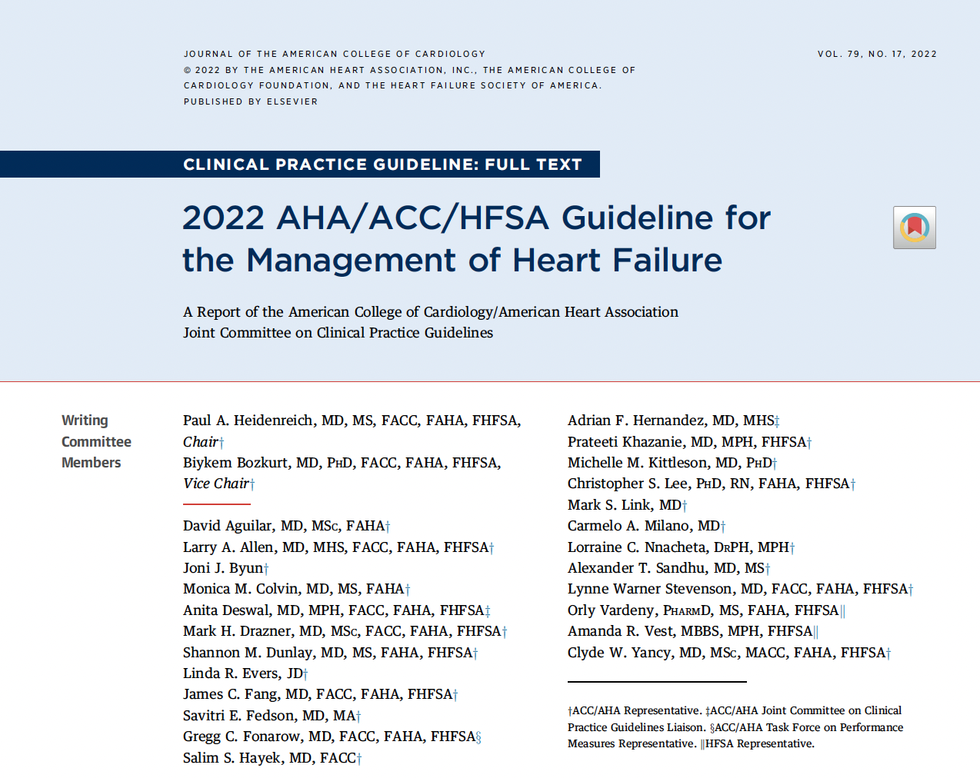
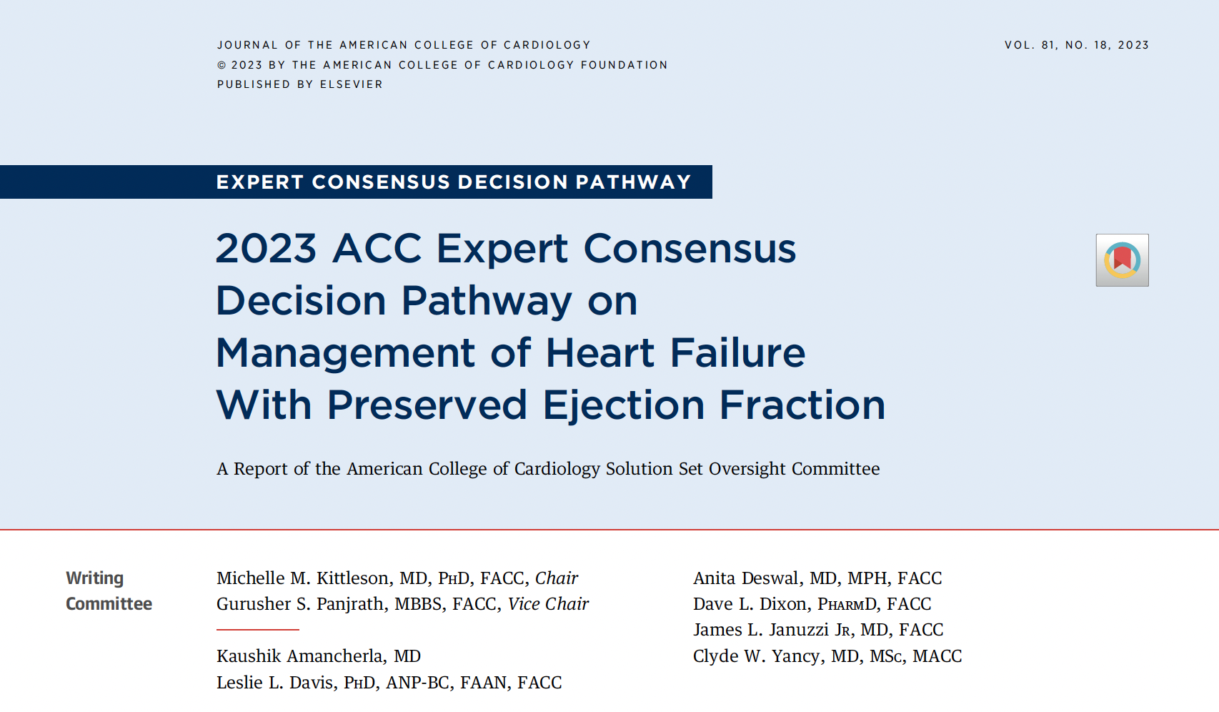
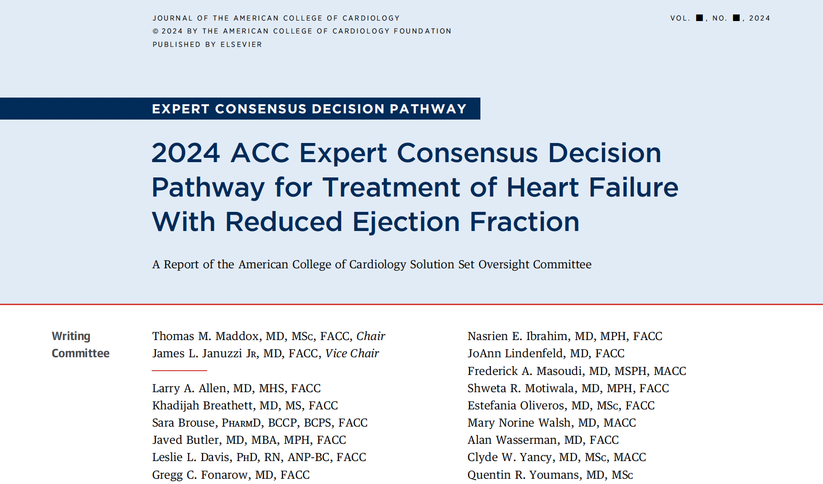
Heart Failure Guidelines
Clinical Practice Guideline
2022 AHA/ACC/HFSA Guideline for the Management of Heart Failure
A report of the American College of Cardiology/America Heart Association Joint Committee on Clinical Practice Guidelines
Expert Consensus Decision Pathway
2023 ACC Expert Consensus Decision Pathway on Management of HFpEF
A report of the American College of Cardiology Solution Set Oversight Committee
Expert Consensus Decision Pathway
2024 ACC Expert Consensus Decision Pathway for Treatment of HFrEF
A report of the American College of Cardiology Solution Set Oversight Committee
ACC, American College of Cardiology; AHA, American Heart Association; HFpEF, heart failure with preserved ejection fraction; HFrEF, heart failure with reduced ejection fraction; HFSA, Heart Failure Society of America
Adapted from: 1. Heidenreich PA. J Am Coll Cardiol. 2022;79: e263-e421. 2. Kittleson MM. J Am Coll Cardiol. 2023;81:1835-1878. 3. Maddox TM. J Am Coll Cardiol. 2024;83:1444-1488.
Notes:
HF is a complex clinical syndrome with manifestations that result from any impairment of ventricular filling or ejection of blood.
HF is diagnosed in the presence of current or prior symptoms and or signs caused by a structural and/or functional cardiac abnormality and corroborated by
elevated natriuretic peptide levels and/or objective evidence of cardiogenic pulmonary or systemic congestion
Maddox TM, et al. 2024 ACC expert consensus decision pathway for treatment of heart failure with reduced ejection fraction: a report of the American College of Cardiology Solution Set Oversight Committee. J Am Coll Cardiol 2024;XX:XXX-XX.

Slide 13
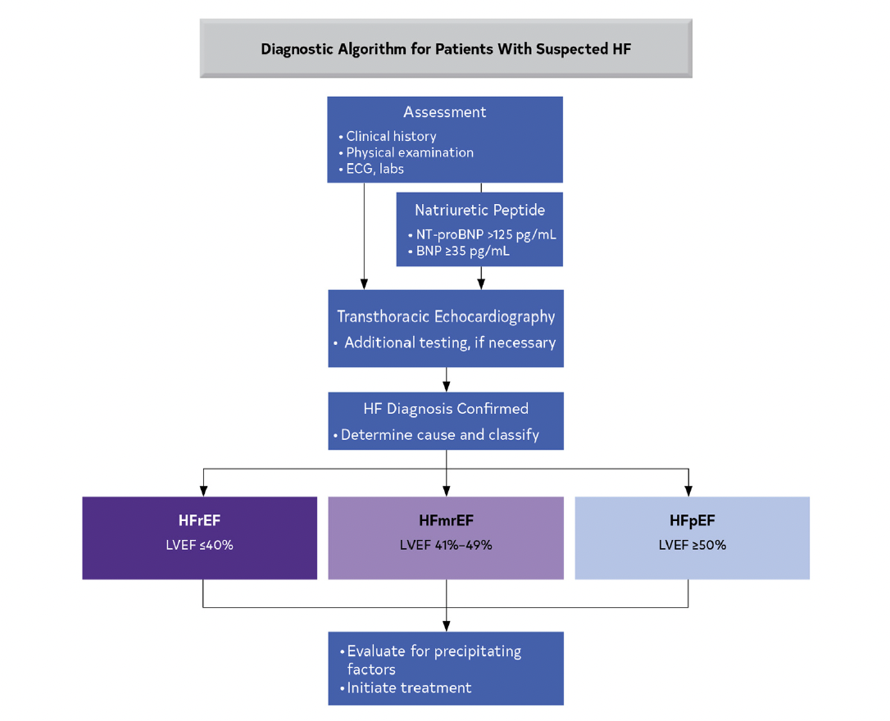
Diagnostic Algorithm for Patients with Suspected HF
Assessment
Clinical history
Physical examination
ECG, labs
Natriuretic peptide
NT-proBNP >125 pg/mL
BNP ≥35 pg/mL
Transthoracic echocardiography
Additional testing, if necessary
HF diagnosis confirmed
Determine cause and classify
Nonpharmacologic measures for all
HFrEF
LVEF ≤40%
HFmrEF
LVEF 41%-49%
HFpEF
LVEF ≥50%
BNP, B-type natriuretic peptide; ECG, electrocardiogram; HFmrEF, heart failure with mid-range ejection fraction; HFpEF, heart failure with preserved ejection fraction; HFrEF, heart failure with reduced ejection fraction; NT-proBNP, N-terminal pro-b-type natriuretic peptide
Evaluate for precipitating factors
Initiate treatment
Adapted from Heidenreich PA. J Am Coll Cardiol. 2022;79:e263-e421.
Notes:
HF is a complex clinical syndrome with manifestations that result from any impairment of ventricular filling or ejection of blood.
HF is diagnosed in the presence of current or prior symptoms and or signs caused by a structural and/or functional cardiac abnormality and corroborated by
elevated natriuretic peptide levels and/or objective evidence of cardiogenic pulmonary or systemic congestion

Slide 14
Nonpharmacologic Measures

Slide 15
Should We Restrict Sodium and/or Fluids?

Slide 16
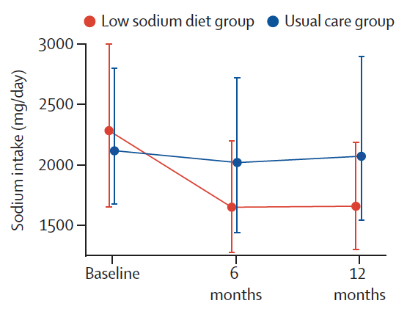
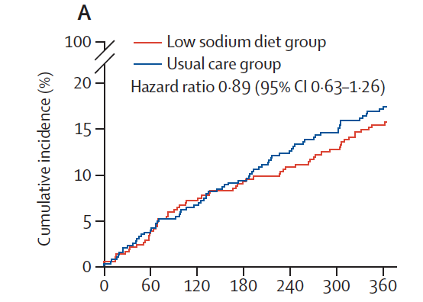
SODIUM-HF
2286
mg/day
2073 mg/day
2119
mg/day
1658 mg/day
806 patients hospitalized, NYHA class II-III HF; 67 years old; 33% women
Low-sodium diet group
Usual care group
Sodium restriction did NOT result in changes in the measured clinical outcomes
Small improvements were seen in QOL and NYHA functional class
Low-sodium diet group
Usual care group
3,000
20
2,500
2,286 mg/day
15
Sodium intake (mg/day)
2,073 mg/day
Cumulative incidence (%)
2,000
10
2,119 mg/day
1,658 mg/day
5
1,500
Hazard ratio, 0.89 (95% CI 0.63-1.26)
0
Baseline
6 months
12 months
0
60
120
180
240
300
360
Days from randomization
CI, confidence interval; NYHA, New York Heart Association; QOL, quality of life; SODIUM-HF, Study of Dietary Intervention Under 100 mmol in Heart Failure
Adapted from Ezekowitz JA. Lancet. 2022;399:1391-1400.
Notes:
In ambulatory patients with heart failure, a dietary intervention to reduce sodium intake did not reduce clinical events
Ezekowitz JA, Colin-Ramirez E, Ross H, Escobedo J, Macdonald P, Troughton R, Saldarriaga C, Alemayehu W, McAlister FA, Arcand J, Atherton J, Doughty R, Gupta M, Howlett J, Jaffer S, Lavoie A, Lund M, Marwick T, McKelvie R, Moe G, Pandey AS, Porepa L, Rajda M, Rheault H, Singh J, Toma M, Virani S, Zieroth S; SODIUM-HF Investigators. Reduction of dietary sodium to less than 100 mmol in heart failure (SODIUM-HF): an international, open-label, randomised, controlled trial. Lancet. 2022 Apr 9;399(10333):1391-1400. doi: 10.1016/S0140-6736(22)00369-5. Epub 2022 Apr 2. PMID: 35381194.

Slide 17
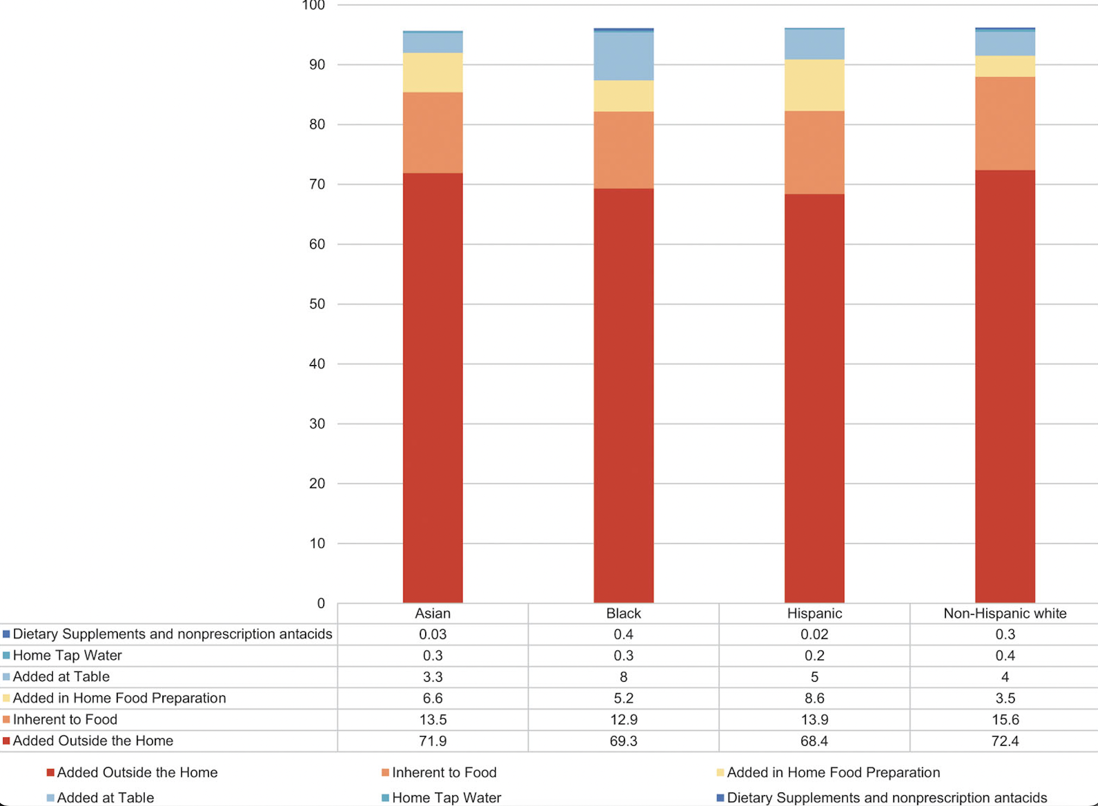
Sources of Sodium in Adults in 3 Geographic Regions in the United States
Sodium is in the food before you get it
Sodium is
in the food
before you get it
Adapted from Tsao CW. Circulation. 2022;145:e153-e639.

Slide 18
Guidelines: Sodium Restriction in HF
Class IIa
For patients with Stage C HF, avoiding excessive sodium intake is reasonable to reduce congestive symptoms (LOE: C-LD)
    The AHA currently recommends a reduction of sodium intake to <2,300 mg/day for general cardiovascular health promotion; however, there are no trials to support this level of restriction in patients with HF
AHA, American Heart Association; C-LD, level C-limited data; LOE, level of evidence
Heidenreich PA. J Am Coll Cardiol. 2022;79:e263-e421.
Notes:
Restricting dietary sodium is a common nonpharmacological treatment for patients with HF symptomatic with congestion, but specific recommendations have been based on low-quality evidence.
The AHA currently recommends a reduction of sodium intake to <2300 mg/d for general cardiovascular health promotion (12); however, there are no trials to support this level of restriction in patients with HF (13).

Slide 19
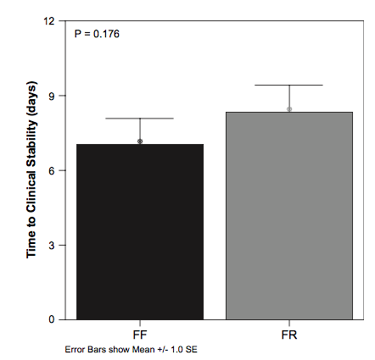
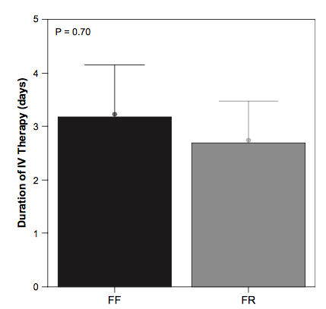
Fluid Restriction in NYHA Class 4 HF
12
P=0.176
5
P=0.70
4
9
3
6
Time to clinical stability (days)
Duration of IV therapy (days)
2
3
1
0
0
Free fluid
Fluid restricted
Free fluid
Fluid restricted
Error bars show mean +/- 1.0 SE
SE, standard error
Adapted from Travers B. J Cardiac Fail. 2007;13:128-132.
Notes:
To examine the clinical effect of fluid restriction in patients admitted to the hospital with class IV heart failure (HF).
Methods and Results: This is a single-blind randomized controlled study. Time to clinical stability was compared between the fluid restricted (FR: n 5 34) and free fluid (FF: n 5 33) groups respectively show- ing no significant difference (8.3 6 6.3 days versus 7.0 6 6.0 days, P 5 .17). There was no significant difference between groups in time to discontinuation of intravenous diuretic therapy (FR: 2.7 6 4.5 days, FF: 3.2 6 5.6 days, P 5 .70). Changes from baseline to achievement of clinical stability in serum urea (P 5 .23), serum creatinine (P 5 .14), BNP (P 5 .42), and sodium (P 5 .14) did not differ between the FF and FR groups. Baseline serum sodium levels did not predict the time to clinical stability (b 5 􏰀0.11, 95% CI: 􏰀0.60, 0.23).
Conclusions: Fluid restriction is not an evidence-based therapy although it is occasionally applied in the management of HF. These results suggest that FR is not of any clinical benefit in patients with acute de- compensated HF and this hypothesis should be tested in a larger randomized controlled study. (J Cardiac Fail 2007;13:128e132)

Slide 20
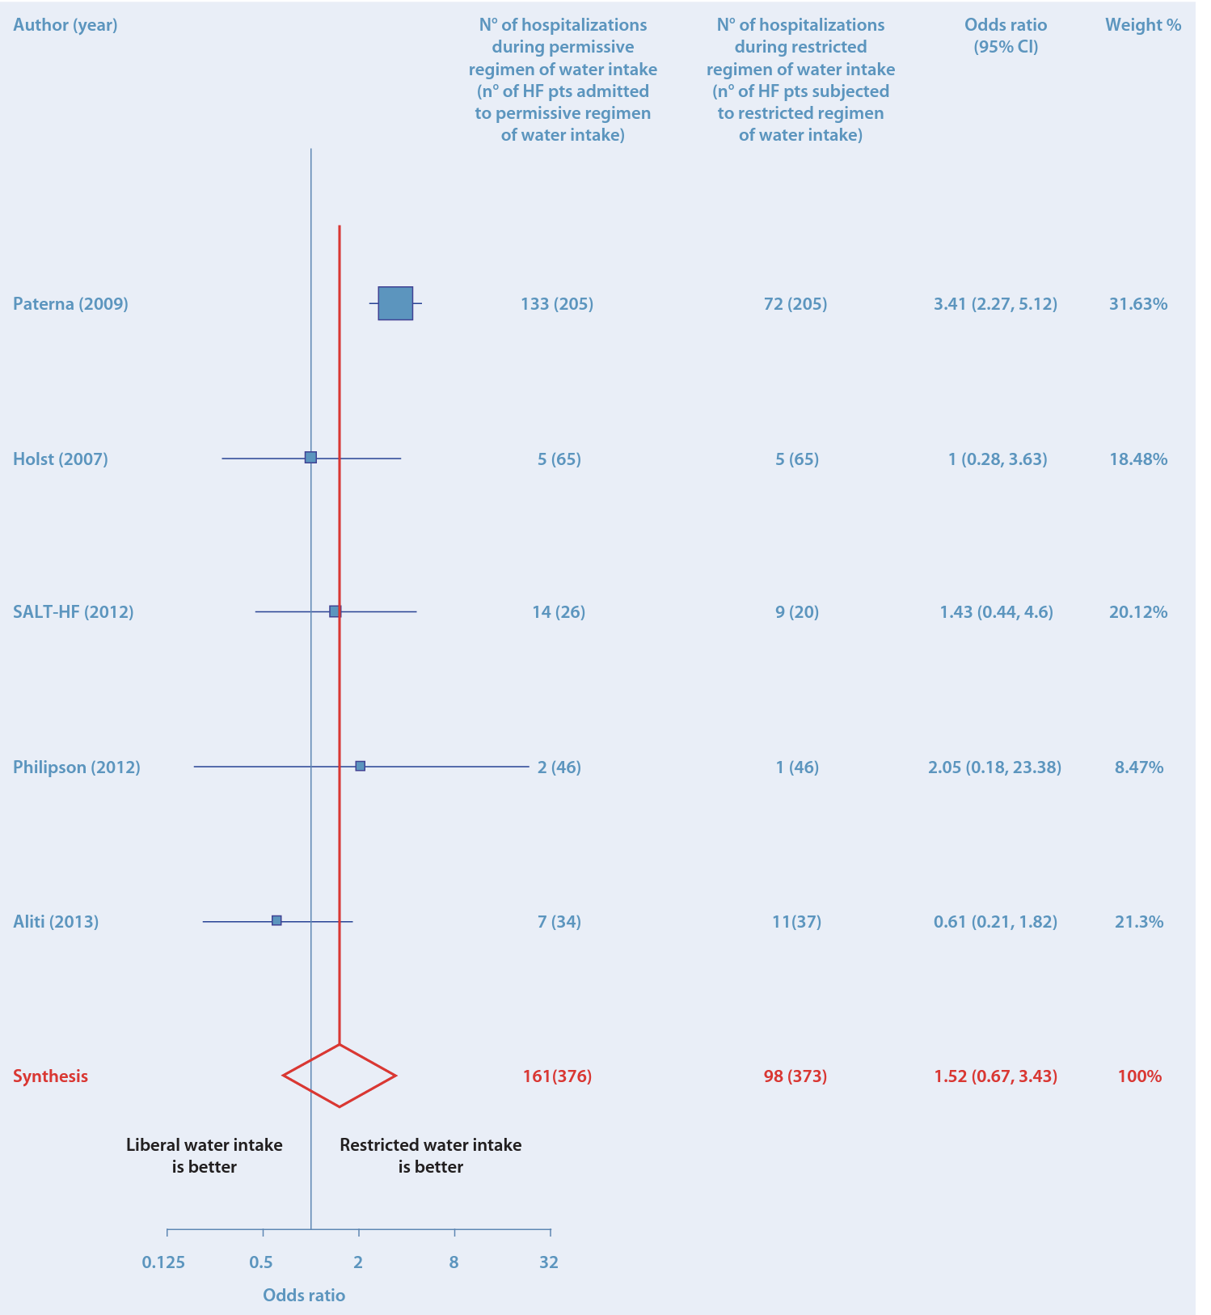
Fluid Restriction: No Benefit
Meta-analysis of 6 trials
HHF
Hospitalizations for HF
No difference in HHF, mortality, IV diuretic use, Cr, Sodium
Author (year) |  | No. of hospitalizations during permissive regimen of water intake (No. of HF patients admitted to permissive regimen of water intake) | No. of hospitalizations during restricted regimen of water intake (No. of HF patients subjected to restricted regimen of water intake) | Odds ratio (95% CI) | Weight %
Paterna (2009) |  | 133 (205) | 72 (205) | 3.41 (2.27, 5.12) | 31.63%
Holst (2007) |  | 5 (65) | 5 (65) | 1 (0.28, 3.63) | 18.48%
SALT-HF (2012) |  | 14 (26) | 9 (20) | 1.43 (0.44, 4.6) | 20.12%
Philipson (2012) |  | 2 (46) | 1 (46) | 2.05 (0.18, 23.38) | 8.47%
Aliti (2013) |  | 7 (34) | 11 (37) | 0.61 (0.21, 1.82) | 21.3%
Synthesis |  | 161 (376) | 98 (373) | 1.52 (0.67, 3.43) | 100%
Liberal water intake is better
0.125
0.5
2
8
32
Restricted water intake is better
Odds ratio
Cr, creatinine; HHF, hospitalization for heart failure; IV, intravenous; No., number
Adapted from De Vecchis R. Herz. 2016;41:63-75.
Notes:
In a meta-analysis of RCTs on fluid restriction in HF in general, restricted fluid intake compared with free fluid consumption did not result in reduced hospitalization or mortality rates, changes in thirst, the duration of intravenous diuretic use, serum creatinine, or serum sodium levels (4).
De Vecchis R, Baldi C, Cioppa C, Giasi A, Fusco A. Effects of limiting fluid intake on clinical and laboratory outcomes in patients with heart failure. Results of a meta-analysis of randomized controlled trials. Herz. 2016 Feb;41(1):63-75. doi: 10.1007/s00059-015-4345-9. Epub 2015 Aug 21. PMID: 26292805

Slide 21
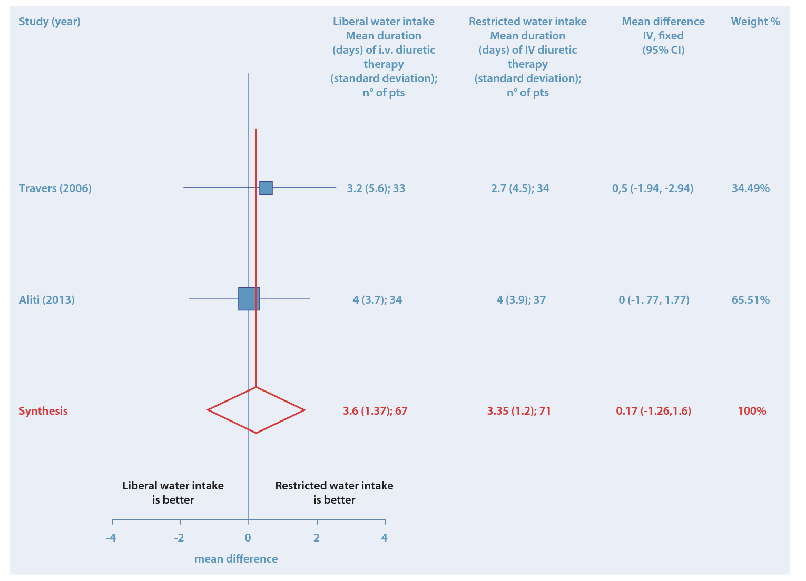
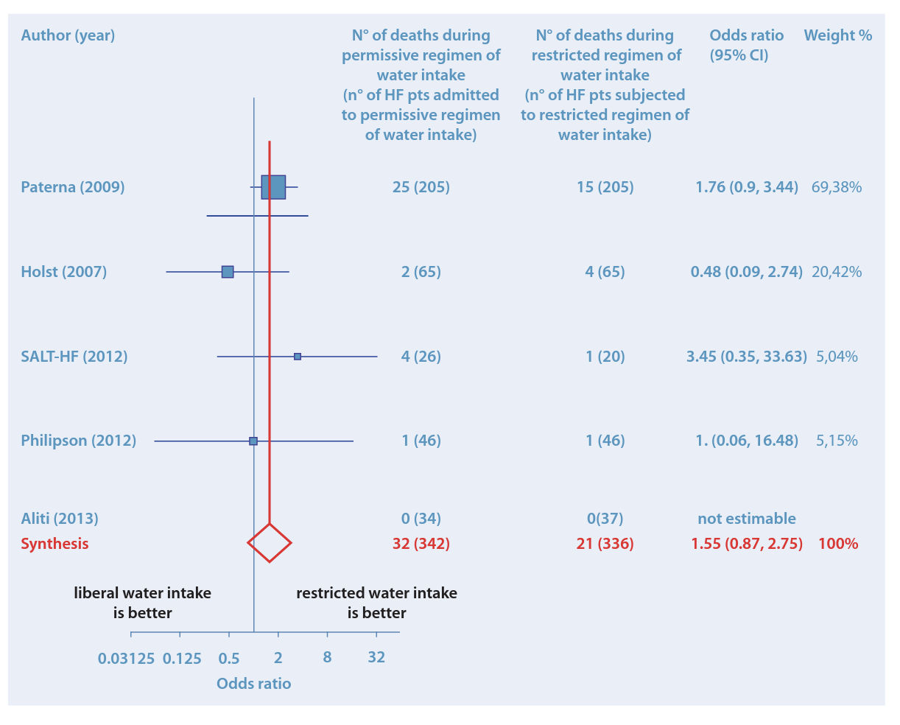
Fluid Restriction: No Benefit
Meta-analysis of 6 trials
Need for IV diuretics
Death
Study (year) |  | Liberal water intake Mean duration (days) of IV diuretic therapy (standard deviation); no. of patients | Restricted water intake Mean duration (days) of IV diuretic therapy (standard deviation); no. of patients | Mean difference IV, fixed (95% CI) | Weight %
Travers (2006) |  | 3.2 (5.6); 33 | 2.7 (4.5); 34 | 0.5 (-1.94, -2.94) | 34.49%
Aliti (2013) |  | 4 (3.7); 34 | 4 (3.9); 37 | 0 (-1.77, 1.77) | 65.51%
Synthesis |  | 3.6 (1.37); 67 | 3.35 (1.2); 71 | 0.17 (-1.26,1.6) | 100%
Author (year) |  | No. of deaths during permissive regimen of water intake (no. of HF patients admitted to permissive regimen of water intake) | No. of deaths during restricted regimen of water intake (no. of HF patients subjected to restricted regimen of water intake) | Odds ratio (95% CI) | Weight %
Paterna (2009) |  | 25 (205) | 15 (205) | 1.76 (0.9, 3.44) | 69.38%
Holst (2007) |  | 2 (65) | 4 (65) | 0.48 (0.09, 2.74) | 20.42%
SALT-HF (2012) |  | 4 (26) | 1 (20) | 3.45 (0.35, 33.63) | 5.04%
Philipson (2012) |  | 1 (46) | 1 (46) | 1 (0.06, 16.48) | 5.15%
Aliti (2013) |  | 0 (34) | 0 (37) | Not estimable
Synthesis |  | 32 (342) | 21 (336) | 1.55 (0.87, 2.75) | 100%
Death
Need for IV diuretics
Liberal water intake is better
-4
-2
0
2
4
Restricted water intake is better
Mean difference
IV, intravenous; No, number
Liberal water intake is better
Restricted water intake is better
0.03125
0.5
2
8
32
Adapted from De Vecchis R. Herz. 2016;41:63-75.
Odds ratio
Notes:
In a meta-analysis of RCTs on fluid restriction in HF in general, restricted fluid intake compared with free fluid consumption did not result in reduced hospitalization or mortality rates, changes in thirst, the duration of intravenous diuretic use, serum creatinine, or serum sodium levels (4).
De Vecchis R, Baldi C, Cioppa C, Giasi A, Fusco A. Effects of limiting fluid intake on clinical and laboratory outcomes in patients with heart failure. Results of a meta-analysis of randomized controlled trials. Herz. 2016 Feb;41(1):63-75. doi: 10.1007/s00059-015-4345-9. Epub 2015 Aug 21. PMID: 26292805

Slide 22
Guidelines: Fluid Restriction in HF
Class IIb
For patients with advanced HF and hyponatremia, the benefit of fluid restriction to reduce congestive symptoms is uncertain (LOE: C-LD)
Heidenreich PA. J Am Coll Cardiol. 2022;79:e263-e421.
Notes:
Hyponatremia and diuretic-refractory congestion is common in advanced HF and is associated with poor clinical (5,6) and patient-reported outcomes (7). Moreover, improvement in hyponatremia has been shown to improve clinical outcomes (8,9).
Fluid restriction is commonly prescribed for patients with hyponatremia in acute HF but only improves hyponatremia modestly (1).
Although restricting fluid is a common recommendation for patients with HF, evidence in this area is of low quality (10), and many studies have not included patients with advanced HF specifically.
Moreover, fluid restriction has limited-effect on clinical outcomes or diuretic use (4).
Although HF nutritional counseling typically focuses on restricting sodium and fluid, patients with advanced HF have the greatest risk of developing cachexia or malnutrition (11).
Hence, dietary restrictions and recommendation should be both evidence-based and comprehensive.

Slide 23
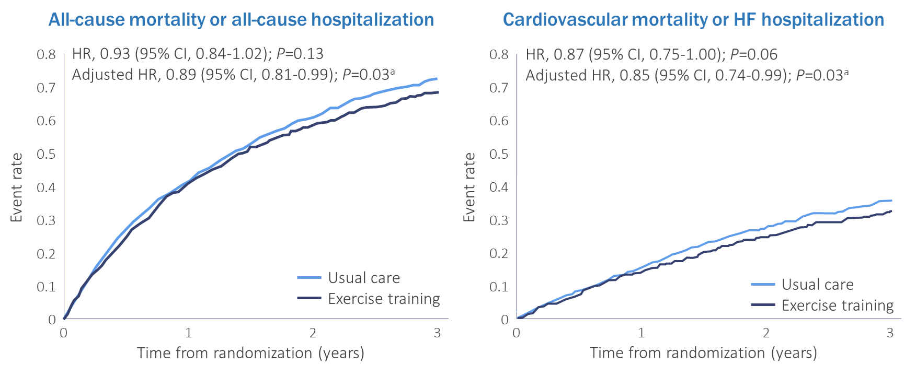
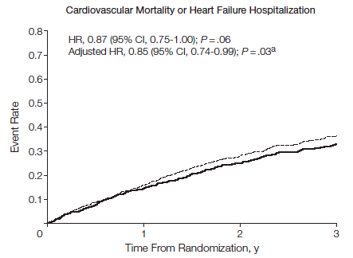
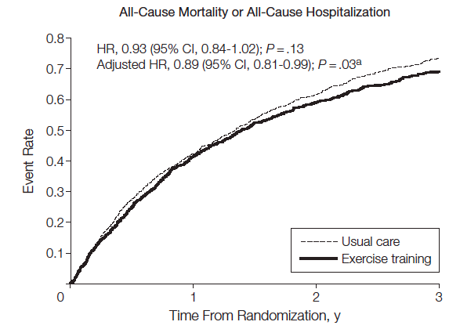
HF-ACTION
HF-ACTION, Heart Failure: A Controlled Trial Investigating Outcomes of Exercise Training; HR, hazard ratio
Adapted from O’Connor CM. JAMA. 2009;301:1439-1450.
Notes:
Exercise training in patients with HF is safe and has numerous benefits. In a major trial of exercise and HF, exercise training was associated with a reduction in CVD mortality or hospitalizations in the exercise training group after adjustment for risk factors (1). Meta-analyses show
that cardiac rehabilitation improves functional capacity, exercise duration, and health-related QOL.
Multicenter, randomized controlled trial of 2331 medically stable outpatients with HFrEF ; Median follow-up was 30 months
O'Connor CM, Whellan DJ, Lee KL, Keteyian SJ, Cooper LS, Ellis SJ, Leifer ES, Kraus WE, Kitzman DW, Blumenthal JA, Rendall DS, Miller NH, Fleg JL, Schulman KA, McKelvie RS, Zannad F, Piña IL; HF-ACTION Investigators. Efficacy and safety of exercise training in patients with chronic heart failure: HF-ACTION randomized controlled trial. JAMA. 2009 Apr 8;301(14):1439-50. doi: 10.1001/jama.2009.454. PMID: 19351941; PMCID: PMC2916661.

Slide 24
Guidelines: Exercise in HF
Class I
For patients with HF who are able to participate, exercise training (or regular physical activity) is recommended to improve functional status, exercise performance, and QOL (LOE: A)
Class IIa
In patients with HF, a cardiac rehabilitation program can be useful to improve functional capacity, exercise tolerance, and health-related QOL (LOE: B-NR)
B-NR, level B, nonrandomized; QOL, quality of life
Heidenreich PA. J Am Coll Cardiol. 2022;79:e263-e421.

Slide 25
Clinical Pearls
Moderate sodium restriction is reasonable
Exercise is recommended
Fluid restriction is not associated with any improved metric in heart failure
Notes:
#Pearl 1
#Pearl 2
#Pearl 3

Slide 26
HFrEF Guidelines

Slide 27
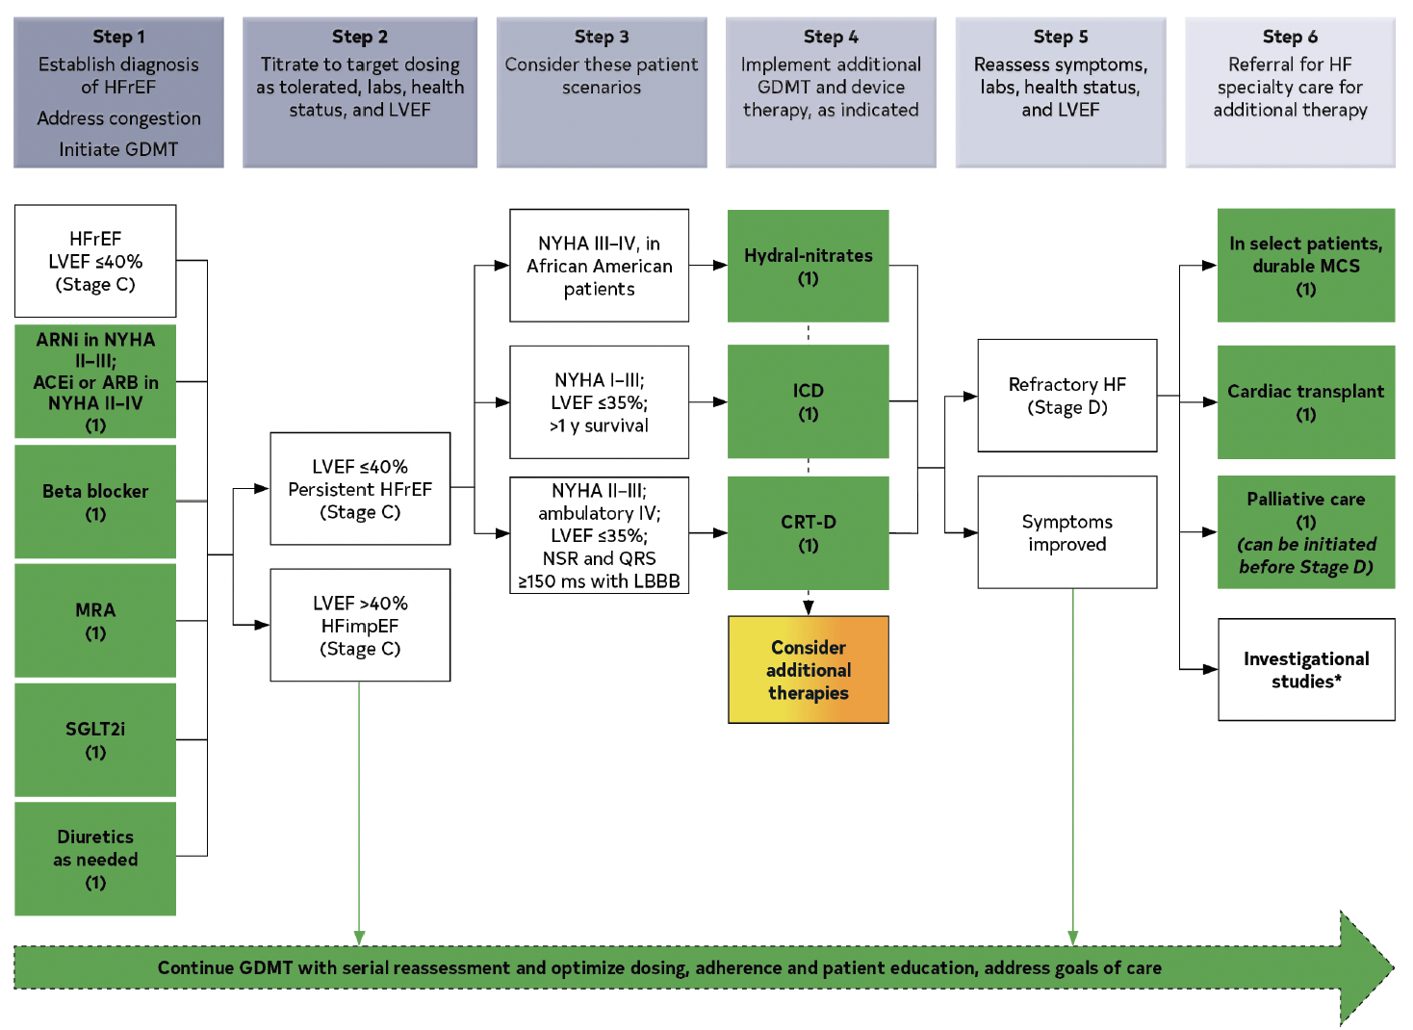
Guidelines for Symptomatic HFrEF Management
Step 1
Establish diagnosis of HFrEF, address congestion, initiate GDMT
Step 2
Titrate to target dosing as tolerated, labs, health status, and LVEF
Step 3
Consider these patient scenarios
Step 4
Implement additional GDMT and device therapy as indicated
Step 5
Reassess symptoms, labs, health status, and LVEF
Step 6
Referral for HF specialty care for additional therapy
HFrEF
LVEF ≤40% (Stage C)
NYHA III-IV in Black patients
Hydral-nitrates (1)
In select patients,
durable MCS (1)
ARNi in NYHA II-III; ACEi
or ARB in NYHA II-IV (1)
NYHA I-III; LVEF ≤35%;
>1 year survival
ICD (1)
Refractory HF (Stage D)
Cardiac transplant (1)
LVEF ≤40%
Persistent HFrEF (Stage C)
Beta-blocker (1)
Palliative care (1) (can be initiated before Stage D)
NYHA II-III; ambulatory IV; LVEF ≤35%; NSR and QRS ≥150 ms with LBBB
CRT-D (1)
Symptoms improved
MRA (1)
Investigational studies (clinical trials not
universally available)
LVEF >40%
HFimpEF (Stage C)
Consider additional therapies
SGLT2i (1)
Diuretics as needed (1)
Continue GDMT with serial reassessment and optimize dosing, adherence, and patient education, address goals of care
(1) Indicates class 1 (strong) guideline recommendation; ACEi, angiotensin-converting enzyme inhibitor; ARB, angiotensin receptor blocker; ARNi, angiotensin receptor/neprilysin inhibitor; CRT-D, cardiac resynchronization therapy with defibrillation; GDMT, guideline-directed medical therapy; HFimpEF, heart failure with improved ejection fraction; ICD, implantable defibrillator; LBBB, left bundle branch block; LVEF, left ventricular ejection fraction; MCS, mechanical circulatory support; MRA, mineralocorticoid receptor antagonist; NSR, normal sinus rhythm; SGLT2i, sodium-glucose cotransporter-2 inhibitor
Adapted from Heidenreich PA. J Am Coll Cardiol. 2022;79: e263-e421.

Slide 28
Evidence to Support an ACE Inhibitor in HFrEF
Analysis of 32 trials of ACE inhibitors in patients with symptomatic heart failure
(ACE inhibitor n=3,870; placebo n=3,235)
Total Mortality
Death or Hospitalization
CHF Hospitalization
10
0
-10
-20
Risk of Mortality (%)
−23%
-23%
OR, 0.77 (0.67-0.88);
P<0.001
-35%
OR, 0.65 (0.57-0.74);
P<0.001
-31%
OR, 0.69 (0.58-0.83),
P<0.001
-30
OR 0.77 (0.67–0.88),
p<0.001
−31%
-40
−35%
OR, 0.69 (0.58–0.83),
p<0.001
-50
-60
OR, 0.65 (0.57–0.74),
p<0.001
Adapted from Garg R et al. JAMA. 1995;273(18):1450-1456.

Slide 29
Evidence to Support an ARB in HFrEF
2,028 patients with symptomatic HFrEF not receiving an ACE inhibitor because of prior intolerance randomized to candesartan or placebo for a median of 33.7 months (CHARM-Alternative trial)
50
406 (40.0%)
40
334 (33.0%)
30
Proportion with CV death
or CHF hospitalization (%)
20
10
HR, 0.77 (95% CI, 0.67-0.89); P=0.0004
0
0
1
2
3
3.5
Years
CHF, congestive heart failure; CV, cardiovascular
Adapted from Granger CB et al. Lancet. 2003;362:772-776.

Slide 30
PARADIGM-HF Trial
8,442 patients with NYHA class II-IV HFrEF (left ventricular ejection fraction ≤40%) randomized to sacubitril/valsartan or enalapril for a median of 27 months
1.0
1.0
0.6
0.6
Sacubitril/valsartan
Enalapril
0.5
0.5
0.4
117 events (26.5%)
CV Death or HF Hospitalization (%)
Sacubitril/Valsartan
Enalapril
CV death or HF hospitalization (%)
0.4
1,117 events (26.5%)
0.3
0.3
914 events (21.8%)
0.2
914 events (21.8%)
0.2
0.1
Number needed to treat = 21
0
HR 0.80 (95% CI, 0.73–0.87), p<0.001
0.1
Number needed to treat=21
HR, 0.80 (95% CI, 0.73-0.87); P<0.001
0
180
360
540
720
900
1080
1260
0
Days since Randomization
0
180
360
540
720
900
1,080
1,260
Days since randomization
CV, cardiovascular; HR, hazard ratio; PARADIGM-HF, Prospective comparison of ARNi [angiotensin receptor–neprilysin inhibitor] with ACEi [angiotensin-converting–enzyme inhibitor] to Determine Impact on Global Mortality and Morbidity in Heart Failure Trial
Adapted from McMurray JJV. N Engl J Med. 2014;371:993-1004.
Notes:
In the Paradigm trial we saw an improvement in the primary endpoint of CV death, HHF when an ARNI was compared to the ACEI enalapril in patients with an EF </= 40%.

Slide 31
Evidence to Support a β-Blocker in HFrEF
  US carvedilol study¹
Carvedilol
(n=696)
  CIBIS II²
1.0
1.0
Bisoprolol
(n=1,327)
0.8
0.8
Survival
Placebo
(n=398)
Survival
Risk reduction=65%
P<0.001
Risk reduction=34%
P<0.0001
Placebo
(n=1,320)
0.6
0.6
0
0
0
3
6
9
12
0
200
400
600
800
Months
Time after inclusion (days)
  MERIT-HF³
  COPERNICUS⁴
1.0
Metoprolol CR/XL
(n=1,990)
1.0
Carvedilol
(n=1,156)
0.8
0.8
Survival
Placebo
(n=2,001)
Survival
0.6
Risk reduction=34%
P=0.0062
0.6
Risk reduction=35%
P=0.0014
Placebo
(n=1,133)
0
0
0
3
6
9
12
15
18
21
0
3
6
9
12
15
18
21
Months of follow-up
Months
Adapted from: 1. Packer M et al. N Engl J Med. 1996;334:1349-1355. 2. CIBIS II Investigators. Lancet. 1999;353:9-13. 3. MERIT-HF Study Group. Lancet. 1999;353:2001-2007. 4. Krum H et al. Am Heart J. 2006;151:55-61.

Slide 32
Evidence to Support an MRA in HFrEF
  RALES
  (Severe HFrEF)
  30% risk reduction
  EPHESUS
  (Post-MI)
  15% risk reduction
  EMPHASIS-HF
  (Mild HFrEF)
  22% risk reduction
1.00
0.90
0.80
Probability of survival
0.70
0.60
RR, 0.70
P<0.001
RR, 0.85
P<0.008
RR, 0.78
P=0.014
0.50
0.40
0
12
24
36
0
12
24
36
0
12
24
36
Months
Months
Months
Placebo
Spironolactone
Eplerenone
Adapted from: 1. Pitt B et al. N Engl J Med. 1999;341:709-717. 2. Pitt B et al. N Engl J Med. 2003;348:1309-1321. 3. Zannad F et al. N Engl J Med. 2011;364:11-21.

Slide 33
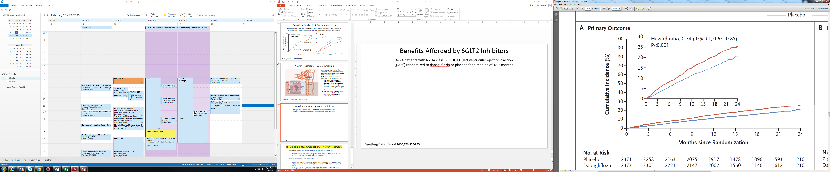
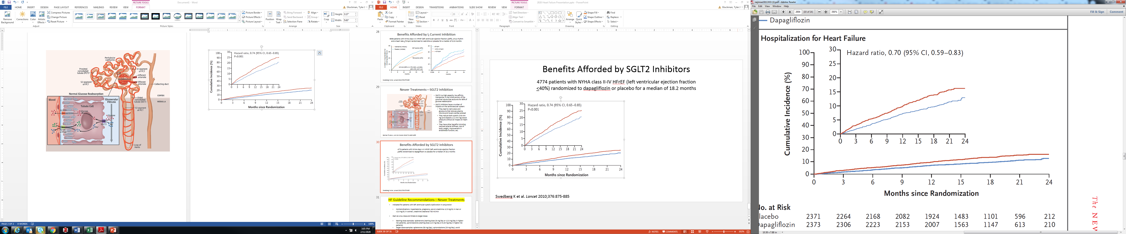
DAPA-HF: T2DM NOT Required
Worsening for Heart Failure or CV Death
26%
4,744 patients with NYHA class II-IV HFrEF (left ventricular ejection fraction ≤40%) 11% ARNi; eGFR >30 mL/min/1.73 m²
Hospitalization for Heart Failure
Worsening for heart failure or CV death
Hospitalization for heart failure
30%
30
Placebo
Dapagliflozin
30
Placebo
Dapagliflozin
25
25
20
20
Cumulative incidence (%)
Cumulative incidence (%)
15
15
26%
30%
10
10
5
HR, 0.74 (95% CI, 0.65-0.85); P<0.001
5
HR, 0.70 (95% CI, 0.59-0.83)
0
0
0
3
6
9
12
15
18
21
24
0
3
6
9
12
15
18
21
24
Months since randomization
Months since randomization
eGFR, estimated glomerular filtration rate; T2DM, type 2 diabetes mellitus
Adapted from McMurray JJV. N Engl J Med. 2019;381:1995-2008.
Notes:
McMurray JJV. Dapagliflozin in patients with heart failure and reduced ejection fraction. N Engl J Med 2019;381:1995-2008.

Slide 34
Quadruple Therapy for Heart Failure and Mortality Benefits
 | Relative risk reduction | 2-year mortality
None |  | 35%
ARNi | 28% | 25%
+β-blocker | 35% | 16%
+MRA | 30% | 12%
+SGLT2i | 17% | 10%
Quadruple treatment | 73% | 10%
ARNi, angiotensin receptor-neprilysin inhibitor; SGLT2i, sodium-glucose cotransporter-2 inhibitor
Bassi NS. JAMA Cardiol. 2020;5:948-951.
Notes:
To quantify the projected gains for deaths prevented or postponed with comprehensive implementation of SGLT2-i therapy for patients with HFrEF in the United States.
Bassi NS, et al. Association of Optimal Implementation of Sodium-Glucose Cotransporter 2 Inhibitor Therapy With Outcome for Patients With Heart Failure. JAMA Cardiol. 2020;5(8):948-951

Slide 35
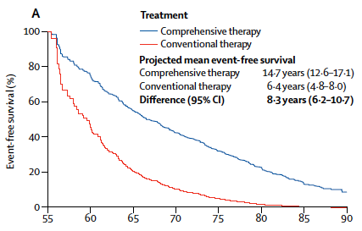

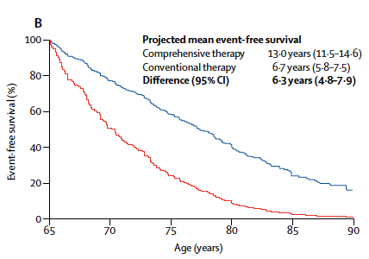
New Era in HF: β-Blocker, ARNi, MRA + SGLT2i
At age 55 years
At age 55 years
At age 65 years
100
100
80
Comprehensive therapy
Conventional therapy
80
Comprehensive therapy
Conventional therapy
60
60
At age 65 years
Event-free survival (%)
Event-free survival (%)
40
40
20
20
0
0
55
60
65
70
75
80
85
90
65
70
75
80
85
90
Age (years)
Age (years)
Projected mean event-free survival
Comprehensive therapy | 14.7 years (12.6-17.1)
Conventional therapy | 6.4 years (4.8-8.0)
Difference (95% CI) | 8.3 years (6.2-10.7)
Projected mean event-free survival
Comprehensive therapy | 13.0 years (11.5-14.6)
Conventional therapy | 6.7 years (5.8-7.5)
Difference (95% CI) | 6.3 years (4.8-7.9)
Adapted from Vaduganathan M. Lancet. 2020;396:121-128.
Notes:
We estimated that comprehensive disease-modifying pharmacological therapy (consisting of an ARNI, β blocker, MRA, and SGLT2 inhibitor) reduces the hazard of cardiovascular death or hospital admission for heart failure significantly compared with conventional therapy (consisting of an angiotensin-converting enzyme [ACE] inhibitor or angiotensin receptor blocker [ARB and β blocker).

Slide 36
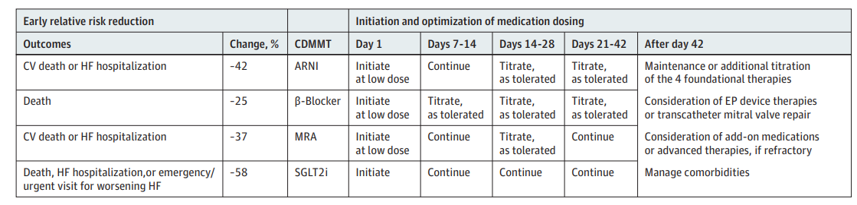
Quadruple Therapy for Heart Failure:
Where to Start
 | Early relative risk reduction |  | Initiation and optimization of medication dosing
CDMMT | Outcomes | Change, % | Day 1 | Days 7-14 | Days 14-28 | Days 21-42 | After 42 days
ARNi | CV death or HF hospitalization | -42 | Initiate at low dose | Continue | Titrate, as tolerated | Titrate, as tolerated | Maintain or additionally titrate 1 of the 4 foundational therapies Consider EP device therapies or transcatheter mitral valve repair Consider add-on medications or advanced therapies if refractory Manage comorbidities
β-blocker | Death | -25 | Initiate at low dose | Titrate, as tolerated | Titrate, as tolerated | Titrate, as tolerated
MRA | CV death or HF hospitalization | -37 | Initiate at low dose | Continue | Titrate, as tolerated | Continue
SGLT2i | Death, HF hospitalization, or emergency/urgent visit for worsening HF | -58 | Initiate | Continue | Continue | Continue
CDMMT, comprehensive disease-modifying medical therapy; EP, electrophysiologic
Adapted from Greene SJ. JAMA Cardiology. 2021;6:743-744.
Notes:
Greene SJ, Butler J, Fonarow GC. Simultaneous or Rapid Sequence Initiation of Quadruple Medical Therapy for Heart Failure-Optimizing Therapy With the Need for Speed. JAMA Cardiol. 2021 Jul 1;6(7):743-744. doi: 10.1001/jamacardio.2021.0496. PMID: 33787823.

Slide 37
Benefits of Hydralazine + Nitrate (A-Heft)
All-cause mortality (%)
First HF
hospitalization (%)
Patient-reported
QOL status
15
43%
30
33%
0
24.4
n=518
n=532
10.2
-2
10
6.2
20
-4
16.4
5
-6
n=32
n=54
n=85
n=130
0
10
-8
P=0.012
P<0.001
P<0.01
Hydralazine/nitrate + standard therapies
Placebo + standard therapies
A-HeFT, African-American Heart Failure Trial, QOL, quality of life
Taylor AL. N Engl J Med. 2004;351(20):2049-2057.
Notes:
1050 African American patients with NYHA class III/IV HFrEF randomized to hydralazine/nitrate or placebo for a mean of 10 months* (A-HeFT Trial)
43 percent reduction in the rate of death from any cause [hazard ratio, 0.57; P=0.01
33 percent relative reduction in the rate of first hospitalization for heart failure [16.4 percent vs. 22.4 percent, P=0.001]
improvement in the quality of life [change in score, –5.6±20.6 vs. –2.7±21.2, with lower scores indicating better quality of life; P=0.02; range of possible values, 0 to 105]
If fixed-dose combination is available, the initial dose should be 1 tablet (containing 37.5 mg of hydralazine hydrochloride and 20 mg of isosorbide dinitrate) 3 times daily
If the two drugs are used separately, both pills should be administered at least 3 times daily
Target daily dose: hydralazine hydrochloride (225 mg/day) and isosorbide dinitrate (120 mg/day
Two RCTs, V-HeFT I (Vasodilator Heart Failure Trial) and A-HeFT (African-American Heart Failure Trial), established benefit of the combination of hydralazine-isosorbide dinitrate in self-identified African Americans.

Slide 38
Practical Tips
Work on the 4 pillars of heart failure FIRST: β-blockers, ARNi, MRA, and SGLT2i.
Increase dosing to the highest attainable for the patient.
If blood pressure is still >130/80 mm Hg or if symptoms persist, consider additional therapies.

Slide 39
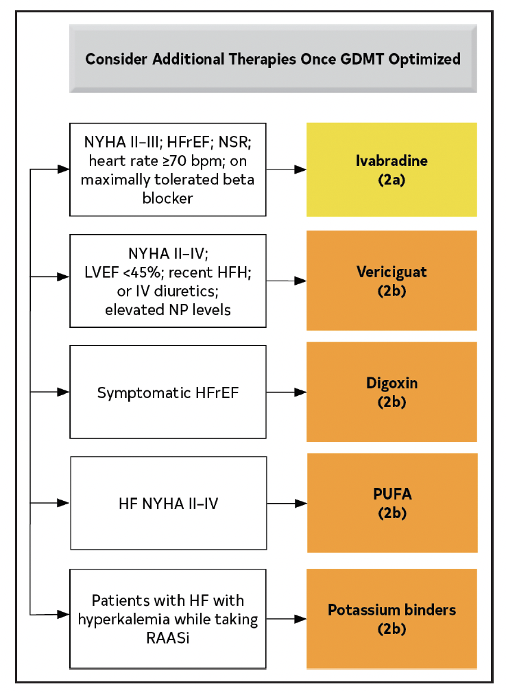
HFrEF (≤40%) Additional Therapies
Consider additional therapies once GDMT is optimized
NYHA II-III; HFrEF; NSR; HR ≥70 bpm; on maximally tolerated β-blocker
Ivabradine (2a)
NYHA II-IV; LVEF <45%; recent HFH; or IV diuretics; elevated NP levels
Vericiguat (2b)
Symptomatic HFrEF
Digoxin (2b)
HF NYHA II-IV
PUFA (2b)
Patients with HF with hyperkalemia while taking RAASi
Potassium binders (2b)
(2a) indicates moderate-strength guideline recommendation (defined as is reasonable; can be useful/effective/beneficial); (2b) indicates weak-strength guideline recommendation; HFH, heart failure hospitalization; HR, heart rate; PUFA, polyunsaturated fatty acids; RAASi, renin-angiotensin-aldosterone system inhibitors
Adapted from Heidenreich PA. J Am Coll Cardiol. 2022;79:e263-e421.

Slide 40
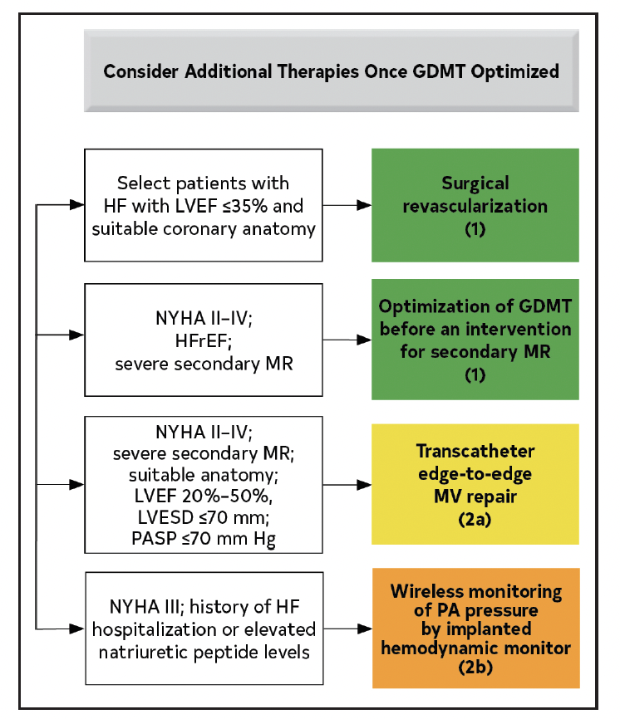
HFrEF (≤40%) Additional Therapies
Consider additional therapies once GDMT is optimized
Select patients with HF with LVEF ≤35% and suitable coronary anatomy
Surgical revascularization (1)
NYHA II-IV; HFrEF; severe secondary MR
Optimization of GDMT before an intervention for secondary MR (1)
NYHA II-IV; severe secondary MR; suitable anatomy; LVEF 20%-50%, LVESD ≤70 mm; PASP ≤70 mm Hg
Transcatheter edge-to-edge MV repair (2a)
NYHA III; history of HF hospitalization or elevated natriuretic peptide levels
Wireless monitoring of PA pressure by implanted hemodynamic monitor (2b)
(2a) indicates moderate-strength guideline recommendation (defined as is reasonable; can be useful/effective/beneficial); (2b) indicates weak-strength guideline recommendation; MV, mitral valve; LVESD, left ventricular end-systolic diameter; PA, pulmonary artery; PASP, pulmonary arterial systolic pressure
Adapted from Heidenreich PA. J Am Coll Cardiol. 2022;79:e263-e421.

Slide 41
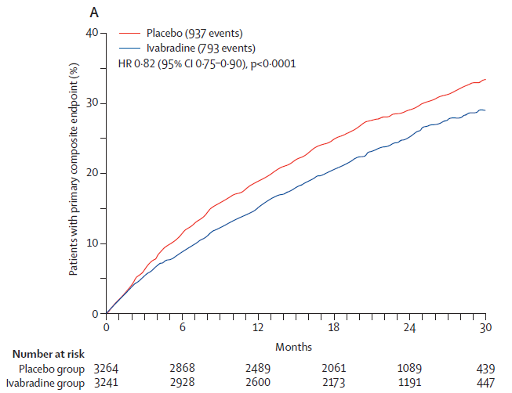
SHIFT (Ivabradine)
40
Placebo (937 events)
Ivabradine (793 events)
30
Patients with primary composite end point (%)
20
10
HR, 0.82 (95% CI 0.75-0.90); P<0.0001
0
0
6
12
18
24
30
Number at risk
Placebo group | 3,264 | 2,868 | 2,489 | 2,061 | 1,089 | 439
Ivabradine group | 3,241 | 2,928 | 2,600 | 2,173 | 1,191 | 447
Months
SHIFT, Ivabradine and Outcomes in Chronic Heart Failure
Adapted from Swedberg. Lancet. 2010;376(9744):875-885.
Notes:
Blocks I_{f} channel
Slows heart rate
Few if any other CV effects
> 6500 HF patients (NYHA II-IV)
LVEF < 35%
Resting HR > 70 BPM in SINUS
had been admitted to hospital for heart failure within the previous year
Primary endpoint: composite of CV death/HF hospitalization
On maximally tolerated beta-blocker
The effect was driven mainly by hospital admissions for worsening heart failure, which occurred in 672 (21%) of patients on placebo and 514 (16%) of those taking ivabradine (HR 0·74, 95% CI 0·66–0·83, p<0·0001; figure 3). Cardiovascular deaths were not significantly reduced in the ivabradine group (p=0·128; figure 3), but deaths due to heart failure did fall significantly (HR 0·74, 95% CI 0·58–0·94, p=0·014; figure 4). All-cause deaths did not differ between groups, but all-cause hospital admissions were significantly reduced (HR 0·89, 95% CI 0·82–0·96, p=0·003). There was no difference in other cause-specific deaths, including sudden cardiac deaths (48% of cardiovascular deaths).

Slide 42
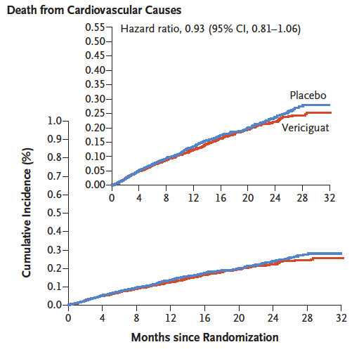
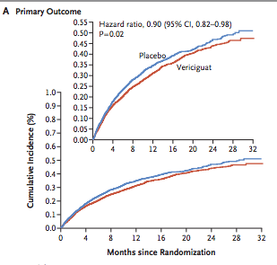
VICTORIA
5,050 patients with NYHA class II-IV HFrEF (<45%) with prior HHF or HF hospitalization or outpatient diuretic therapy for HF within 3 months randomized to vericiguat or placebo
CV death or hospitalization for HF
CV death
CV Death
0.50
Placebo
Vericiguat
0.50
Placebo
Vericiguat
CV Death or Hospitalization for Heart Failure
0.40
0.40
0.30
0.30
Cumulative incidence (%)
Cumulative incidence (%)
0.20
0.20
0.10
HR, 0.90 (95% CI, 0.85-0.98); P=0.02
0.10
HR, 0.93 (95% CI, 0.81-1.06)
0.00
0.00
0
4
8
12
12
20
24
28
32
0
4
8
12
12
20
24
28
32
Months since randomization
Months since randomization
HR, hazard ratio; VICTORIA, Vericiguat Global Study in Subjects with Heart Failure with Reduced Ejection Fraction
Adapted from Armstrong PW et al. N Engl J Med. 2020;382:1883-1893.
Notes:
In the VICTORIA trial, vericiguat was added to GDMT in patients with an EF <45% and a recent hospitalization. We saw an improvement in the composite outcome of CV death or HHF but no difference in CV death as a single endpoint. NNT = 24 to prevent a hospitalization/death
n a sub-analysis of the VICTORIA study, patients with an NT-proBNP level <8,000 pg/mL demonstrated greater reductions in HHF and CV death, combined and separately, than patients with NT-proBNP levels >8,000 pg/mL; Patients with NT-proBNP levels <4,000 pg/mL demonstrated the greatest benefit in these endpoints. These data indicates that measuring NT-proBNP might identify patients who would benefit most from vericiguat, allowing for individualized treatment.
Vericiguat fits into our HF armamentarium after ARNI, Beta-blocker, MRA and SGLT2 in that high-risk group of patients with recent hospitalization.
It does also fill a niche role in the EF 40-45% population probably after SGLT2i and MRA
The other group I consider this medication in frequently is that patient with significant renal dysfunction and/or hyperkalemia limiting other therapies such as ARNI/ACEI/ARB/MRA.
Symptomatic hypotension occurred in 9.1% of the patients in the vericiguat group and in 7.9% of the patients in the placebo group (P = 0.12), and syncope occurred in 4.0% of the patients in the vericiguat group and in 3.5% of the patients in the placebo group (P = 0.30)
For patients in sinus rhythm, the criteria included a BNP of at least 300 pg per milliliten or an NT-proBNP level of at least 1000 pg per milliliter. For patients in atrial fibrillation, the criteria included a BNP level of at least 500 pg per milliliter or an NT-proBNP level of at least 1600 pg per milliliter.
Exclusion criteria included a systolic blood pressure of less than 100 mm Hg; concurrent or anticipated use of long-acting nitrates, soluble guanylate cyclase stimulators, or phosphodiesterase
type 5 inhibitors; and use of intravenous inotropes or implantable left ventricular assist devices.
60% of the patients received triple therapy (a betablocker and a mineralocorticoid antagonist combined with either an angiotensin-converting– enzyme inhibitor, an angiotensin-receptor blocker,
or sacubitril–valsartan) and 15% received an angiotensin–neprilysin inhibitor.
NNT = 24 to prevent a hospitalization/death

Slide 43
HFmrEF Guidelines

Slide 44
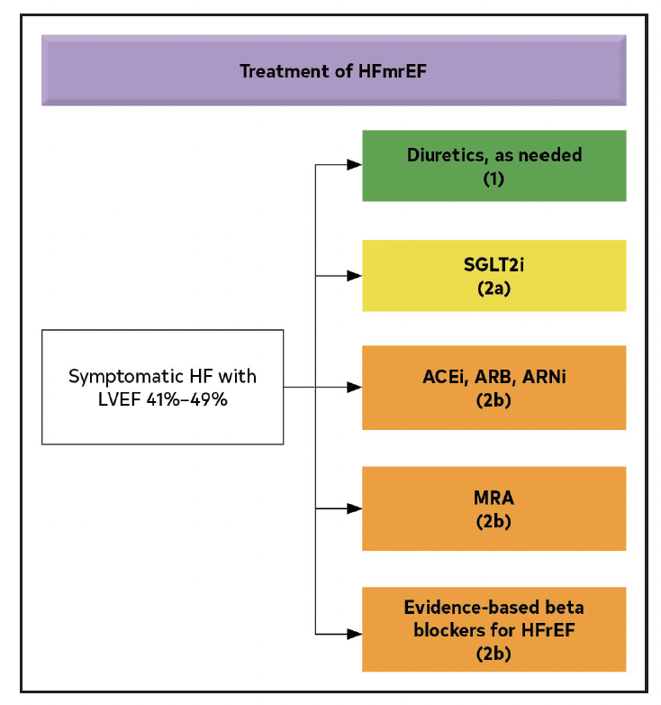
Management of HFmrEF (41%-49%)
Treatment for HFmrEF
Diuretics, as needed (1)
SGLT2i (2a)
Symptomatic HF with LVEF 41%-49%
ACEi, ARB, ARNi (2b)
MRA (2b)
Evidence-based β-blockers for HFrEF (2b)
HFmrEF, heart failure with midrange ejection fraction
Adapted from Heidenreich PA. J Am Coll Cardiol. 2022;79:e263-e421.

Slide 45
HFpEF Guidelines

Slide 46
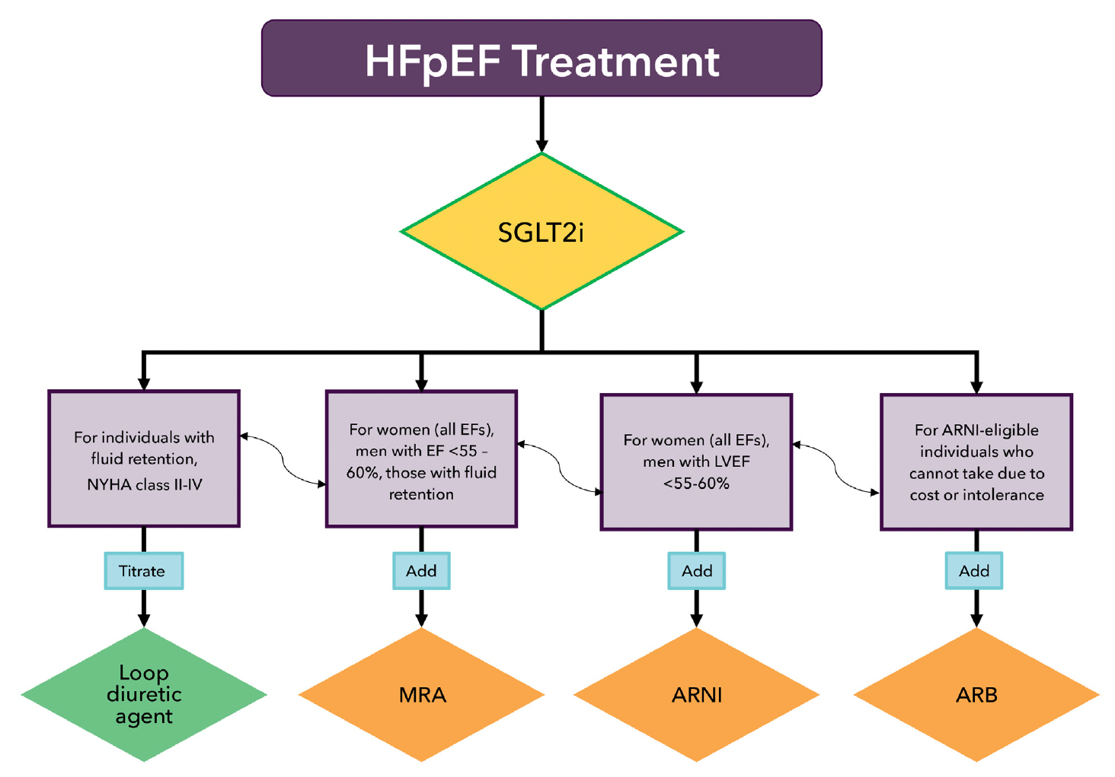
Management of HFpEF
HFpEF treatment
SGLT2i
For individuals with fluid retention, NYHA class II-IV
For women (all EFs), men with EF <55%-60%, those with fluid retention
For women (all EFs), men with LVEF
<55%-60%
For ARNi-eligible individuals who cannot take due to cost or intolerance
Titrate
Add
Add
Add
Loop diuretic agent
MRA
ARNi
ARB
ARNi, angiotensin receptor/neprilysin inhibitor; HFpEF, heart failure with preserved ejection fraction; SGLT2i, sodium-glucose cotransporter-2
Adapted from Kittleson MM. J Am Coll Cardiol. 2023;81:1835-1878.
Notes:
Kittleson MM, et al. 2023 ACC Expert Consensus Decision Pathway on Management of Heart Failure With Preserved Ejection Fraction: A Report of the American College of Cardiology Solution Set Oversight Committee. J Am Coll Cardiol. 2023;81:1835-1878 PMID: 37137593.

Slide 47
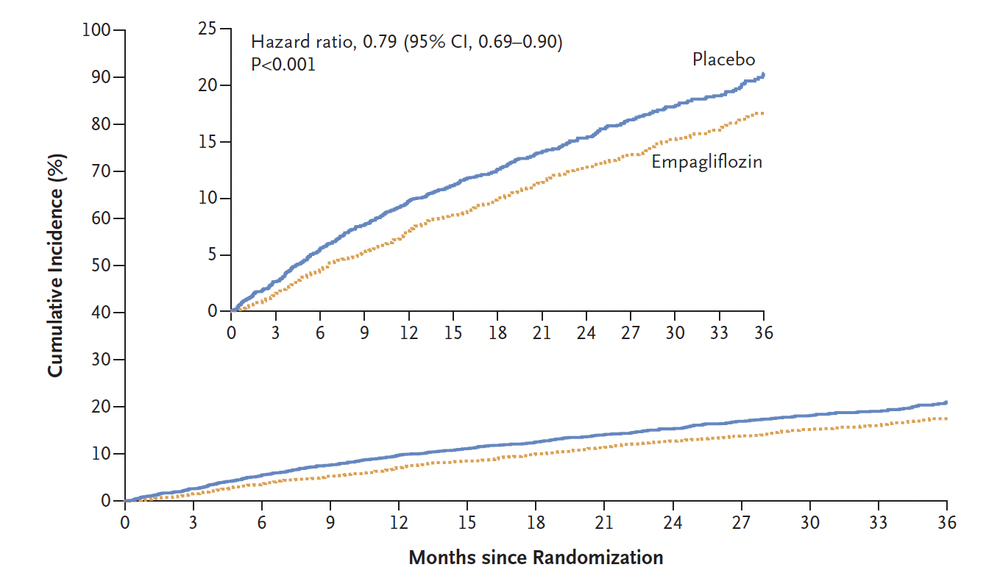
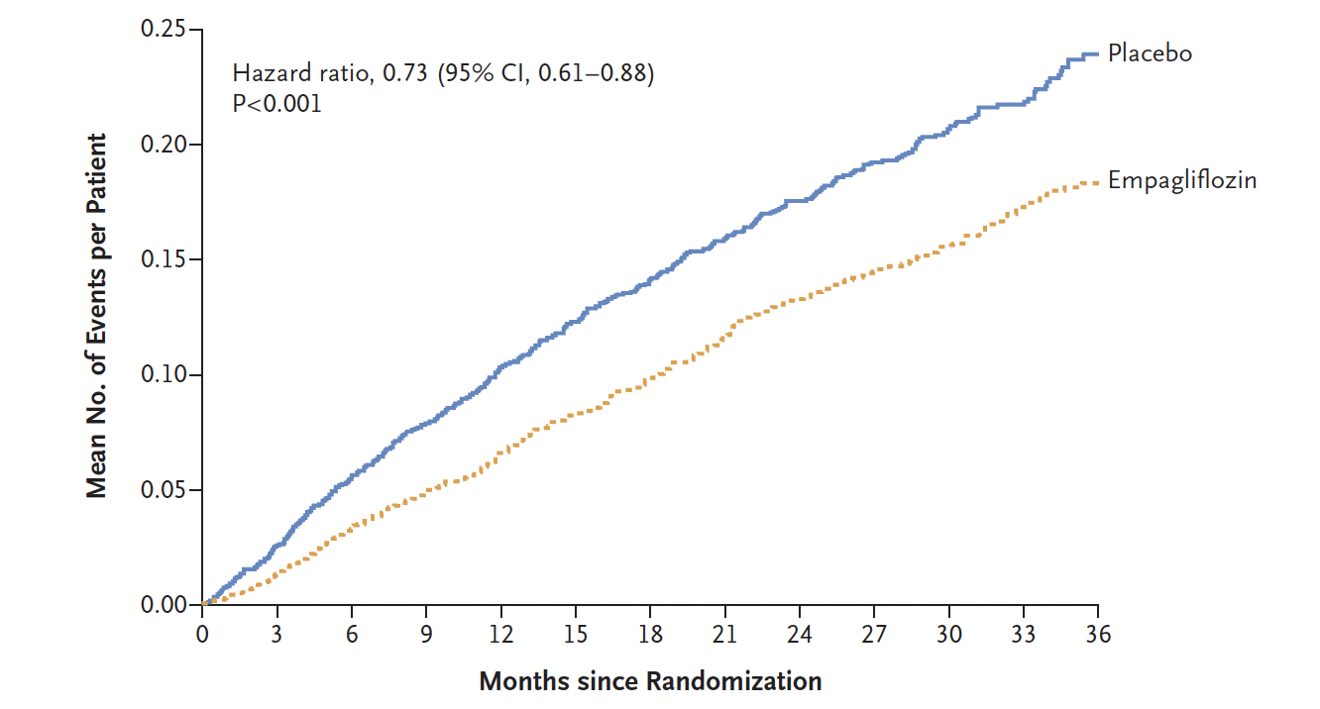
EMPEROR-Preserved
5,988 patients with HFpEF (LVEF >40%), eGFR >20 mL/min/1.73 m²
CV Death or Hospitalization for HF
CV death or hospitalization for HF
Hospitalization for HF
Hospitalization for HF
25
Placebo
Empagliflozin
0.25
Placebo
Empagliflozin
20
0.20
15
0.15
Cumulative incidence (%)
Mean no. of events per patient
10
21%
0.10
27%
5
HR, 0.79 (95% CI, 0.69-0.90); P<0.001
0.05
HR, 0.73 (95% CI, 0.61-0.88); P<0.001
0
0.00
0
6
12
18
24
30
36
0
6
12
18
24
30
36
Months since randomization
Months since randomization
EMPEROR-Preserved, Empagliflozin in Heart Failure with a Preserved Ejection Fraction; HR, hazard ratio; LVEF, left ventricular ejection fraction
Adapted from Anker SD. N Engl J Med. 2021;385:1451-1461.
Notes:
N Engl J Med 2021; 385:1451-1461

Slide 48
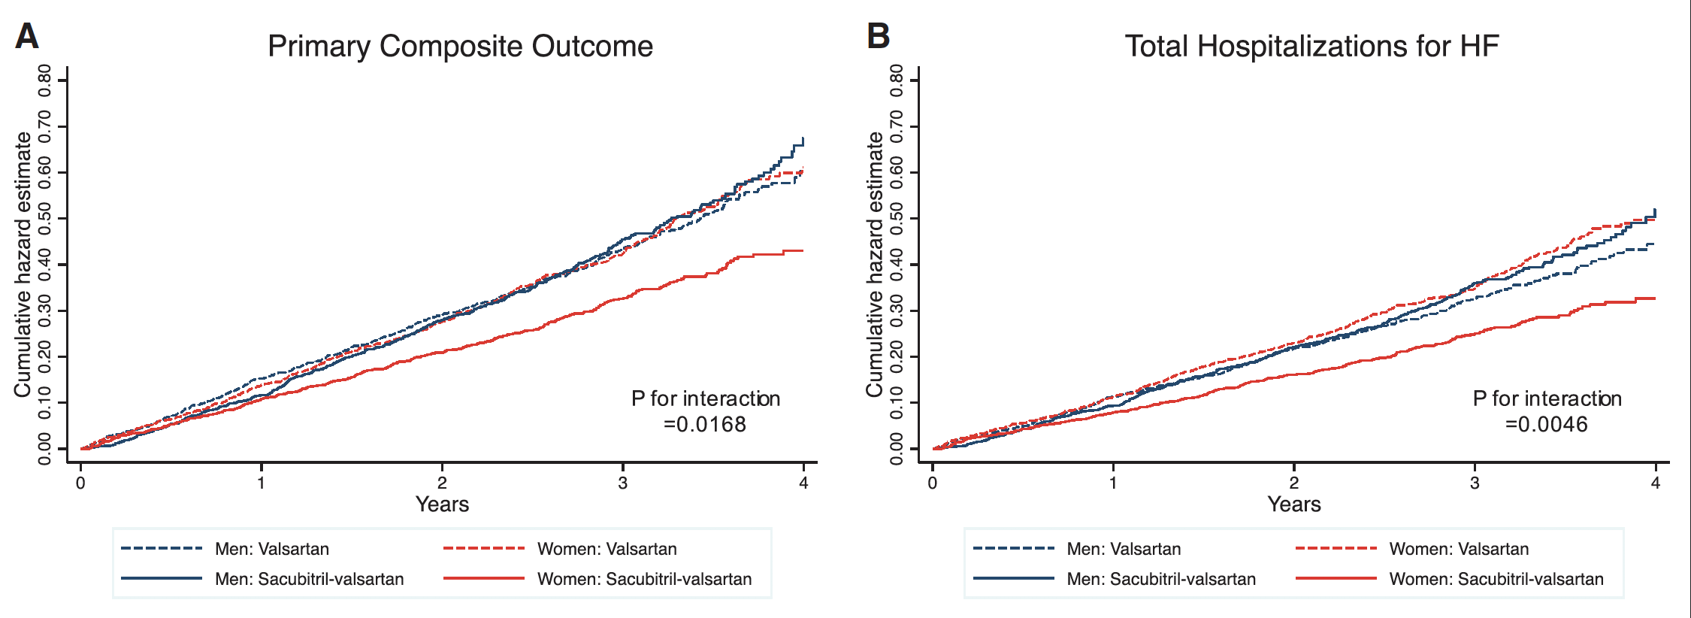
PARAGON-HF
4,822 patients with NYHA class II-IV HFpEF (left ventricular ejection fraction ≥45%)
randomized to sacubitril/valsartan or valsartan
Primary composite outcome
Total hospitalizations for HF
0.80
Women RR, 0.73 (0.59-0.90)
Men RR, 1.03 (0.84-1.25)
0.80
Women RR, 0.67 (0.53-0.85)
Men RR, 1.07 (0.85-1.34)
Women RR: 0.73 (0.59-0.90)
Men RR: 1.03 (0.84-1.25)
Women RR: 0.67 (0.53-0.85)
Men RR: 1.07 (0.85-1.34)
0.60
0.60
Cumulative hazard estimate
Cumulative hazard estimate
0.40
0.40
0.20
0.20
P for interaction=0.0168
P for interaction=0.0046
0.00
0.00
0
1
2
3
4
0
1
2
3
4
Years
Years
Men: Sacubitril/valsartan
Women: Sacubitril/valsartan
Men: Valsartan
Women: Valsartan
PARAGON-HF, Prospective Comparison of ARNi with ARB Global Outcomes in HF with Preserved Ejection Fraction; RR, relative risk
Adapted from Solomon SD. N Engl J Med. 2019;381:1609-1620.

Slide 49
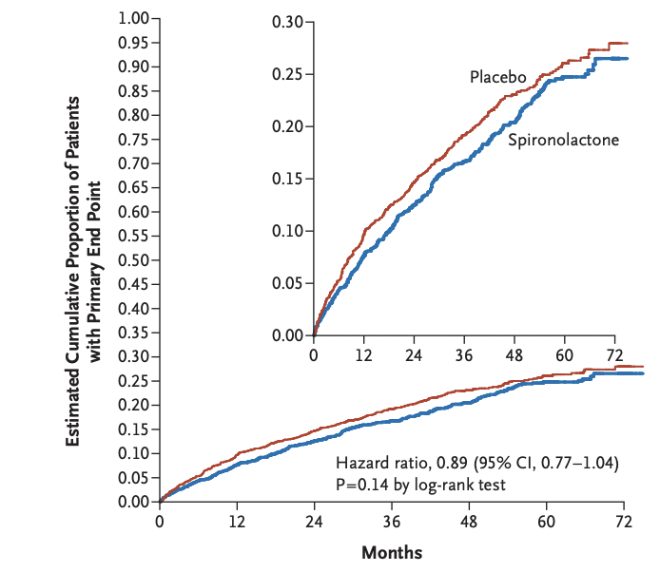
TOPCAT
3,445 patients with NYHA class II-IV HFpEF (LVEF >45%) randomly assigned to receive spironolactone or placebo for a mean of 3.3 years
CV death, aborted cardiac arrest, HHF
0.30
Placebo
Spironolactone
Estimated cumulative proportion of patients with primary end point
0.20
11%
0.10
HR, 0.89 (95% CI, 0.77-1.04); P=0.14 by log-rank test
0.00
0
12
24
36
48
60
72
Months
TOPCAT, Treatment of Preserved Cardiac Function with an Aldosterone Antagonist
Adapted from Pitt B. N Engl J Med. 2014;370:1383-1392.
Notes:
Pitt B. Spironolactone for Heart Failure with Preserved Ejection Fraction. N Engl J Med 2014;370:1383-92.
death from cardiovascular causes, aborted cardiac arrest, or hospitalization for the management of heart failure.

Slide 50
Medications for HFpEF
EMPEROR-Preserved
Empagliflozin vs placebo
CV death + HHF
HR, 0.79 (0.69-0.90; P=0.0003)
DELIVER
Dapagliflozin vs placebo
CV death + HHF
HR, 0.82 (0.73-0.92; P< 0.001)
PARAGON-HF
Sacubitril/valsartan vs valsartan
CV death + total (1st and recurrent) HHF
RR, 0.87 (0.75-1.01; P=0.06)
TOPCAT
Spironolactone vs placebo
CV death + HHF + aborted cardiac arrest
HR, 0.89 (0.77-1.04; P=0.14)
21%
13%
18%
11%
CV, cardiovascular; HHF, hospitalization for heart failure; HR, hazard ratio; RR, rate ratio

Slide 51
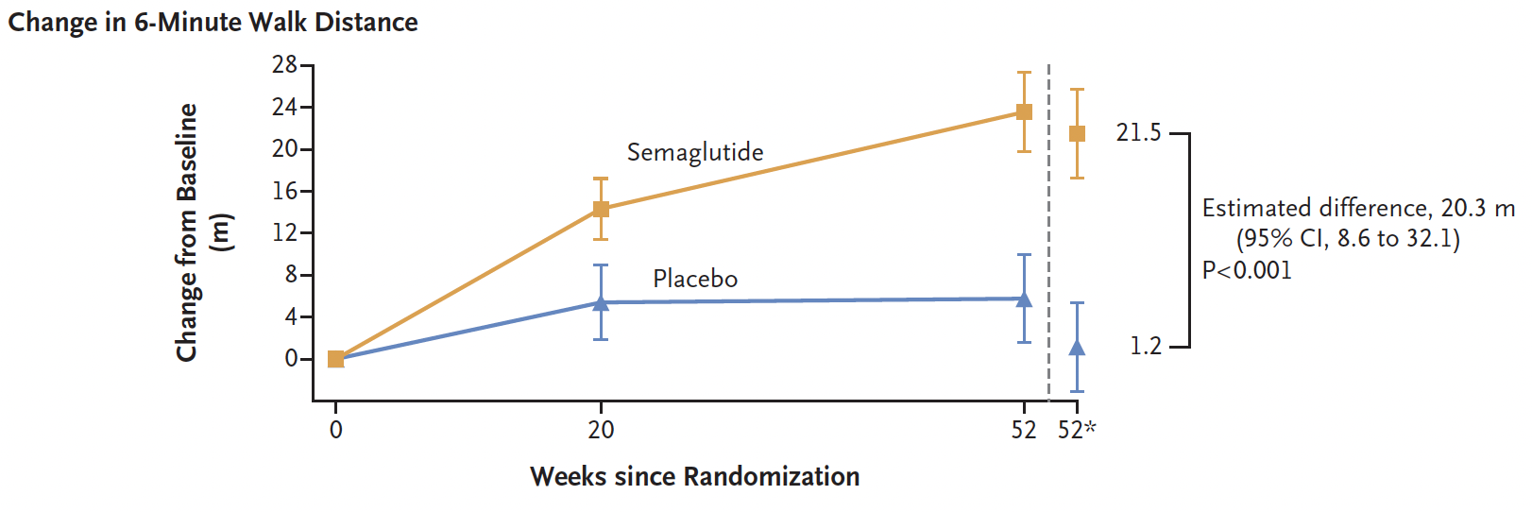
STEP HFpEF
529 patients with HFpEF (LVEF ≥45%) and BMI ≥30 kg/m² randomly assigned to receive semaglutide or placebo for 52 weeks
Change in 6-minute walk distance
28
Placebo
Semaglutide
24
20
21.5
16
Estimated difference, 20.3 m (95% CI,
8.6-32.1); P<0.001
Change from baseline (m)
12
8
4
0
1.2
0
20
52
52*
Weeks since randomization
*Week 52 data are estimated based on analysis of covariance and imputation of missing data
BMI, body mass index; STEP HFpEF, Semaglutide in Patients with Heart Failure with Preserved Ejection Fraction and Obesity
Adapted from Kosiborod MN. N Engl J Med. 2023;389:1069-1084.
Notes:
Kosiborod MN, et al. Semaglutide in Patients with Heart Failure with Preserved Ejection Fraction and Obesity. N Engl J Med. 2023 Sep 21;389(12):1069-1084. PMID: 37622681.
We randomly assigned 529 patients who had heart failure with preserved ejection fraction and a body-mass index (the weight in kilograms divided by the square of the height in meters) of 30 or higher to receive once-weekly semaglutide (2.4 mg) or placebo for 52 weeks. The dual primary end points were the change from baseline in the Kansas City Cardiomyopathy Questionnaire clinical summary score (KCCQ-CSS; scores range from 0 to 100, with higher scores indicating fewer symptoms and physical limitations) and the change in body weight. Confirmatory secondary end points included the change in the 6-minute walk distance; a hierarchical composite end point that included death, heart failure events, and differences in the change in the KCCQ-CSS and 6-minute walk distance; and the change in the C-reactive protein (CRP) level.
The mean change in the KCCQ-CSS was 16.6 points with semaglutide and 8.7 points with placebo (estimated difference, 7.8 points; 95% confidence interval [CI], 4.8 to 10.9; P<0.001), and the mean percentage change in body weight was −13.3% with semaglutide and −2.6% with placebo (estimated difference, −10.7 percentage points; 95% CI, −11.9 to −9.4; P<0.001). The mean change in the 6-minute walk distance was 21.5 m with semaglutide and 1.2 m with placebo (estimated difference, 20.3 m; 95% CI, 8.6 to 32.1; P<0.001). In the analysis of the hierarchical composite end point, semaglutide produced more wins than placebo (win ratio, 1.72; 95% CI, 1.37 to 2.15; P<0.001). The mean percentage change in the CRP level was –43.5% with semaglutide and –7.3% with placebo (estimated treatment ratio, 0.61; 95% CI, 0.51 to 0.72; P<0.001). Serious adverse events were reported in 35 participants (13.3%) in the semaglutide group and 71 (26.7%) in the placebo group.

Slide 52
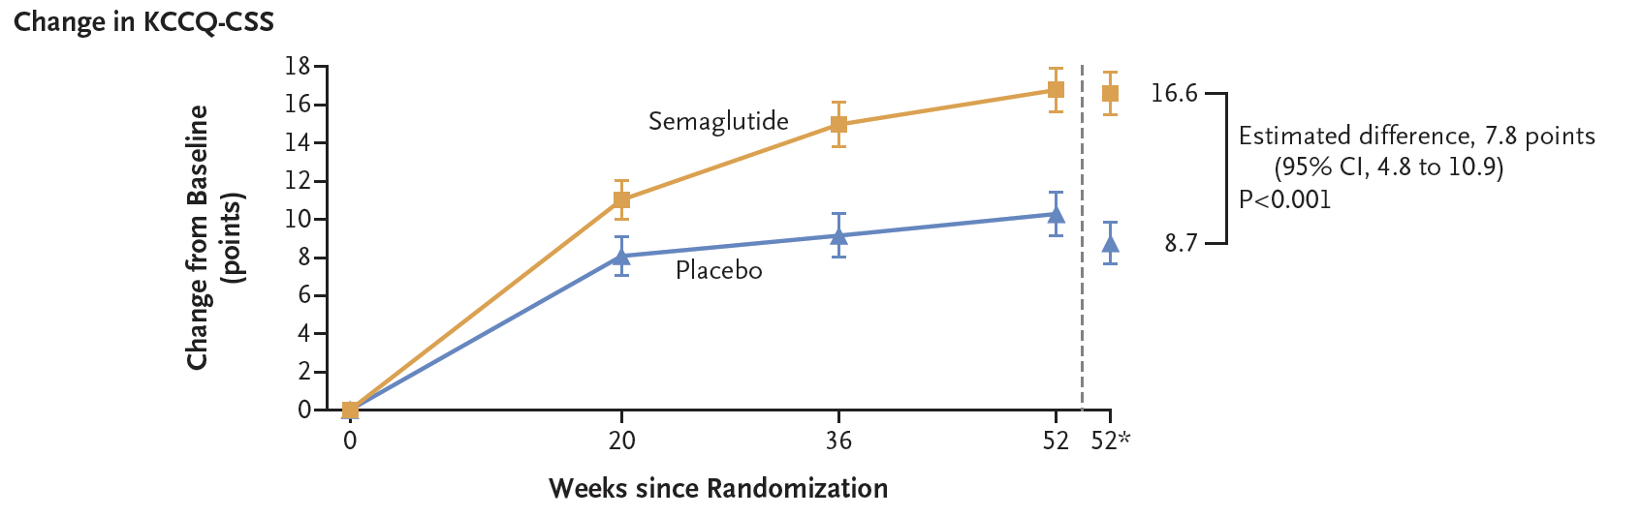
STEP HFpEF
529 patients with HFpEF (LVEF ≥45%) and BMI ≥30 kg/m² randomly assigned to receive semaglutide or placebo for 52 weeks
Change in KCCQ-CSS
18
Placebo
Semaglutide
16
16.6
14
Estimated difference, 7.8 points (95% CI,
4.8-10.9); P<0.001
12
10
8.7
Change from baseline (points)
8
6
4
2
0
0
20
36
52
52*
Weeks since randomization
*Week 52 data are estimated based on analysis of covariance and imputation of missing data
BMI, body mass index; KCCQ-CSS, Kansas City Cardiomyopathy Questionnaire-Clinical Summary Score
Adapted from Kosiborod MN. N Engl J Med. 2023;389:1069-1084.
Notes:
Kosiborod MN, et al. Semaglutide in Patients with Heart Failure with Preserved Ejection Fraction and Obesity. N Engl J Med. 2023 Sep 21;389(12):1069-1084. PMID: 37622681.
We randomly assigned 529 patients who had heart failure with preserved ejection fraction and a body-mass index (the weight in kilograms divided by the square of the height in meters) of 30 or higher to receive once-weekly semaglutide (2.4 mg) or placebo for 52 weeks. The dual primary end points were the change from baseline in the Kansas City Cardiomyopathy Questionnaire clinical summary score (KCCQ-CSS; scores range from 0 to 100, with higher scores indicating fewer symptoms and physical limitations) and the change in body weight. Confirmatory secondary end points included the change in the 6-minute walk distance; a hierarchical composite end point that included death, heart failure events, and differences in the change in the KCCQ-CSS and 6-minute walk distance; and the change in the C-reactive protein (CRP) level.
The mean change in the KCCQ-CSS was 16.6 points with semaglutide and 8.7 points with placebo (estimated difference, 7.8 points; 95% confidence interval [CI], 4.8 to 10.9; P<0.001), and the mean percentage change in body weight was −13.3% with semaglutide and −2.6% with placebo (estimated difference, −10.7 percentage points; 95% CI, −11.9 to −9.4; P<0.001). The mean change in the 6-minute walk distance was 21.5 m with semaglutide and 1.2 m with placebo (estimated difference, 20.3 m; 95% CI, 8.6 to 32.1; P<0.001). In the analysis of the hierarchical composite end point, semaglutide produced more wins than placebo (win ratio, 1.72; 95% CI, 1.37 to 2.15; P<0.001). The mean percentage change in the CRP level was –43.5% with semaglutide and –7.3% with placebo (estimated treatment ratio, 0.61; 95% CI, 0.51 to 0.72; P<0.001). Serious adverse events were reported in 35 participants (13.3%) in the semaglutide group and 71 (26.7%) in the placebo group.

Slide 53
Optimizing Care

Slide 54
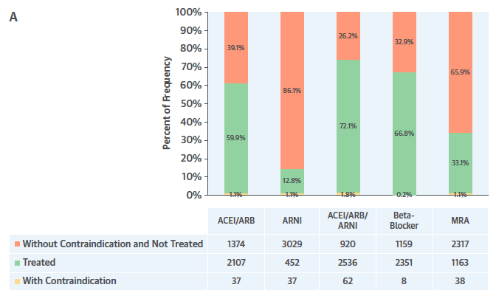
Prescription of GDMT Is Low: CHAMP-HF
100%
80%
60%
40%
20%
0%
CHAMP-HF registry
3,518 patients
29% female
Mean age: 66 years
Mean EF: 29%
Percent of frequency
⁓1% of patients in this contemporary US study were on optimal dosing of the medications known to improve outcomes in patients with HFrEF
CHAMP-HF, Change the Management of Patients with Heart Failure
Adapted from Greene SJ. J Am Coll Cardiol. 2018;72:351-366.

Slide 55
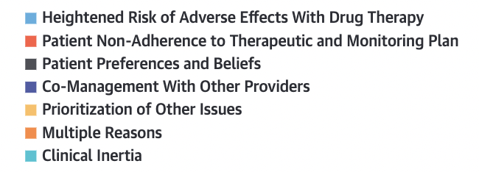
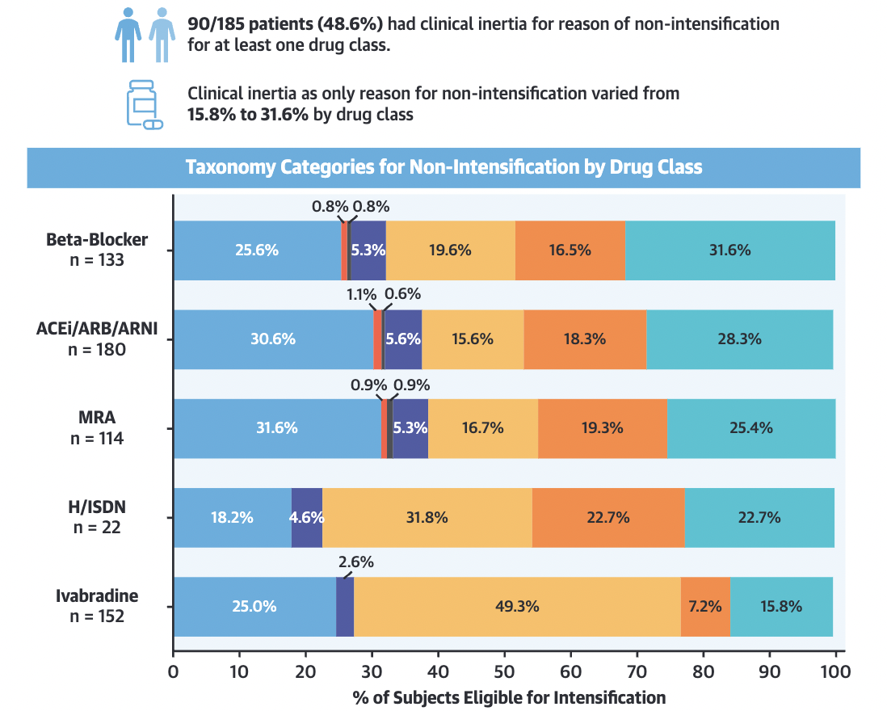
Taxonomy Categories for Nonintensification by Drug Class
90/185 patients (48.6%) had clinical inertia for reason of nonintensification for at least 1 drug class
Clinical inertia as only reason for nonintensification varied from 15.8% to 31.6% by drug class
Ivabradine
n=152
H/ISDN
n=22
MRA
n=114
ACEi/ARB/ARNi
n=180
β-blocker
n=133
0%
20%
40%
60%
80%
100%
H/ISDN, hydralazine/isosorbide dinitrate
% of subjects eligible for intensification
Adapted from Swat SA. JACC Heart Fail. 2023;11(11):1579-1591.
Notes:
Swat SA, Helmkamp LJ, Tietbohl C, Thompson JS, Fitzgerald M, McIlvennan CK, Harger G, Ho PM, Ahmad FS, Ahmad T, Buttrick P, Allen LA. Clinical Inertia Among Outpatients With Heart Failure: Application of Treatment Nonintensification Taxonomy to EPIC-HF Trial. JACC Heart Fail. 2023 Jul 31:S2213-1779(23)00375-X. doi: 10.1016/j.jchf.2023.06.022. Epub ahead of print. PMID: 37589610.

Slide 56
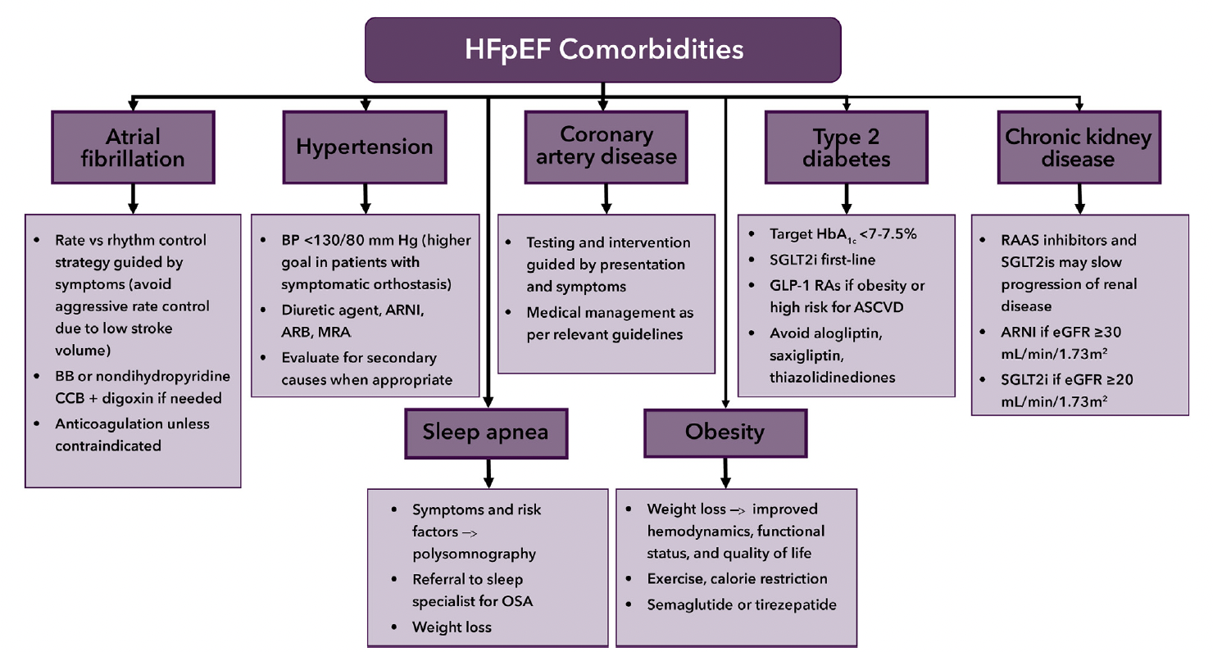
HFpEF Comorbidities
Atrial fibrillation
Obesity
Rate vs rhythm control strategy guided by symptoms (avoid aggressive rate control due to low stroke volume)
β-blocker or nondihydropyridine CCB + digoxin if needed
Anticoagulation unless contraindicated
Weight loss → improved hemodynamics, functional status, and quality of life
Exercise, calorie restriction
Semaglutide or tirzepatide
Hypertension
Type 2 diabetes mellitus
Blood pressure <130/80 mm Hg (higher goal in patients with symptomatic orthostasis)
Diuretic agent, ARNi, ARB, MRA
Evaluate for secondary causes when appropriate
Target HbA1c <7%-7.5%
SGLT2i 1st line
GLP-1 RAs if obesity or high risk for ASCVD
Avoid alogliptin, saxagliptin, thiazolidinediones
Sleep apnea
Chronic kidney disease
Symptoms and risk factors → polysomnography
Referral to sleep specialist for OSA
Weight loss
RAAS inhibitors and SGLT2is may slow progression of renal disease
ARNi if eGFR ≥30 mL/min/1.73 m²
SGLT2i if eGFR ≥20 mL/min/1.73 m²
ARB, angiotensin receptor blocker; ARNi, angiotensin receptor neprilysin inhibitor; ASCVD, atherosclerotic cardiovascular disease; CCB, calcium channel blocker; eGFR, estimated glomerular filtration rate; GLP-1 RA, glucagon-like peptide-1 receptor agonist; HbA1c, hemoglobin A1c; MRA, mineralocorticoid receptor antagonist; OSA, obstructive sleep apnea; RAAS, renin-angiotensin-aldosterone system; SGLT2i, sodium/glucose cotransporter 2 inhibitor
Coronary artery disease
Testing and intervention guided by presentation and symptoms
Medical management as per relevant guidelines
Adapted from Kittleson MM. J Am Coll Cardiol. 2023;81:1835-1878.
Notes:
Kittleson MM, et al. 2023 ACC Expert Consensus Decision Pathway on Management of Heart Failure With Preserved Ejection Fraction: A Report of the American College of Cardiology Solution Set Oversight Committee. J Am Coll Cardiol. 2023;81:1835-1878 PMID: 37137593.

Slide 57
Practical Tips
Assess GDMT at EVERY visit in EVERY patient.
If a patient is not on optimal dose, ask why.
Patient reason?
Clinician reason?

Slide 58
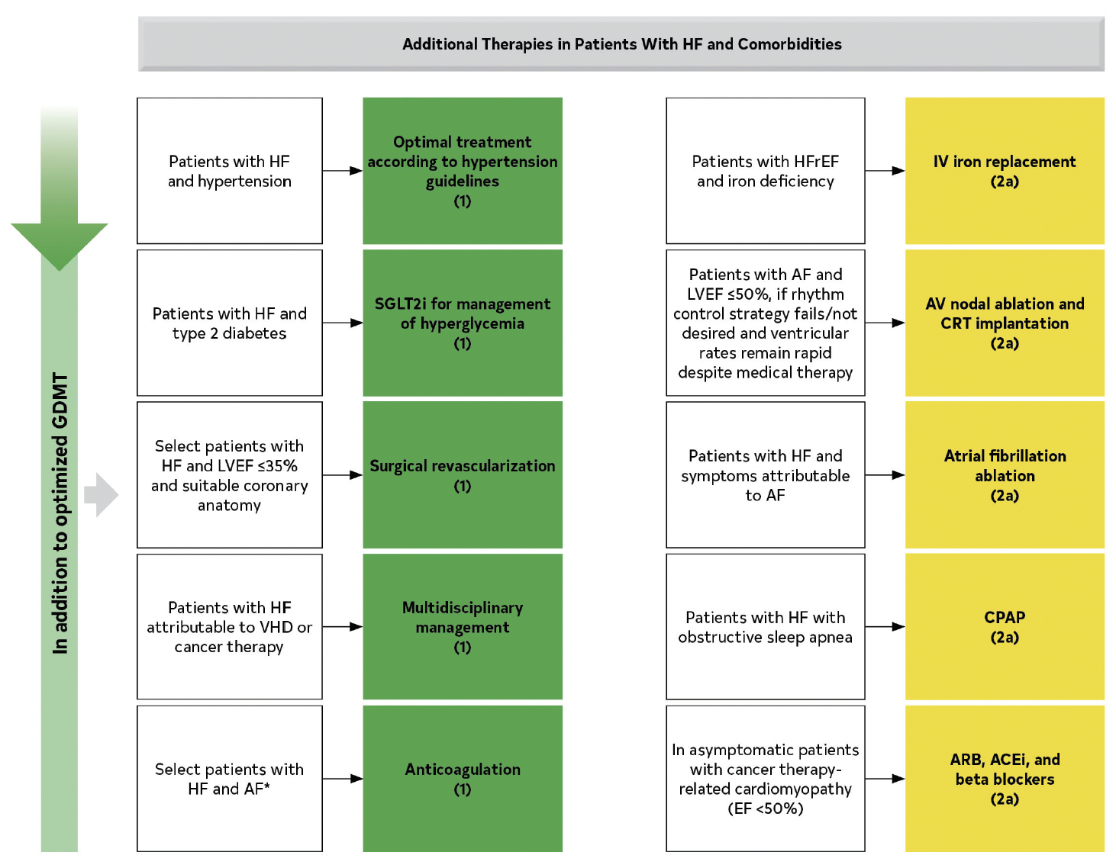
Top Takeaways from the HF Guidelines
Additional therapies in patients with HF and comorbidities
Patients with HF and hypertension
Optimal treatment according to hypertension guidelines (1)
Patients with HFrEF and iron deficiency
IV iron replacement (2a)
Patients with HF and T2DM
SGLT2i for management of hyperglycemia (1)
Patients with AF and LVEF ≤50%, if rhythm control strategy fails/not desired and ventricular rates remain rapid despite medical therapy
AV nodal ablation and CRT implantation (2a)
Select patients with HF and LVEF ≤35% and suitable coronary anatomy
Surgical revascularization (1)
Patients with HF and symptoms attributable to AF
Atrial fibrillation ablation (2a)
In addition to optimized GDMT
Patients with HF attributable to VHD or cancer therapy
Multidisciplinary management (1)
Patients with HF with obstructive sleep apnea
CPAP (2a)
Select patients with HF and AF*
Anticoagulation (1)
In asymptomatic patients with cancer therapy-related cardiomyopathy (EF <50%)
ARB, ACEi, and β-blockers (2a)
CPAP, continuous positive airway pressure; CRT, cardiac resynchronization therapy; T2DM, type 2 diabetes mellitus; VHD, valvular heart disease
Adapted from Heidenreich PA. J Am Coll Cardiol. 2022;79: e263-e421.

Slide 59
Core Quality Measures Collaborative:
Value-Based Care Metrics
Heart failure: ACEi or ARB or ARNi therapy for LVSD
Heart failure: β-blocker therapy for LVSD
Measure description: % of adults 18 years or older with heart failure with current/prior LVEF <40% who were seen in in previous 12 months and prescribed above therapy
Measure description: % of adults 18 years or older with heart failure with current/prior LVEF <40% who were seen in previous 12 months and prescribed above therapy
LVEF, left ventricular ejection fraction; LVSD, left ventricular systolic dysfunction
Partnership for Quality Measurement. Accessed 4/1/24. https://p4qm.org/sites/default/files/2023-06/CQMC-Cardiology-Core-Set-v4.0-508.pdf

Slide 60
Clinical Pearls
Set the baseline with patient: Medications will be increased regularly
Make sure patient’s diagnosis is appropriately classified as HFrEF, HFmrEF, or HFpEF
Optimize GDMT in ALL patients
Notes:
#Pearl 1
#Pearl 2
#Pearl 3

Slide 61
Treatment Monitoring

Slide 62
Example: Optimizing Follow-Up
Visit
Visit + labs
Visit
Visit
Visit
 | Early relative risk reduction
CDMMT | Outcomes | Change, % | Day 1 | Days 7-14 | Days 14-28 | Days 21-42 | After 42 days
ARNi | CV death or HF hospitalization | -42 | Initiate at low dose | Continue | Titrate, as tolerated | Titrate, as tolerated | Maintain or additionally titrate 1 of the 4 foundational therapies Consider EP device therapies or transcatheter mitral valve repair Consider add-on medications or advanced therapies if refractory Manage comorbidities
β-blocker | Death | -25 | Initiate at low dose | Titrate, as tolerated | Titrate, as tolerated | Titrate, as tolerated
MRA | CV death or HF hospitalization | -37 | Initiate at low dose | Continue | Titrate, as tolerated | Continue
SGLT2i | Death, HF hospitalization, or emergency/urgent visit for worsening HF | -58 | Initiate | Continue | Continue | Continue
Initiation and optimization of medication dosing
Visit + labs
Visit
Visit
Visit
Visit
CDMMT, comprehensive disease-modifying medical therapy; CV, cardiovascular; EP, electrophysiologic
Adapted from Greene SJ. JAMA Cardiology. 2021;6:743-744.
Notes:
Greene SJ, Butler J, Fonarow GC. Simultaneous or Rapid Sequence Initiation of Quadruple Medical Therapy for Heart Failure-Optimizing Therapy With the Need for Speed. JAMA Cardiol. 2021 Jul 1;6(7):743-744. doi: 10.1001/jamacardio.2021.0496. PMID: 33787823.

Slide 63
Heart Failure: Stages and Functional Class
ACCF/AHA stage |  | NYHA classification
A | At high risk for HF but without structural heart disease or symptoms of HF | None
B | Structural heart disease but without signs or symptoms of HF | I | No limitation of physical activity. Ordinary physical activity does not cause symptoms of HF
C | Structural heart disease with prior or current symptoms of HF | I | Same as above
 |  | II | Slight limitation of physical activity. Comfortable at rest but ordinary physical activity results in symptoms of HF
 |  | III | Marked limitation of physical activity. Comfortable at rest but less than ordinary activity causes symptoms of HF
 |  | IV | Unable to carry out any physical activity without symptoms of HF or symptoms of HF at rest
D | Refractory HF requiring specialized interventions | IV | Unable to carry out any physical activity without symptoms of HF or symptoms of HF at rest
ACCF, American College of Cardiology Foundation; AHA, American Heart Association; NYHA, New York Heart Association
Adapted from Yancy CW et al. J Am Coll Cardiol. 2013;62:1495-1539.

Slide 64
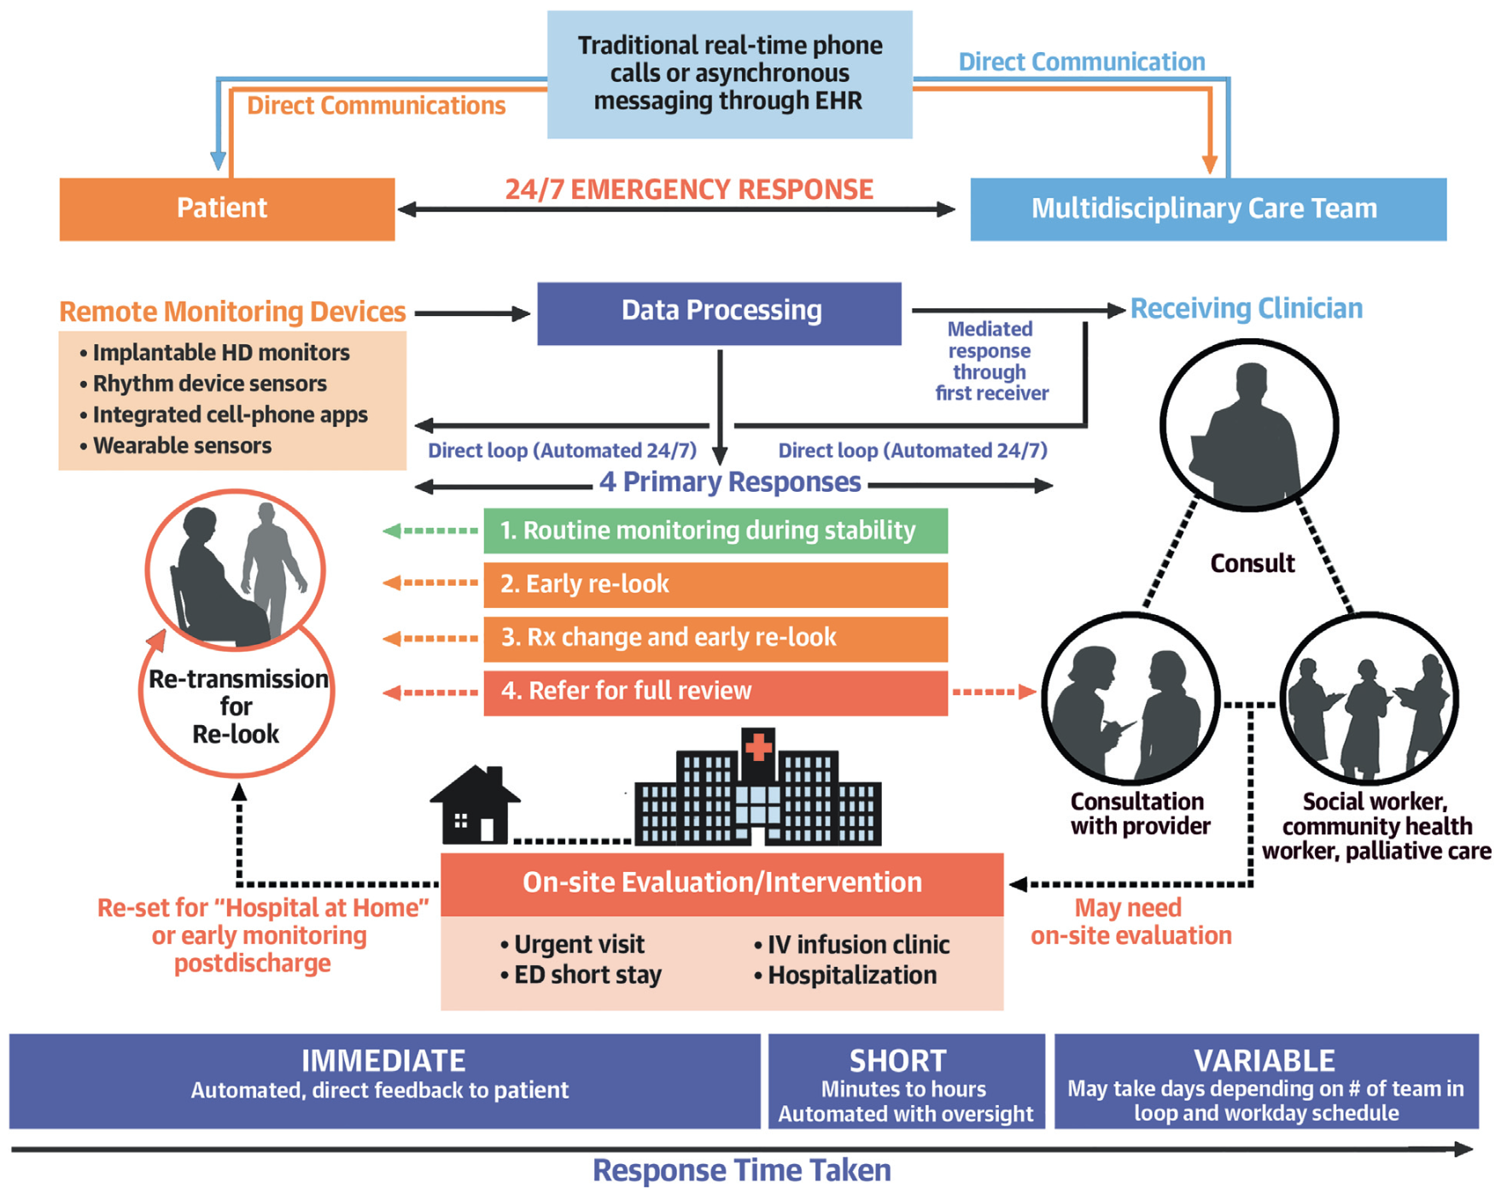
Integrating Monitoring and Management: Remote Ambulatory Monitoring
Traditional real-time phone calls or asynchronous messaging through EHR
Patient
24/7 emergency response
Multidisciplinary care team
Remote monitoring
Data processing
Receiving clinician
Devices
Implantable HD monitors
Rhythm device sensors
Integrated cell-phone apps
Wearable sensors
Transmitted data
Weight and vital signs
Lung congestion/ thoracic fluid
Hemodynamic pressure monitoring
Proprietary algorithms with multi-parameter risk scores
FDA approvals
Implantable pulmonary artery pressure monitor (CardioMEMS Heart Sensor) for NYHA class II-III HF
Mediated response through 1st receiver
Direct loop (automated 24/7)
Direct loop (automated 24/7)
Consult
4 primary responses
Routine monitoring during stability
Early re-look
Treatment change + early re-look
Refer for full review
Re-transmission for re-look
Consultation with clinician
Social worker, community health worker, palliative care
Re-set for “hospital at home” or early monitoring post-discharge
Onsite evaluation/intervention
May need onsite evaluation
Response time may be immediate, short, or variable
Stevenson LW et al. J Am Coll Cardiol. 2023;81:2272-2291.

Slide 65
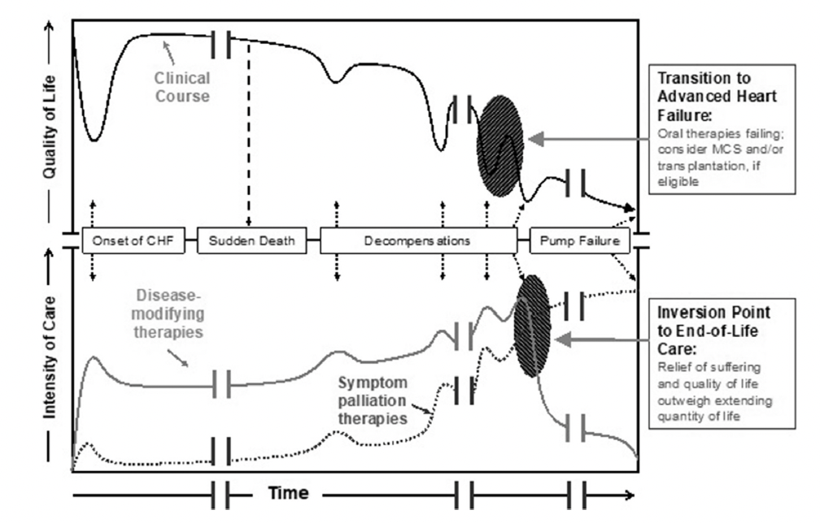
Don’t Forget About Palliative Care and Hospice
Transition to advanced heart failure
Oral therapies failing; consider MCS and/or transplantation, if eligible
Clinical course
Quality of life
Onset of CHF
Sudden death
Decompensations
Pump failure
Inversion point to
end-of-life care
Relief of suffering and quality of life outweigh extending quantity of life
Disease-modifying therapies
Intensity of care
Symptom palliation therapies
Time
CHF, congestive heart failure
Adapted from Heidenreich PA. J Am Coll Cardiol. 2022;79:e263-e421.

Slide 66

EMPA-REG: Change in eGFR
Change in eGFR over 192 weeks
78
76
74
Adjusted mean eGFR (mL/min/1.73 m²)
72
70
Placebo
Empagliflozin 10 mg
Empagliflozin 25 mg
68
66
Baseline
4
12
28
52
66
80
94
108
122
136
150
164
178
192
Week
EMPA-REG, Empagliflozin, Cardiovascular Outcomes, and Mortality in Type 2 Diabetes
Adapted from Wanner C. N Engl J Med. 2016;375:1801-1802.
Notes:
Wanner C, Inzucchi SE, Zinman B. Empagliflozin and progression of kidney disease in type 2 diabetes. N Engl J Med. 2016;375:1801–2.
Shown are estimates of the probability of a first occurrence of a prespecified renal composite outcome of incident or worsening nephropathy and of a post hoc renal composite outcome (a doubling of the serum creatininelevel, the initiation of renal-replacement therapy, or death from renal disease among patients who received at least one dose of either empagliflozin or placebo.
Rates of adverse events consistent with acute renal failure (including acute kidney injury) or hyperkalemia in the empagliflozin group were
lower than or similar to those in the placebo group, regardless of whether patients had impaired kidney function at baseline.
Incident or worsening nephropathy occurred in 525 of 4124 patients (12.7%) in the empagliflozin group and in 388 of 2061 (18.8%) in the placebo group (hazard ratio in the empagliflozin group, 0.61; 95% confidence interval, 0.53 to 0.70; P<0.001). Doubling of the serum creatinine level occurred in 70 of 4645 patients (1.5%) in the empagliflozin group and in 60 of 2323 (2.6%) in the placebo group, a significant relative risk reduction of 44%. Renal-replacement therapy was initiated in 13 of 4687 patients (0.3%) in the empagliflozin group and in 14 of 2333 patients (0.6%) in the placebo group, representing a 55% lower relative risk in the empagliflozin group. There was no significant between-group difference in the rate of incident albuminuria. The adverse-event profile of empagliflozin in patients with impaired kidney function at baseline was similar to that reported in the overall trial population.

Slide 67

SGLT2i and Genitourinary Urinary Tract Infections
Urinary tract infection
No increased risk of UTI with SGLT2i
Genital mycotic infection
3X higher with SGLT2i
Female > male
Fournier gangrene
Very rare
No increased risk with SGLT2i
Cardiovascular benefits in DM ↓Death from CV causes, nonfatal MI, and nonfatal stroke
Cardiovascular benefits in HF Irrespective of DM status
HFrEF:↓ All-cause death/HFH HFpEF:↓ All-cause death/HFH
After SGLT2i discontinuation:
↑ All-cause death/HFH
Quality of life
Renal benefits
Irrespective of DM status
↓ Adverse renal outcomes
Minimizing risks and maximizing benefits
Risk factor assessment: glycemic control, urinary tract obstruction, history of recurrent infection
Universal counseling: recognition of signs and symptoms, perineal hygiene maintenance
Minimize interruption: continue SGLT2i in mild-moderate and stable severe infections
Timely reinitiation: as soon as infection is controlled and no other contraindications
Genitourinary tract infections in patients taking SGLT2is
Risks of genitourinary tract infections
Other side effects of SGLT2i
Ketoacidosis
Volume depletion/orthostatic hypotension
Cardiorenal benefits
DM, diabetes mellitus; MI, myocardial infarction; UTI, urinary tract infection
Adapted from Kittipibul V. J Am Coll Cardiol. 2024;83(16):1568-1578.

Slide 68
Practical Tips: SGLT2i
Safe to initiate in eGFR ≥20 mL/min/1.73 m².
  OK to continue if eGFR falls below this
Decline in eGFR (⁓3-4 mL/min/1.73 m²) is expected.
Patients on dialysis should not be started on SGLT2i.

Slide 69
Practical Tips: SGLT2i
Can increase risk of genital mycotic infections.
Do not increase risk of urinary tract infections.
Benefit greater than risk in nearly every situation.

Slide 70
Clinical Pearls
Check creatinine and potassium 7-10 days after starting MRA or changing dose
Checking renal function and potassium every 3 months is reasonable
Assessing for control comorbidities during follow-up visits is appropriate
Notes:
#Pearl 1
#Pearl 2
#Pearl 3

Slide 71
Collaboration with Cardiology

Slide 72

When to Refer to Cardiology
Patient with suspected or known HFpEF: PCC to cardiovascular specialist
C
H
E
C
K
I
N
Collaboration
High-risk features
Extensive evaluation needed
Cardiorenal syndrome
Knowledge of HFpEF mimics
Increased
need for diuretic agents
NYHA class III or IV symptoms
Need for specialist care to manage comorbidities, including AF, HTN, DM, CAD
HF hospitalizations, pulmonary hypertension, RV dysfunction
Need for exercise testing, invasive hemodynamic assessment, CMR
Valvular disease, HCM, amyloid, pericardial disease
AF, atrial fibrillation; CAD, coronary artery disease; CMR, cardiac magnetic resonance; DM, diabetes mellitus; HCM, hypertrophic cardiomyopathy; HF, heart failure; HTN, hypertension; PCC, primary care clinician; RV, right ventricle
Adapted from Kittleson MM. J Am Coll Cardiol. 2023;81:1835-1878.
Notes:
Kittleson MM, et al. 2023 ACC Expert Consensus Decision Pathway on Management of Heart Failure With Preserved Ejection Fraction: A Report of the American College of Cardiology Solution Set Oversight Committee. J Am Coll Cardiol. 2023;81:1835-1878 PMID: 37137593.

Slide 73

When to Refer to Advanced Heart Failure
Cardiovascular specialist to advanced heart failure specialist
I
N
H
A
L
E
In need of diagnosis
Nonresponsive to diuretic agents or medical therapy; Natriuretic peptides extremely high
Hospitalized frequently for HF
Acute or chronic
end-organ dysfunction
Low blood pressure
Evidence of HFpEF mimics
Lack of conventional HFpEF risk factors; exercise-intolerant-only phenotype
Resistance to diuretic agents or medical therapy; progressive symptoms; NT-proBNP >3,000 pg/mL, BNP >1,000 pg/mL
2 or more HF hospitalizations in the past year
Worsening kidney or liver function; cardiac cachexia
Systolic blood pressure <100 mm Hg
Management of rare or unusual cardiomyopathies
Adapted from Kittleson MM. J Am Coll Cardiol. 2023;81:1835-1878.
Notes:
Kittleson MM, et al. 2023 ACC Expert Consensus Decision Pathway on Management of Heart Failure With Preserved Ejection Fraction: A Report of the American College of Cardiology Solution Set Oversight Committee. J Am Coll Cardiol. 2023;81:1835-1878 PMID: 37137593.

Slide 74

When to Refer to Advanced Heart Failure
Cardiovascular specialist to advanced heart failure specialist
I
N
E
E
D
H
E
L
P
Inotropes
NYHA class/
natriuretic peptides
End-organ dysfunction
Ejection fraction
Defibrillator shocks
Hospitalizations
Edema/
escalating diuretic agents
Low BP
Prognostic medications
Previous or ongoing requirement for dobutamine, milrinone, dopamine, or levosimendan
Persisting NYHA functional class III/IV and/or high BNP or
NT-proBNP
Worsening renal or liver dysfunction
Very low ejection fraction (<25%)
Recurrent appropriate defibrillator shocks
At least 1 hospitalization with HF in the past 12 months
Persistent fluid overload and/or increased diuretic requirement
Consistently low BP (systolic <90-100 mm Hg)
Inability to up-titrate (or need to decrease/
cease) ACEis,
β-blockers, ARNis, or MRAS
ACEi, angiotensin-converting enzyme inhibitor; ARNi, angiotensin-receptor neprilysin inhibitor; BNP, B-type natriuretic peptide; BP, blood pressure; MRA, mineralocorticoid receptor antagonist; NT-proBNP, N-terminal pro-B-type natriuretic peptide
Adapted from Guglin M. J Am Coll Cardiol. 2020;75:1471-1487.

Slide 75

Team-Based Care
Home care
Physicians
Diagnosis and ongoing monitoring
Nursing
Referral to palliative care
Prescription,
titration, and
monitoring
of GDMT
Geriatrics
The care team: skills and members
Coordination
with primary
care and
specialists
Patient and
caregiver
education about
prognosis and
treatment
Social work
Comorbidity
specialists
Psychological
support and
prescription
assistance
Lifestyle
modifications
and ongoing
monitoring
of progress
Pharmacy
Palliative care
Advanced practice professionals
GDMT, guideline-directed medical therapy
Adapted from Kittleson MM. J Am Coll Cardiol. 2023;81:1835-1878.

Slide 76

Heart Failure Is Expensive
40,000
EF ≤30%
EF 31%-40%
30,000
Mean per-patient Medicare Part A and B payments ($USD)
20,000
10,000
P=0.11
0
0
2
4
6
8
10
12
Months after discharge
USD, United States dollars
Adapted from Harrington J. J Am Heart Assoc. 2023;12:e028820.
Notes:
Harrington J, Sun JL, Fonarow GC, et al. Clinical Profile, Health Care Costs, and Outcomes of Patients Hospitalized for Heart Failure With Severely Reduced Ejection Fraction. J Am Heart Assoc. 2023 May 16;12(10):e028820. doi: 10.1161/JAHA.122.028820. Epub 2023 May 9. PMID: 37158118; PMCID: PMC10227282.

Slide 77


Financial Implications of HF
The overall mean annual out-of-pocket healthcare expenses was $4,423
Highest category of out-of-pocket spending
Adapted from Wang SY. J Am Heart Assoc. 2021;10:e022164.
Notes:
Wang SY, Valero-Elizondo J, Ali HJ, Pandey A, Cainzos-Achirica M, Krumholz HM, Nasir K, Khera R. Out-of-Pocket Annual Health Expenditures and Financial Toxicity From Healthcare Costs in Patients With Heart Failure in the United States. J Am Heart Assoc. 2021 Jul 20;10(14):e022164. doi: 10.1161/JAHA.121.022164. Epub 2021 May 16. PMID: 33998273; PMCID: PMC8483501.
Total out-of- pocket healthcare expenditures included yearly care-specific costs and insurance premiums. We evaluated 2 outcomes of financial toxicity: (1) high financial burden—total out-of-pocket healthcare expense to postsubsistence income ratio of >20%, and (2) catastrophic financial burden with the ratio of >40%—a bankrupting expense defined by the World Health Organization.
The overall mean annual out-of- pocket healthcare expenses were $4423 with medications and health insurance premiums representing the largest categories of cost. Overall, 14% of families experienced a high burden and 5% experienced a catastrophic burden.
Among the two-fifths of families considered low income, 24% experienced a high financial burden, whereas 10% experienced a catastrophic burden.
Low-income families had 4-fold greater risk-adjusted odds of high financial burden (odds ratio [OR] , 3.9; 95% CI, 2.3–6.6), and 14-fold
greater risk-adjusted odds of catastrophic financial burden (OR, 14.2; 95% CI, 5.1–39.5) compared with middle/high-income families.

Slide 78

Financial Implications of HF
The overall mean annual out-of-pocket healthcare expenses was $4,423
Overall:
14% of families experienced a high burden
5% experienced a catastrophic burden
Low income:
24% experienced a high burden
10% experienced a catastrophic burden
4X
4X
14X
14X
Adapted from Wang SY. J Am Heart Assoc. 2021;10:e022164.
Notes:
Wang SY, Valero-Elizondo J, Ali HJ, Pandey A, Cainzos-Achirica M, Krumholz HM, Nasir K, Khera R. Out-of-Pocket Annual Health Expenditures and Financial Toxicity From Healthcare Costs in Patients With Heart Failure in the United States. J Am Heart Assoc. 2021 Jul 20;10(14):e022164. doi: 10.1161/JAHA.121.022164. Epub 2021 May 16. PMID: 33998273; PMCID: PMC8483501.
Total out-of- pocket healthcare expenditures included yearly care-specific costs and insurance premiums. We evaluated 2 outcomes of financial toxicity: (1) high financial burden—total out-of-pocket healthcare expense to postsubsistence income ratio of >20%, and (2) catastrophic financial burden with the ratio of >40%—a bankrupting expense defined by the World Health Organization.
The overall mean annual out-of- pocket healthcare expenses were $4423 with medications and health insurance premiums representing the largest categories of cost. Overall, 14% of families experienced a high burden and 5% experienced a catastrophic burden.
Among the two-fifths of families considered low income, 24% experienced a high financial burden, whereas 10% experienced a catastrophic burden.
Low-income families had 4-fold greater risk-adjusted odds of high financial burden (odds ratio [OR] , 3.9; 95% CI, 2.3–6.6), and 14-fold
greater risk-adjusted odds of catastrophic financial burden (OR, 14.2; 95% CI, 5.1–39.5) compared with middle/high-income families.

Slide 79
Case Scenario

Slide 80

Patient Case
Sam, 68 Years Old
68-year-old man with HTN, HFrEF, T2DM, and a baseline creatinine 1.5 mg/dL (GFR 40 mL/min) is referred to the heart failure clinic for management
He complains of dyspnea on exertion
Echocardiogram with EF 25%-30%, no valve disease
GFR, glomerular filtration rate; HTN, hypertension; T2DM, type 2 diabetes mellitus

Slide 81
Patient Case
Sam, 68 Years Old
Medications:
Metoprolol succinate
100 mg daily
Enalapril 5 mg BID
Furosemide 20 mg daily
Atorvastatin 40 mg daily
Metformin 500 mg daily
Physical exam:
VS: HR 62 bpm, BP 130/92
mm HG , RR 16 breaths/min
Lungs: Clear bilaterally
Cardiac: S1S2, regular rate and rhythm, II/VI systolic ejection murmur at RUSB; JVD 10 cm H₂O
Extremities: 1+ pitting edema bilaterally
What is the best next option for this
patient’s management?
104 24
4.5 24 1.6
90
BID, twice daily; HR, heart rate; JVD, jugular venous distention; RR, respiratory rate; RUSB, right upper sternal border; S1S2, normal S1 and S2; VS, vital signs

Slide 82
Patient Case
Sam, 68 Years Old
Continue metoprolol succinate 100 mg daily
Stop enalapril
After 36 hours, start sacubitril/valsartan 49/51 mg BID
Start dapagliflozin 10 mg daily
Keep BP log and return in 2 weeks
What is the best next option for this
patient’s management?

Slide 83
Patient Case
Sam, 68 Years Old
Feeling improved, still with 1+ edema
Start spironolactone 25 mg daily
Keep BP log and return in 1 week for labs
What is the best next option for this
patient’s management?

Slide 84
Patient Case
Sam, 68 Years Old
Labs are stable
Titrate sacubitril/valsartan to 97/103 mg BID
What is the best next option for this
patient’s management?

Slide 85
Conclusion

Slide 86
Key Takeaways
HF has high morbidity and mortality
GDMT improves morbidity and mortality
Patient-centered care is always important
Notes:
#Pearl 1
#Pearl 2
#Pearl 3

Slide 87
Additional Tools and Resources
American College of Cardiology (ACC):
CardioSmart: Heart Failure
(https://www.cardiosmart.org/topics/heart-failure)
Heart Failure and SGLT2is—The New Pillar in Care
(https://www.acc.org/Education-and-Meetings/Products-and-Resources/Features/Heart-Failure-and-SGLT2is#:~:text=The%20ACC’s%20
Heart%20Failure%20and,of%20patients%20with%20heart%20failure)
American Heart Association: https://www.heart.org/en/health-topics/heart-failure
Notes:
Please add tools and local or national resources

Slide 88
Thank you!

Slide 89
Bibliography
Anker SD, Butler J, Filippatos G, et al. Empagliflozin in heart failure with a preserved ejection fraction. N Engl J Med. 2021;385(16):1451-1461. doi: 10.1056/NEJMoa2107038
Armstrong PW, Pieske B, Anstrom KJ, et al. Vericiguat in patients with heart failure and reduced ejection fraction. N Engl J Med. 2020;382(20):1883-1893. doi: 10.1056/NEJMoa1915928
Bassi NS, Ziaeian B, Yancy CW, Fonarow GC. Association of optimal implementation of sodium-glucose cotransporter 2 inhibitor therapy with outcome for patients with heart failure. JAMA Cardiol. 2020;5(8):948-951. doi: 10.1001/jamacardio.2020.0898
Bozkurt B, Ahmad T, Alexander KM, et al. Heart failure epidemiology and outcomes statistics: A Report of the Heart Failure Society of America. J Card Fail. 2023;29(10):1412-1451. doi:10.1016/j.cardfail.2023.07.006
Bristow MR, Gilbert EM, Abraham WT, et al. Carvedilol produces dose-related improvements in left ventricular function and survival in subjects with chronic heart failure. Circulation. 1996;94(11);2807-2816. doi: 10.1161/01.cir.94.11.2807
CIBIS II investigators. The cardiac insufficiency bisoprolol study II (CIBIS-II): a randomised trial. Lancet. 1999;353(9146):9-13. doi: 10.1016/S0140-6736(98)11181-9
De Vecchis R, Baldi C, Cioppa C, Giasi A, Fusco A. Effects of limiting fluid intake on clinical and laboratory outcomes in patients with heart failure. Results of a meta-analysis of randomized controlled trials. Herz. 2016;41(1):63-75. doi: 10.1007/s00059-015-4345-9
Ezekowitz JA, Colin-Ramirez E, Ross H, et al. Reduction of dietary sodium to less than 100 mmol in heart failure (SODIUM-HF): an international, open-label, randomised, controlled trial. Lancet. 2022;399(10333):1391-1400. doi: 10.1016/S0140-6736(22)00369-5
Garg R, Yusuf S. Overview of randomized trials of angiotensin-converting enzyme inhibitors on mortality and morbidity in patients with heart failure. JAMA. 1995;273(18):1450-1456.

Slide 90
Bibliography
Granger CB, McMurray JJV, Yusuf S, et al. Effects of candesartan in patients with chronic heart failure and reduced left-ventricular systolic function intolerant to angiotensin-converting-enzyme inhibitors: the CHARM-Alternative trial. Lancet. 2003;362(9386):772-776. doi: 10.1016/S0140-6736(03)14284-5
Greene SJ, Butler J, Albert NM, et al. Medical therapy for heart failure with reduced ejection fraction: the CHAMP-HF registry. J Am Coll Cardiol. 2018;72(4):351-366. doi: 10.1016/j.jacc.2018.04.070
Greene SJ, Butler J, Fonarow GC. Simultaneous or rapid sequence initiation of quadruple medical therapy for heart failure-optimizing therapy with the need for speed. JAMA Cardiol. 2021;6(7):743-744. doi: 10.1001/jamacardio.2021.0496
Guglin M, Zucker MJ, Borlaug BA, et al. Evaluation for heart transplantation and LVAD implantation: JACC council perspectives. J Am Coll Cardiol. 2020;75(12):1471-1487. doi: 10.1016/j.jacc.2020.01.034
Harrington J, Sun JL, Fonarow GC, et al. Clinical profile, health care costs, and outcomes of patients hospitalized for heart failure with severely reduced ejection fraction.
J Am Heart Assoc. 2023;12(10):e028820. doi: 10.1161/JAHA.122.028820
Heidenreich PA, Bozkurt B, Aguilar D, et al. 2022 AHA/ACC/HFSA guideline for the management of heart failure: a report of the American College of Cardiology/American Heart Association Joint Committee on Clinical Practice Guidelines. J Am Coll Cardiol. 2022;79(17):e263-e421. doi: 10.1016/j.jacc.2021.12.012
Kittipibul V, Cox ZL, Chesdachai S, Fiuzat M, Lindenfeld J, Mentz, RJ. Genitourinary tract infections in patients taking SGLT2 inhibitors: JACC review topic of the week. J Am Coll Cardiol. 2024;83(16):1568-1578.
Kittleson MM, Panjrath GS, Amancherla K, et al. 2023 ACC expert consensus decision pathway on management of heart failure with preserved ejection fraction: a report of the American College of Cardiology Solution Set Oversight Committee. J Am Coll Cardiol. 2023;81(18):1835-1878. doi: 10.1016/j.jacc.2023.03.393
Kosiborod MN, Abildstrøm SZ, Borlaug BA, et al. Semaglutide in patients with heart failure with preserved ejection fraction and obesity. N Engl J Med. 2023;389(12):1069-1084. doi: 10.1056/NEJMoa2306963

Slide 91
Bibliography
Krum H, Mohacsi P, Katus HA, et al. Are beta-blockers needed in patients receiving spironolactone for severe chronic heart failure? An analysis of the COPERNICUS study. Am Heart J. 2006;151(1):55-61. doi: 10.1016/j.ahj.2005.03.054
Maddox TM, Januzzi JL, Allen LA, et al. 2024 ACC expert consensus decision pathway for treatment of heart failure with reduced ejection fraction: a report of the American College of Cardiology Solution Set Oversight Committee. J Am Coll Cardiol. 2024;83(15):1444-1488. doi: 10.1016/j.jacc.2023.12.024
Martin SS, Aday AW, Almarzooq ZI, et al. 2024 heart disease and stroke statistics: a report of US and global data from the American Heart Association. Circulation. 2024;149(8):e347-e913. doi: 10.1161/CIR.0000000000001209
McMurray JJV, Solomon SD, Inzucchi SE, et al. Dapagliflozin in patients with heart failure and reduced ejection fraction. N Engl J Med. 2019;381(21):1995-2008. doi: 10.1056/NEJMoa1911303
MERIT-HF Study Group. Effect of metoprolol CR/XL in chronic heart failure: metoprolol CR/XL randomised intervention trial in congestive heart failure (MERIT-HR). Lancet. 1999;353(9169):2001-2007.
O’Connor CM, Whellan DJ, Lee KL, et al. Efficacy and safety of exercise training in patients with chronic heart failure: HF-ACTION randomized controlled trial. JAMA. 2009;301(14):1439-1450. doi: 10.1001/jama.2009.454
Packer M, Bristow MR, Cohn JN, et al. The effect of carvedilol on morbidity and mortality in patients with chronic heart failure. N Engl J Med. 1996;334(21):1349-1355. doi: 10.1056/NEJM199605233342101
Packer M, Poole-Wilson PA, Armstrong PW, et al. Comparative effects of low and high doses of the angiotensin-converting enzyme inhibitor, lisinopril, on morbidity and mortality in chronic heart failure. Circulation. 1999;100(23):2312-2318. doi: 10.1161/01.cir.100.23.2312
Partnership for Quality Measurement. Consensus Core Set: Cardiology. Accessed 4/1/24. https://p4qm.org/sites/default/files/2023-06/CQMC-Cardiology-Core-Set-v4.0-508.pdf

Slide 92
Bibliography
Pitt B, Zannad F, Remme WJ, et al. The effect of spironolactone on morbidity and mortality in patients with severe heart failure. N Engl J Med. 1999;341(10):709-717. doi: 10.1056/NEJM199909023411001
Pitt B, Remme W, Zannad F, et al. Eplerenone, a selective aldosterone blocker, in patients with left ventricular dysfunction after myocardial infarction. N Engl J Med. 2003;348(14):1309-1321. doi: 10.1056/NEJMoa030207
Pitt B, Pfeffer MA, Assmann SF, et al. Spironolactone for heart failure with preserved ejection fraction. N Engl J Med. 2014;370(15):1383-1392. doi: 10.1056/NEJMoa1313731
Sayed A, Abramov D, Fonarow GC, et al. Reversals in the decline of heart failure mortality in the US, 1999 to 2021. JAMA Cardiol. 2024:e240615. doi: 10.1001/jamacardio.2024.0615
Shah KS, Xu H, Matsouaka RA, et al. Heart failure with preserved, borderline, and reduced ejection fraction: 5-year outcomes. J Am Coll Cardiol. 2017;70(20):2476-2486. doi: 10.1016/j.jacc.2017.08.074
Solomon SD, McMurray JJV, Anand IS, et al. Angiotensin-neprilysin inhibition in heart failure with preserved ejection fraction. N Engl J Med. 2019;381(17):1609-1620. doi: 10.1056/NEJMoa1908655
Swat SA, Helmkamp LJ, Tietbohl C, et al. Clinical inertia among outpatients with heart failure: application of treatment nonintensification taxonomy to EPIC-HF trial. JACC Heart Fail. 2023;11(11):1579-1591. doi: 10.1016/j.jchf.2023.06.022
Swedberg K, Komajda M, Böhm M, et al. Ivabradine and outcomes in chronic heart failure (SHIFT): a randomised placebo-controlled study. Lancet. 2010;376(9744):875-885. doi: 10.1016/S0140-6736(10)61198-1
Taylor AL, Ziesche S, Yancy C, et al. Combination of isosorbide dinitrate and hydralazine in blacks with heart failure. N Engl J Med. 2004;351(20):2049-2057. doi: 10.1056/NEJMoa042934

Slide 93
Bibliography
Travers B, O’Loughlin C, Murphy NF, et al. Fluid restriction in the management of decompensated heart failure: no impact on time to clinical stability. J Card Fail. 2007;13(2):128-132. doi: 10.1016/j.cardfail.2006.10.012
Tsao CW, Aday AW, Almarzooq ZI, et al. Heart disease and stroke statistics-2022 update: a report from the American Heart Association. Circulation. 2022;145(8):e153-e639. doi: 10.1161/CIR.0000000000001052
Vaduganathan M, Claggett BL, Jhund PS, et al. Estimating lifetime benefits of comprehensive disease-modifying pharmacological therapies in patients with heart failure with reduced ejection fraction: a comparative analysis of three randomised controlled trials. Lancet. 2020;396(10244):121-128. doi: 10.1016/S0140-6736(20)30748-0
Wang SY, Valero-Elizondo J, Ali HJ, et al. Out-of-pocket annual health expenditures and financial toxicity from healthcare costs in patients with heart failure in the United States. J Am Heart Assoc. 2021;10(14):e022164. doi: 10.1161/JAHA.121.022164
Wanner C, Inzucchi SE, Zinman B. Empagliflozin and progression of kidney disease in type 2 diabetes. N Engl J Med. 2016;375:1801-1802. doi: 10.1056/NEJMc1611290
Yancy CW, Jessup M, Bozkurt B, et al. 2013 ACCF/AHA guideline for the management of heart failure: executive summary: a report of the American College of Cardiology Foundation/American Heart Association Task Force on Practice Guidelines. J Am Coll Cardiol. 2013;62(16):1495-1539. doi: 10.1016/j.jacc.2013.05.020
Zannad F, McMurray JJV, Krum H, et al. Eplerenone in patients with systolic heart failure and mild symptoms. N Engl J Med. 2011;364(1):11-21. doi: 10.1056/NEJMoa1009492

