Slide 1
PAD & CLTI
Natural History & Medical Management
Matthew Krantz, MD FACS, FSVS
Associate Professor of Surgery
Vascular Surgeon
Marshall University School of Medicine

Slide 2
No financial disclosures

Slide 3
Outline
Natural History of PVD
Diagnosis of PVD
Management of PVD
Outcomes of PVD

Slide 4
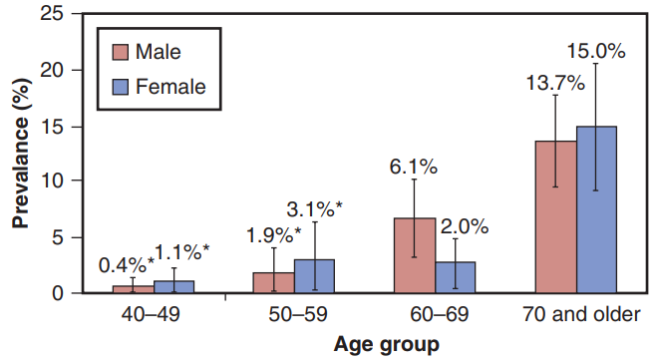
Peripheral Arterial Disease (PAD)
Atherosclerotic occlusive disease of the lower extremity arteries
Affects >200 million people worldwide
  ~8.5 million in the US
  Prevalence increases with age
From Selvin E, Erlinger TP. Prevalence of and risk factors for peripheral arterial disease in the United States: results from the National Health and Nutrition Examination Survey, 1999–2000. Circulation. 2004;110(6):738–743.

Slide 5
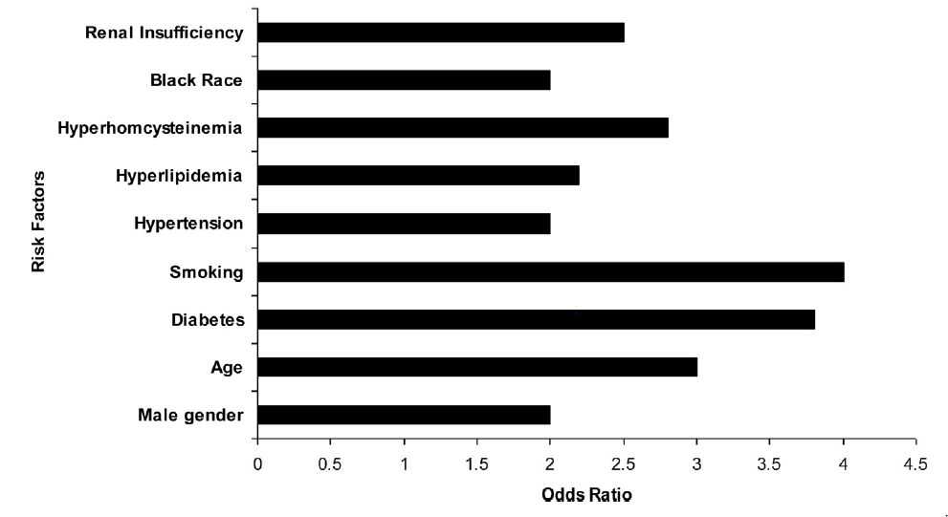
Risk Factors of PAD
Society for Vascular Surgery practice guidelines for atherosclerotic occlusive disease of the lower extremities: Management of asymptomatic disease and claudication. Conte, Michael S. et al. Journal of Vascular Surgery, Volume 61, Issue 3, 2S - 41S.e1
Notes:
Focus here on Age, HTN, HLP, smoking, DM, obesity

Slide 6
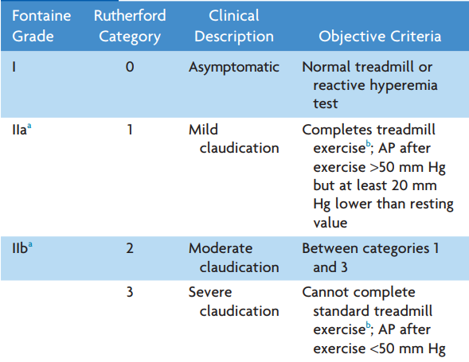

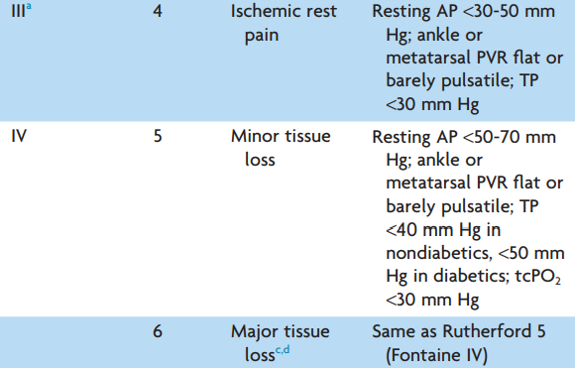
Stages of PAD
Claudication
Chronic Limb Threatening Ischemia
Notes:
AP=ankle pressure

Slide 7
Natural History of PAD
Asymptomatic
  Majority of patients
  Incidentally discovered arterial stenosis/occlusion
  2.7x greater risk of mortality vs non-PAD
  5.6x greater risk of cardiovascular mortality
  ~7% progress to intermittent claudication over 5 years
Sigvant B, Lundin F, Wahlberg E. The risk of disease progression in peripheral arterial disease is higher than expected: a meta-analysis of mortality and disease progression in peripheral arterial disease. Eur J Vasc Endovasc Surg . 2016;51(3):395–403.
Notes:
History ranges from asymptomatic to tissue loss
Most of the therapy focuses on reducing cardiovascular mortality

Slide 8
Natural History of PAD
Intermittent Claudication
  Reproducible muscle pain brought on by exercise and relieved by rest
  Symptoms occur one level distal to area of stenosis/occlusion
    Aortoiliac disease: => Buttock, thigh, hip pain
    Femoropopliteal disease => Calf pain
  Severity based on distance until symptoms develop
  Differential Diagnosis:
    Spinal disease
    Venous disease
    Joint Disease
Notes:
Charley horse
Run a marathon
Fatigue
REPRODUCIBLE – occurs at the same distance every time, not good or bad days or positional
Localized tissue hypoxia: muscle demand for oxygen is not met by arterial flow

Slide 9
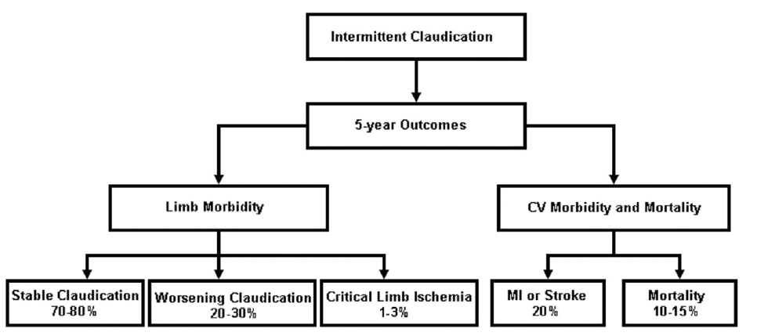
Natural History of PAD
Intermittent Claudication outcomes
Notes:
Risk factors for progression include DM, continued smoking
1% risk of limb loss per year for IC v 3% cardiovascular mortality

Slide 10
Natural History of PVD
Chronic Limb Threatening Ischemia
  Peripheral vascular disease with either:
    Rest pain
    Non healing ulcers
  Prevalence ~1.3% of all PAD
  Major amputation rate of 22% per year
  Mortality 22% per year
  WIFi score can be used to estimate risk of amputation
Notes:
Nehler M.R, Duval S, Diao L, et al. Epidemiology of peripheral arterial disease and critical limb ischemia in an insured national population. J Vasc Surg . 2014;60(3):686–695 e2.

Slide 11
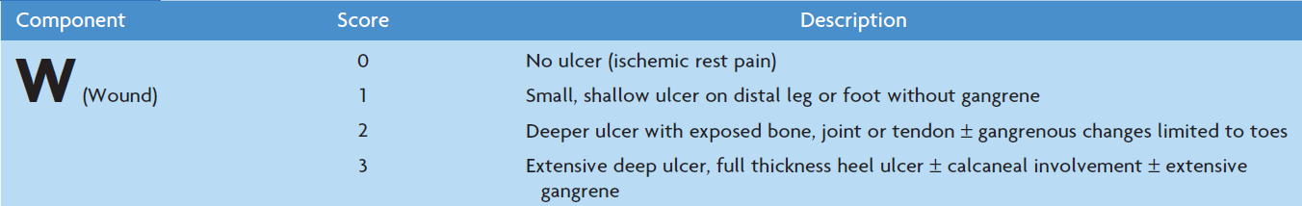
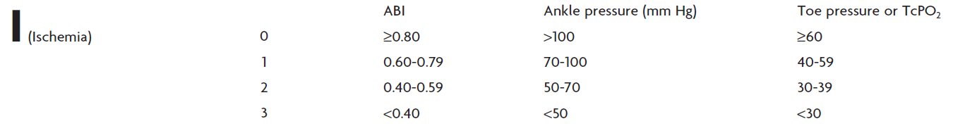

WIFi score
The Society for Vascular Surgery Lower Extremity Threatened Limb Classification System: Risk stratification based on Wound, Ischemia, and foot Infection (WIfI). Mills, Joseph L. et al. Journal of Vascular Surgery, Volume 59, Issue 1, 220 - 234.e2
Notes:
Rest pain / Wound formation and healing multifactorial
Not simply based off pressure measurements
Wound, Ischemia, Foot Infection
Allows comparison of outcomes by disease severity

Slide 12
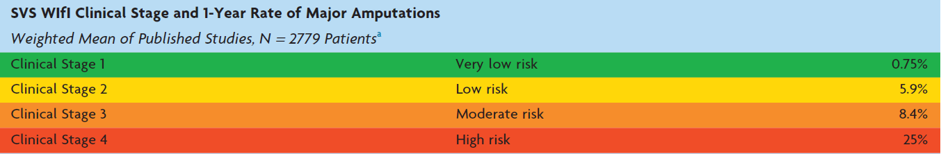
SVS WIfI Stage vs 1yr Major Amp

Slide 13
Stages of PAD
Claudication
Chronic Limb Threatening Ischemia
Notes:
AP=ankle pressure

Slide 14
Diagnosing PAD
History:
  Symptoms:
    Distance until pain starts
    Distance until unable to walk further
    Change if leaning forward/backward
  Length of time present
  Prior interventions
  History of wounds
  History of spinal surgery
  Comorbidities:
    Cardiopulmonary disease
Notes:
Should have reproducible symptoms

Slide 15
Diagnosing PAD
Physical Exam:
  Color of foot
    Capillary refill
    Dependent rubor
  Temperature of foot/leg
  Hair loss
  Wounds:
    Depth
    Odor
    Drainage
BLE Pulse exam:
  DP/PT
  Popliteal
  Femoral
  Palpate and Doppler

Slide 16
Diagnosing PAD
ABI: single or multilevel
Exercise Testing
Duplex Ultrasound
CT Angiogram
Angiography
Notes:
Good pulse exam best way to diagnose: includes femoral popliteal and pedal pulse exam, radial and ulnar pulses, both feet not just the affected

Slide 17
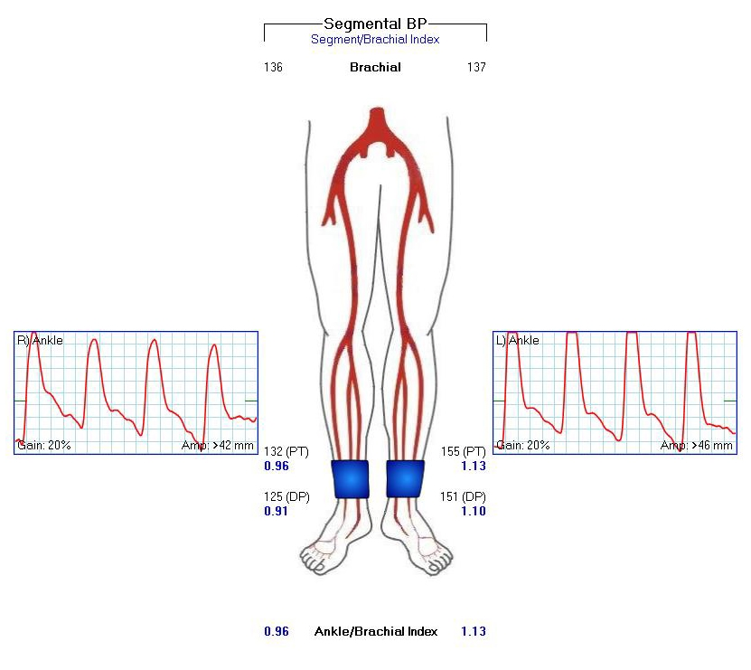
ABIs
Ankle/brachial index
Normal > 0.9-1.3
Mild PVD 0.75-0.9
Moderate PVD 0.4-0.75
Severe PVD <0.4
Toe Brachial Index:
  Normal >0.6
  Falsely elevated from calcific disease
        DM, CKD/ESRD
Notes:
Describe How it is done

Slide 18
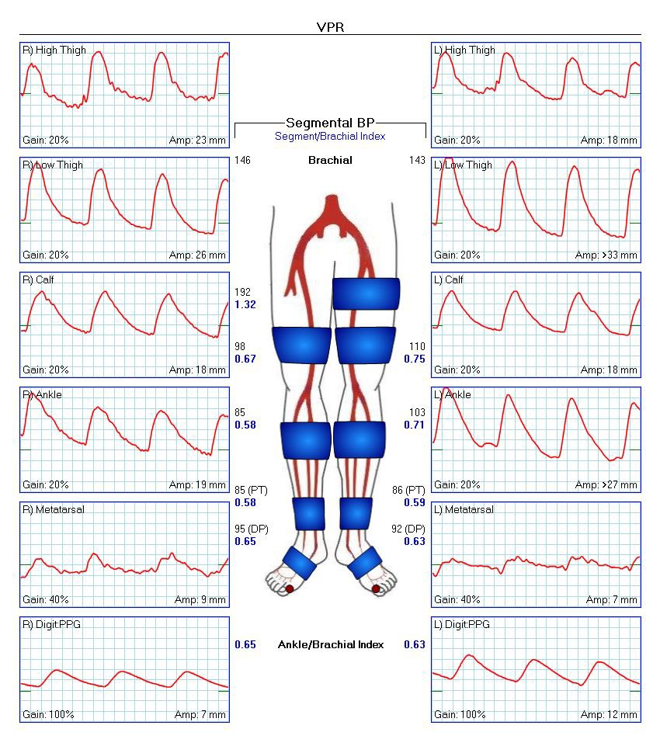
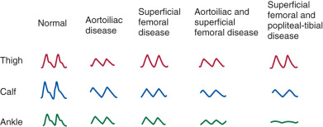
Segmental Pressures / Waveforms
Notes:
Difference in 30mmHg between sides or down the leg
Gives an idea of where the stenosis is located

Slide 19
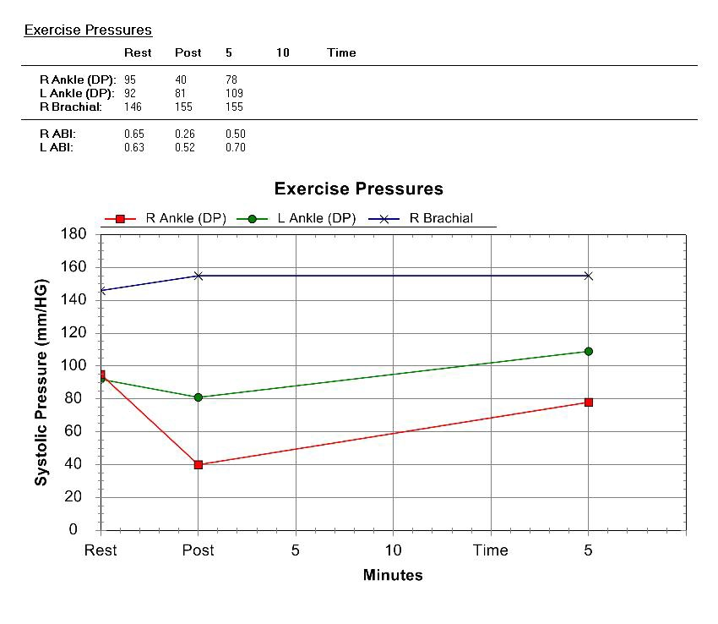
Exercise Testing
Compare ABI pre- and post-exercise
Note the time until ABIs return to baseline
Notes:
Standard Protocol:
Grade = 12%
Rate = 2 mph
Time = 5 min

Slide 20
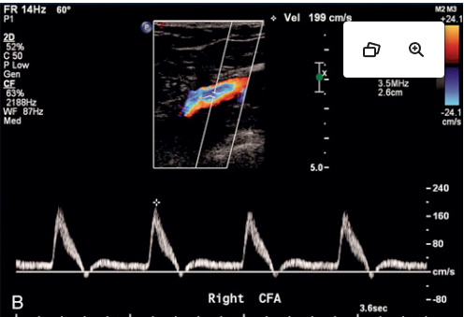
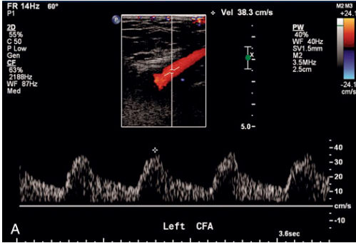
Further Diagnostic Adjuncts
Duplex Ultrasound
Useful in patients with:
    CKD/ESRD
    Tibial level disease
  Caution in:
    Aortoiliac disease
    Large body habitus
    Scarring (from prior interventions)
    Stents
Notes:
Describe how this works
Looks at Peak systolic velocity as estimate of stenosis, can also look at the waveforms

Slide 21
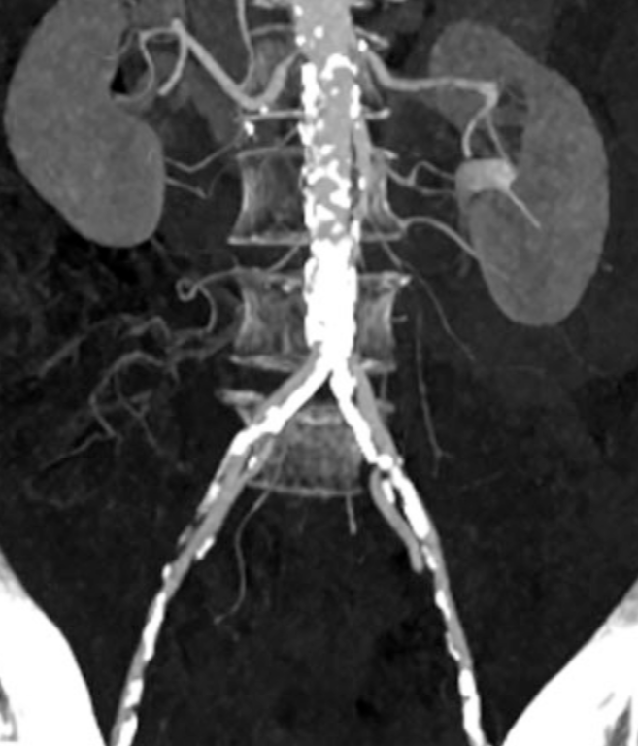
Further Diagnostic Adjuncts
CTA
  Visualizes aortoiliac disease
  Helpful for case planning: stent sizing
  Caution in:
    CHF patients
    Joint replacement: scatter artifact
    CKD
    Calcific Disease
    Tibial level disease
Notes:
How to tell outrunning contrast from occlusion

Slide 22
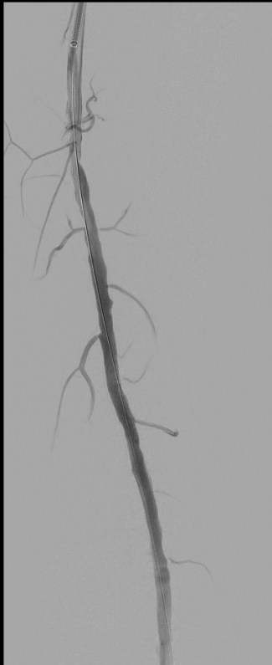
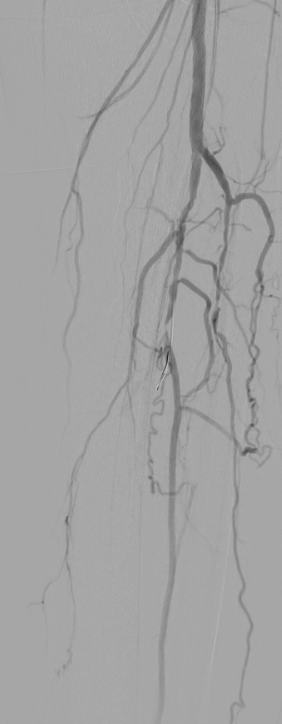
Further Diagnostic Adjuncts
Angiography
  Diagnostic and therapeutic
  Caution in:
    Cannot tolerate anesthesia
    CKD: can do CO2 angiogram or minimal contrast
    Large body habitus: difficult to access
    Prior surgery/intervention
Notes:
Risks of surgery, risks of contrast

Slide 23
Managing PAD
What are our goals?
  Decrease mortality from atherosclerotic disease
  Improve ability to walk / Quality of life
  Depends on symptomatology
Notes:
Goals depend on where on the spectrum the patient is located:
Asx: decrease mortality from athero
Claudication: improve QoL, decrease mortality
CLTI: heal wound, stop the rest pain

Slide 24
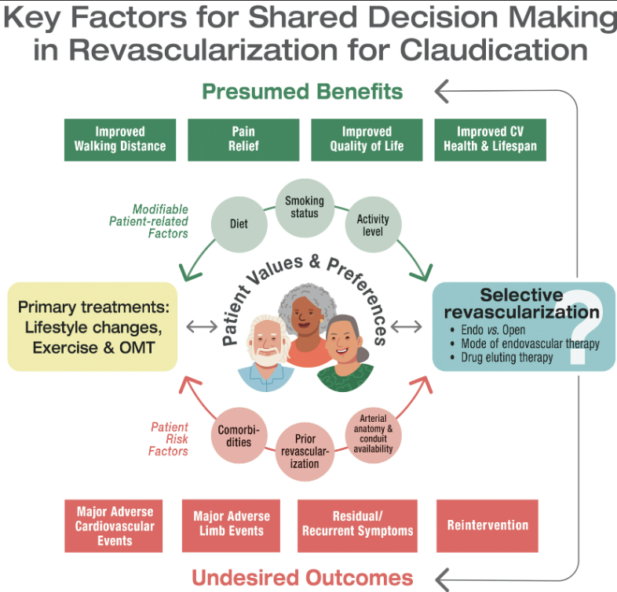

Slide 25
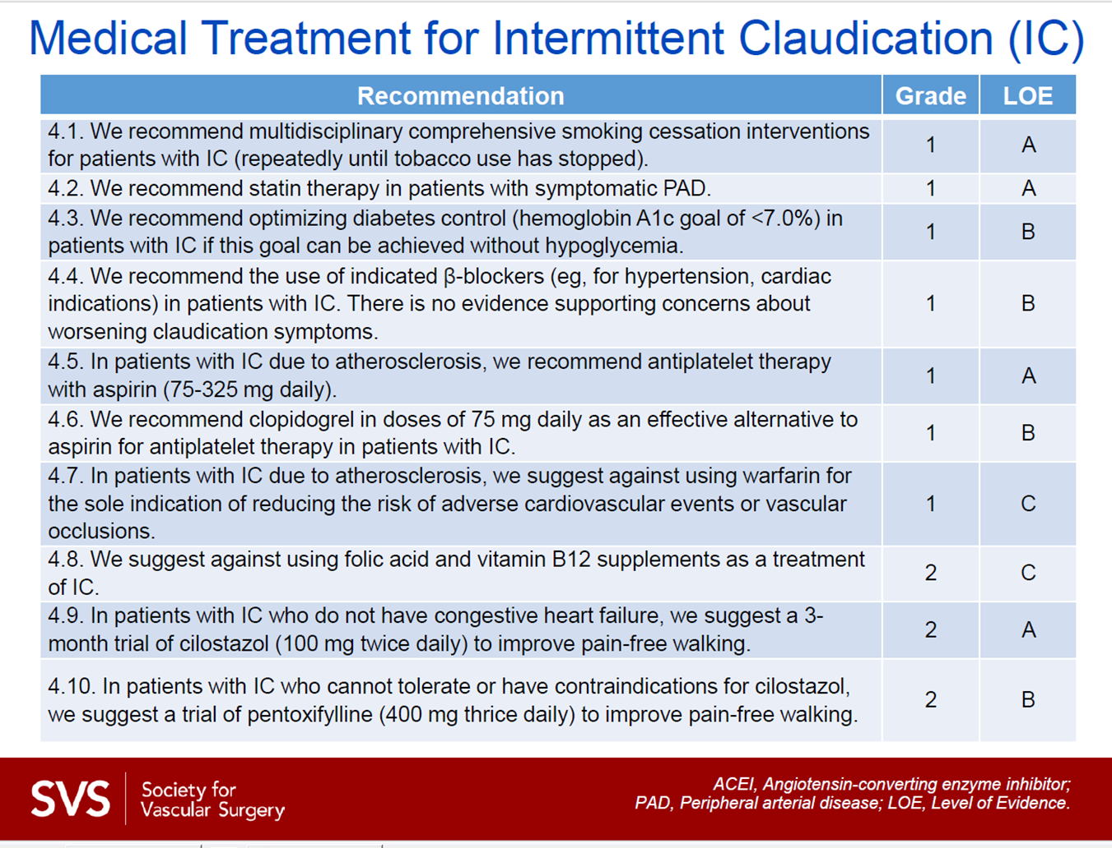
Medically Managing PAD

Slide 26

Smoking Cessation
Directly advise patients to quit
Select a quit date
Alcohol can decrease success rates
Others in household should consider quitting
Anticipate withdrawal symptoms: mood, concentration, nausea, headache
  Can peak at 2 weeks
Notes:
Tobacco use will diminish patency rates of interventions, worsen cardiac outcomes, frequently when one intervention fails the patient is worse off than prior

Slide 27
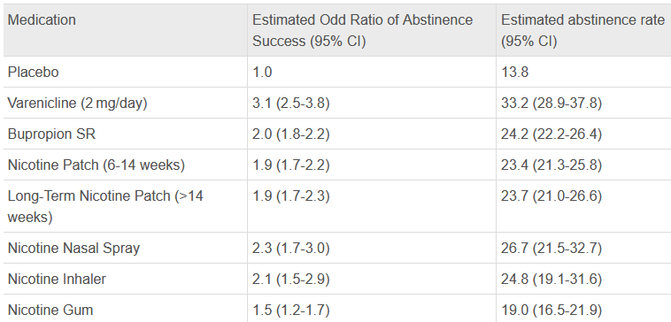
Smoking Cessation

Slide 28
Glycemic Control
HgbA1C of 7 is goal
  ACCORD Trial
    RCT of DM2 to HgbA1C of 7-7.9% vs less than 6%
    Primary Endpoint: Composite CV death, MI, stroke
    ~10,000 pts included
    Intensive-therapy group had relative increase in mortality of 22% and an absolute increase of 1.0%
  Action in Diabetes and Vascular Disease (ADVANCE) study and the Veterans Affairs Diabetes Trial (VADT) failed to show tight glycemic control decreases mortality

Slide 29
Glycemic Control
Treatment
  Lifestyle modification
  Metformin 1st line pharmacologic
    reduced diabetes-related death and all-cause mortality by 42% and 36% in UKPDS
  Second line (Sulfonylurea vs Insulin)
  No clear evidence one class of meds decreases progression of PAD
Notes:
UK Prospective diabetes study

Slide 30
Diabetes Management
SVS recs to prevent Diabetic Foot Ulcers
(1) annual foot examination by provider w/ training in foot care
(2) peripheral neuropathy testing w/ foot exam
(3) Education about preventative foot care
(4) custom therapeutic footwear in high-risk patients, including those with significant neuropathy, foot deformities, or previous amputation
(5) glycemic control (hemoglobin A1c <7%).

Slide 31
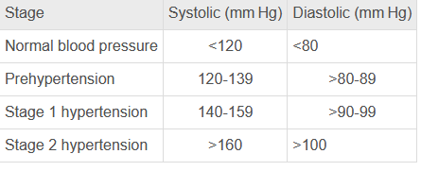
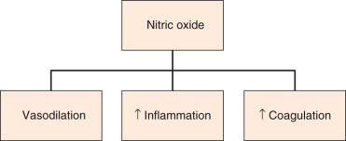
Blood Pressure Control
Endothelial Dysfunction decreases NO

Slide 32
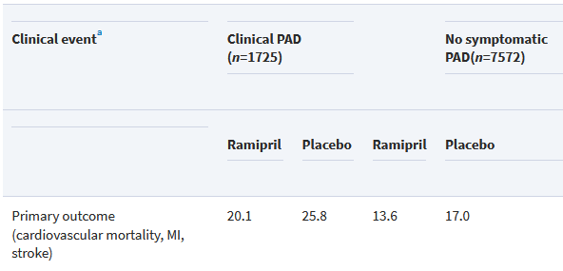
Blood Pressure Control
Lifestyle modifications
Heart Outcomes Prevention Evaluation (HOPE) study
  RCT ABI as predictor of CV events and ramipril on PAD
  PAD patients (ABI <0.9) treated w/ ramipril
  Reduction in cardiovascular events

Slide 33
Blood Pressure Control
Goal SBP 140/90, if >60y/o then 150/90
First line management is thiazide diuretic
Second line is dependent on comorbidities
  Uncomplicated HTN (ACE, BB, CCB)
  DM – ACE/ARB
  CAD/CHF – BB
No contraindication for beta-blockers in PVD

Slide 34
Lipid Lowering Agents
POSCH Trial
  RCT for partial ileal bypass, 838 pts
  Primary endpoint death; secondary endpoint atherosclerosis
  44% risk reduction for development of an abnormal ABI
  Clinical manifestations of PAD was reduced by 30%
Notes:
Decreased fat absorption

Slide 35
Statins
HMG-CoA reductase inhibition
Reduce risk of CAD, stroke, PVD, death
Reduces LDL in a dose-dependent fashion
Pleiotropic effects on the vasculature:
  Decreased inflammation
  Plaque stabilization
  Improved endothelial function
Risks: transient transaminitis, rhabdo (4 in 1000), myopathy
Takemoto M, Liao JK. Pleiotropic effects of 3‐hydroxy‐3‐methylglutaryl coenzyme a reductase inhibitors. Arterioscler Thromb Vasc Biol. 2001;21:1712–1719.

Slide 36
Statins
RCT between placebo and 40mg atorvastatin (only 86 patients)
  By 6mo, statin group could walk 90m further than placebo
  ABI improved by 0.1
  Improvement in symptoms by the questionnaire
Mondillo S, et al. Effects of simvastatin on walking performance and symptoms of intermittent claudication in hypercholesterolemic patients with peripheral vascular disease. Am J Med . 2003;114(5):359–364

Slide 37
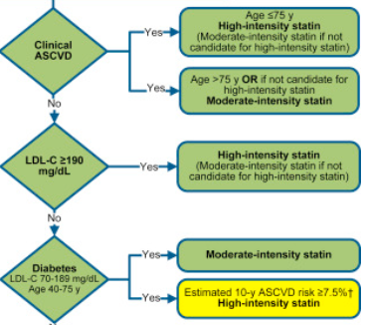
Statins
Goal LDL less 100mg/dL
If High risk patient,
  LDL less 70 mg/dL
Neil J. Stone, et, al 2013 ACC/AHA Guideline on the Treatment of Blood Cholesterol to Reduce Atherosclerotic Cardiovascular Risk in Adults: A Report of the American College of Cardiology/American Heart Association Task Force on Practice Guidelines,Journal of the American College of Cardiology, Volume 63, Issue 25, Part B, 2014, Pages 2889-2934,
Notes:
ASCVD” atherosclerotic cardiovascular disease

Slide 38
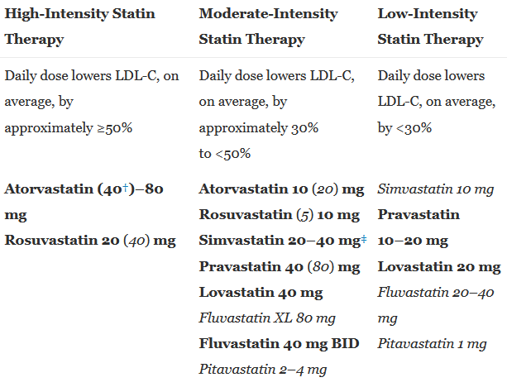
Lipid Lowering Agents

Slide 39

Symptom Management
Cilostazol
3-month trial at a dose of 100 mg twice daily
50% improvement in claudication symptoms
In combination with exercise therapy
PDE 3 inhibitor => increases cAMP=> vasodilation
No mortality benefit
Contraindicated in:
      CHF, CKD, and hepatic impairments
    Side effects:
      Headaches, nausea, diarrhea
Notes:
Does have some antiplatelet effect

Slide 40
Symptom Management
Pentoxifylline
  400 mg TID
  Inhibits PDE and potentiates prostacyclin => vasodilation
  Can be tried in pts with contraindication to cilostazol

Slide 41

Exercise Therapy
Supervised or Home
Minimum 3 times per week
30-60 minute sessions
12 weeks duration

Slide 42
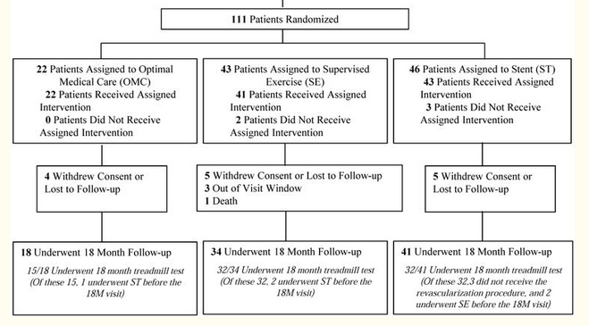
CLEVER Trial
AOID claudication
RCT, 29 centers
2007-2011
999 pts screened
Moderate to severe claudication

Slide 43
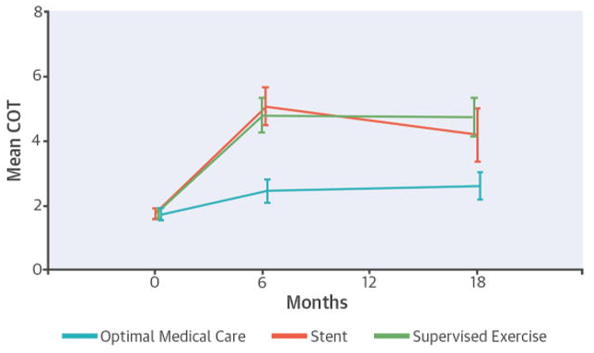
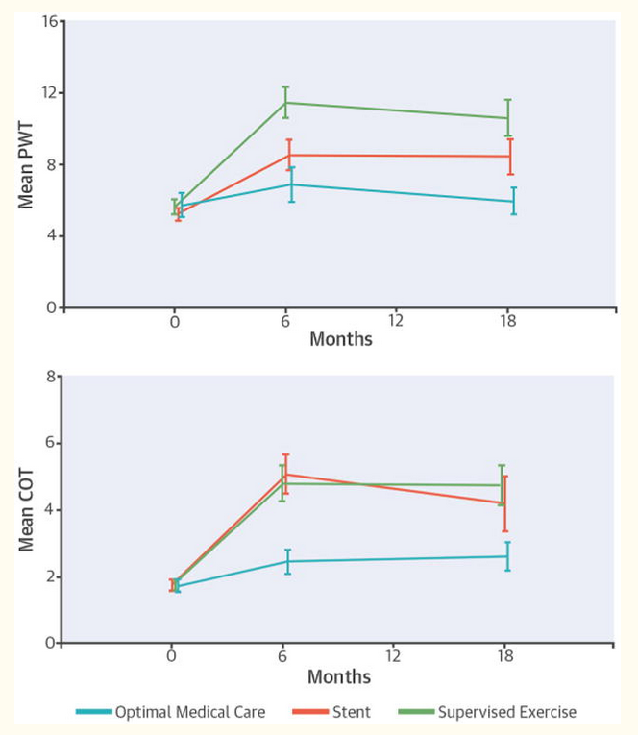
CLEVER TRIAL
Stent & Supervised Exercise statistically better than Optimal Med Care
Murphy TP, Cutlip DE, Regensteiner JG, et al. Supervised exercise, stent revascularization, or medical therapy for claudication due to aortoiliac peripheral artery disease: the CLEVER study [published correction appears in J Am Coll Cardiol. 2015 May 12;65(18):2055]. J Am Coll Cardiol. 2015;65(10):999–1009. doi:10.1016/j.jacc.2014.12.043

Slide 44
Treatment algorithm - Claudication
Smoking cessation
Aspirin, high intensity statin
  Glycemic and BP control
Walking program
Cilostazol, 100mg bid x 3mo
Then consider intervention

Slide 45
Medical Management in CLTI
PVD with rest pain or ulceration
Same Optimal medical therapy as claudication
Ultimately will require revascularization
Notes:
Recall that CLTI is PVD with ulceration or rest pain

Slide 46
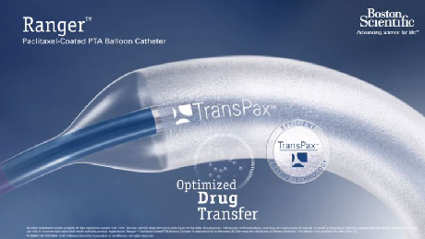

Interventional Treatment options
Angiographic:
  Balloon angioplasty
  Drug coated balloon angioplasty
  Stenting
Open:
  Endarterectomy
  Bypass
Notes:
Treatment tailored based on location of disease

Slide 47
Interventional Treatment Options
Tailored based on:
  Symptoms
  Comorbidities
  Location of disease, aortoiliac, femoropopliteal, tibial, inframalleolar, combined
  Prior interventions

Slide 48
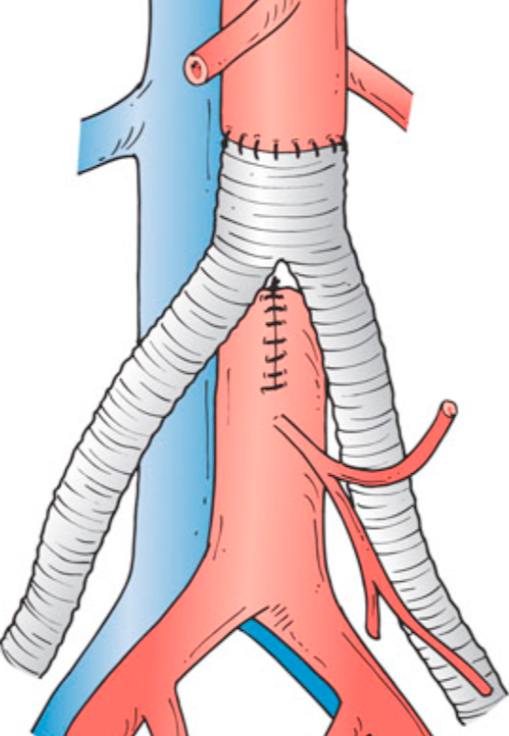
Aortoiliac treatment options
Aortic Occlusion:
  Aortobifemoral bypass: 4% 30d mortality
    85-90% 5 year patency, 75-85% at 10 years
  Axbifemoral bypass: 60-70% 5 year patency
Iliac disease:
  Angioplasty/stenting: 78% 3 years patency
  Fem-fem bypass: 70% 5 year patency
  Ax fem bypass

Slide 49
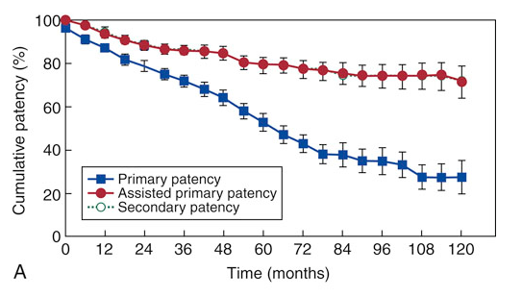
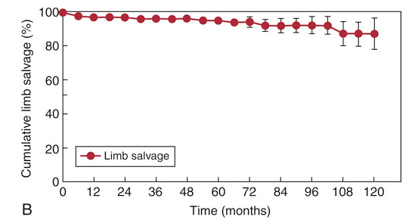
Aortoiliac Treatment Options
Iliac disease – angioplasty and stenting
Galaria II, Davies MG. Percutaneous transluminal revascularization for iliac occlusive disease: long-term outcomes in Trans-Atlantic Inter-Society Consensus A and B lesions. Ann Vasc Surg. 2005;19:352–360.

Slide 50
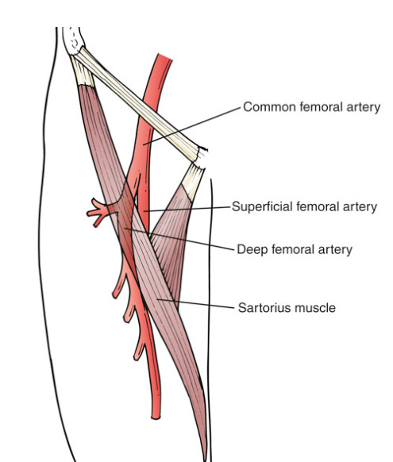
Common Femoral Treatment
Common femoral endarterectomy
  Profundaplasty
Balloon angioplasty
Notes:
Importance of the profunda femoris

Slide 51
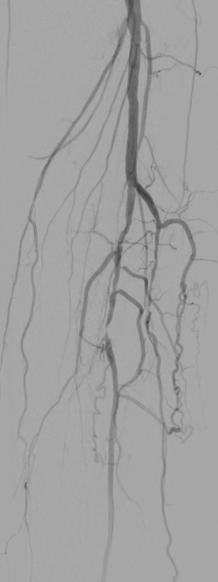
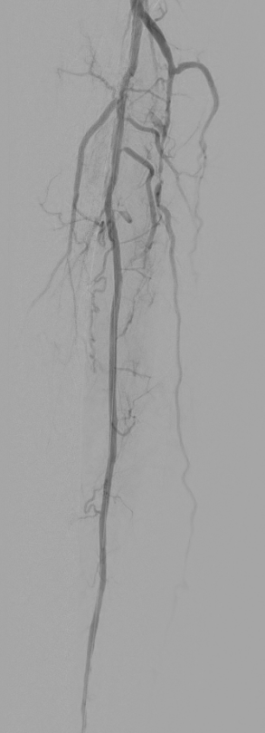
Infra-inguinal Treatments
SFA/popliteal:
  Balloon angioplasty/stenting
  Bypass
Tibial:
  Balloon angioplasty
  Bypass

Slide 52
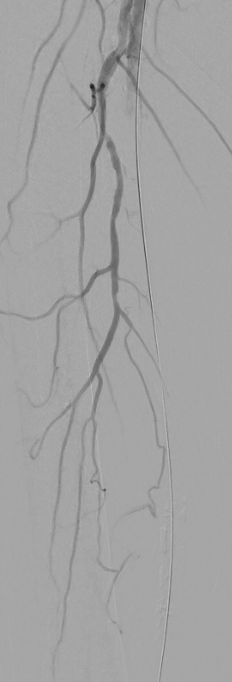
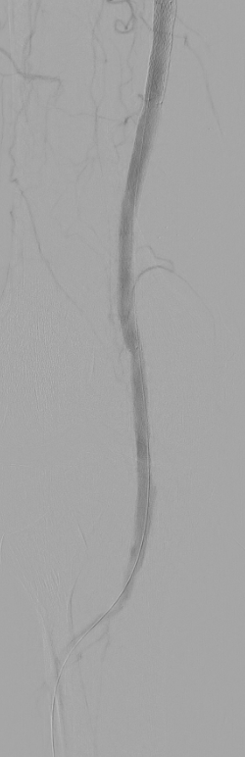
Infra-Inguinal Treatment
Plain Balloon Angioplasty: 35% restenosis at 1 year
Drug Coated Balloon angioplasty:
  70-75% patency at 1 year
Stenting: drug coated or plain
  65-75% at 1 year with plain self expanding stent
  83% at 1 year with Zilver Drug eluting stent
  Can be harder to revasc after stenting
  DCBs more expensive
Notes:
Paclitaxel
Cons: DCBs are more expensive

Slide 53
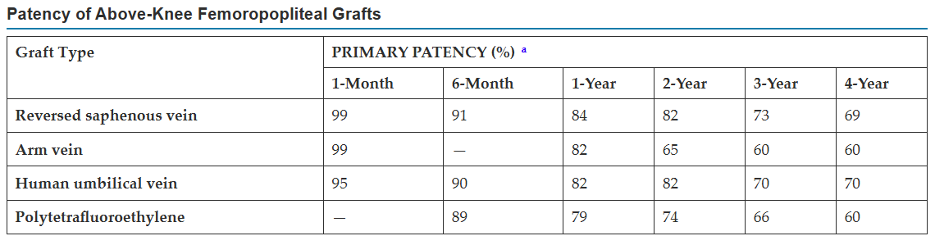
Infra-Inguinal Treatment

Slide 54
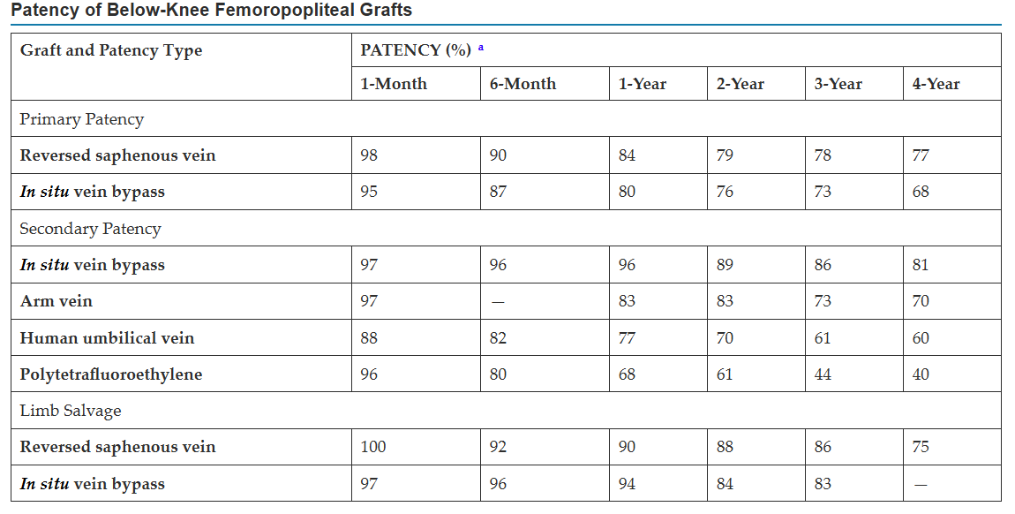
Infra-Inguinal Treatment

Slide 55
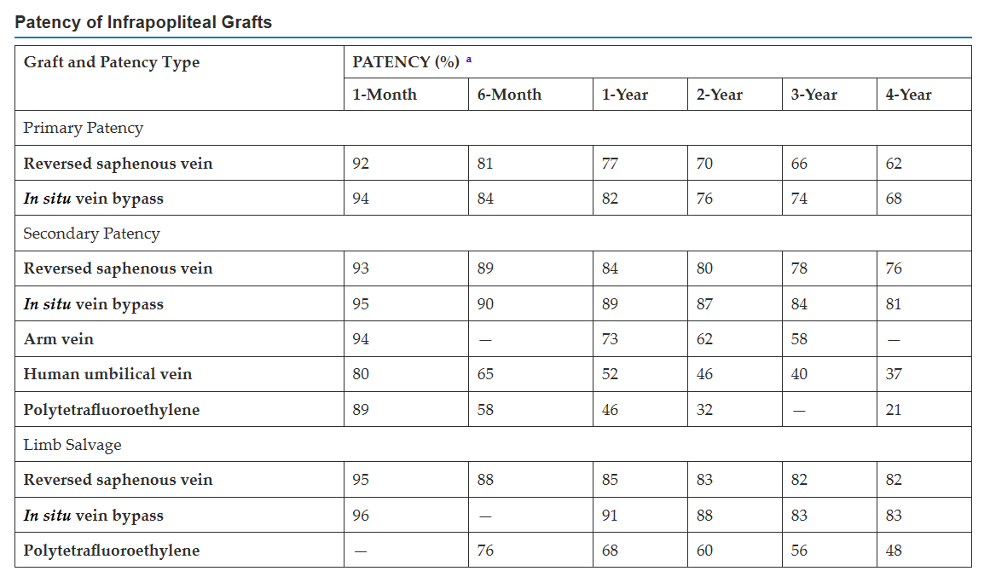
Infra-Inguinal Treatment

Slide 56
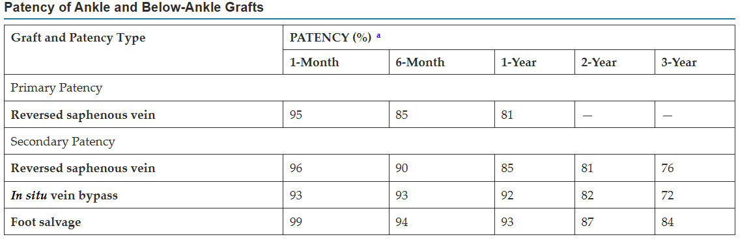
Infra-Inguinal Treatment

Slide 57
Infra-Inguinal Management
Patency rates:
  Fem-above knee: 82% at 2 years
  Fem-Below knee: 79% at 2 years
  Fem-tibial: 70% at 2 years
  Fem-below ankle: 81% at 1 year
Vein bypasses must be monitored with yearly duplexes:
  Evaluate for stenosis, and early intervention

Slide 58
Medically Managing PAD

Slide 59
Conclusions
Diagnosis first via physical exam, then ABI
Categorize by symptoms:
Asymptomatic
Claudicant: long or short distance
CLTI: rest pain, wounds
Everyone gets maximal medical management:
  Aspirin, high intensity statin
  SMOKING CESSATION
Further tailor treatment based on symptoms;
  Asymptomatic and long distance claudicants: monitor, annual ABI
  Short distance claudicants: walking program, cilostazol, ?intervention
  Chronic Limb Threatening Ischemia: needs an intervention
    Intervention dependent on location of disease

Slide 60
Thank you for your time
Matthew Krantz, MD FACS, FSVS
Associate Professor of Surgery
Vascular Surgeon
Marshall University School of Medicine

