Slide 1


Acute Stroke Rehabilitation
Helping Patients Understand Stroke Rehabilitation Patient and Family Stroke Education on Medical Management

Slide 2


WHAT IS A STROKE?
A sudden loss of blood flow to an area of the brain that causes decreased oxygen to the brain, which leads to brain cell death
ISCHEMIC | HEMORRHAGIC | TIA (Transient Ischemic Attack)
Blood Clot BLOCKS a Blood Vessel • Embolic vs. Thrombotic | Blood Vessel LEAKS or RUPTURES • Hypertension is the leading cause | “Mini Stroke” • Temporary loss of Blood flow • Similar symptoms of stroke that resolve in 24 hours or less
87% OF ALL STROKES | 13% OF ALL STROKES

Slide 3

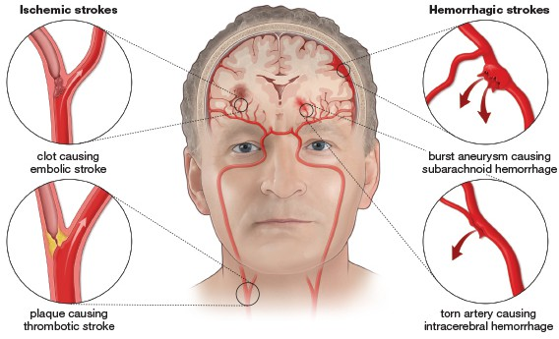
ISCHEMIC VERSUS HEMORRHAGIC STROKE
Encompass Health | Confidential information

Slide 4










LEADING CAUSES OF STROKE
PREVENTING ANOTHER STROKE
HIGH BLOOD PRESSURE
Monitor Blood Pressure
Keep Below 130/80 mm Hg
A-FIB
Manage with medication provided by MD
DIABETES
Diet and Exercise
Take Insulin as prescribed by MD
CHOLESTEROL
Total Cholesterol : <150 mg/dL
LDL : <100 mg/dL
Blood Thinners
Avoid sitting OR not moving for long periods of time
BLOOD CLOTS
Enco
mpass Health | Confidential information
4

Slide 5

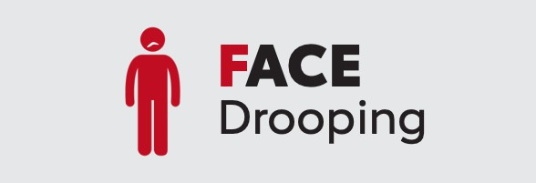


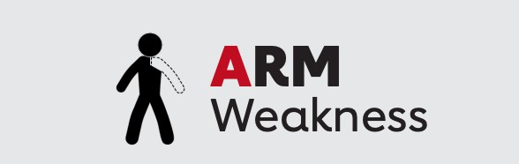



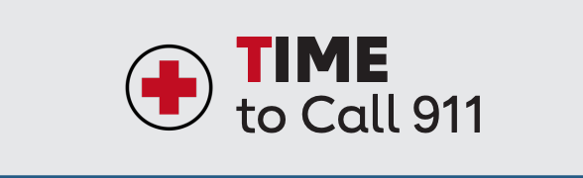

Slide 6

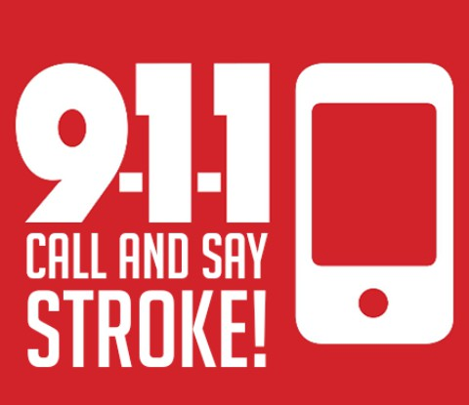
ADDITIONAL SIGNS AND SYMPTOMS OF A STROKE
Sudden headache with no known cause
Sudden numbness of the face, arm, or leg, especially on one side
•
Sudden trouble seeing in one or both eyes
Sudden Trouble walking, dizziness or loss of balance
Sudden confusion, trouble speaking or understanding speech, trouble swallowing
Encompass Health Stroke Education | Confidential information

Slide 7
RISK FACTORS FOR STROKE
CHANGEABLE RISK FACTORS
HIGH BLOOD PRESSURE • HIGH CHOLESTEROL • HEART/BLOOD VESSEL DISEASE (Atherosclerosis, CAD, A-fib) • DIABETES | INACTVITY • SMOKING/ALCOHOL CONSUMPTION • OBESITY • HIGH STRESS
UNCHANGABLE RISK FACTORS
PREVIOUS STROKE OR TIA (mini-stroke)
•
GENDER (Woman > Men)
•
RACE (Greater in African Americans/Native Americans)
•
FAMILY HISTORY OF HEART DISEASE
•
AGE (>55 years old)

Slide 8
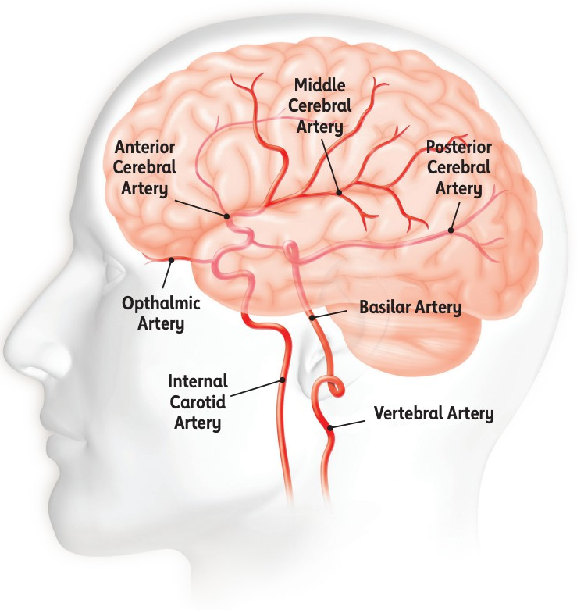
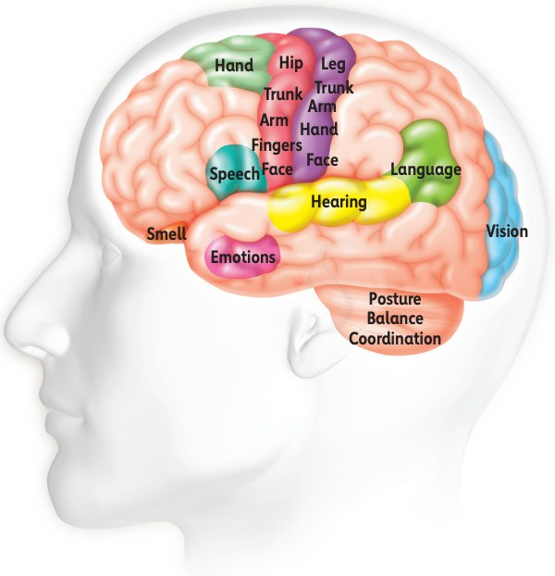
ANATOMY OF THE BRAIN

Slide 9
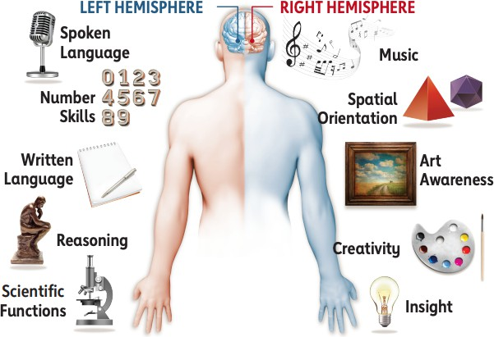

Slide 10
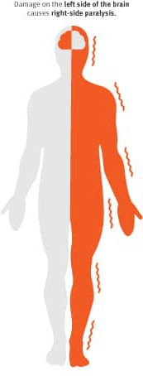
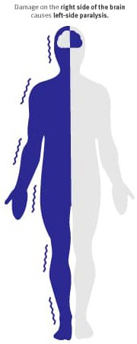

Stroke on LEFT Side of Brain
RIGHT Sided Weakness
Cautious
More aware of deficits
Difficulty communicating or Understanding speech
Can have loss of RIGHT
vision
Difficulty swallowing
Stroke on RIGHT Side of Brain
LEFT sided weakness
Less aware of deficits; Impulsive
Decreased spatial awareness
Can be socially inappropriate
Can have LEFT sided neglect
Can have loss of LEFT vision
Difficulty swallowing

Slide 11
DEPRESSION
ADDITIONAL EFFECTS AFTER HAVING A STROKE
SEIZURES MEMORY
PAIN
FATIGUE
THINKING
SPASTICITY
INCONTINENCE
SLEEPING

Slide 12
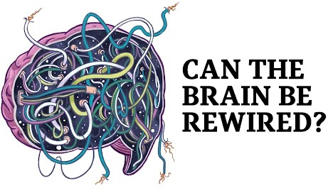

HOW DOES YOUR BRAIN RECOVER?
After a stroke your brain goes through a process known as Neuroplasticity.
Neuroplasticity is the brain’s ability to CHANGE and ADAPT to form new connections to regain function. This mechanism allows the brain to recover from a stroke.
Yes, through neuroplasticity the brain rewires itself by using undamaged areas of the brain to take over functions for the damaged areas after a stroke

Slide 13
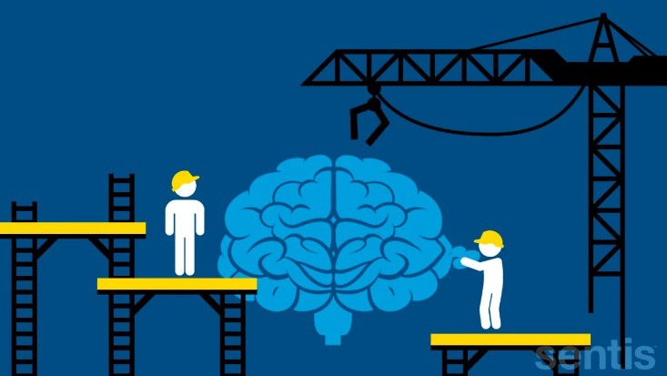
Continued: HOW DOES YOUR BRAIN RECOVER?
When you have a stroke some major parts of your brain go “offline”.
Your brain then needs to learn how to turn those parts back on by growing new connections in the brain.
The process of recovery starts with building those new connections.

Slide 14
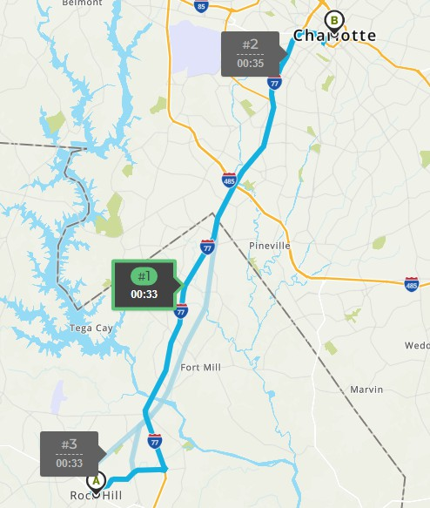
Encompass Health | Confidential information

Slide 15
Dealing with the Stroke Patient and Family
Kinds of Strokes “CVA”
Effects of CVA Communicating with the Patient and family
How PT,OT, and Speech Therapy improve outcomes

Slide 16
Questions?

Slide 17
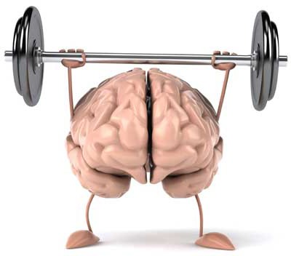
STRATEGIES TO GET THE MOST OUT OF YOUR RECOVERY:
Use your affected side as much as you can
‒ The less you use your affected side, the less recovery occurs
‒ The more you use your affected side, the better & easier it will move
Stay motivated and do things you enjoy.
‒ The more motivated you are, the better your recovery
Challenge yourself
‒ The more difficult something is, the more the brain changes
Repeat exercises and tasks multiple times
‒ The more you do something the stronger those pathways/ connections become
Do activities that relate to your daily tasks
‒ Walking, dressing, stairs, etc.

Slide 18
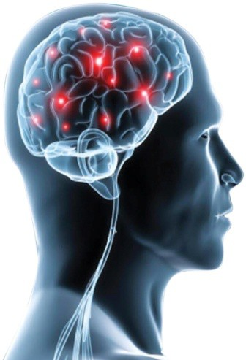
WHAT CAN LIMIT YOUR RECOVERY?
Time
‒ The earlier you start rehab; the quicker recovery can occur.
Pain
‒ Having a lot of pain can make it hard to use your affected side and/or participate in therapy. It is important to talk to manage pain.
Age
  The younger you are, the more likely your brain will recover quicker.

Slide 19
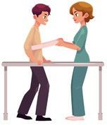
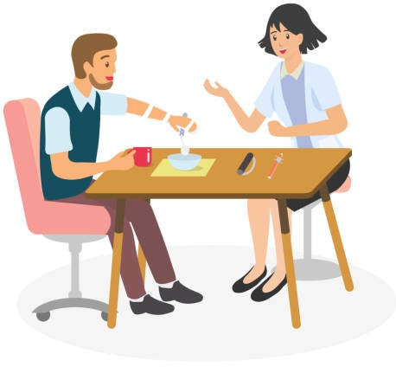

PHYSICAL THERAPISTS
SPEECH THERAPISTS
Help you with your communication, cognition (thinking skills) and swallowing function.
Help improve walking, wheelchair mobility, stair climbing, ramp and curb negotiation.
Focus on LEs, balance, coordination, vestibular

Slide 20
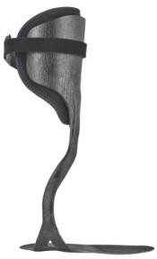
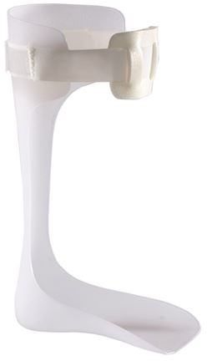
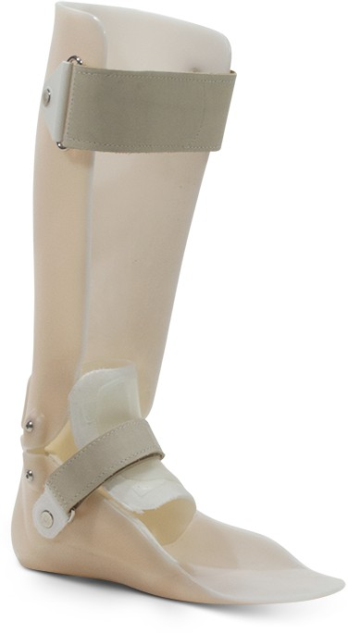
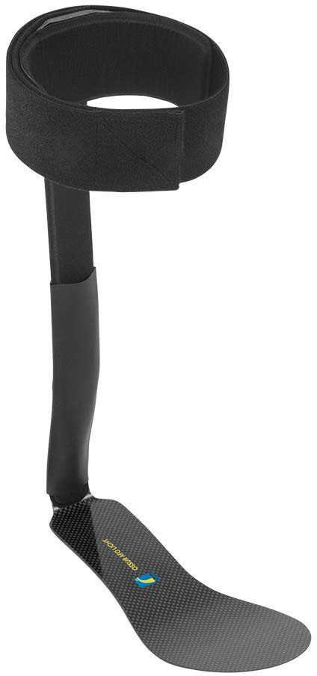


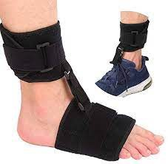
POSTERIOR LEAF AFO
JOINTED AFO
GROUND REACTION AFO
AFOS USED IN PT
CARBON FIBER AFO
SOFT FOOT DROP BRACE
Encompass Health Stroke Education | Confidential information

Slide 21
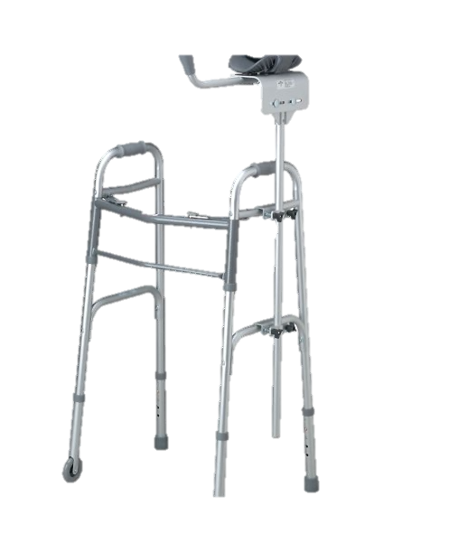
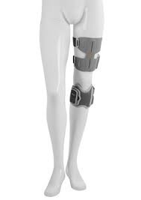
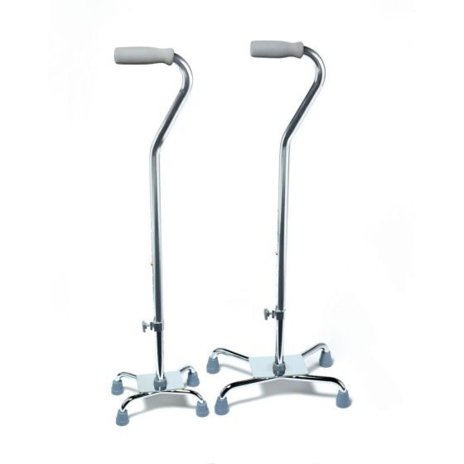
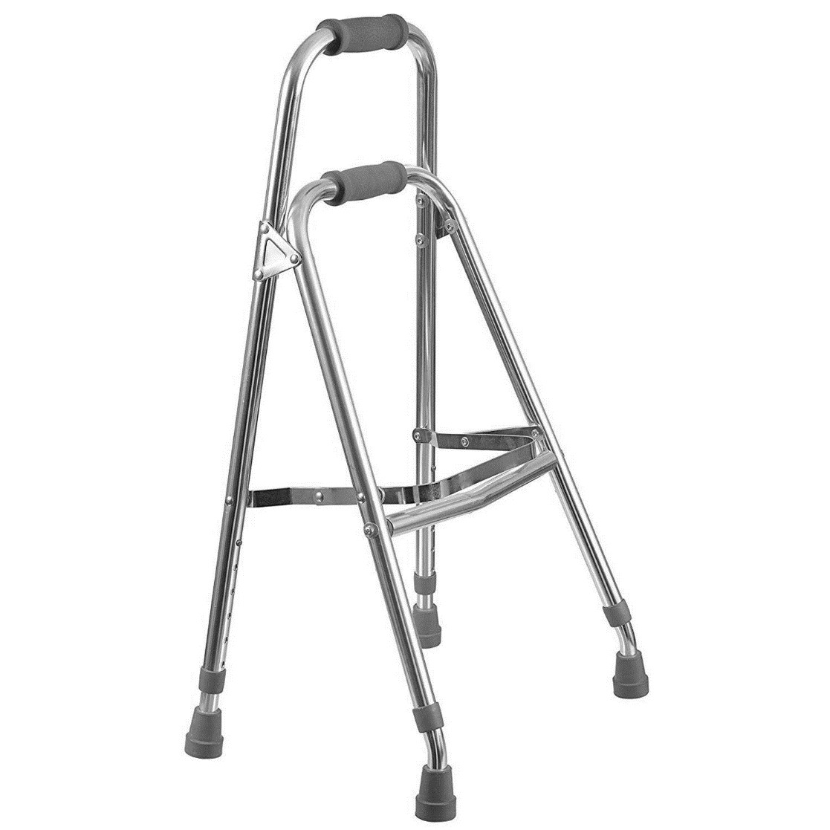
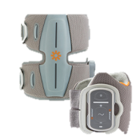
WALKING DEVICES USED IN THERAPY
BIONESS L300
ROLLING WALKER WITH PLATFORM
QUAD CANES
HEMIWALKER
21

Slide 22
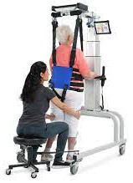
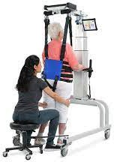
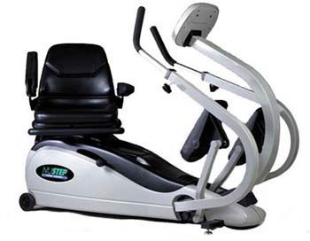

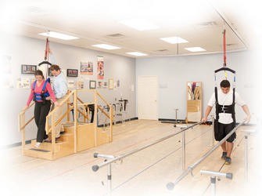
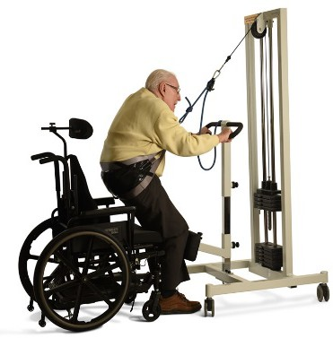
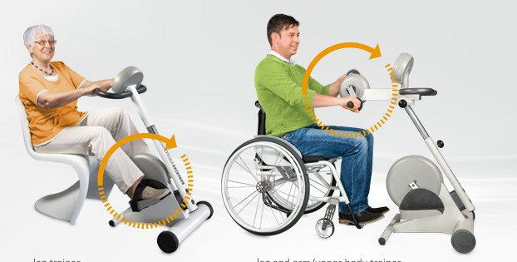
PT EQUIPMENT
NUSTEP
LITE GAIT
FREESTEP
NEUROGYM
MOTOMED

Slide 23
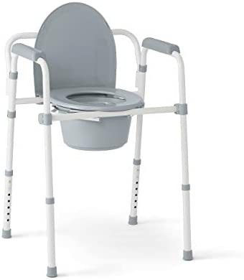
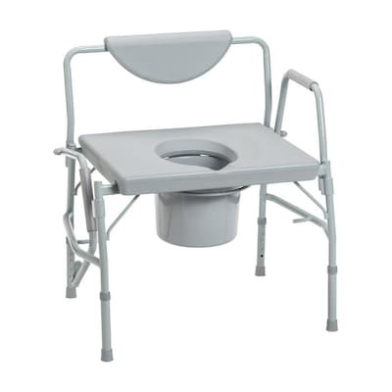
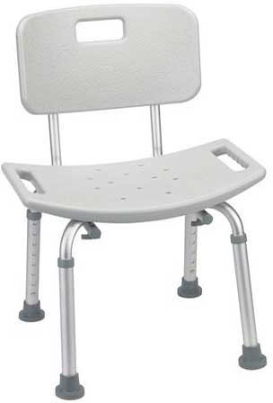
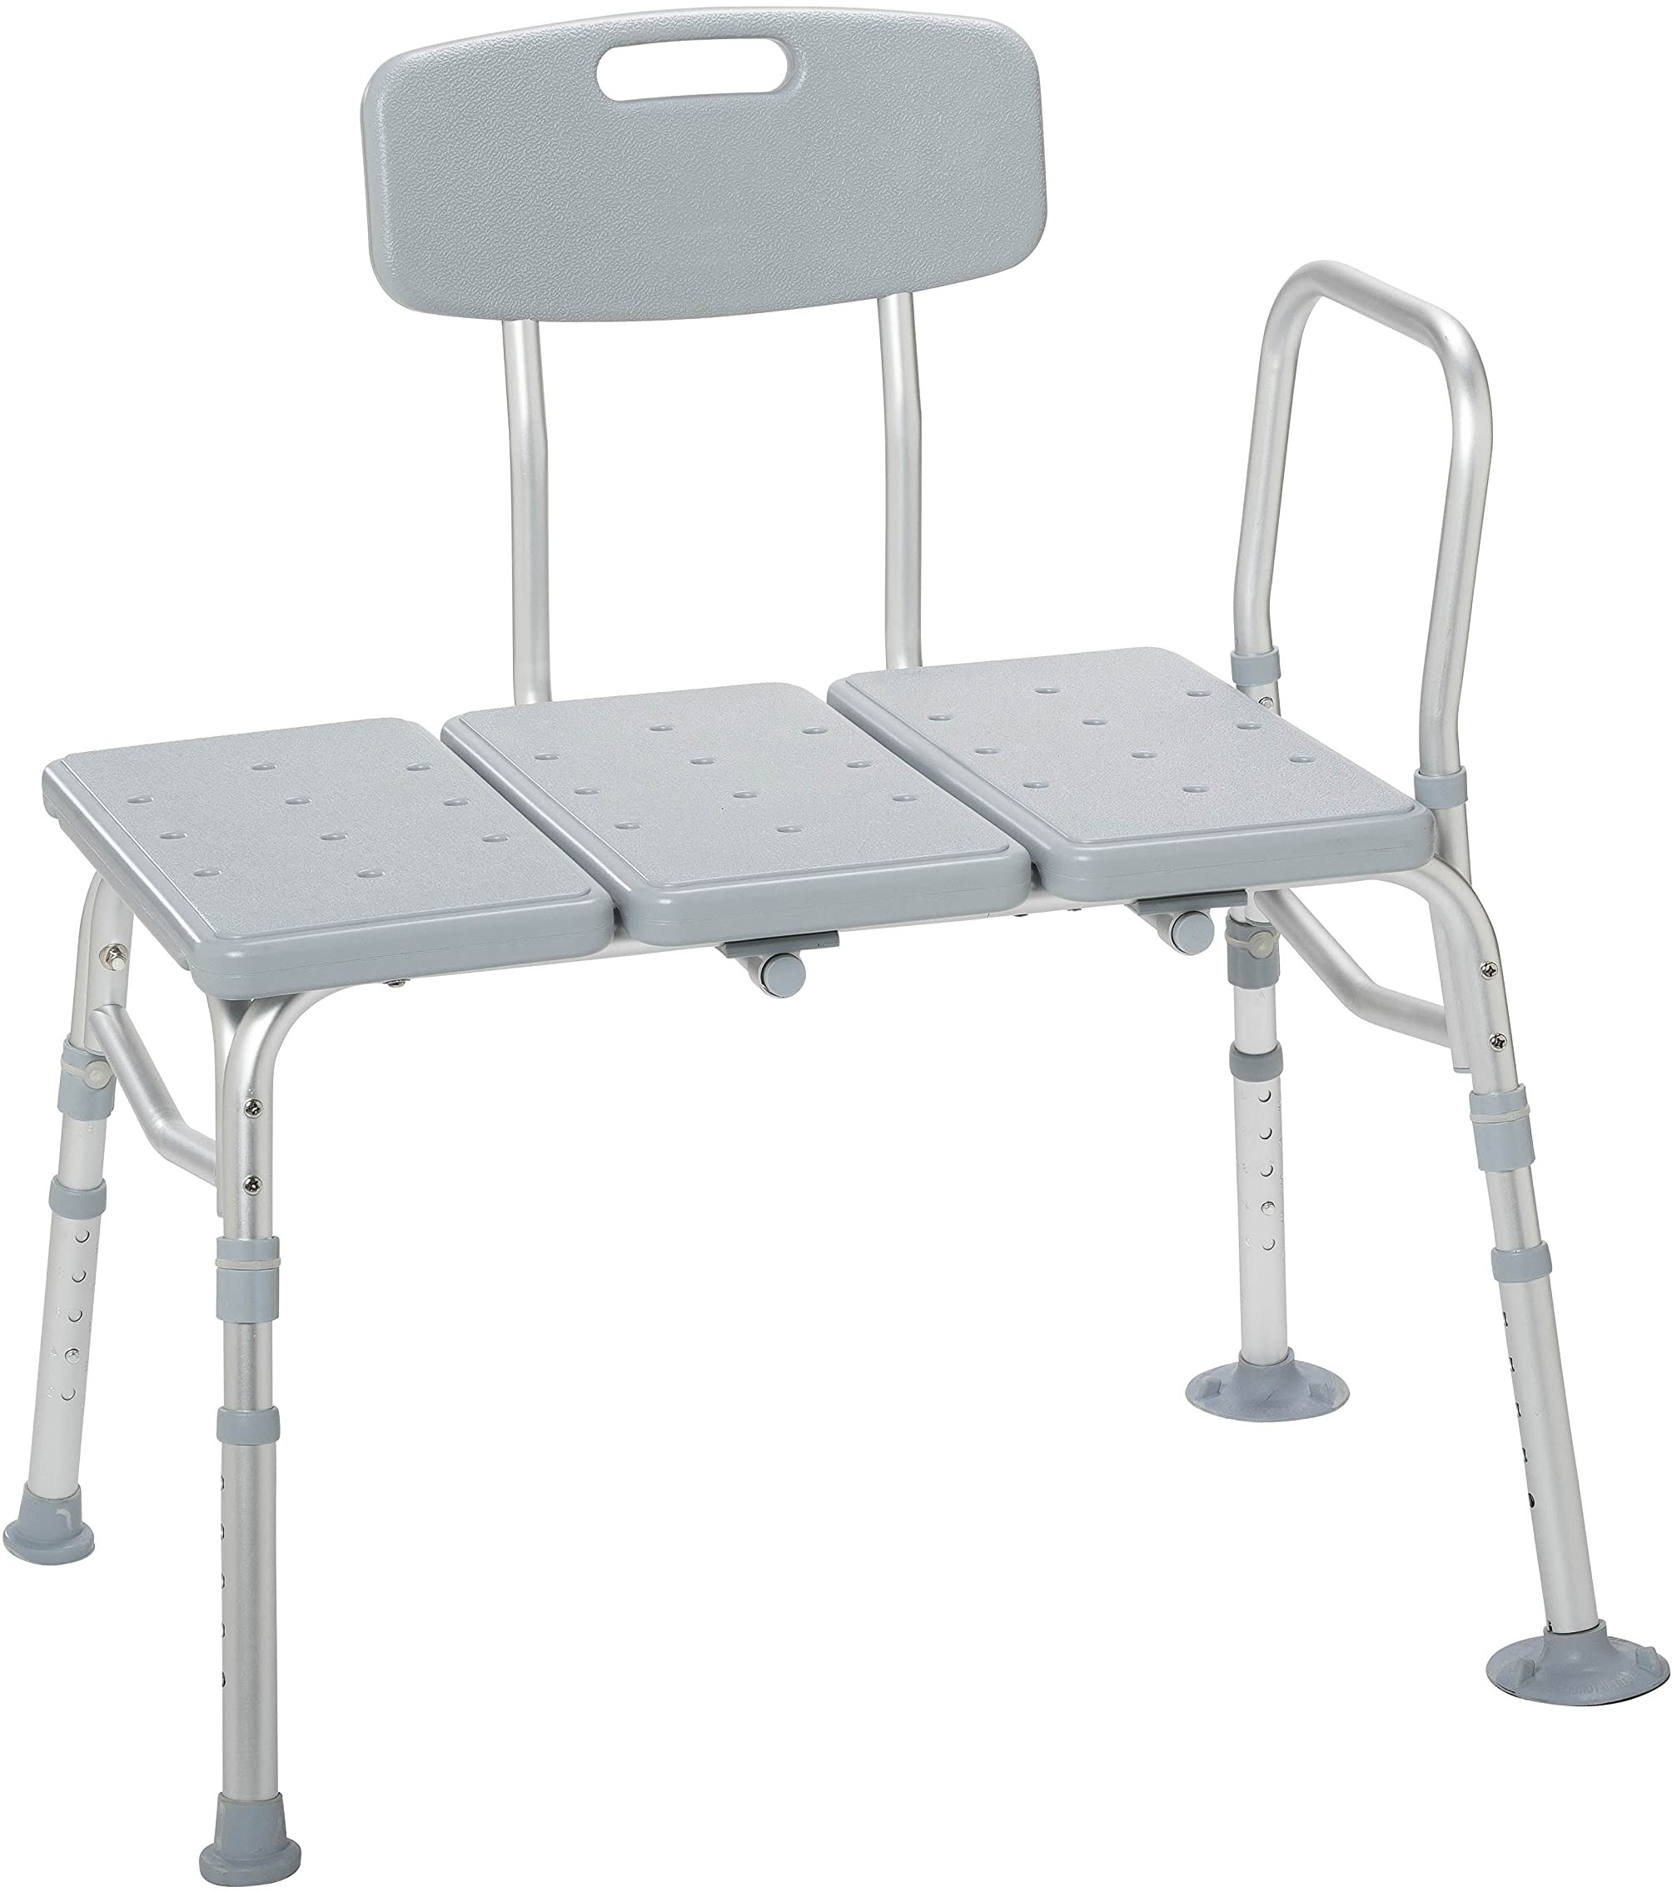
BATHROOM EQUIPMENT USED IN OT
STANDARD COMMODE | DROP ARM COMMODE | SHOWER CHAIR | TUB TRANSFER BENCH

Slide 24
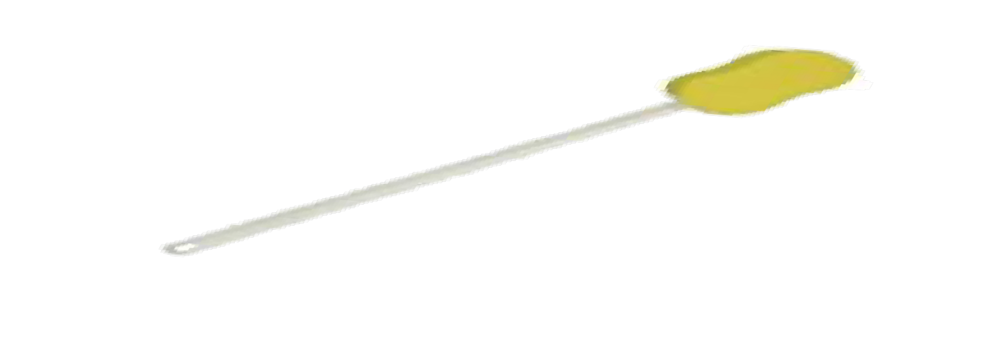
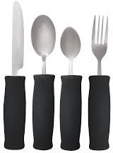
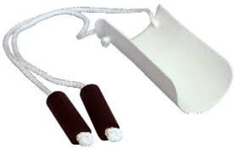
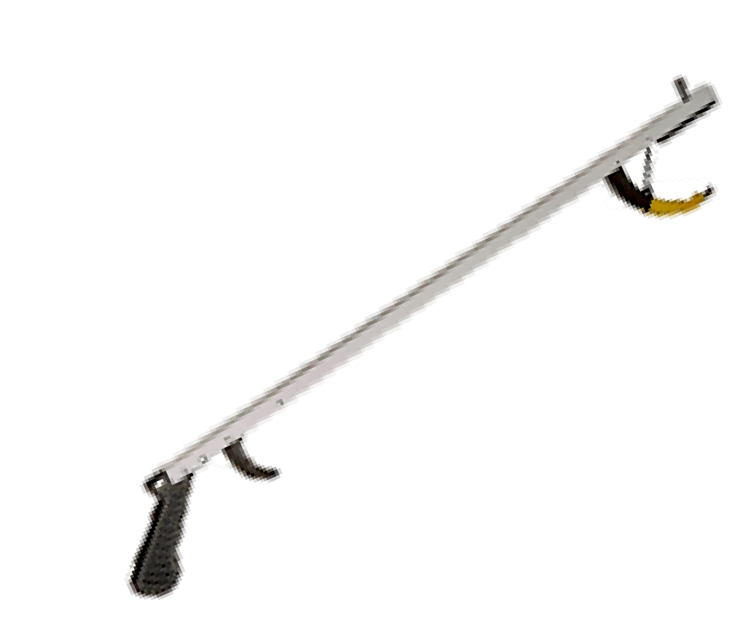


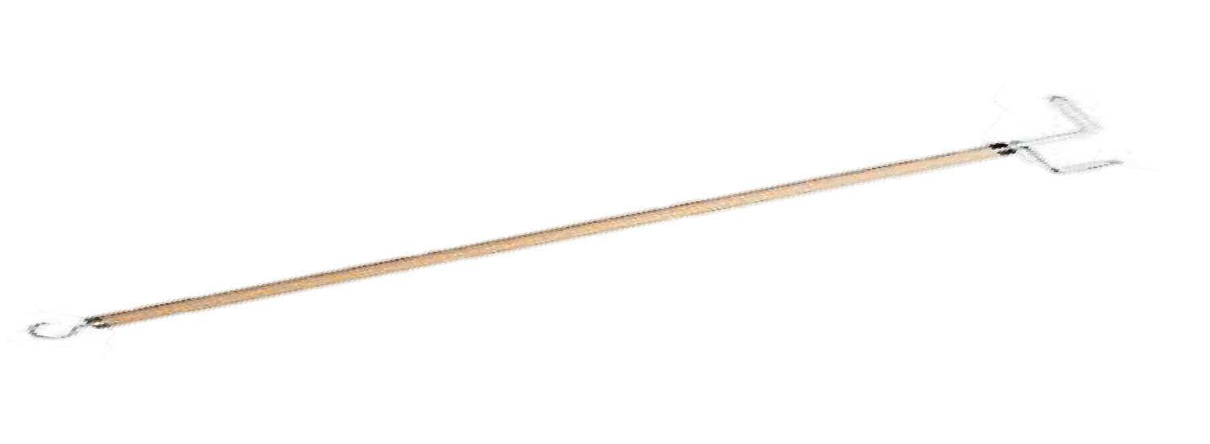
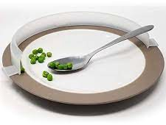
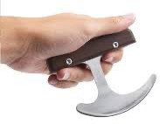
LONG HANDLED SPONGE
BUILT UP UTENSILS
SOCK AIDE
ADAPTIVE EQUIPMENT
REACHER
PLATE GUARD
ROCKER KNIFE
DRESSING STICK

Slide 25
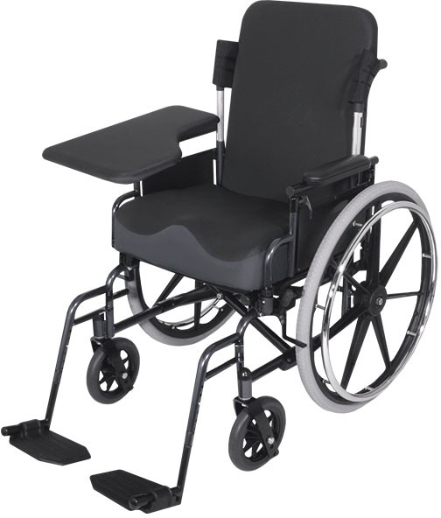

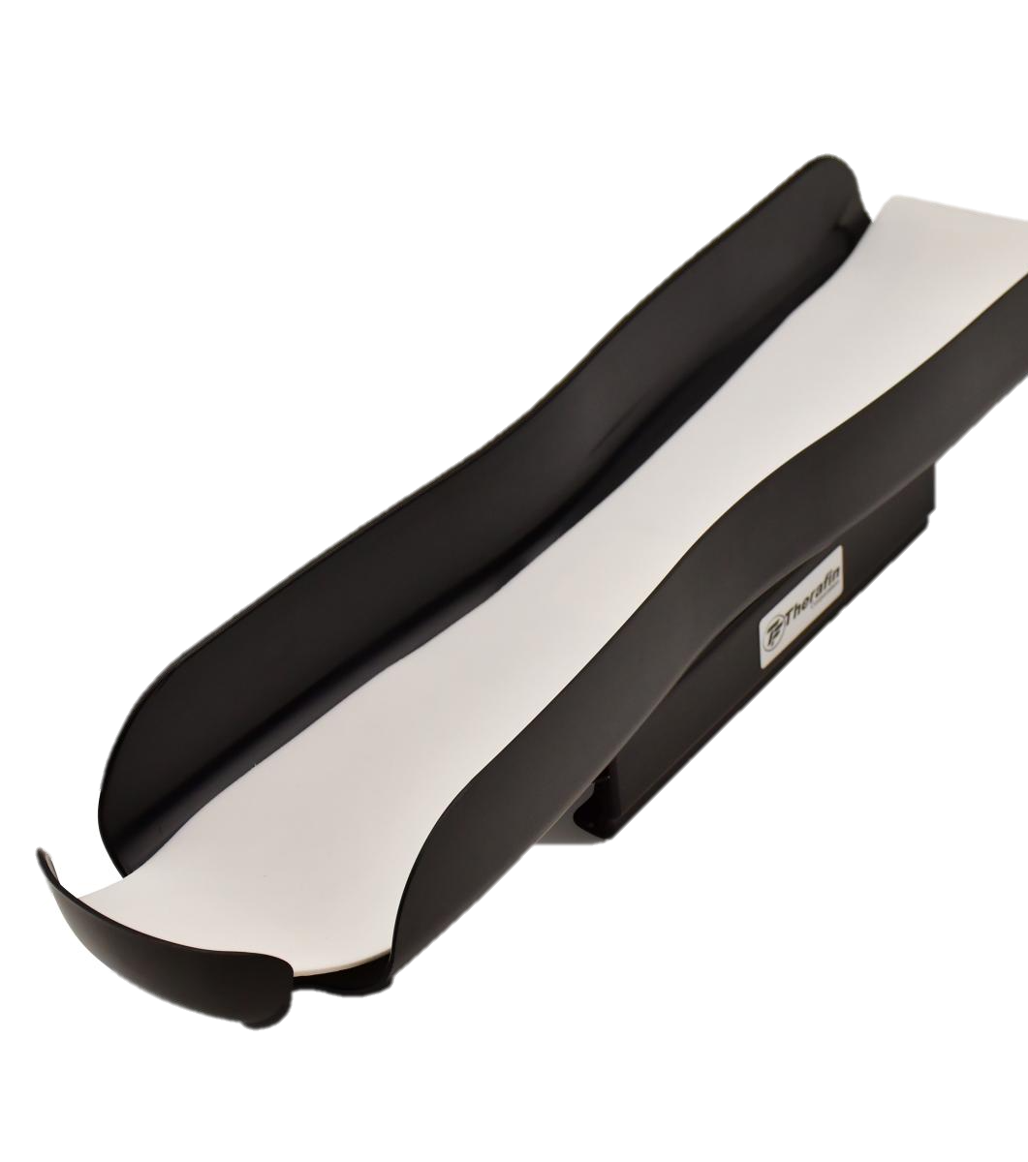
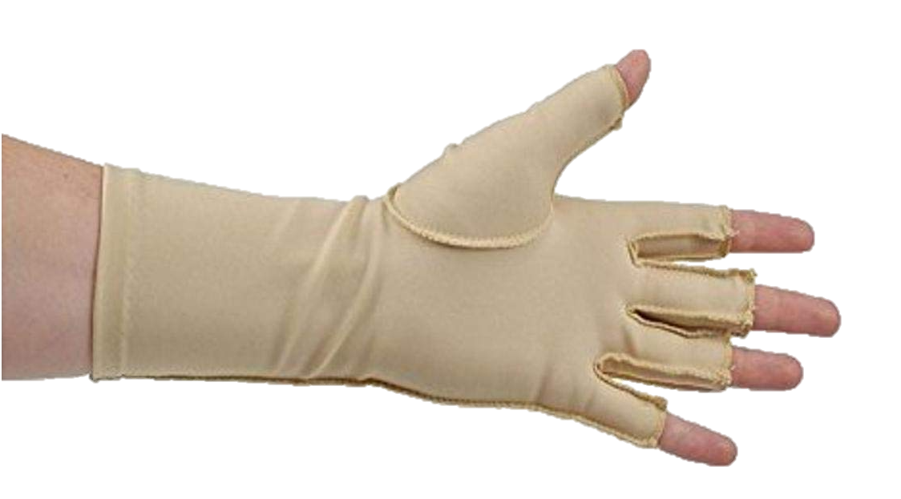
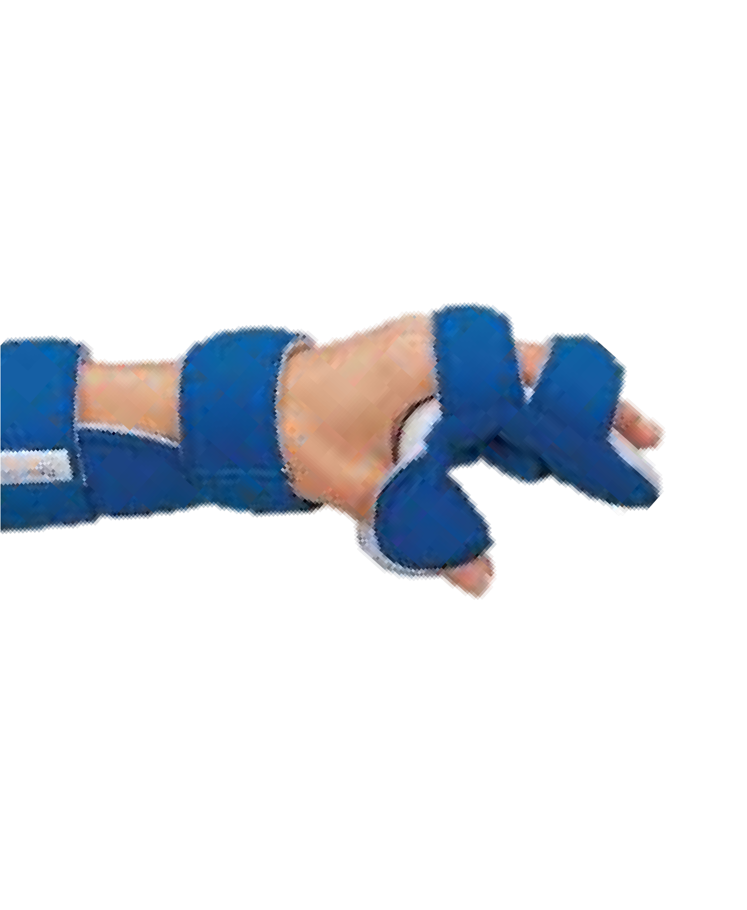
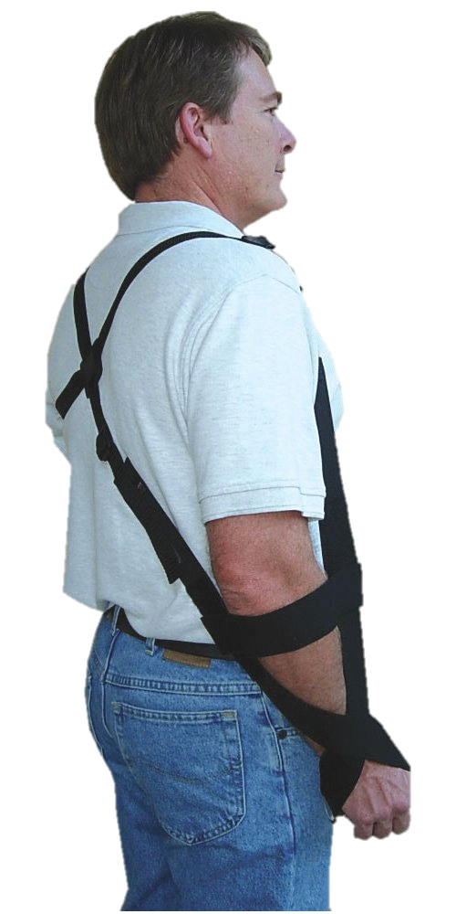
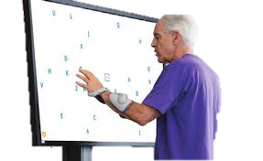

OT EQUIPMENT CONTINUED…
ARM TROUGH
EDEMA GLOVE
HALF LAP TRAY
RESTING HAND SPLINT
Bioness Integrated Therapy System (BITS)
BIONESS H200
GIV MOHR SLING

Slide 26

HOME SAFTEY TECHNIQUES AFTER A STROKE

Slide 27

FALL PREVENTION TECHNIQUES AFTER A STROKE

Slide 28

WHAT IS DYSPHAGIA?
Difficulty chewing or swallowing solid foods or liquids due to muscle weakness
Can lead to food/liquid getting into lungs (aspiration),which may lead to pneumonia

Slide 29

SIGNS OF DYSPHAGIA
Cough/choking while eating or drinking
Pocketing- holding food in their mouth/cheek
Leaking Food from the corner of their mouth
Regurgitation or food coming back up after they swallow
Complaint that food is stuck in chest or throat after swallowing
Trouble swallowing pills

Slide 30

MODFIED BARIUM SWALLOW TEST
Encompass Health | Confidential information

Slide 31



Fiberoptic Endoscopic Evaluation of Swallowing (FEES)

Slide 32
STRATEGIES FOR SAFE SWALLOWING
Small sips and small bites
Diet/liquid modifications
No straw
Check mouth for pocketed food
Positioning changes such as chin tuck
Alternating liquids and solids
Upright posture in bed or wheelchair (not reclined or laying down)
Meds presentation: crushed vs whole, with water or applesauce.

Slide 33



VITAL STIM THERAPY
A treatment method used to strengthen, retrain, and improve motor control of the swallowing muscles using Neuromuscular Electrical Stimulation (NMES)

Slide 34
COMMUNICATION DEFICITS SEEN WITH STROKES
Apraxia – Inability to perform purposeful movements of lips and tongue which prevents patient from saying sounds correctly
Dysarthria – slow or slurred speech
Expressive Aphasia – difficulty with talking and reading information
Receptive Aphasia - difficulty with understanding speech and commands
Global Aphasia – BOTH expressive and receptive aphasias
Speech Therapists will provide communication options for patients including Augmentative/Alternative communication boards for patients with tracheostomies

Slide 35

Communicating better with Patient
Encourage and praise attempts to speak
Make eye contact
Speak slowly and clearly
Reduce background noise
Allow extra time for responding
Give choices to ease decision making
Be an active listener
Keep sentences and questions short

Slide 36


COGNITIVE FUNCTION

Slide 37






ATTENTION TO TASK: WATCHING TV
FINANCES
FUNCTIONAL TASKS RELATED TO COGNITION
READING A CALENDAR
READING A NEWSPAPER
TELLING TIME

