Slide 1
New and Noteworthy:
Medications Coming to Market
Sarah Embrey, PharmD, BCPS
Clinical Pharmacy Specialist
Enterprise Medication Use Team
WVU Medicine
Sarah.Embrey@wvumedicine.org

Slide 2
Objectives
Identify new medications currently available or coming to market soon
Discuss how new medications may impact patient care and treatment guidelines
Review the biosimilar drug approval process and the effect on prescribers

Slide 3
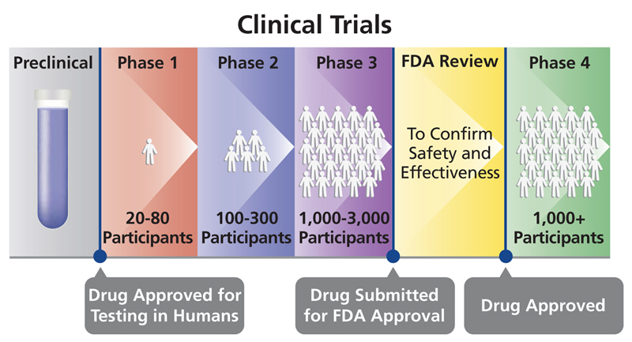
Drug Approval Process
PDUFA
https://oncobites.blog/2019/12/17/how-does-a-drug-get-approved/
Notes:
Phase I – safety, done in healthy patients (except oncology)
Phase II – efficacy is primary focus, but safety is secondary. Tested in “sick” patients
Phase III – “real world” population, look for adverse effects missed in smaller sample sizes of previous groups. Also still looking at safety and efficacy
Phase IV – post-marketing studies

Slide 4
What’s a PDUFA?
PDUFA = Prescription Drug User Fee Act
Once FDA accepts a filing for drug approval, review must be completed within 10 months
  “Deadline” for review is the PDUFA date
Priority Review = PDUFA date within 6 months
Dates not written in stone – FDA can request additional information and extend the date

Slide 5
Trends among pipeline medications

Slide 6
General Trends: More Of…
New indications rather than new drugs
Very niche genetic therapies
Oncology agents
Non-oral therapies
But things have slowed down!

Slide 7
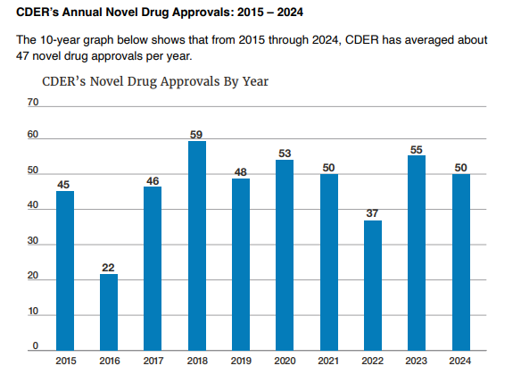
FDA Novel Drug Approval Trends
46 novel drug approvals in 2025
13 novel drugs approved so far in 2026
Notes:
CDER is center for drug evaluation and research
CDER identified 24 of the 50 novel drugs approved (48%) in 2024 as first-in-class. These drugs produce a novel pharmacologic effect, the impact or influence that a drug has on the body or a specific biological target, in a disease

Slide 8
Orphan Drugs/Rare Disease Treatment
Hemophilia A and B
Duchenne Muscular Dystrophy
Spinal Muscular Atrophy
Glycogen Storage Disease
Leber Hereditary Optic Neuropathy and Amaurosis 4
Huntington’s Disease
Hereditary Angioedema
Notes:
Take Care of Maya documentary

Slide 9
Other Updates
FDA rule from May 2025 expanding pathways for changing status of prescription meds to OTC status… like statins
Increased use of AI to speed up the review process at the FDA
Targeted therapies/personalized medicine utilizing genetic testing and biomarkers (more than just oncology)
Manufacturers staying busy with generic products – great for consumers

Slide 10
Biosimilars: a growing area

Slide 11
All in a Name…
Biologic
Medication that comes from organism
Can’t be made from “chemical recipe”
Biosimilar
Very similar to the original biologic it is modeled after
No clinically meaningful differences from the original biologic
Interchangable Biosimilar
Biosimilar product that can be substituted without the intervention of the prescriber
“Pharmacy-level substitution”
Medication
Created from chemicals
Able to create more based on “recipe”
Can create generics that are exact copies of branded medication
Not able to be 100% the same (no generic biologics)

Slide 12
Biosimilar Overview
OK to substitute without authorization from provider!
Patented Drug Approval
Biosimilar Approval
Biosimilar Approved to be Interchangable
Notes:
The FDA previously approved Rezvoglar as a biosimilar in December 2021 based on data demonstrating that there were no clinically meaningful differences between the biosimilar and the reference product. As an interchangeable biosimilar, Rezvoglar may now be substituted for Lantus at the pharmacy level without the need for an intervention from the prescriber.

Slide 13



Old dogs new tricks

Slide 14
New - Anaphylm: Epinephrine
Stage: Pending
Route: sublingual/buccal/oral
Indication: anaphylactic reactions
Class: alpha agonist
Bottom line: “Listerine strip” + EpiPen? Likely school nurse approved
Notes:
Size of postage stamp; avoids issues with the nasal epinephrine Neffy related to nasal polyps

Slide 15
New – ND0612: Carbidopa/Levodopa
Stage: CRL
Route: subcutaneous
Indication: Parkinson’s disease
Class: aromatic amino acid decarboxylation inhibitor and dopamine receptor agonist
Bottom line: 24h/day continuous subcutaneous infusion – avoids issues with frequent oral redosing, but at a tradeoff
Notes:
Pumps system with 2 infusion sites, administration site is abdomen. Increases bioavailability and reduces variability to provide more reliable relief of motor changes.
Also looking at “daytime” wear vs 24 hour in studies – so this one may be a little bit further out.
Two other subcutaneous continuous infusion products in development for PD. One of these needs surgical installation. Cost estimated to be upwards of $100k per year.

Slide 16
New – topical Semaglutide
Stage: currently withdrawn
Route: topical (transdermal patch)
Indication: type 2 diabetes
Class: glucagon-like peptide-1 agonist
Bottom line: gone for now but will likely try for a comeback
Question – what are your patients’ experiences with patches?
Notes:
Bioavailability was the main problem with this – studies were showing greater than 50% total. Delivery device was called HeroPatch.

Slide 17
New – Rybelsus: Semaglutide
Stage: Approved
Route: oral
Indication: MACE risk reduction
Class: glucagon-like peptide-1 agonist
Bottom line: at what point are we treating the underlying cause of disease vs treating the actual disease?
Notes:
The Food and Drug Administration (FDA) has approved Rybelsus® (semaglutide) to reduce the risk of major adverse cardiovascular events (MACE) (cardiovascular [CV] death, nonfatal myocardial infarction [MI], or nonfatal stroke) in adults with type 2 diabetes mellitus (T2DM) who are at high risk for these events.
The approval was based on the randomized, double-blind, parallel-group, placebo-controlled SOUL trial (ClinicalTrials.gov Identifier: NCT03914326), which evaluated oral semaglutide, a glucagon-like peptide-1 (GLP-1) receptor agonist, in adults 50 years and older with T2DM and established CV disease and/or chronic kidney disease (estimated glomerular filtration rate <60mL/min/1.73m²).
For each part of the composite endpoint, results showed:
CV death: 6.2% (oral semaglutide) vs 6.6% (placebo) (HR, 0.93 [95% CI, 0.80-1.09]).
Nonfatal MI: 4.0% (oral semaglutide) vs 5.2% (placebo) (HR, 0.74 [95% CI, 0.61-0.89]).
Nonfatal stroke: 3.0% (oral semaglutide) vs 3.3% (placebo) (HR, 0.88 [95% CI, 0.70-1.11]).

Slide 18
New – Semaglutide
Stage: Pending/Phase III
Route: subcutaneous
Indication: metabolic dysfunction-associated steatohepatitis (MASH), PAD in T2DM
Class: glucagon-like peptide-1 agonist
Bottom line: 13% (26.4 meters) improvement in maximum walking distance compared to placebo… no new updates since 2025, but potential Alzheimer’s benefit
Notes:
Semaglutide is a GLP-1 agonist that is available as a subcutaneous agent under the brand name Ozempic. Semaglutide has been shown to reduce measures of neuro-inflammation which may affect cognition and function.
Ozempic is being evaluated in a Phase 3 (NCT05891496) randomized double-blind placebo-controlled clinical study investigating the effects of Semaglutide subcutaneous (SC) once-weekly versus placebo on central and peripheral inflammation in 24 participants aged 55 to 75 years with Alzheimer's Disease (AD). Estimated study completion is in September 2025.
Participants will receive either semaglutide or placebo once weekly SC injections for 12 weeks during study intervention period 1 as an add on therapy to standard of care. All participants will receive 1.0 mg semaglutide SC injections once weekly for 52 weeks during study intervention period 2 as an add-on therapy to standard of care.
Primary endpoint measure is to evaluate change in gene expression assessed by single-cell ribonucleic acid sequencing (scRNAseq) (cells in cerebrospinal fluid [CSF]) and change in gene expression assessed by scRNAseq (cells in blood) from baseline to week 12.

Slide 19
New – Wegovy: Semaglutide
Stage: Pending/Phase III
Route: subcutaneous
Indication: HF with HFpEF in obesity
Class: glucagon-like peptide-1 agonist
Bottom line: maybe the fifth pillar of heart failure GDMT?

Slide 20
New – Leqembi Iqlik: Lecanemab-irmb
Stage: priority review
Route: subcutaneous
Indication: Alzheimer’s disease (initiation and maintenance)
Class: amyloid beta protein inhibitor
Bottom line: Available for maintenance now; patients must receive 18 months of IV infusions every 2 weeks currently, so this could be a new start
Notes:
Should the FDA approve the LEQEMBI IQLIK 500 mg SC dosing regimen (two 250 mg injections), the autoinjector could be used to administer a once-weekly starting dose, as an alternative to the current bi-weekly intravenous (IV) dosing. This would enable patients and care partners to choose SC administration at home for both treatment initiation and the currently approved maintenance therapy (360 mg), offering the option of SC or IV administration throughout the entire treatment journey. The injection time for LEQEMBI IQLIK autoinjector takes approximately 15 seconds per each 250 mg injection. The SC formulation also has the potential to reduce healthcare resources associated with IV dosing, such as infusion preparation and nurse monitoring, while streamlining the overall AD treatment pathway.

Slide 21
New – GTx-104: nimodipine
Stage: CRL
Route: IV
Indication: subarachnoid hemorrhage
Class: dihydropyridine calcium channel blocker
Bottom line: an obvious good addition – what took so long?
Notes:
Nimodipine is currently available only in oral capsule and oral liquid formulations.
GTX-104's IV formulation would offer an alternative administration route vs. nasogastric tube administration in unconscious or dysphagic patients. Given the likely dosing regimen, GTX-104 will likely only be administered in the hospital inpatient setting.
Grace Therapeutics notes that intravenous delivery of GTx-104 has the potential to lower food effects, drug-to-drug interactions, and eliminate potential dosing errors vs. other alternative nimodipine products.
GTx-104 has obtained Orphan Drug Designation for the treatment of aSAH.
Likely to be very expensive at 10-20k per treatment course. Orphan drug for inpatient use.

Slide 22
Status Update
Bijuva: estrogen and progesterone | Approved and available (hot flashes)
RSQ-777: bumetanide | Approved, not yet available (nasal)
Bronchitol: mannitol | Approved, not yet available
Risperidone implant | No updates, still pending
Cirara: glyburide | Not approved yet
Inhaled alprazolam | Not approved yet
Oral amphotericin B | No updates
Slenyto: melatonin | Not approved yet

Slide 23
For the kids

Slide 24
Mounjaro - Tirzepatide
Stage: Approved
Route: subcutaneous
Indication: improve glycemic control in pediatric patients 10 years of age and older with type 2 DM
Class: glucagon-like peptide-1 agonist
Bottom line: good for now, but what’s the endgame?

Slide 25
Ajovy – fremanezumab-vfrm
Stage: Approved
Route: subcutaneous
Indication: prevention of episodic migraine in patients 6-17 years of age
Class: calcitonin gene-related peptide inhibitor
Bottom line: monthly injection that could improve quality of life for kids
Notes:
SPACE is a Phase 3, multicenter, randomized, double-blind, placebo-controlled, parallel-group study comparing the efficacy, safety, and tolerability of monthly SC administration of Ajovy versus placebo over a 12-week period for the preventive treatment of episodic migraine in 237 pediatric patients aged 6 to 17 years. • The trial demonstrated statistically significant improvements in reducing monthly migraine days (MMDs; −2.5 vs. −1.4; P = 0.0210) and monthly headache days (MHD; −2.6 vs. −1.5; P = 0.0172) compared to placebo, with a safety profile consistent with that observed in the adult population. Place in Therapy • If approved, Ajovy would be the only CGRP antagonist for migraine prevention in adults and for episodic migraine prevention in pediatric patients. Other preventative CGRP antagonists are indicated in adults only. •
In the United States, approximately 5% of children are diagnosed with migraine by 10 years of age, and the overall estimated prevalence is around 10%.

Slide 26
High Dollar Genetic and Novel Therapies
Kresladi
Marnetegragene autotemcel
For leukocyte adhesion deficiency
Doruxapapogene ralaplasmid
Treatment of recurrent respiratory papillomatosis
$500K per treatment course
DB-OTO
Limb-girdle muscular dystrophy
$750K per year
$3 million x 1 dose
Ribitol
Friedreich’s ataxia
$500K per year
Nomlabofusp
Otoferlin-related hearing loss
$2 million x 1 dose per ear
Notes:
DB-OTO is an investigational, cell-selective, dual adeno-associated virus (AAV) vector gene therapy designed to provide durable, physiological hearing to individuals with profound, congenital hearing loss caused by variants of the OTOF gene. • Otoferlin-related deafness is reported to occur in an estimated 10,000–20,000 people in the United States, which is a small percentage of the 28.8 million patients in the United States estimated to have hearing loss. • On October 12, 2025, Regeneron announced that updated data were published in the New England Journal of Medicine from the pivotal Phase 2 CHORD trial. These latest results show that 11 of 12 participants have experienced clinically meaningful hearing improvements, including three who achieved normal hearing levels. Additionally, eight participants with longer follow-ups showed stability or continued improvement in their hearing, and among three who completed speech assessments, all showed significant improvement.

Slide 27
Fresh and new

Slide 28
Cytisinicline
Stage: Pending
Route: oral
Indication: smoking cessation ade
Class: nicotinic acetylcholine receptor agonist
Bottom line: similar to Chantix, but dosed TID rather than BID; going after the e-cigarette/vaping indication specifically, but it’s natural
Notes:
Cytisinicline is a plant-based alkaloid with a high binding affinity to the nicotinic acetylcholine receptor. It is believed to aid in treating nicotine addiction for smoking and e-cigarette cessation by acting as a partial agonist and interacting with nicotine receptors in the brain, reducing the severity of withdrawal symptoms, and reducing the reward and satisfaction associated with nicotine products.
Mechanism of action is similar to that of Chantix, works by reducing severity of withdrawal and reducing the satisfaction associated with smoking; agent has a 6-week treatment, with an option to extend to 12-weeks.
Cytisinicline is dosed as 3mg TID for either 6-weeks or 12-week in clinical trials and will primarily compete with generic versions of varenicline (Brand name: Chantix), given BID, as an aid to smoking cessation in adults.
This agent is also in development as a treatment to aid in nicotine e-cigarette cessation (formal Phase 3 planned for 1H 2026); there are no FDA-approved treatments for this specific indication. If approved, would be the first FDA-approved nicotinic acetylcholine receptor agonist for the aid to nicotine e-cigarette cessation.
Positive differentiators of cytisinicline therapy include the flexible treatment duration and better GI tolerability compared to Chantix; additionally, should the vaping indication receive approval in 2026, this will further differentiate this agent’s place in therapy.
A potential additional benefit of cytisinicline is that some patients may be willing to try it for smoking cessation because it is a natural, plant-based product. Furthermore, any “new” therapy is likely to lead to some patients who previously were unable to quit smoking to make additional attempts.

Slide 29
Revascor: Rexlemestrocel-L
Stage: Phase III
Route: IV
Indication: chronic heart failure; hypoplastic left heart syndrome
Class: stem cell therapy
Bottom line: 1 time treatment, “improves survival in high-risk patients with ischemic heart failure and inflammation” – difficulty with logistics of treatment
Notes:
Results from the randomized, controlled DREAM-HF trial in patients with chronic heart failure with reduced ejection fraction (HFrEF) identified the control group at highest risk of cardiovascular death as being those with ischemic etiology and inflammation and showed that a single intramyocardial injection of Mesoblast’s mesenchymal precursor cell therapy (MPCs; rexlemestrocel-L) resulted in a sustained reduction in cardiovascular mortality in these high-risk patients. This identifies the target HFrEF population that is responsive to REVASCOR therapy.
“Mesoblast’s allogeneic MPCs may restore the balance between anti-inflammatory and pro-inflammatory cytokines in the damaged, inflamed heart. A single administration of MPCs appears sufficient to improve survival and other major clinical outcomes in high-risk HFrEF patients with inflammation. These effects are seen on top of existing treatments that target neurohormonal imbalances and congestion, providing a disease-modifying approach not achievable with standard-of-care alone.”
The newly published results showed that over a mean follow-up of 30 months in the DREAM-HF trial:
Factors portending the greatest risk for cardiovascular death in control patients were inflammation (baseline plasma high-sensitivity C-reactive protein ≥2 mg/L; p=0.003) and ischemic HFrEF etiology (p=0.097), with increased cardiovascular death risk of 61% and 38%, respectively.
A single intra-myocardial MPC administration significantly lowered the risk of cardiovascular death in HFrEF patients with inflammation regardless of whether plasma hsCRP or plasma IL-6 was used as inflammatory biomarker by 80% (p=0.003) and 60% (p=0.037) respectively.
MPCs reduced 2-point MACE (heart attack or stroke) by 57% (p=0.016) and 3-point MACE (cardiovascular death, heart attack, stroke) by 35% (p=0.049) in patients with ischemic HFrEF (n=303) compared to controls.
MPCs reduced 2-point and 3-point MACE by 88% (p=0.005) and 52% (p=0.018) respectively, in patients with ischemic HFrEF and inflammation (n=158) compared to controls.

Slide 30
RBT-1: iron sucrose; stannic protoporfin
Stage: Phase 3
Route: IV
Indication: reduce risk of postoperative complications in patients undergoing cardiothoracic surgery
Class: iron supplement
Bottom line: may lead to fewer transfusions during CT surgery, relatively cost effective
Notes:
RBT-1 is a combination of stannic protoporfin and iron sucrose. The product is thought to activate a preconditioning response through antioxidant, anti-inflammatory, and iron-scavenging pathways to protect against organ damage, postoperative complications, and the need for blood products in patients undergoing cardiothoracic surgery. • RBT-1 is administered as a single IV infusion over 1–2 hours, given 24–48 hours prior to elective cardiac and/or valve surgery. • The Phase 3 PROTECT trial (NCT06021457) is a pivotal, randomized (1:1), placebo-controlled study evaluating the effect of RBT-1 on reducing the risk of postoperative complications in 454 adults undergoing cardiac surgery. The study was completed in June 2025, but no data are available at the time of this publication. • RBT-1 received Breakthrough and Fast Track designations from the FDA.

Slide 31
Cefepime/Taniborbactam
Stage: Phase III
Route: IV
Indication: ventilator associated pneumonia, complicated urinary tract infection
Class: cephalosporin/beta-lactamase inhibitor
Bottom line: another tool in the multidrug resistant infection toolbelt for gram negative infections
Notes:
Taniborbactam is a beta-lactamase inhibitor (BLI) that, in combination with cefepime, may offer a potential treatment option for patients with serious bacterial infections caused by difficult-to-treat drug resistant gram-negative bacteria, most notably carbapenem-resistant Enterobacterales (CRE) and carbapenem-resistant Pseudomonas aeruginosa (CRPA). Many of these organisms are also multidrug-resistant (MDR), further limiting treatme
CERTAIN-1 (Cefepime Rescue with Taniborbactam in cUTI) (ClinicalTrials.gov – NCT03840148) was a global, randomized, double-blind, active-controlled non-inferiority Phase 3 study evaluating the efficacy, safety, and tolerability of cefepime-taniborbactam compared to meropenem in adults with cUTI, including acute pyelonephritis. The trial enrolled 661 adult patients who were randomized 2:1 to receive cefepime-taniborbactam 2.5g q8h or meropenem 1g q8h for 7 days (up to 14 days for patients with bacteremia). The primary efficacy endpoint evaluated the composite clinical and microbiologic response (i.e., bacterial eradication) at the Test of Cure (TOC) visit (Day 19-23) in the microbiological intent-to-treat (microITT) population as specified by FDA and European Medicines Agency guidance.nt options.

Slide 32
OP0595: nacubactam
Stage: Developing
Route: IV
Indication: treatment of carbapenem-resistant Enterobacterales (CRE)
Class: beta-lactamase inhibitor
Bottom line: needs to find a beta-lactam antibiotic friend, but looks promising so far for CRE
Notes:
OP0595 (nacubactam) injection is under development outside of the United States by Meiji Seika Pharma and is currently in Phase 3 trials (Integral-1 and Integral-2). It is being studied in combination with aztreonam or cefepime for cUTI, AP, HABP, VABP, and cIAI due to carbapenem-resistant Enterobacterales (CRE). • The Integral-1 (NCT05887908) and Integral-2 (NCT05905055) studies are comparing the efficacy and safety of cefepime/nacubactam or aztreonam/nacubactam (2 g cefepime or aztreonam and 1 g nacubactam IV over 60 minutes, every 8 hours for 5–14 days) with either imipenem/cilastatin (1 g imipenem/1 g cilastatin IV over 60 minutes, every 8 hours) or best available therapy for the treatment of cUTI or AP in adults. Integral-2 includes patients with targeted infections due to CRE. o The primary efficacy endpoint of the trials is the proportion of patients who achieve composite clinical and microbiological success at the test of cure (TOC) in the microbiological modified intentto-treat (m-MITT) population. Integral-2’s primary efficacy endpoint also included composite endpoints derived from the efficacy outcomes of each infection type. o Integral-1 was completed in November 2024; both cefepime/nacubactam and aztreonam/ nacubactam were noninferior to imipenem/cilastatin for the primary endpoint. Regimens with nacubactam had similar safety profiles to the control

Slide 33
All That And…
Drug Shortages
Insurance Copay
Regular vs Specialty Pharmacy
Previous /Step Therapies
Patient Compliance
Adverse Effects
REMS Programs
Interactions

Slide 34
The pharmacist’s plea

Slide 35
Accurate Medication Reconciliation
Many more non-oral and non-daily medications
  Easy for patients to forget what they are “currently” taking
Significant drug interactions/additional considerations may be present
  May not always be obvious to the patient when these are relevant vs not

Slide 36
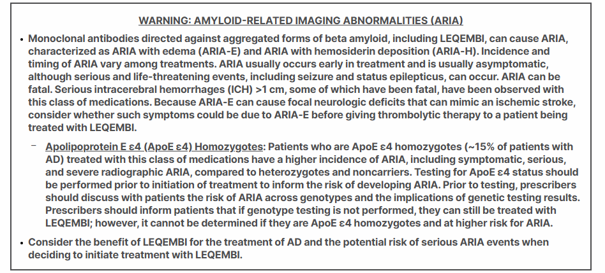
Leqembi (lecanemab-irmb)
Notes:
AMYLOID-RELATED IMAGING ABNORMALITIES
Medications in this class, including LEQEMBI, can cause ARIA-E, which can be observed on MRI as brain edema or sulcal effusions, and ARIA-H, which includes microhemorrhage and superficial siderosis. ARIA can occur spontaneously in patients with AD, particularly in patients with MRI findings suggestive of cerebral amyloid angiopathy (CAA), such as pretreatment microhemorrhage or superficial siderosis. ARIA-H generally occurs with ARIA-E. Reported ARIA symptoms may include headache, confusion, visual changes, dizziness, nausea, and gait difficulty. Focal neurologic deficits may also occur. Symptoms usually resolve over time.
Incidence of ARIA
Symptomatic ARIA occurred in 3% and serious ARIA symptoms in 0.7% with LEQEMBI. Clinical ARIA symptoms resolved in 79% of patients during the period of observation. ARIA, including asymptomatic radiographic events, was observed: LEQEMBI, 21%; placebo, 9%. ARIA-E was observed: LEQEMBI, 13%; placebo, 2%. ARIA-H was observed: LEQEMBI, 17%; placebo, 9%. No increase in isolated ARIA-H was observed for LEQEMBI vs placebo.
Incidence of ICH
ICH >1 cm in diameter was reported in 0.7% with LEQEMBI vs 0.1% with placebo. Fatal events of ICH in patients taking LEQEMBI have been observed.

Slide 37
Summary
Many new medications currently in the development pipeline
Cost will continue to be a factor for patients when prescribing new medications
Important to have level-setting conversations with patients regarding new treatments looking at the big picture of their individual needs

Slide 38
References
Research C for DE and. Development & approval process | drugs. FDA. August 25, 2025. Accessed April 27, 2026. https://www.fda.gov/drugs/development-approval-process-drugs
Research C for DE and. Prescription drug user fee amendments. FDA. April 15, 2026. Accessed April 27, 2026. https://www.fda.gov/industry/fda-user-fee-programs/prescription-drug-user-fee-amendments
IPD analytics | the industry leader in drug life-cycle insights. IPD Analytics. Accessed April 27, 2026. https://www.ipdanalytics.com

Slide 39
New and Noteworthy:
Medications Coming to Market
Sarah Embrey, PharmD, BCPS
Clinical Pharmacy Specialist
Enterprise Medication Use Team
WVU Medicine
Sarah.Embrey@wvumedicine.org

