Slide 1



Optimizing Outcomes in Chronic Wound Management
Improving Healing Through Evidence-Based, Patient-Centered Care
Presented by: Elisha Payne, APRN
Notes:
Today we will focus on optimizing outcomes in chronic wound management with an emphasis on clinical decision-making

Slide 2
Presentation objectives
Define chronic wounds
Review pathophysiology
Differentiate pressure, diabetic, and vascular ulcers
Apply evidence-based treatment strategies
Recognize complications and systemic influences

Slide 3
What is a chronic wound?
A chronic wound is a wound that fails to progress through the normal stages of healing in an expected timeframe, typically within 4 weeks, or does not show measurable improvement after appropriate treatment.
As Defined by Advances in Wound Care Journal

Slide 4
Normal Wound Healing Physiology
🩸 Hemostasis
🔥 Inflammation
🌱 Proliferation (granulation, angiogenesis, epithelialization)
🔁 Remodeling
Notes:
Normal wound healing progresses through four overlapping phases: hemostasis, inflammation, proliferation, and remodeling.
Hemostasis occurs immediately after injury. Platelets aggregate and clot formation begins, stabilizing the wound and releasing growth factors that initiate healing.
The inflammatory phase follows and is characterized by vasodilation, increased vascular permeability, and migration of neutrophils and macrophages. These cells remove debris and bacteria while signaling the next phase of healing.
During the proliferative phase, fibroblasts produce collagen, angiogenesis occurs, and granulation tissue forms. Epithelialization begins, and the wound contracts.
Finally, the remodeling phase strengthens the wound through collagen reorganization and maturation. This phase can last months to years.
In chronic wounds, this orderly progression becomes disrupted. Most commonly, the wound becomes stalled in the inflammatory phase. Persistent inflammation leads to elevated proteases such as matrix metalloproteinases, which degrade growth factors and extracellular matrix. Instead of progressing to granulation and tissue repair, the wound remains in a cycle of tissue breakdown.
Clinically, when we see a wound that is not reducing in size, continues to produce excessive exudate, or demonstrates persistent slough, we should consider that it may be stuck in this inflammatory state. The goal of advanced wound care is often to shift the wound environment out of chronic inflammation and back into a healing trajectory.

Slide 5
Pathophysiology of Chronic Wounds
🔥 Persistent inflammation
🦠 Biofilm formation
💔 Impaired angiogenesis
🌬 Tissue hypoxia
♻ Repeated ischemia-reperfusion
Notes:
Chronic wounds develop because the normal healing cascade becomes dysregulated. Several key pathophysiologic mechanisms drive this process.
🔥 Persistent Inflammation
In acute healing, inflammation is temporary and controlled. In chronic wounds, however, inflammatory cells such as neutrophils and macrophages remain persistently activated. This results in elevated levels of pro-inflammatory cytokines and matrix metalloproteinases (MMPs). These enzymes degrade growth factors and extracellular matrix components that are necessary for tissue repair. Instead of building new tissue, the wound environment continues to break it down.
🦠 Biofilm Formation
Many chronic wounds contain bacterial biofilms — structured microbial communities encased in a protective extracellular matrix. Biofilms are resistant to antibiotics and evade host immune responses. They perpetuate low-grade inflammation and prevent epithelialization. This is why mechanical disruption, such as debridement or ultrasound therapy, is often necessary in stalled wounds.
💔 Impaired Angiogenesis
New blood vessel formation is critical during the proliferative phase. In chronic wounds, angiogenesis is impaired due to diabetes, vascular disease, smoking, and chronic inflammation. Without adequate capillary growth, oxygen and nutrient delivery is insufficient to support granulation tissue formation.
🌬 Tissue Hypoxia
Oxygen is essential for collagen synthesis, fibroblast activity, and bacterial defense. Chronic wounds often exist in a hypoxic environment due to arterial insufficiency, edema, pressure, or microvascular disease. Persistent hypoxia shifts the wound toward necrosis rather than regeneration.
♻ Repeated Ischemia-Reperfusion Injury
In pressure injuries and vascular disease, tissues undergo cycles of reduced blood flow followed by reperfusion. This process generates reactive oxygen species and oxidative stress, further damaging cellular structures and prolonging inflammation.

Slide 6
Systemic Factors that delay healing
🍬 Diabetes
🫀 Peripheral arterial disease
🌊 Venous insufficiency
🥣 Malnutrition
🚬 Smoking
⚖ Obesity
🪑 Immobility
🩸 Anemia
🧪 CKD
💊 Steroid use
Notes:
Chronic wounds rarely fail because of local wound care alone. More often, systemic conditions create a physiologic environment that impairs tissue repair. Identifying and correcting these factors is essential for optimizing outcomes.
🍬 Diabetes
Hyperglycemia impairs leukocyte function, reduces chemotaxis and phagocytosis, and increases susceptibility to infection. It also disrupts collagen synthesis and angiogenesis. Microvascular disease further compromises oxygen delivery. Tight glycemic control is one of the most impactful interventions for improving wound healing.
🫀 Peripheral Arterial Disease (PAD)
PAD reduces arterial blood flow, limiting oxygen and nutrient delivery. Without adequate perfusion, fibroblasts cannot synthesize collagen effectively. Always assess pulses and consider ABI testing before initiating compression or aggressive debridement.
🌊 Venous Insufficiency
Venous hypertension causes capillary leakage, edema, and inflammatory mediator accumulation. Persistent edema impairs oxygen diffusion and nutrient exchange. Compression therapy, when appropriate, addresses the underlying mechanism.
🥣 Malnutrition
Protein is critical for collagen formation and immune function. Deficiencies in protein, vitamin C, zinc, and overall caloric intake impair granulation tissue formation. Albumin may reflect inflammation rather than nutrition alone, but nutritional assessment remains vital.
🚬 Smoking
Nicotine causes vasoconstriction and reduces oxygen delivery. Carbon monoxide decreases oxygen-carrying capacity. Smoking also impairs fibroblast activity and collagen deposition. Even short-term cessation improves tissue oxygenation.
⚖ Obesity
Obesity increases inflammatory cytokines, impairs mobility, and contributes to venous hypertension and pressure injuries. Adipose tissue has relatively poor vascularity, which further impairs healing.
🪑 Immobility
Reduced mobility increases risk for pressure injuries and venous stasis. Muscle contraction normally assists venous return; without it, edema worsens. Mobility promotion is a therapeutic intervention, not just prevention.
🩸 Anemia
Hemoglobin carries oxygen necessary for collagen synthesis and cellular metabolism. Low hemoglobin reduces tissue oxygenation and delays healing. Consider evaluating and addressing reversible causes.
🧪 Chronic Kidney Disease (CKD)
CKD contributes to uremia, anemia, protein imbalance, and chronic inflammation. These factors collectively impair wound healing. Additionally, vascular calcification is more common, complicating perfusion assessment.
💊 Steroid Use
Chronic corticosteroid use suppresses inflammation but also inhibits fibroblast proliferation, collagen synthesis, and angiogenesis. When possible, dose minimization or coordination with the prescribing specialist may support improved healing.

Slide 7
Pressure injury Pathophysiology
🛏️ Prolonged pressure → ischemia
↔ Shear and friction
💧 Moisture-associated skin damage
🩻 Microvascular occlusion
📍 Common sites: sacrum, heels, hips, occiput
Notes:
Pressure injuries develop when mechanical forces exceed the tissue’s ability to tolerate them. The process is ischemic at its core, but multiple contributing mechanisms are involved.
🛏️ Prolonged Pressure → Ischemia
When external pressure exceeds capillary closing pressure — approximately 32 mmHg — blood flow to the tissue is compromised. Sustained compression leads to reduced oxygen and nutrient delivery, resulting in cellular hypoxia, anaerobic metabolism, and eventual tissue necrosis. Deep tissue damage may begin at the muscle level before skin changes become visible.
↔ Shear and Friction
Shear occurs when the skin remains stationary while underlying tissues shift, such as when the head of the bed is elevated. This stretches and distorts blood vessels, worsening ischemia at a deeper level. Friction, on the other hand, causes superficial epidermal damage. Shear is more destructive because it affects deeper structures and compromises microcirculation.
💧 Moisture-Associated Skin Damage (MASD)
Excess moisture from incontinence, perspiration, or wound drainage macerates the skin, weakening its barrier function. Macerated skin is more susceptible to breakdown under minimal pressure or friction. Moisture also alters skin pH, increasing bacterial colonization risk.
🩻 Microvascular Occlusion
In vulnerable populations — including older adults, diabetics, and patients with vascular disease — microvascular circulation is already compromised. Capillary collapse, endothelial dysfunction, and thrombosis further reduce perfusion. This explains why some patients develop deep tissue injury rapidly despite seemingly minimal external pressure.
📍 Common Sites: Sacrum, Heels, Hips, Occiput
Pressure injuries occur most frequently over bony prominences where soft tissue padding is minimal. In supine patients, the sacrum and heels are highest risk. In lateral positioning, the greater trochanters are vulnerable. In patients with limited mobility or medical devices, additional areas may be affected.

Slide 8
Pressure injury Classification
⚠️ Stage I – Non-blanchable erythema
⚠️ Stage II – Partial thickness loss
⚠️ Stage III – Full-thickness loss, adipose visible
⚠️ Stage IV – Exposed bone, tendon, muscle
❓ Unstageable – Covered by slough or eschar
🦋 Kennedy Terminal Ulcer – Rapid onset, end-of-life

Slide 9
Pressure injury Characteristics
📍 Located over bony prominences
🩹 May be painful unless neuropathy present
🌀 Tunneling/undermining common

Slide 10
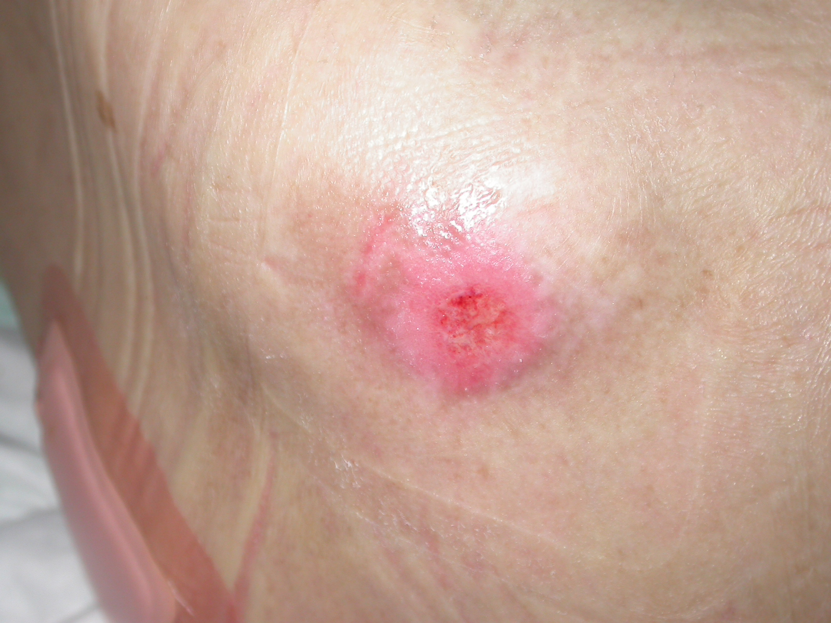
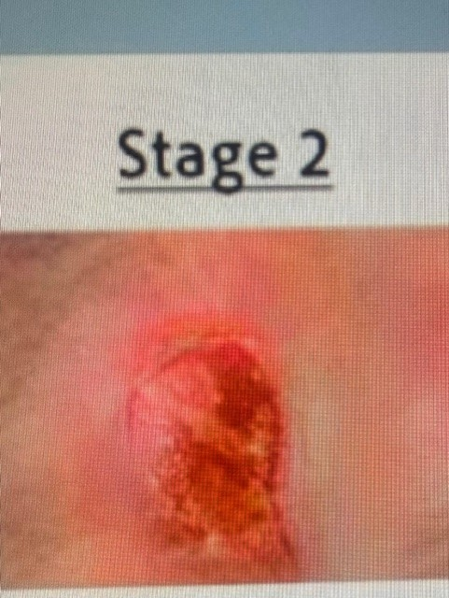
Pressure INJURY stages
Stage I
Stage II

Slide 11
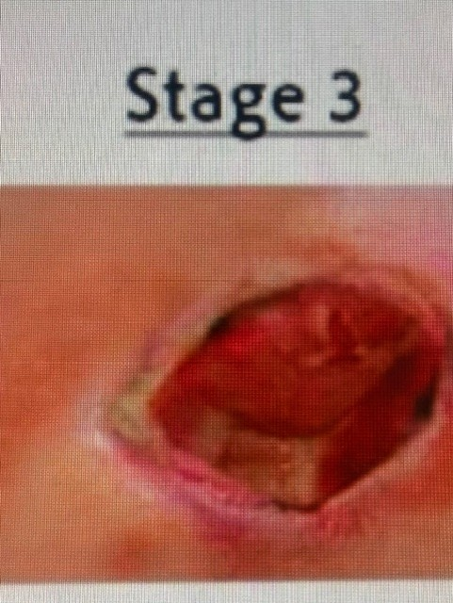
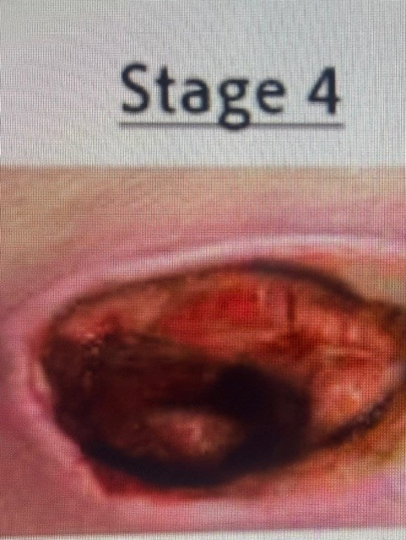
Pressure Ulcer Stages
Stage III
Stage IV

Slide 12
Pathophysiology of Diabetic Ulcers
🦶 Peripheral neuropathy
⚠️ Loss of protective sensation
🔁 Repetitive trauma
🫀 Microvascular disease
🍬 Hyperglycemia impairs immunity
Notes:
Peripheral Neuropathy
Chronic hyperglycemia damages peripheral nerves over time.
Sensory, motor, and autonomic nerves can all be affected.
Sensory neuropathy reduces the patient’s ability to feel pain, temperature, and pressure.
Motor neuropathy causes muscle imbalance and foot deformities such as hammertoes or Charcot foot, creating abnormal pressure points.
Autonomic neuropathy decreases sweating, leading to dry, cracked skin that is more vulnerable to breakdown and infection.
Neuropathy is one of the primary contributors to diabetic foot ulcer formation
Loss of Protective Sensation
Patients lose the normal pain response that would usually warn them of injury.
They may continue walking on an injured area without realizing damage is occurring.
Minor trauma such as poorly fitting shoes, stepping on objects, burns from hot water, or friction may go unnoticed.
Because pain is absent or reduced, wounds are often discovered late after significant tissue damage has already occurred.
Loss of protective sensation greatly increases risk for ulcer recurrence and delayed treatment
Repeated Trauma
Continuous pressure and friction occur over high-risk areas of the foot, especially bony prominences.
Repetitive stress causes skin breakdown and underlying tissue injury.
Patients may continue ambulating despite tissue damage because they cannot feel pain.
Callus formation often develops over pressure areas; underneath the callus, tissue ischemia and ulceration can progress.
Repeated trauma combined with impaired healing creates chronic, non-healing wounds.
Microvascular Disease
Diabetes damages small blood vessels and impairs microcirculation.
Reduced blood flow decreases oxygen and nutrient delivery to tissues.
Poor circulation limits the body’s ability to support tissue repair and fight infection.
Ischemia contributes to delayed wound healing and increased tissue necrosis.
Microvascular dysfunction also impairs removal of waste products and inflammatory mediators from the wound environment.
5. Hyperglycemia Impairs Immunity
Elevated blood glucose weakens normal immune system function.
Neutrophil chemotaxis, phagocytosis, and bacterial killing become impaired.
High glucose levels promote bacterial growth and increase infection risk.
Persistent inflammation develops, preventing wounds from progressing normally through healing phases.
Infections in diabetic ulcers may spread rapidly into deeper tissues, bone, or bloodstream if untreated.
Glycemic control is essential for wound healing and infection prevention.

Slide 13
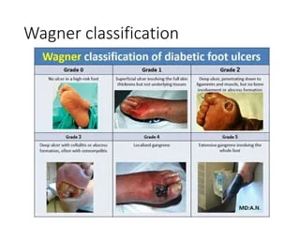
Wagner-Meggitt Classification
1 – Superficial ulcer
2 – Deep ulcer (tendon/joint)
3 – Abscess or osteomyelitis
4 – Partial foot gangrene
5 – Whole foot gangrene

Slide 14
Clinical Characteristics of Diabetic Ulcers
📍 Location: Most commonly on plantar surface (metatarsal heads, heel), toes, or areas of repetitive pressure
🔵 Surrounded by callus or hyperkeratotic tissue
😶 Often painless due to peripheral neuropathy
⬇️ Reduced protective sensation (abnormal monofilament testing)
🕳 May probe to tendon, joint, or bone in deeper ulcers
🦠 High risk for infection (warmth, erythema, purulent drainage)
💧 Variable drainage depending on depth and infection status
🦶 Associated foot deformities (Charcot foot, hammertoes, bunions)
🩸 Possible diminished pedal pulses if concurrent PAD present
⏳ Delayed healing, especially with poor glycemic control

Slide 15
Vascular Ulcer Pathophysiology
🫀 Venous: venous hypertension → edema→ inflammation
❤️‍🔥 Arterial: insufficient perfusion → hypoxia
Notes:
Vascular ulcers develop due to impaired blood flow, which disrupts oxygen and nutrient delivery to tissues, leading to cellular injury and delayed wound healing. They are broadly classified as arterial (ischemic) or venous (congestive) in origin.
Arterial Ulcers:
Caused by peripheral arterial disease resulting in reduced arterial perfusion. Atherosclerotic plaque narrows vessels, decreasing oxygen delivery to distal tissues. Chronic ischemia leads to tissue necrosis, particularly in areas with limited collateral circulation.
Venous Ulcers:
Result from chronic venous insufficiency. Venous valve dysfunction causes reflux and venous hypertension. Elevated pressure leads to capillary leakage, edema, inflammation, and impaired oxygen diffusion, ultimately causing skin breakdown.
Key Mechanism:
Both types involve inadequate tissue perfusion — arterial ulcers from decreased inflow, venous ulcers from impaired outflow — resulting in hypoxia, inflammation, and impaired healing.

Slide 16
Venous Ulcer Versus Arterial ulcer
Venous Ulcers | Arterial Ulcers
Medial Lower Leg | Toes, Foot, Ankle
Shallow, irregular borders | “Punched-out,” well-defined borders
Red, granulating, may have fibrin | Pale, dry, necrotic, or eschar
Heavy Exudate | Minimal Exudate/Dry

Slide 17
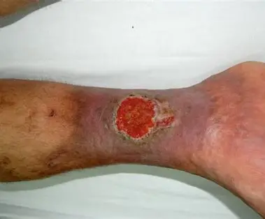
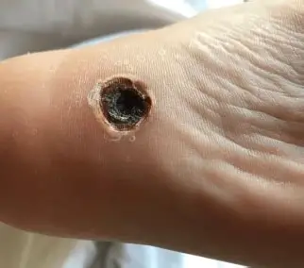
Venous Stasis Versus Arterial Ulcers

Slide 18
Core Principles of all chronic wounds
🎯 Identify and treat underlying cause
🧼 Debridement (when appropriate)
💧 Moist wound healing
🦠 Infection control
🛏️ Offload/redistribute pressure
🩸 Optimize perfusion
🌡 Address systemic factors
Notes:
1. Identify and Treat Underlying Causes of Wounds
Healing will not occur if the underlying cause is not corrected.
Examples: pressure, diabetes, vascular disease, edema, infection, malnutrition.
Treat the “whole patient,” not just the wound.
Prevention of recurrence is a major goal.
2. Debridement — Removal of Nonviable Tissue and Biofilm
Removes dead tissue, slough, eschar, and bacterial biofilm.
Helps decrease infection risk and inflammation.
Promotes formation of healthy granulation tissue.
Can be surgical, enzymatic, autolytic, mechanical, or biologic.
3. Moist Wound Healing
Wounds heal faster in a moist environment.
Moisture supports cell migration and tissue growth.
Too dry = delayed healing/cracking.
Too wet = maceration and skin breakdown.
Goal is balanced moisture management.
4. Infection Control
Chronic wounds are highly susceptible to infection.
Monitor for redness, warmth, drainage, odor, swelling, increased pain, or fever.
Biofilm and bacterial burden delay healing.
May require cleansing, topical antimicrobials, or systemic antibiotics.
5. Offloading / Redistribute Pressure
Reduces pressure, friction, and shear on vulnerable tissue.
Essential for diabetic foot ulcers and pressure injuries.
Includes repositioning schedules, specialty mattresses, heel protectors, diabetic footwear, and assistive devices.
Continued pressure prevents healing.
6. Optimize Perfusion
Tissue needs oxygen and nutrients to heal.
Assess for arterial disease, edema, venous insufficiency, or ischemia.
Encourage smoking cessation and management of vascular disease.
Poor circulation greatly delays wound healing.
7. Address Systemic Factors
Nutrition, hydration, glucose control, mobility, and chronic disease management all affect healing.
Protein deficiency impairs collagen formation and tissue repair.
Hyperglycemia increases infection risk and inflammation.
Medications, age, and immune status also influence healing outcomes.
Key Closing Point
Successful wound healing requires a multidisciplinary approach focused on correcting underlying problems, supporting tissue repair, and preventing additional injury.

Slide 19
Non-Pharmacologic Interventions
🔄 Repositioning schedules
🛏️ Pressure redistribution surfaces
🦶 Offloading boots
🧦 Compression therapy
🚭 Smoking cessation
🍬 Glycemic control
🚶 Mobility promotion

Slide 20
Nutritional & Lifestyle Support
🥩 1.25–1.5 g/kg/day protein
🍊 Vit C & zinc if deficient
💧 Hydration
🍬 Glycemic optimization
⚖ Weight management
🩸 Treat anemia

Slide 21
Conservative Treatment Recommendations
🛏️ Pressure ulcers: foam, hydrocolloid, alginate, NPWT
🦶 Diabetic ulcers: collagen, NPWT, antimicrobials, offloading
🫀 Venous ulcers: compression, foam/alginate, silver
❤️‍🔥 Arterial ulcers: keep dry, avoid debridement
Notes:
Pressure Ulcers
Foam dressings: Absorb drainage, cushion pressure areas, maintain moisture balance.
Hydrocolloid dressings: Promote moist wound healing and support autolytic debridement.
Alginate dressings: Highly absorbent; useful for moderate-to-heavy drainage.
NPWT (Negative Pressure Wound Therapy): Removes excess fluid, decreases edema, promotes granulation tissue formation.
Diabetic Ulcers
Collagen dressings: Support tissue growth and stimulate healing in chronic wounds.
NPWT: Helps contract wound edges, manage drainage, and improve granulation tissue.
Antimicrobial dressings: Reduce bacterial burden and help prevent infection.
Offloading: Redistributes pressure to prevent continued tissue trauma and allow healing.
Venous Ulcers
Compression therapy: Main treatment; improves venous return and decreases edema.
Foam/alginate dressings: Manage drainage and maintain moist healing environment.
Silver dressings: Provide antimicrobial activity for wounds with high bacterial burden or infection risk.
Arterial Ulcers
Keep dry: Prevents tissue maceration in poorly perfused wounds.
Avoid debridement unless ordered by vascular specialist: Removing stable eschar may expose tissue to infection when blood flow is inadequate.
Focus on perfusion: Vascular evaluation and circulation improvement are priorities.

Slide 22
Debridement Options
Autolytic | Uses the body’s own enzymes and moisture beneath an occlusive dressing to naturally break down and remove necrotic tissue.
Enzymatic | Applies topical chemical agents to selectively digest and dissolve devitalized tissue
Mechanical | Removes nonviable tissue through physical force, such as irrigation, wet-to-dry dressings, or wound cleansing techniques.
Sharp | Involves the use of sterile instruments (scalpel, scissors) to quickly and precisely remove necrotic or infected tissue

Slide 23
CONTRAINDICATIONS
🚫 Debridement Contraindicated in ischemia without perfusion

Slide 24
Complications of Pressure Ulcers
🦴 Osteomyelitis
🤒 Sepsis
😣 Chronic pain
🌀 Fistula formation
🕊 End-of-life skin failure

Slide 25
Complications of Diabetic Ulcers
🦠 Abscess
🦴 Osteomyelitis
🔥 Necrotizing infection
🦿 Amputation
🔁 Recurrence

Slide 26
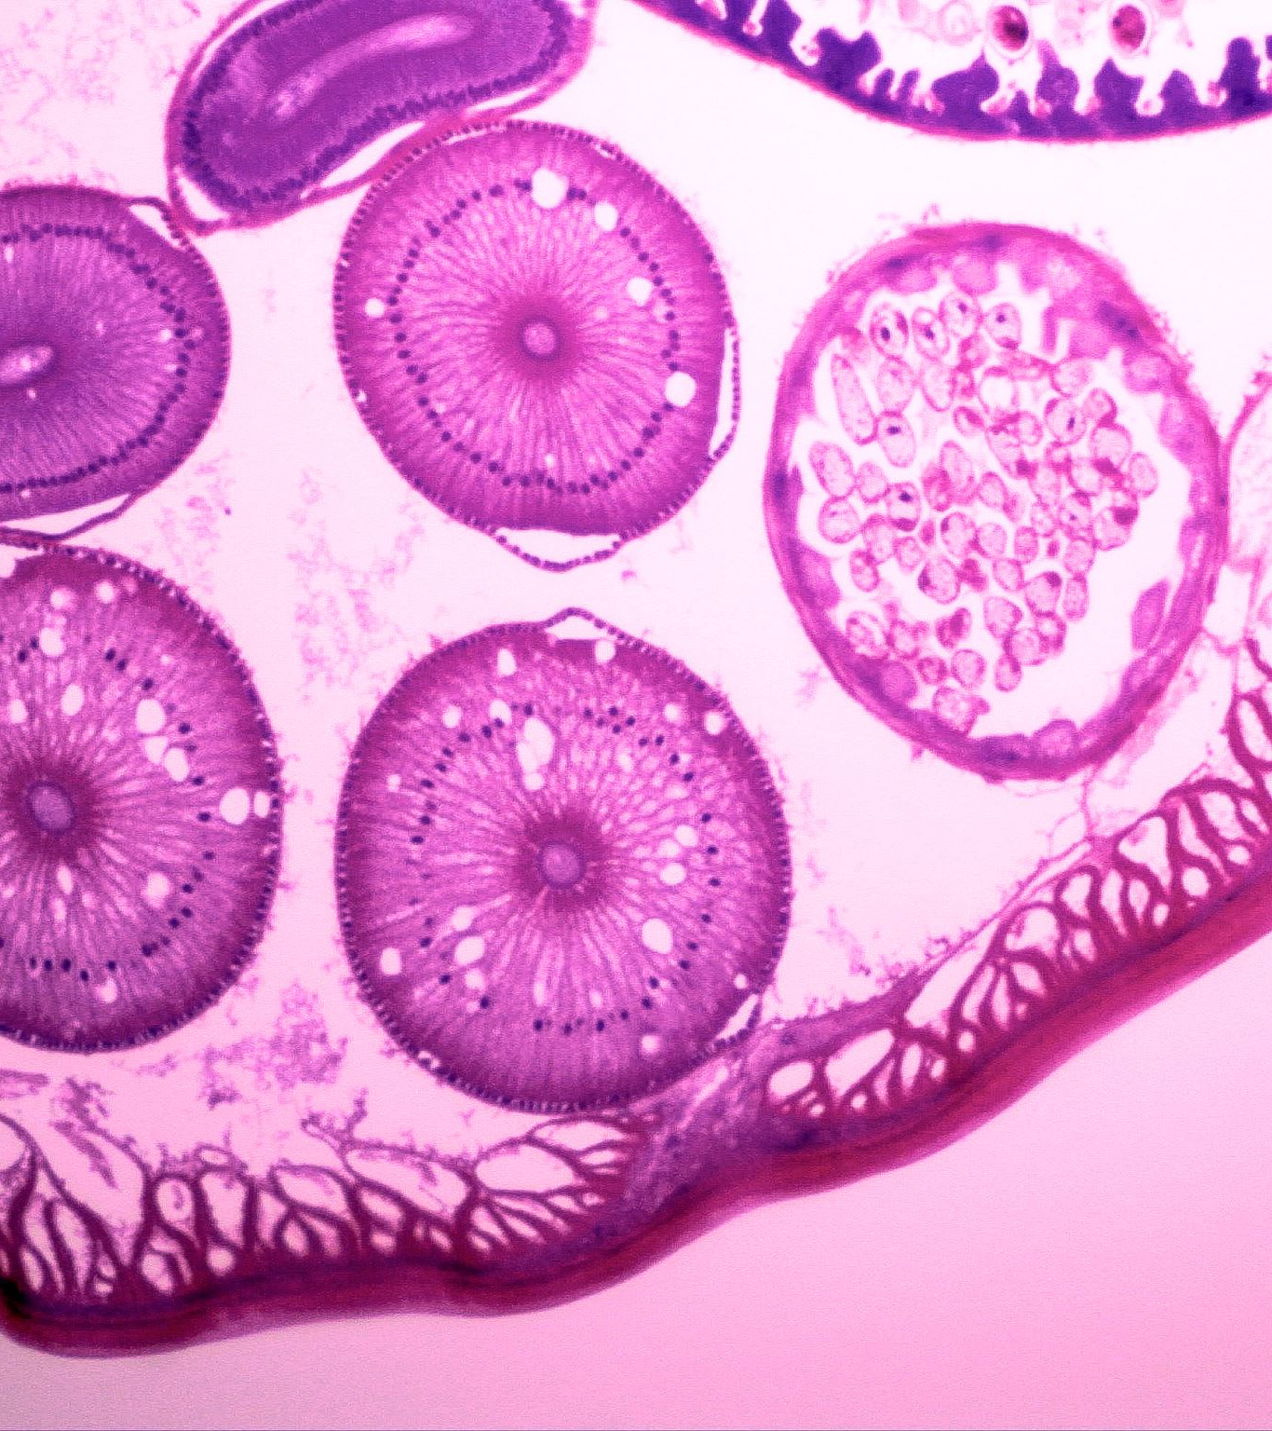
Complications of vascular ulcers
🧫 Cellulitis
🦵 Chronic edema
🟤 Lipodermatosclerosis
🖤 Gangrene (arterial)

Slide 27
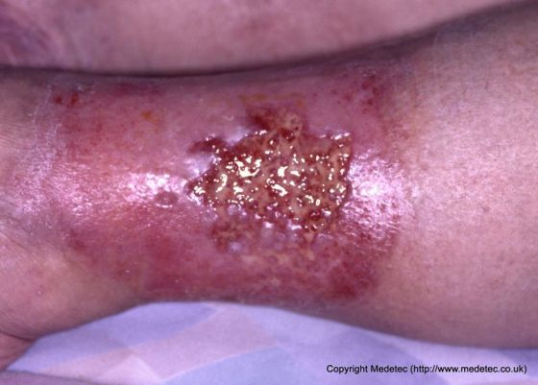
Wound Infection & Cellulitis: Early Identification and Intervention

Slide 28
Wound Infection & Cellulitis: Early Identification and Intervention
🔹 Mild to Moderate Skin/Soft Tissue Infections (non-MRSA suspected)
Cephalexin (Keflex) – good for streptococcal and MSSA coverage
Dicloxacillin – MSSA coverage
Amoxicillin-clavulanate (Augmentin) – broad coverage (skin + some anaerobes)
🔹 MRSA Coverage (common in chronic wounds)
Doxycycline – oral MRSA + some gram-positive coverage
Trimethoprim-sulfamethoxazole (Bactrim DS) – MRSA coverage (no strep coverage alone)
Clindamycin – MRSA + strep coverage (watch for C. diff risk)

Slide 29
Wound Infection & Cellulitis: Early Identification and Intervention
Moderate to Severe or Polymicrobial Wound Infections
(often diabetic, pressure injuries, or foul-smelling wounds)
Amoxicillin-clavulanate (Augmentin) – broad outpatient option
Ciprofloxacin + Metronidazole – gram-negative + anaerobic coverage
Levofloxacin (Levaquin) – broad gram-negative coverage (use cautiously in elderly)
Piperacillin-tazobactam (Zosyn) – IV broad-spectrum (hospital/advanced facility use)
Severe Infection / Systemic Signs (cellulitis, osteomyelitis concern, sepsis risk)
Vancomycin – MRSA coverage (IV)
Linezolid (Zyvox) – oral/IV MRSA alternative
Piperacillin-tazobactam + Vancomycin – broad empiric coverage
Ertapenem – broad gram-negative/anaerobic coverage (no Pseudomonas)

Slide 30
Wound Infection & Cellulitis: Early Identification and Intervention
🔹 Suspected Pseudomonas (wet, chronic, diabetic, or water-exposed wounds)
Ciprofloxacin or Levofloxacin (oral option)
Piperacillin-tazobactam (Zosyn) (IV, more severe cases)
Cefepime (IV alternative in higher-level care)
* Metronidazole directly to wound 500mg
Notes:
Pseudomonas smell- Grapes of wrath, sweet fruity, earthy.

Slide 31
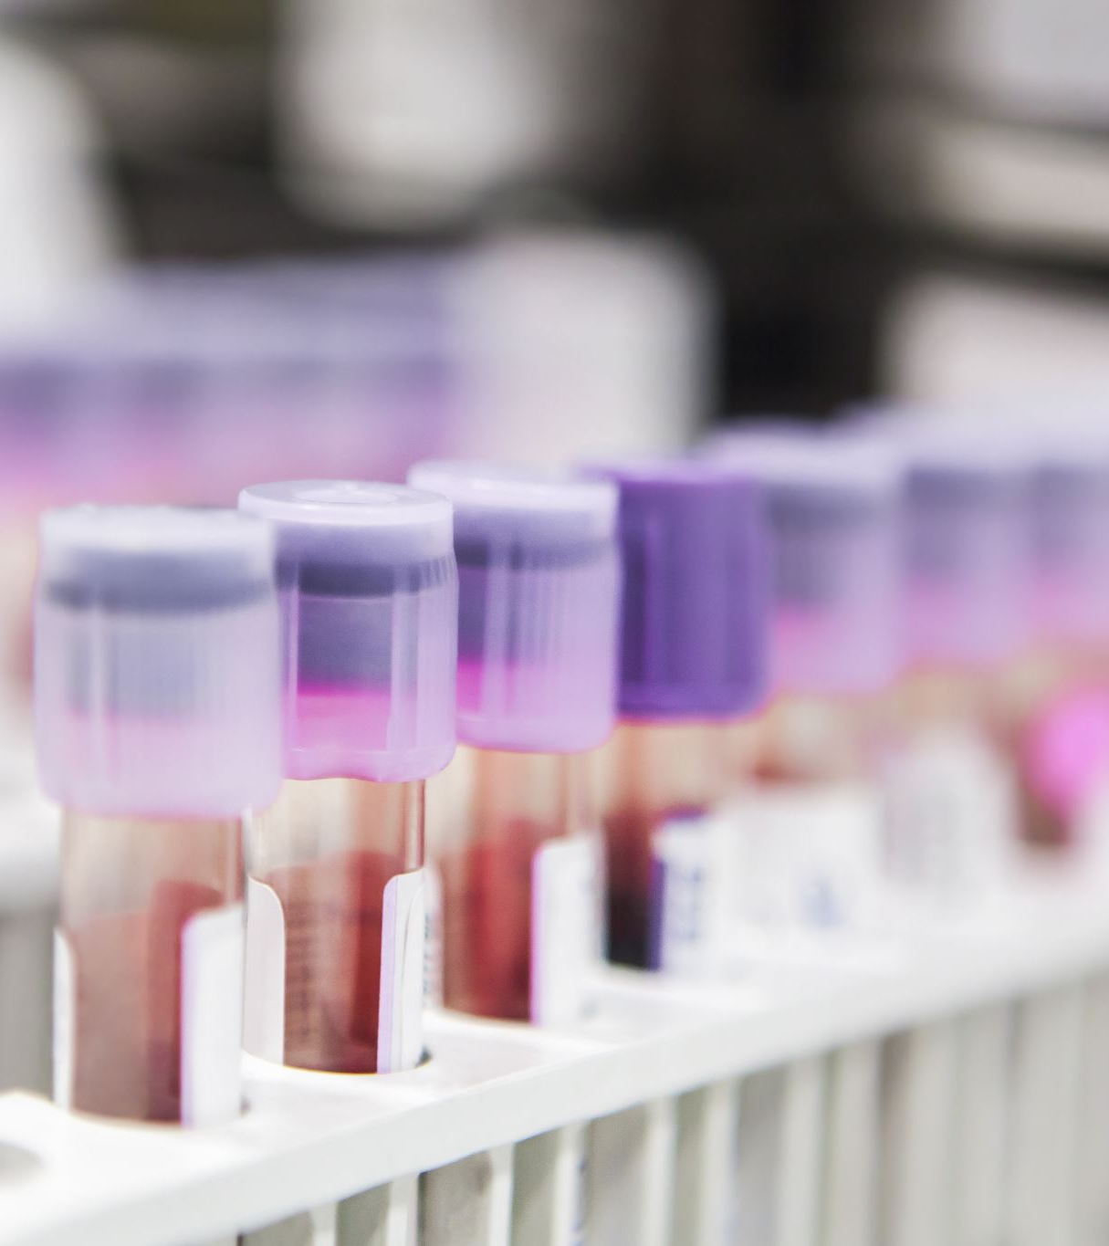
To Culture or Not to Culture: When Wound Cultures Are Indicated
Do not culture every wound
Culture only when infection is clinically present
Use deep tissue samples whenever possible
Always collect before antibiotics
Remember: chronic wounds are often colonized, not infected
Notes:
nly culture clinically infected wounds
Wound cultures should NOT be done routinely
Indicated when there are signs of clinical infection, such as:
Purulent drainage
Increasing erythema, warmth, swelling
Pain or tenderness worsening
Foul odor after cleansing
Delayed healing with deterioration
Systemic signs (fever, leukocytosis, sepsis concern)
👉 Key point: Clinical assessment comes first—not culture alone
2. Obtain cultures before starting antibiotics
Collect specimen prior to empiric antibiotic therapy whenever possible
Helps ensure accurate organism identification and sensitivities
Prefer deep tissue over surface swabs
Gold standard:
Tissue biopsy
Curettage of viable tissue
Needle aspiration (if abscess present)
These better represent true infecting organisms
Avoid superficial swabs when possible because they often reflect colonizing flora rather than infection
👉 IDSA and other guidelines consistently recommend deep tissue sampling
Avoid culturing uninfected or colonized wounds
Chronic wounds are frequently colonized with bacteria
Colonization ≠ infection
Culturing without infection signs leads to:
Unnecessary antibiotics
Resistance
Misleading results
Proper specimen collection technique matters
Clean/debride wound before sampling
Avoid pus, eschar, and surface exudate
Sample from:
Wound base or advancing margin
Viable tissue (not necrotic tissue)
When cultures are especially indicated
Non-healing or worsening wounds despite treatment
Suspected deep infection (cellulitis, abscess, osteomyelitis)
Immunocompromised patients
High risk for resistant organisms (e.g., MRSA history)
Systemic illness or rapid progression

Slide 32
When to refer
🦴 Suspected osteomyelitis
📏 ABI <0.8 or >1.3, need for vascular intervention
🧪 Suspected malignancy

Slide 33
Key Takeaways
🔍 Identify etiology first
🦶 Offload/compress appropriately
🌡 Optimize systemic health
📦 Use evidence-based dressings
⏱ Reassess every 2–4 weeks

Slide 34
Advanced wound therapies
&
Practice optimization
✂️ Sharp/selective debridement
🧬 CTPs/amniotic grafts
🌀 NPWT
🔊 Low-frequency ultrasound
📏 ABI testing
🦶 Diabetic foot exam

Slide 35
Debridement & Coding
Home/office based
🧾 Selective: 97597/97598
🧾 Excisional: 11042–11045
📝 Document depth, tissue removed, area, hemostasis

Slide 36
Amniotic Grafts / CTPs
🧬 CPT 15271–15278
🧾 Q-codes based on brand
📝 Require failed 4 weeks standard therapy
📏 Serial measurements
🚫 Limit applications

Slide 37
Low-Frequency Ultrasound (Arobella/MIST)
🔊 CPT 97610
🦠 Biofilm disruption
😣 Good for painful wounds of if debridement not tolerated
📝 Document duration, tissue pre/post

Slide 38
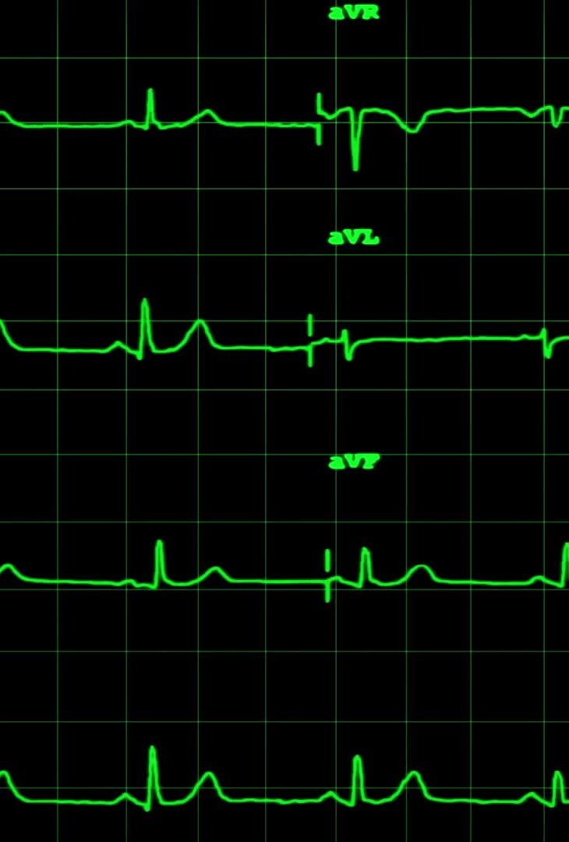
ABI testing/ Coding
📏 CPT 93922/93923
🫀 Detect arterial disease
🚫 <0.5 = severe ischemia
📝 Document indication + interpretation

Slide 39
Comprehensive Diabetic Foot Exam
🦶 G0245–G0247
🧪 Sensory testing
🦵 Vibration/pulses
📋 Deformities/skin integrity
📊 Risk stratification

Slide 40
Maximizing Outcomes While Maintaining Compliance
📝 Treat etiology first
📚 Document thoroughly
⏱ Reassess 2–4 weeks
⬆ Escalate appropriately
🧾 Ensure medical necessity

Slide 41
Key elements for documentation
Clearly identify wound etiology (pressure, venous, arterial, diabetic, surgical, traumatic)
Document stage using current NPIAP guidelines (for pressure injuries)
Precise measurements every assessment (length × width × depth in cm)
Include undermining/tunneling (location using clock method + depth in cm)
Describe wound bed (granulation %, slough %, eschar %, exposed structures)
Drainage (amount, color, odor)
Periwound condition (maceration, erythema, induration, callus, edema)
Pain assessment (scale, character, impact on care)
Signs of infection (local and systemic findings)
Photographic documentation per facility policy

Slide 42
High risk documentation areas
Medical necessity clearly stated for skilled wound care
Ongoing need for skilled services (why nursing is required vs caregiver)
Consistency between diagnosis, staging, and treatment plan
Evidence of measurable progress OR rationale for lack of progress
Provider orders match treatment rendered
Debridement documentation includes:
Type (sharp, enzymatic, etc.)
Tissue removed
Instruments used (if sharp)
Bleeding and hemostasis
Patient tolerance
Supply usage supported by wound size and drainage
Frequency of dressing changes justified
Updated plan of care with modifications documented

Slide 43
Expert language
❌ Avoid Vague Language
“Wound looks better.”
“Stable.”
“About the same.”
“Healing well.”
“No change.”
✅ Use Objective, Measurable Language
“Wound measures 2.4 cm × 1.8 cm × 0.3 cm, decreased from 2.8 cm × 2.0 cm × 0.3 cm on prior assessment.”
“Granulation tissue increased from 40% to approximately 65% of wound bed.”
“Drainage decreased from moderate to scant serosanguinous.”
“No increase in erythema, warmth, edema, or drainage noted.”

Slide 44

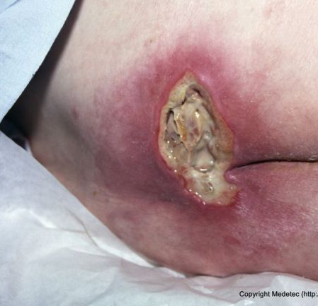
What Am I Looking At? Wound Type Recognition
Notes:
Unstageable pressure ulcer.
Debride the slough
Control infection/biofilm
Balance moisture and offload pressure

Slide 45
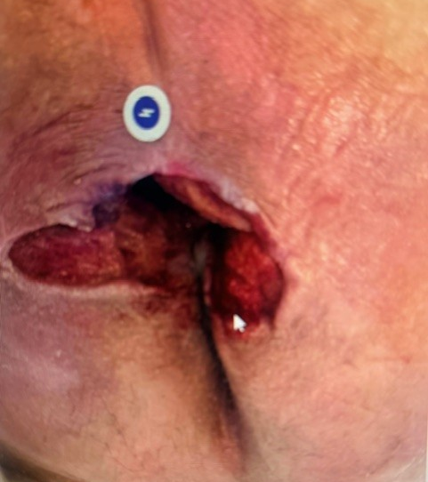
What Am I Looking At? Wound Type Recognition
5 cm of tunneling at 11’o’clock
Undermining at 2cm around the total area of the wound

Slide 46
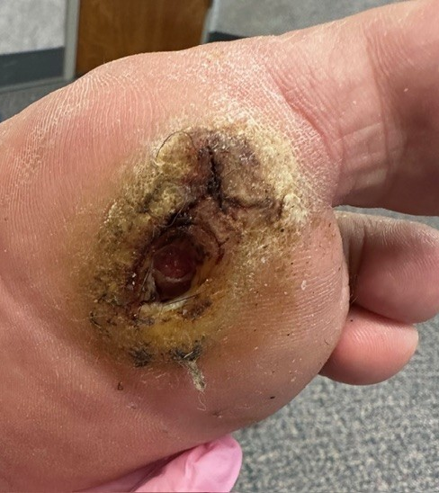
What Am I Looking At? Wound Type Recognition

Slide 47
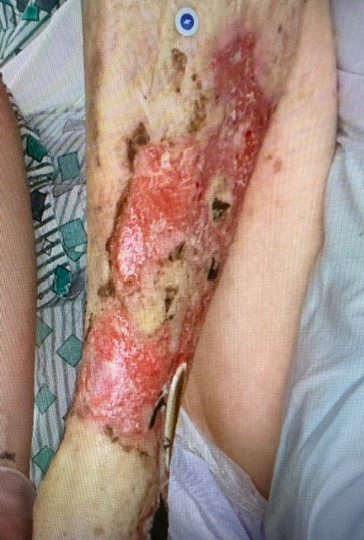
What Am I Looking At? Wound Type Recognition

Slide 48
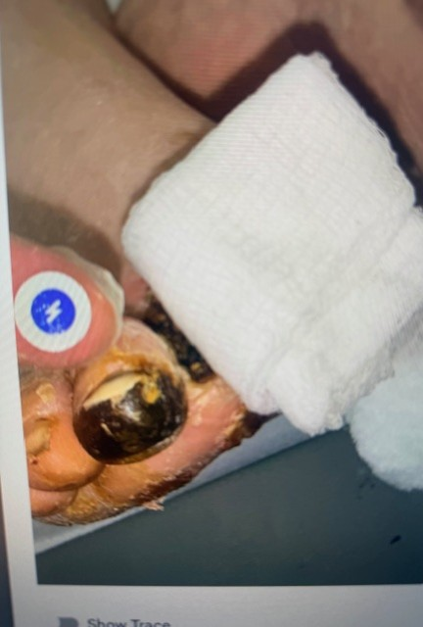
What Am I Looking At? Wound Type Recognition

Slide 49
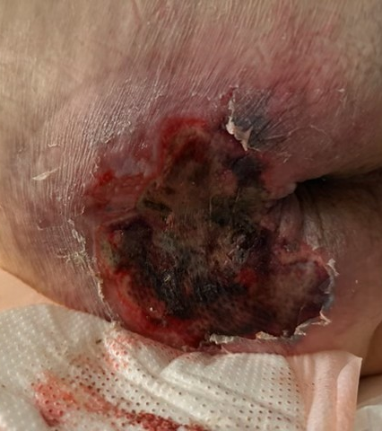
What Am I Looking At? Wound Type Recognition
Developed within a few hours
Pear shaped discoloration initially

Slide 50
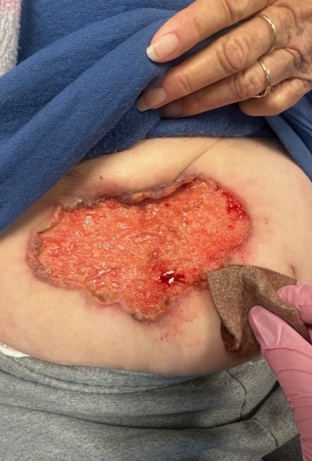
What Am I Looking At? Wound Type Recognition
-Wound started as a small “sore”
-No history of abdominal surgeries
-Highly Vascular and bleeding

Slide 51

QUESTIONS????
Notes:
I want to end with this:::::Wound care requires a patient-centered approach that focuses not only on the wound itself but also on identifying and treating underlying causes, while using evidence-based interventions to support healing and prevent recurrence. Accurate assessment and documentation are essential because they guide clinical decision-making, track progress, and ensure safe, effective, and consistent care.

Slide 52
References
Eming, S. A., Krieg, T., & Davidson, J. M. (2007). Inflammation in wound repair: Molecular and cellular mechanisms. Journal of Investigative Dermatology, 127(3), 514–525. https://doi.org/10.1038/sj.jid.5700701
Frykberg, R. G., & Banks, J. (2015). Challenges in the treatment of chronic wounds. Advances in Wound Care, 4(9), 560–582. https://doi.org/10.1089/wound.2015.0635
National Institute for Health and Care Excellence (NICE). (2023). Diabetic foot problems: Prevention and management. https://www.nice.org.uk
Nunan, R., Harding, K. G., & Martin, P. (2014). Clinical challenges of chronic wounds: Searching for an optimal animal model to recapitulate their complexity. Disease Models & Mechanisms, 7(11), 1205–1213. https://doi.org/10.1242/dmm.016782
Rodrigues, M., Kosaric, N., Bonham, C. A., & Gurtner, G. C. (2019). Wound healing: A cellular perspective. Physiological Reviews, 99(1), 665–706. https://doi.org/10.1152/physrev.00067.2017
Singh, N., Armstrong, D. G., & Lipsky, B. A. (2005). Preventing foot ulcers in patients with diabetes. JAMA, 293(2), 217–228. https://doi.org/10.1001/jama.293.2.217
Stevens, D. L., et al. (2014). Practice guidelines for skin and soft tissue infections. Clinical Infectious Diseases, 59(2), e10–e52. https://doi.org/10.1093/cid/ciu296

