Slide 1

THE NURSE PRACTITIONER CHARTING SCHOOL
5 tips to STOP charting at home for nurse practitioners

Slide 2

Erica D the NP Charting Coach
  Family nurse practitioner
  Wife, mom
  Formerly burned-out

Slide 3

The Nurse Practitioner
Charting School
Helping overwhelmed nurse practitioners improve charting so they can create a better work-life balance and STOP charting at home!

Slide 4
Charting Challenges
  Lack of education about charting in NP school
  Employer push to see more patients
    15 min appointments, double booked
  Other tasks we have to do
    Med refills, review notes, patient messages
  Lack of support in healthcare setting
    NPs checking in patients, no support staff
  Personal obligations and family

Slide 5
Charting Causes...
  Increased time to complete chart
  Increased frustrations and overwhelm
  Loss of revenue
  Inaccurate/incomplete documentation
  Legal risks
  Second guessing clinical decisions
  Lack of work-life balance
  Nurse practitioner burnout

Slide 6
You are replaceable at work.
You are NOT replaceable at home.

Slide 7

I help nurse practitioners STOP charting at home!

Slide 8
Charting Tips
  Complete time log
  Creating charting templates
  Utilizing smart phrases
  Time management tips in room
  Problem-focused chart notes

Slide 9

  Complete Time Log
  Write out how currently spending time
  How long acute vs chronic visit
  How long seeing patient and charting
  How long addressing cheif complaint vs allowing patients to bring up multiple concerns
  How long addressing EHR inbox
  How long socializing with coworkers
Analyze the log. What sticks out? What can you change immediately?

Slide 10
2. Templates
  Templates: outline or format of chart note
  Pulls over information, past medical history, vitals, etc.
  Can be made for certain type of visits
  Sports physical, acute child vs. chronic adult

Slide 11
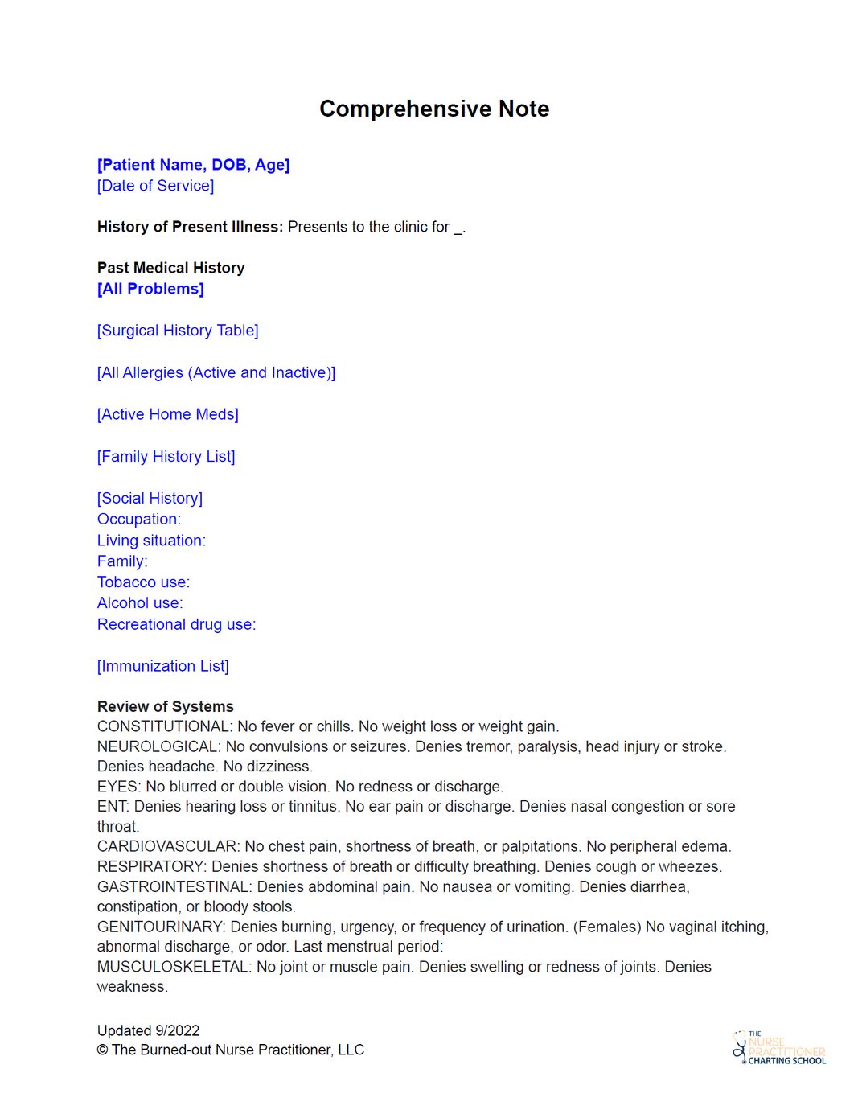
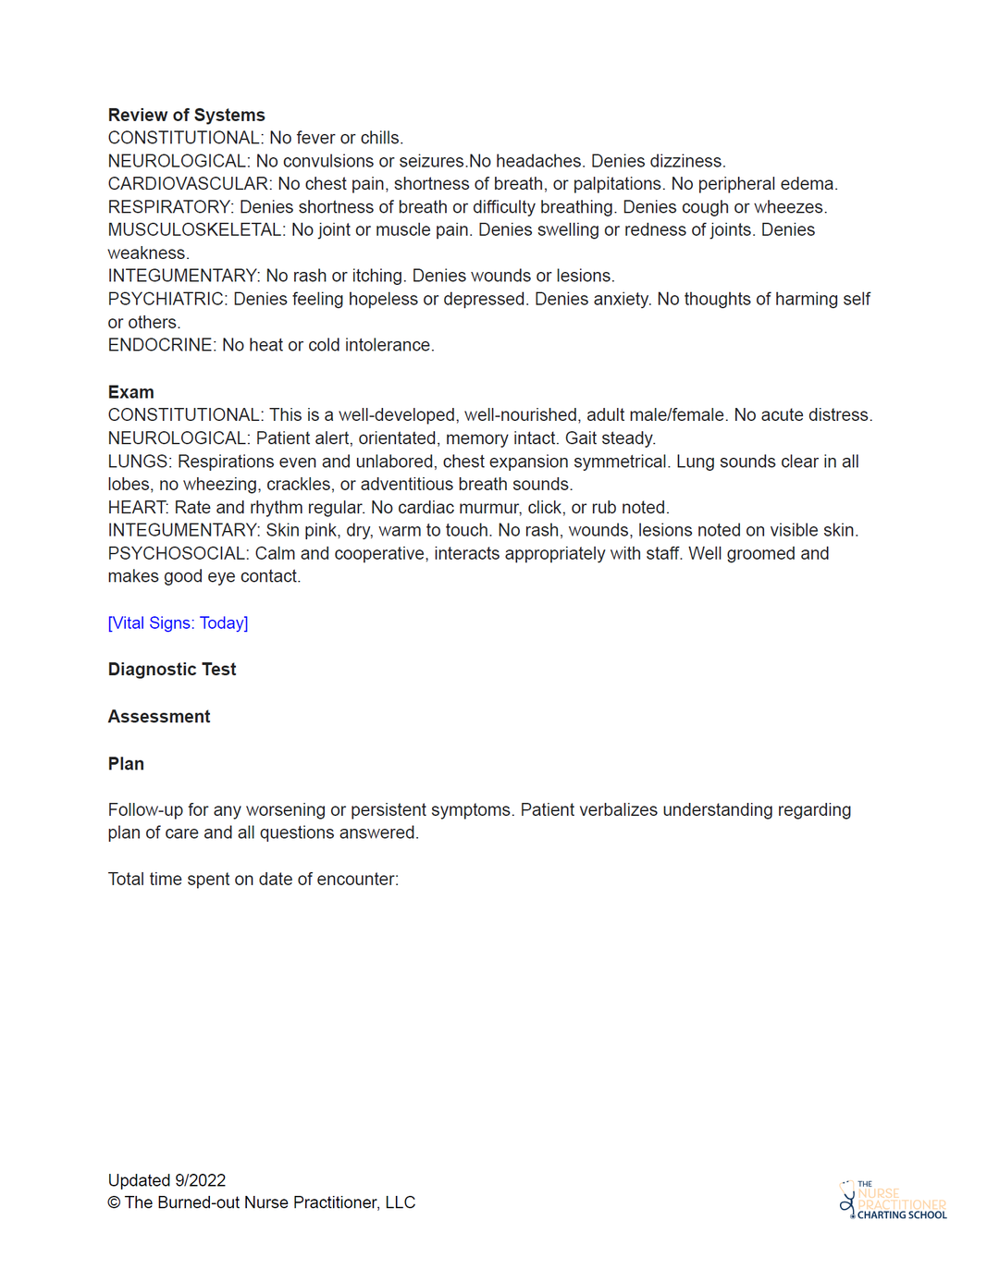

Slide 12
3. Smart phrases
  Smart/dot phrases: commonly used phrases/words
  Create smart phrases for things you constantly type
    i.e. history of present illness, plan of care
    preop history and physical, UTI education, procedures
  Takes time upfront
  Easily implement into chart note

Slide 13
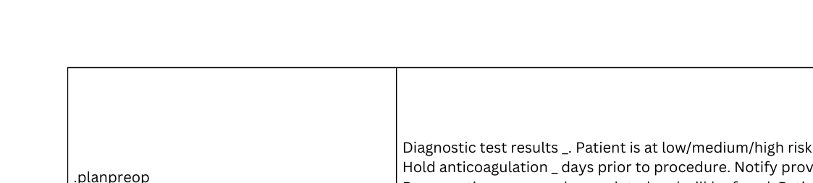
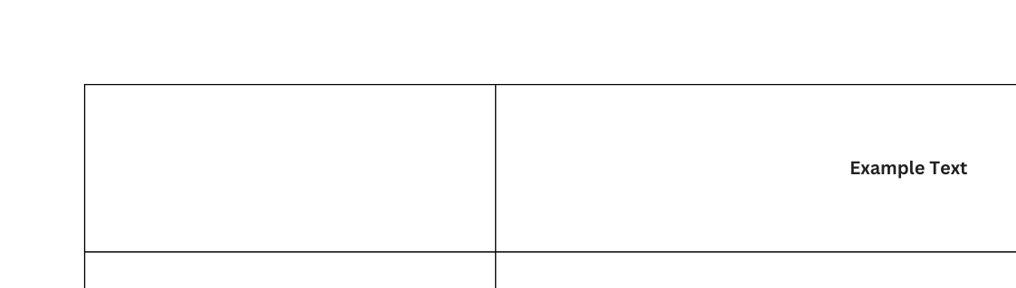

Slide 14
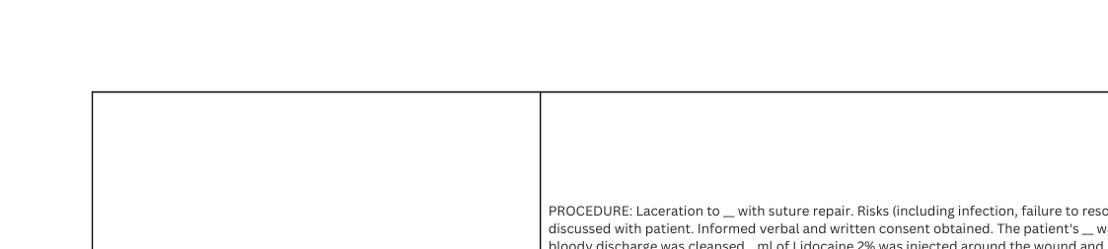
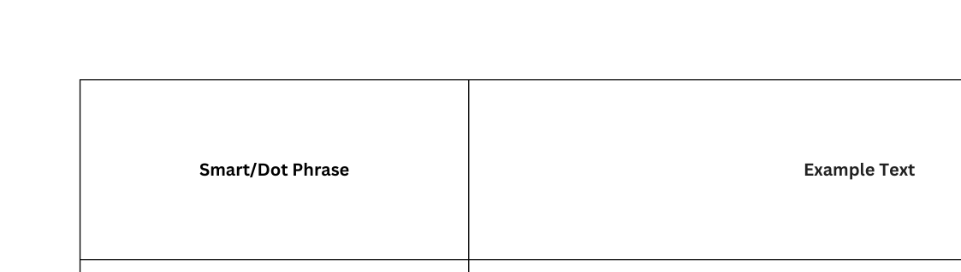

Slide 15

#1 charting mistake as NP
OVERCHARTING!!
  Trained as RNs to document everything
  Want to create “perfect” chart note to look smarter
  Fear of malpractice, cover your butt
Over charting not only takes more time but is NOT necessary!

Slide 16
4. Time management tips in the room
  Set expectations from begining
    “I have the next 10 min with you. What are top 2 concerns you would like to discuss?”
  Ask straight forward questions
    Instead of “tell me about your knee pain” say “What day did it start? What meds have you taken?”
  Be firm if patient brings up another chief complaint
    “I would love to give this concern the proper time and attention, please schedule a follow-up visit.”
  Use movement and visual cues

Slide 17

5. Problem focused chart notes
Problem focused chart notes:
  Clear and straight to the point
  Takes less time to document
  Easier to read
  Less liability

Slide 18

History of present illness
Use OLDCARTS- ask direct questions
Phrases, short sentences, bullet points
Pertinent positives and negatives
Medically necessary ROS
Do not need to complete full review of systems
Do full for preop, annual wellness
In acute visits, I will add "as noted in HPI"
Medically necessary physical exam
Problem focused chart notes
What is important to exam?
Think about system up and below
How will it support your diagnosis?

Slide 19
OLDCARTS
O- onset
L- location
D- duration
C- characteristics
A- aggravating
R- relieving
T- treatment
S- severity

Slide 20
Medically necessary ROS
and exam
  Changes made in 2021 to outpatient coding
  Changes made in 2023 to inpatient, ER, skilled
  No longer need all components in chart note
  Keep ROS and physical exam medically necessary

Slide 21
Medically necessary ROS and exam
  Focus on chief complaint
  Exam to support your diagnosis
  Is doing a complete exam important?
    Increase work load
    Increase legal risks

Slide 22
Example
25-year-old presents with right lower quadrant abdominal pain. Pain began 3 hours ago and worsened. Rates 9/10 sharp pain. Reports low grade fever. Notes nausea and vomiting. Last BM was yesterday, no diarrhea, constipation, or blood in stool.

Slide 23
Example
25-year-old presents with generalized abdominal pain. Pain began 5 days ago and comes and goes. Rates 6/10 cramping pain. Denies fever. Notes nausea, no vomiting. Last BM was 3 days ago. No diarrhea or blood in stool.

Slide 24

If you are spending hours charting at home, you’re allowing other people dictate how your spend your time at work.
Take control of your time!

Slide 25
I am here to help!
-Erica D the
NP Charting Coach
erica@burnedoutnp.com

