Slide 1
AI in Healthcare

Slide 2
Objectives
Progression of AI in medicine
Static data sets versus dynamic real time data
Where has AI been and where is it going
Is AI going to replace providers
What are the ethical considerations
How is it regulated
What is responsible use of AI

Slide 3
Types of AI in Healthcare
Process automation (scheduling, medical coding, note generation)
Predicative Analytics (radiology-medical image interpretation)serves as diagnostic aids
Predicative models to analyze large datasets and identify high risk patients (sepsis alerts) bias in large datasets
Drug development- using model to identify impact on the covid vaccine???
Personalized- genetic history and profile.
Virtual health assistants and chatbots
Operational optimization- staff scheduling and bed management

Slide 4
Medical Applications of AI
Medical imaging and diagnostics
Drug discovery and development
Personalized medicine
Predictive analytics
Patient monitoring and care
Robotic surgery
Disease outbreak prediction
EMR management
Telemedicine and remote care
Clinical decision support
Health chatbots

Slide 5
What are clinicans using?
The most commonly encountered AI in medical context are clinical decision support and image analysis
Ambient listening/scribe
Ethical questions
  Data privacy and data breaches
  Confidentiality
  Informed consent
  Patient autonomy

Slide 6
Progression of AI in medicine
The world’s first artificial medical consultant was created in 1971- INTERNIST-1
  Used a search algorithm to get a clinical diagnosis based on symptoms
  The first AI conference was held at Rutgers University
In the 1980’s, Dxplain – physicians could input symptoms, and system would give a potential diagnosis
Modern AI started in the early 2000’s
  Watson
  Pharmbot

Slide 7
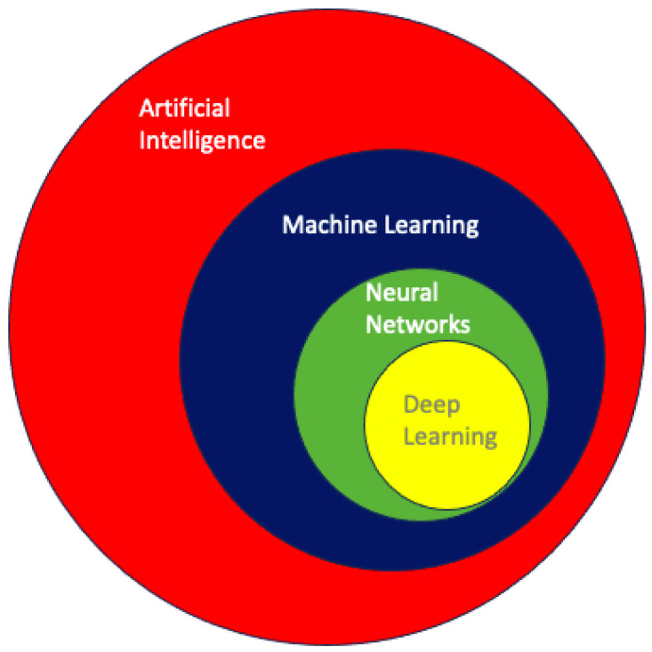
Progression of AI
In 2000’s, machine learning (ML) is using data and algorithms to make predictions.

Slide 8
Radiological image interpretation
ML is the foundation for computer-aided detection(CAD), decreases the number of missed diagnosis
They are not intended to replace the clinician but to enhance interpretation which helps decrease the clinician false negative rate

Slide 9
Do we still need live people?
Concern for loss of jobs
These tools are only as good as the data that is imputed
Change in job needs but not loss

Slide 10
Governance
With the rapid development and the ease of access the need for governance has increased
AI should expand or enhance care to all patients
Establishing trust with AI-assisted healthcare systems
  Data use
  Privacy
  Bias
  Safety
Informed consent from the patient
Mitigate healthcare disparities

Slide 11
AI in education
How learner learn has changed
To produce clinicians that meet the needs of the patient means understanding how to incorporate AI appropriately
AI in medical education curriculum
How do you harness AI tools
Curriculum development

