Slide 1
Diabetes and Hypertension: A 2026 Pharmacotherapy Update
Mike Brown, Pharm.D., Ph.D., BCPS

Slide 2
Conflict of Interest Disclosure
The presenter has no actual or potential conflicts of interest to disclose in relation to the content of this presentation. The views and opinions expressed are solely those of the presenter and do not represent the official position of any affiliated institution or organization.

Slide 3
Overview
Due to large volume of information, will focus on outpatient management of hypertension and diabetes
Review 2025 ACC/AHA Joint Committee on Clinical Practice Guidelines HTN recommendations with focus on outpatient management
Review 2026 ADA and 2026 AACE recommendations for adults with T2DM
Focus on important medication class pearls

Slide 4
Hypertension Causes
Dietary | Non-Dietary | Medications
High sodium; Low potassium; Low Ca/Mag; Low diet quality; Alcohol; Obesity | Genes; Lower physical activity /fitness; sleep disturbances; psychosocial stressors; Air pollution; Sleep apnea; CKD; Primary aldosteronism; Renovascular; Thyroid abnormalities; Pheochromocytoma; Aortic coarctation; Cushing; Acromegaly; | Caffeine; Decongestants; Herbals; NSAIDs/APAP; Bath Salts; Withdrawal of central acting agents; Amphetamines; Antidepressants impacting norepinephrine; Atypical antipsychotics; Immunosuppressants; Oral contraceptives; Systemic corticosteroids; Angiogenesis inhibitors; Tyrosine kinase inhibitors; Androgen deprivation therapy
Notes:
Herbals Ma Huang, ephedra, St Johns,

Slide 5
Hypertension Treatment Thresholds
Group | Blood Pressure
No Relevant Co-Morbid Conditions | SBP >= 140 or DBP >= 80
Clinical CVD | SBP >= 130 or DBP >= 80
No CVD PREVENT Score >= 7.5% DM or CKD Present | SBP >= 130 or DBP >= 80
No CVD PREVENT Score < 7.5% | SBP >= 130 or DBP >= 80 **If lifestyle modifications fail after 3-6 months
Systolic treatment goal is < 130 mmHg with encouragement to reach < 120 mmHg if possible.
Diastolic treatment goal < 80 mmHg.
Circulation. 2025; 152:3114-3218
Notes:
PREVENT gives risk of cardiovascular disease, ASCVD, or heart failure at 10 and 30 years and is designed for use in people without diagnosed CVD
The 120mmhg was the SPRINT trial
Screen for Primary Aldosteronism: Resistant hypertension, hypokalemia, OSA, adrenal mass, family history of early-onset hypertension, stroke at a young age (<40 yo)
Stage 1 130-139/80-89 and Stage 2 >140 or > 90…still retains elevated for > 120/80
Hypertensive Emergency >180/120 mmHg with evidence of acute target organ damage

Slide 6
Therapy Recommendations
General Guidance | Thiazides, ACEi/ARB, and/or CCB
Diabetes | Without CKD -> All first line agents are useful eGFR < 60 mL/min/1.73m2 or albuminuria >= 30 mg/g -> ACEi/ARB
Obesity/Metabolic Syndrome | BMI >= 27 kg/m2 -> GLP-1 receptor agonists BMI >= 35 kg/m2 -> Bariatric surgery
Goal Directed Therapy HFrEF | Beta blocker, Mineralocorticoid Receptor Antagonist, ACEi/ARB/ARNI, SGLT2i Patients Self-Identified as Black or unable to take first line agents for HFrEF -> Add to GDMT hydralazine + isosorbide dinitrate
HFpEF | ACEi/ARB +/- MRA/ARNI; SGLT2i AVOID – Beta blockers
Chronic Coronary Disease | ACEi/ARB or Beta blocker preferred but all indicated
If BP >= 140 or >=90 mmHg, recommend initiation of 2 agents preferably as a combo tablet
Notes:
Of note, it says to consider ACE/ARB even with mild albuminuria
Chronic coronary disease is a progressive hardening of the artery
Avoid beta blockers HFpEF due to negative chronotropic effects

Slide 7
Therapy Recommendations
Atrial Fibrillation | Apply general hypertension medications with consideration of beta blockers for rate control
Valvular Heart Disease | Consider ACEi/ARB therapy for BP which have shown reduction in mortality
Aortic Disease | Beta blockers recommended in addition to generally preferred medications
CKD | Defined: eGFR <60ml/min/1.73m2 or albuminuria >= 30mg/g Prefer inhibitors of RAAS pathway (ACEi/ARB)
Secondary Stroke Prevention | Thiazides, ACEi, or ARB Guidelines state CCBs OK for additional BP lowering if needed, but better evidence with Thiazides and ACEi/ARBs
PAD | ACEi/ARB Goal remains <130/80mmHg
Notes:
Albuminuria is mg albumin / gram creatinine
PAD -> no increased risk of blockage found with this treatment goal

Slide 8
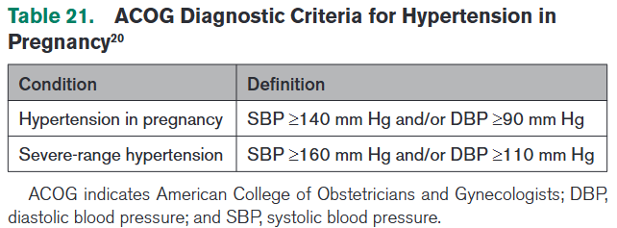
Hypertension and Pregnancy
Preferred Agents:
  Labetalol, Extended-Release Nifedipine, Methyldopa
    Later Line -> HCTZ
Avoid
  Atenolol, ACEi/ARB, Direct renin inhibitors, Nitroprusside, or MRA
Notes:
Preeclampsia:
> 140/90 on 2 occasions at least 4 hours apart after 20 wks gestation OR BP >160/110 once
AND
Proteinuria (>=300mg /24 hour
OR new onset HTN with one of the following
Thrombocytopenia; Renal insufficiency; Impaired liver function; pulmonary edema

Slide 9
Resistant Hypertension
Diagnostic Criteria | Office BP >= 130/80 mmHg on >=3 antihypertensive medications Office BP < 130/80 mmHg but requires 4 antihypertensive medications
Medication Recommendations | Maximize diuretic therapy -> Consider chlorthalidone or indapamide Chlorthalidone + Loop Diuretic CKD Stage 4 + Add spironolactone or eplerenone eGFR >= 45 Add dual endothelin-receptor antagonist (ERA) or vasodilators

Slide 10
ACEi/ARBs
Example Medications:
  ACEi: Lisinopril…or drugs ending in –pril
  ARBs: Losartan…or drugs ending in -sartan
Pearls:
  Monitoring: Scr (Increase anticipated on therapy initiation. > 30% increase may necessitate therapy switch), Potassium, Cough
  Common S/E: Dry cough (ACEi predominant), Dizziness, Hyperkalemia
  Severe S/E: Angioedema (Recommend not rechallenging), Fetal toxicity (Boxed warning)
  **For ACEi -> Entresto, allow a 36 hour washout period
Disease State Considerations
Diabetes
CKD
HFrEF
HFpEF
Chronic Coronary Disease
Valvular Heart Disease
Secondary Stroke Prevention
PAD
Notes:
Olmesartan has an odd reaction for sprue-like enteropathy

Slide 11
ARNI
Example Medications: Sacubitril/Valsartan (Entresto)
Pearls:
  Monitoring: Scr, eGFR, Potassium
  Common S/E: Hypotension, Hyperkalemia, Dizziness
  Severe S/E: Angioedema, Fetotoxicity
  **Remember 36 hour washout of ACEi
Disease State Considerations
HFrEF
HFpEF

Slide 12
Thiazides
Example Medications: Hydrochlorothiazide, Chlorthalidone, Indapamide
Pearls:
  Monitoring: Electrolytes, Scr, Glucose if DM present
  Common S/E: Hypokalemia, Hyponatremia, Hyperuricemia, Hyperglycemia, Hyperlipidemia, Photosensitivity, Gout
  Severe S/E: SJS, Severe hyponatremia
  Sulfonamide-derived drugs
  Reduced efficacy with decreasing CrCl (Especially < 30ml/min)
Disease State Considerations
First Line Agent
Secondary Stroke Prevention
Notes:
Hyperglycemia due to hypokalemia induced reduction in pancreatic insulin secretion.
May increase lithium levels due to decreased renal clearance of lithium

Slide 13
Dihydropyridine CCBs
Example Medications: Amlodipine, Nifedipine, Felodipine
Pearls:
  Monitoring: No common lab monitoring, watch for edema
  Common S/E: Peripheral edema, Flushing , Headache, Tachycardia
  Severe S/E: Gingival hyperplasia (Amlodipine)
Disease State Considerations
First Line Agent
Notes:
Decrease peripheral vascular resistance by blocking calcium channels on vascular smooth muscle

Slide 14
Non-Dihydropyridine CCBs
Example Medications: Verapamil, Diltiazem
Pearls:
  Monitoring: EKG, HR, Drug Interactions (CYP3A4)
  Common S/E: Constipation, Bradycardia, Edema
  Severe S/E: AV Block, Complete Heart Block, HF Decompensation
  Recommend against concurrent therapy with beta blockers…that being said, it is sometimes not avoidable
  Watch different dosage forms for dose conversion as few are AB rated
Disease State Considerations
Supraventricular Arrhythmias
Stable Angina
Later line hypertension therapy

Slide 15
Beta Blockers
Example Medications: Metoprolol, or medications ending in -olol
Pearls:
  Monitoring: HR, Glucose if DM Dx
  Common S/E: Fatigue, Bradycardia, Sexual Dysfunction, Cold Extremities
  Severe S/E: Can mask Hypoglycemia, Bronchospasm, Abrupt Withdrawal Hypertension
Disease State Considerations
HF
Post-MI
A fib
Aortic Disease
Notes:
Inhibit impact of catecholamines at beta 1 and beta 2 adrenergic receptors
Nebivolol is beta 1 selective with activation of nitric oxide
Alpha and Beta Blockers -> Carvediolol and Labetalol

Slide 16
MRAs/K Sparing Diuretics
Example Medications: Spironolactone, Eplerenone, Amiloride, Triamterene
Pearls:
  Monitoring: K+, Scr, BMP
  Common S/E: Hyperkalemia, Gynecomastia (Spironolactone), Menstrual Irregularity, Renal Impairment
  Severe S/E: Severe hyperkalemia particularly if stacking it with ACEi/ARB which is common in HF and Resistant HTN
Disease State Considerations
HFrEF
HFpEF
Resistant HTN
Primary Aldosteronism
Notes:
Block aldosterone receptors in the DCT causing natriuresis and potassium retention

Slide 17
Endothelin Receptor Antagonist
Example Medications: Aprocitentran (Tryvio)
Pearls:
  Monitoring: Weight, Edema, Liver Function, CBC
  Common S/E: Edema, Anemia, Dizziness
  Severe S/E: Teratogenic (Boxed Warning), Hepatotoxicity
Disease State Considerations
Later line therapy after maximization of other options
Notes:
Blocks both ETA and ETB decreasing endothelin mediated vasoconstriction
Use is more resistant, 3rd line agent
REMS requirement for fetotoxicity removed in 2025
CBC for anemia, weight for HF
Able to be used down to eGFR 15

Slide 18
Alpha-2 Agonists
Example Medications: Clonidine, Methyldopa
Pearls:
  Monitoring: BP, HR, Mental Status
  Common S/E: Bradycardia, Dry mouth, Drowsiness
  Severe S/E: Psychotic reactions, Severe withdrawal hypertension/tachycardia
Disease State Considerations
Later line therapy
Methyldopa with pregnancy
Notes:
Reduce sympathetic outflow from CNS
Methyldopa can induce hemolytic anemia, Coombs positive test, drug induced fever, and lupus like syndrome

Slide 19
Direct Vasodilators
Example Medications: Hydralazine and Minoxidil
Pearls:
  Monitoring: HR and BP
  Common S/E: Headache, Reflex tachycardia, Palpitations
  Severe S/E: Lupus-like syndrome (Hydralazine), Pericardial effusion (Minoxidil)
Disease State Considerations
Later line therapy

Slide 20
Future Medication Options HTN
Aldosterone Synthase Inhibitors
  In trials: Baxdrostat and Lorundrostat
  Block CYP11B2 to decrease serum aldosterone
  Potential for hyperkalemia due to decreased aldosterone
RNA Interference (RNAi)
  In trial: Zilebesiran (KARDIA Clinical Trial)
  Targets angiotensinogen for a twice-yearly injection

Slide 21
Diagnosis of Diabetes
Diagnostic Criteria for Diabetes ADA and AACE
A1c >= 6.5% OR
FBG >= 126mg/dL (fasting defined as no food 8 hours)
2 hour plasma glucose >= 200mg/dl OGTT
Symptomatic hyperglycemia or hyperglycemic crisis -> BG > 200mg/dl
Diagnostic Criteria for Pre-Diabetes ADA and AACE
A1c 5.7-6.4%
FBG 100-125mg/dL
2 hour plasma glucose 140-199mg/dL after OGTT
Diabetes Care Volume 49, Supplement 1, January 2026 || Endocrine Practice 32 (2026) 473-518
Notes:
Note if BG > 126, need 2nd independent test if no symptoms of hyperglycemia
Testing to differentiate T1 and T2DM. Use C-Peptide to differentiate if body still producing insulin and islet autoantibodies (although these may be absent in later stage T1DM)

Slide 22
CGM Goals ADA and AACE
Active Time | 70% in last 14 days
Glucose Coefficient of Variation (CV) | ADA <= 36% | AACE <= 33%
Time Above Range (>250mg/dL) | < 5% | ADA Older/Complex < 10%
Time Above Range (>180mg/dL) | < 25% | ADA Older/Complex < 50%
Time In Range (70-180mg/dL) | >70% | ADA Older/Complex > 50%
Time Below Range (<70mg/dL) | <4% | ADA Older/Complex < 1%
Time Below Range (<54mg/dL) | <1% all groups
Notes:
Glucose coefficient of variation (CV) is the spread of glucose values
ADA does have a bit more give for older adults or complex/intermediate health risks
Make sure emergency supply of testing strips available for backup

Slide 23
A1c Glycemic Goals Most Adults with DM
ADA
A1c < 7%
A1c < 6.5% may be appropriate for individuals with low treatment risks
Less stringent goals (7-8%) may be appropriate for those at higher risk of hypoglycemia, cognitive or functional impairment
No A1c goal in setting of limited life expectancy
AACE
A1c < 6.5% OR as close to normal as is safe and achievable
A1c 7-8% targets if:
  Limited life expectancy
  Elevated hypoglycemia risk or unawareness
  Severe/multiple comorbid conditions
  Long duration T2DM
  Prohibitive cognitive and/or psychological status

Slide 24
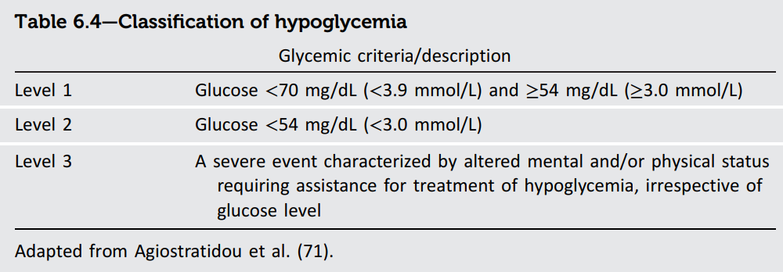
Classification and Treatment Hypoglycemia – ADA
Highlighted Risk Factors
Recent episode
Insulin/SU/Meglitinide
Low awareness
Kidney failure
Dementia
Age
Polypharmacy
Beta-blocker therapy
15:15 Rule – 15g carbohydrates and re-check BG in 15 mins
Glucagon – Unable or unwilling to consume oral carbohydrates -> Train family members
  Dosage forms -> Injection powder for reconstitution, Nasal powder, Prefilled syringe/pen
Notes:
15g carbohydrates – Glucose gel/tab, ½ cup fruit juice or full sugar soda, Tablespoon honey/sugar, Crackers
Avoid fatty foods with the carbohydrates due to delayed absorption

Slide 25
Therapy Recommendations
ASCVD or High Risk | GLP-1 RA with CVD Benefit (Semaglutide, Liraglutide, Dulaglutide) SGLT2i (Empagliflozin, Dapagliflozin, Canagliflozin) -May use in combination if glycemic control above goal -Consider Pioglitazone if no contraindications
Heart Failure | SGLT2i for HFpEF and HFrEF (Dapagliflozin, Empagliflozin) GIP/GLP-1RA or GLP-1RA HFpEF with obesity
MASH/MASLD | GLP-1RA, GIP/GLP-1RA, Pioglitazone Insulin -> Decompensated cirrhosis
Notes:
Mounjaro doing study now for MACE

Slide 26
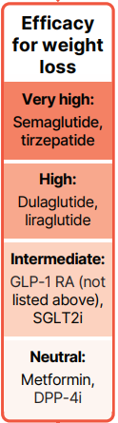
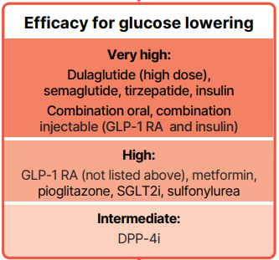
Therapy Recommendations – ADA

Slide 27
Biguanides (Metformin)
Example Medications: Metformin
Pearls:
  Monitoring: eGFR and B12
  Common S/E: GI Upset, Diarrhea, Metallic taste
  Severe Risk: Boxed Warning Lactic Acidosis, Vitamin B12 deficiency
  Higher risk group (eGFR < 30ml/min/1.73m2) likely benefit from holding metformin for 48 hours before IV contrast if possible
Disease State Considerations
Prediabetes
Lower cost medication
Notes:
Decreases hepatic glucose production and improves insulin sensitivity.
Stop when there is hypoxia as risk of lactic acidosis increases.
The IV contrast is especially important with intra-articular like PCA.

Slide 28
SGLT2i
Example Medications: Empagliflozin, Dapagliflozin, Canagliflozin
Pearls:
  Monitoring: eGFR, ketones (If signs of ketoacidosis)
  Common S/E: Risk of UTI or genital mycotic infection. Polyuria.
  Severe: Euglycemic DKA, Fournier’s gangrene
Disease State Considerations
ASCVD
CKD
HTN
HFpEF
HFrEF
Notes:
Sodium-glucose co-transporter 2 (SGLT2)
0.5-1% reduction in A1c, Weight reduction, BP reduction
DKA S/S: Extreme thirst, frequent urination, high BG, high urine ketones, nausea, vomiting, stomach pain, fatigue, fruity scented breath, confusion

Slide 29
GLP-1RA or Mixed GLP-1/GIP
Example Medications:
  GLP1-RAs for DM: Ozempic (Semaglutide); Victoza (Liraglutide); Trulicity (Dulaglutide)
  GLP1RA/GIP: Mounjaro (Tirzepatide)
Pearls:
  Monitoring: Symptoms pancreatitis, Renal function (if GI symptoms could cause volume depletion), Eye health-> especially if DM retinopathy present
  Common S/E: N/V/D and injection site reactions
  Severe S/E: Thyroid C-Cell tumor risk (Boxed warning), Pancreatitis, Gastroparesis
  Some off label use for T1DM, but with possible increase in risk of DKA, hypoglycemia, and GI side effects
Disease State Considerations
Obesity
MASH/MASLD
HF
CKD
Stroke/TIA
Severe Hyperglycemia
Hypoglycemia Risk High
Insulin Combo to Reduce Weight Gain
OSA – Zepbound
Notes:
Glucagon-like peptide-1 agonist and Glucose-dependent insulinotropic polypeptide (GIP)

Slide 30
Thiazolidinediones
Example Medications: Pioglitazone
Pearls:
  Common S/E: Edema, Weight gain, Anemia
  Severe S/E: HF exacerbation (Boxed Warning) -> Contraindicated NYHA Class III/IV, Possible low risk bladder cancer (0.5% vs 0.2% placebo), Macular edema, Bone fractures
  Monitoring: LFTs, Signs and symptoms of fluid retention or heart failure, Ophthalmic exams due to risk of macular edema
Disease State Considerations
Prediabetes
MASH/MASLD
Stroke/TIA
Notes:
Peroxisome proliferator-Activated Receptor Gamma (PPARg) agonist

Slide 31
DPP-4 Inhibitors
Example Medications: Sitagliptin, Saxagliptin, Alogliptin
Pearls:
  Monitoring: Renal function
  Common S/E: Nasopharyngitis, Headache, GI
  Severe S/E: Pancreatitis, Heart Failure Exacerbation (Saxagliptin and Alogliptin)
Disease State Considerations
Lower Cost
Notes:
Dipeptidyl peptidase 4 inhibitors -> Prolong incretin molecules
Sitagliptin cutoffs egfr 30-45 and < 30
Saxagliptin egfr < 45
Alogliptin CrCl 30-60 and < 30

Slide 32
Sulfonylureas/Meglitinides
Example Medications: Glipizide, Glimepiride, Repaglinide, Nateglinide
Pearls:
  Monitoring: Symptoms of hypoglycemia, Renal function, Weight (can cause gain due to insulin secretion)
  Common S/E: Hypoglycemia (take before meals), weight gain, rash
  Severe S/E: Severe hypoglycemia, Hemolytic anemia (Higher risk G6PD deficiency)
  Contains sulfa moiety
  Counsel to take before a meal
Disease State Considerations
Lower cost
Notes:
Stimulate beta cells to release insulin, the Meglitinides are shorter acting
Danger of hypoglycemia will increase with age

Slide 33
Insulin
Pearls:
  Monitoring: FSBG and CGM (if affordable option for the patient)
  Common S/E: Hypoglycemia, Weight Gain, Injection Site Lipodystrophy
  Severe S/E: Severe hypoglycemia
Rapid Acting | Lispro; Aspart; Glulisine; Inhaled
Short Acting | Humulin and Novolin R
Intermediate Acting | Humulin and Novolin N
Long Acting | Glargine
Ultra Long Acting | Degludec
Premixes | Novolog 70/30; Humalog 75/25; Humalog Mix 50/50; Humulin 70/30; Novolin 70/30; Degludec/Liraglutide; Glargine/Lixisenatide
Disease State Considerations
Severe hyperglycemia
Type 1 DM
Resistant T2DM

Slide 34
Future Medication Options DM
Orforglipron
  Daily, oral non-peptide GLP-1 agonist
CagriSema
  Combination of cagrilintide (amylin analog) and semaglutide
  SC injection
Retatrutide
  Triple agonist (GIP/GLP-1/Glucagon)
  SC injection
Notes:
Amylin promotes satiety, and slows gastric emptying

Slide 35
Patient Scenario
A 58 yo male with bipolar I disorder, hypertension, and stage 2 chronic kidney disease (eGFR 52 mL/min/1.73m²) presents to his primary care clinic for a routine follow-up following initiation of HCTZ 25mg daily for blood pressure 2 months ago. His psychiatrist recently optimized his lithium carbonate dose to 600 mg twice daily, and his last serum lithium level drawn 5 days ago was 0.85 mEq/L. How can thiazide type diuretics increase lithium levels in the blood?
A: Inhibition of CYP2D6 a major metabolic enzyme for lithium.
B: Thiazide sodium depletion causes both sodium and lithium reabsorption in the proximal convoluted tubules of the nephron.
C: Alteration of GI absorption by alkalinization of the intestinal tract by HCTZ.
D: Competition with P-glycoprotein-mediated tubular secretion of lithium in the distal nephron.

Slide 36
Patient Scenario
65 yo male patient contacts your clinic because the pharmacy does not have insulin glargine (Lantus) in stock and wishes to dispense ”something called Semglee (insulin glargine-ygfn).” He wants to know if it is safe to take. When can a pharmacy substitute a biosimilar medication?
A: As long as the medication is contained in the Purple Book, it is OK to substitute.
B: Only when Lantus is on back-order.
C: When “brand name only is selected.”
D: The medication has an FDA interchangeable designation and state law allows substitution.

Slide 37
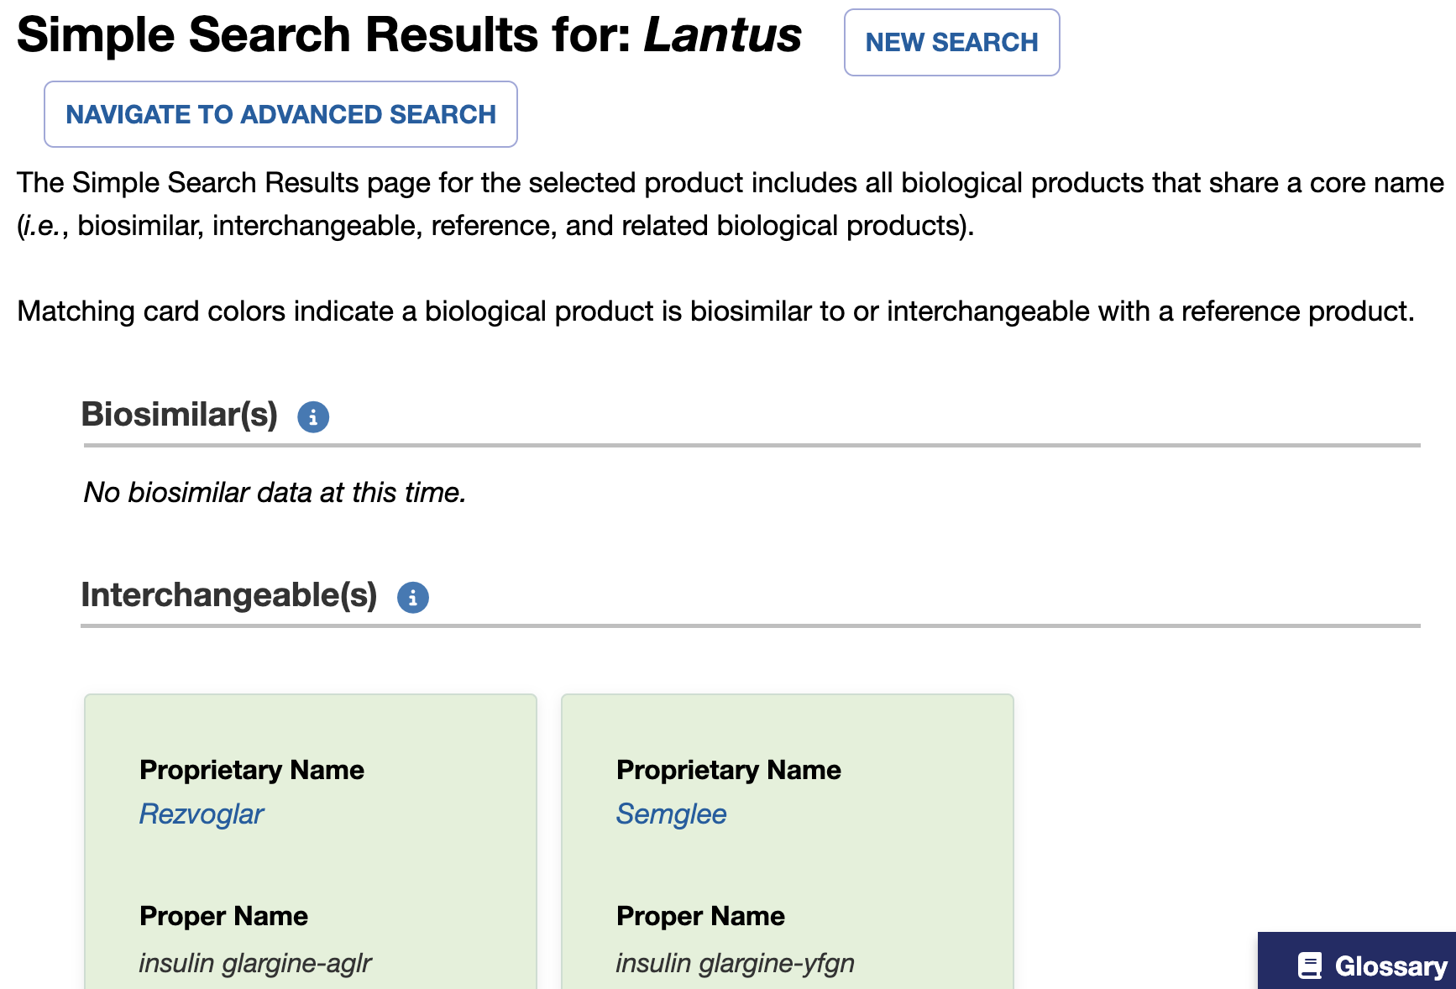
Purple Book
https://purplebooksearch.fda.gov/

Slide 38
Patient Scenario
A 35 yo male with a history of T2DM reports elevated blood pressure on home monitoring and in your office today his blood pressure is 134/84 mmHg. BMI 35 kg/m2, A1c 6.2%, eGFR 102 mL/min/1.73m2, and UACR undetectable. Current medications include metformin SA 500mg BID, Ozempic 1mg weekly, and omeprazole 20mg daily. You want to initiate medication therapy for hypertension, which would be a good starting therapy:
A: Lisinopril 5mg once daily
B: Telmisartan 20mg once daily
C: Amlodipine 5mg once daily
D: Metoprolol SA 50mg daily
E: Either A, B, or C would be appropriate

Slide 39
Patient Scenario
A 55 yo male is newly diagnosed with T2DM. A1c = 7.6% and eGFR 54 ml/min/1.73m2. PMH significant for HF with reduced ejection fraction and hypertension currently well controlled on lisinopril and carvedilol. Which would be the most appropriate pharmacotherapy to start for his diabetes management:
A: Metformin monotherapy titrate to 1,000mg twice daily if tolerated
B: Empagliflozin 10mg once daily titrate to 25mg once daily if tolerated
C: Combination Metformin 1,000mg twice daily with Sitagliptin 100mg once daily
D: Lifestyle modification alone, recheck A1c in 6 months
Notes:
Disease state focused initiation of therapy. Go SGLT2i due to HFrEF diagnosis

Slide 40
References
Circulation. 2025; 152:3114-3218
Diabetes Care Volume 49, Supplement 1, January 2026
Endocrine Practice 32 (2026) 473-518
FDA Purple Book
NIH DailyMed -> Medication Package Inserts

